Slide 1




BANKING
MODERN DATA STACK
A production-grade data engineering pipeline
from OLTP to analytics-ready dashboards
PostgreSQL
Kafka
Snowflake
dbt
Airflow
Power BI
Omkar Badadale
Swipe →

Slide 2
WHAT I BUILT
An end-to-end real-time
banking data pipeline
6-Table OLTP Schema
Customers, accounts, transactions, loans,
branches, and audit log with ENUMs and triggers
Real-Time CDC
Debezium captures every INSERT, UPDATE,
DELETE from PostgreSQL WAL in real time
Medallion Architecture
Bronze (raw) → Silver (typed) → Gold (marts)
with SCD Type-2 history tracking via dbt
Enterprise Dashboards
Power BI connected to Snowflake Gold layer
with 4 dashboard pages

Slide 3
THE PIPELINE
How data flows from
source to dashboard
01
PostgreSQL
OLTP source with ACID,
ENUMs, triggers, audit log
02
Kafka + Debezium
WAL-based CDC streams
every change in real time
03
MinIO (S3)
Date-partitioned JSON
files in object storage
04
Airflow
Orchestrates ingestion
with batch FLATTEN
05
Snowflake
Bronze → Silver → Gold
Medallion Architecture
06
dbt
Staging, marts, SCD-2,
data quality tests
07
Power BI
3-page enterprise
dashboard on Gold layer

Slide 4
THE HARD PROBLEM
Debezium doesn't send
clean data
Debezium's JsonConverter base64-encodes PostgreSQL NUMERIC types, sends dates as days-since-epoch, and timestamps as microsecond integers. Most tutorials skip this entirely.
WHAT DEBEZIUM SENDS
WHAT IT ACTUALLY MEANS
"annual_income": "IOl6"
"date_of_birth": 13429
"created_at": 1707003388657140
annual_income: $21,569.22
date_of_birth: 2006-10-04
created_at: 2024-02-04 03:36
Built a custom Snowflake JavaScript UDF to decode
base64 byte arrays back to usable dollar amounts.

Slide 5
THE OPTIMIZATION
From hours to minutes
V1
V2
~11 HOURS
~3 MINUTES
One INSERT per record
New connection per row
3 seconds per record
Open → Insert → Commit → Close
... repeated 40,000 times
One INSERT per file
One connection per table
3 seconds per 100 records
LATERAL FLATTEN(PARSE_JSON(...))
... batch insert in one query
220x faster
Pipelines break between systems, not inside them.

Slide 6
DATA MODELING WITH DBT
From raw CDC payloads
to business-ready marts
BRONZE
Raw Debezium CDC payloads stored
as Snowflake VARIANT (semi-structured JSON)
5 tables
SILVER
Typed, deduplicated, Debezium-decoded.
Custom UDF for base64 NUMERIC,
epoch-to-timestamp conversions
4 staging views + 2 SCD snapshots
GOLD
dim_customers, dim_accounts,
fct_transactions, fct_daily_balances,
fct_loan_performance
2 dimensions + 3 fact tables

Slide 7
BY THE NUMBERS
10
6
40K+
Docker
Services
OLTP
Tables
CDC
Events
11
8
220x
dbt
Models
Phases
Built
Speed
Improvement

Slide 8
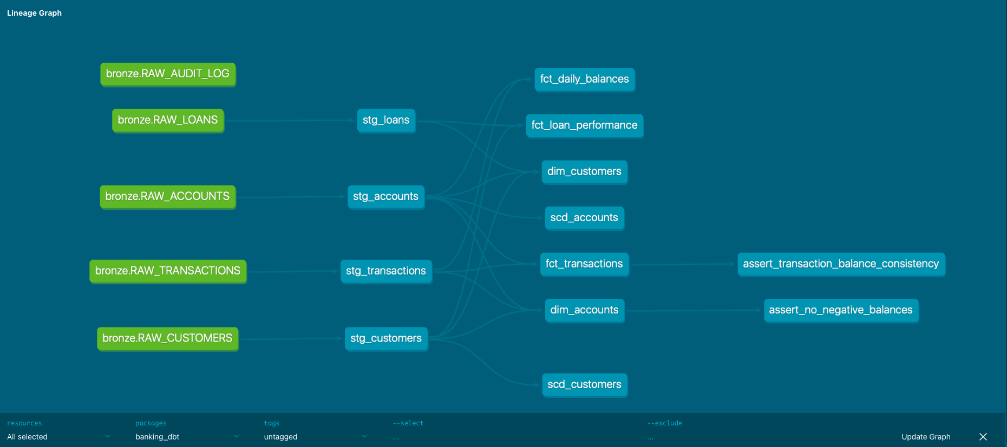
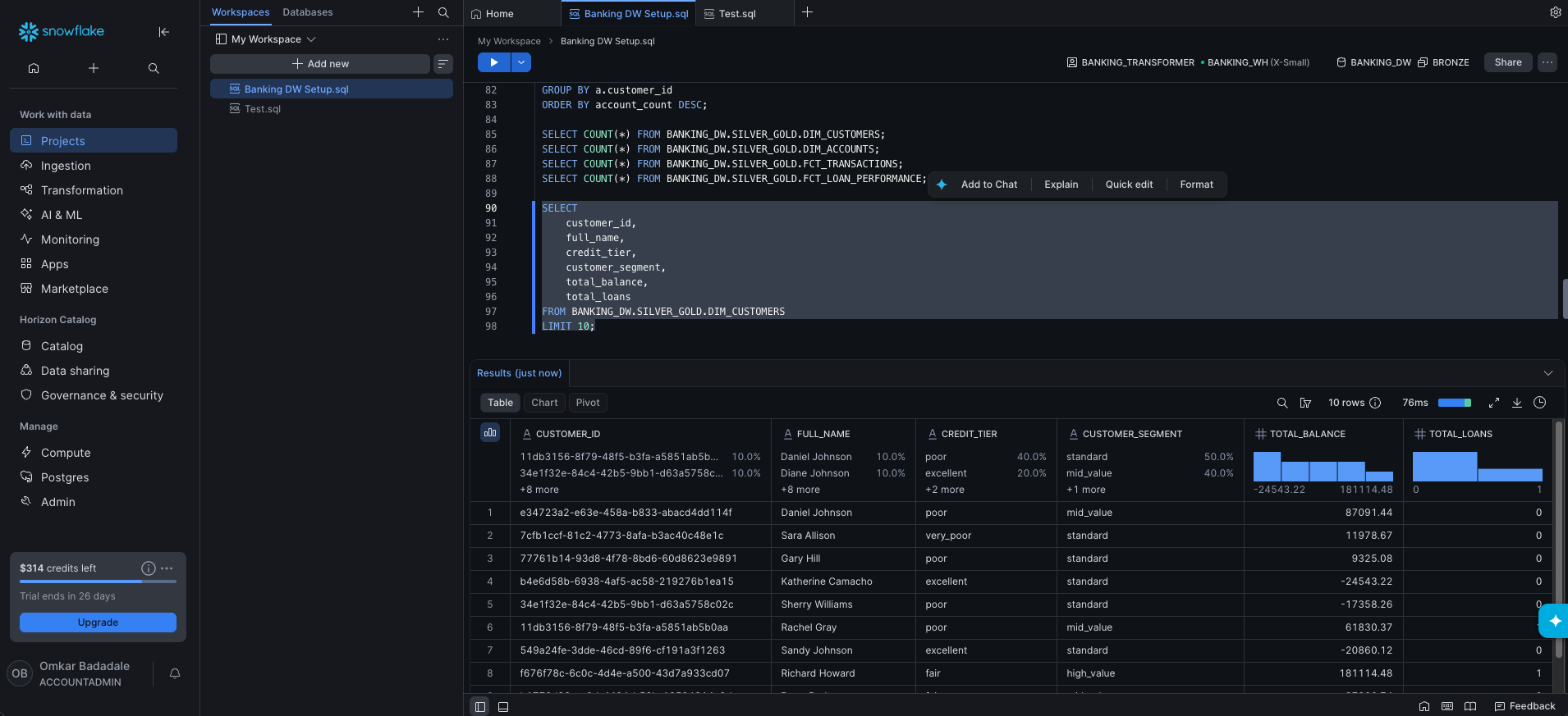
LINEAGE GRAPH + DASHBOARDS
[ dbt Lineage Graph Screenshot ]

Slide 9
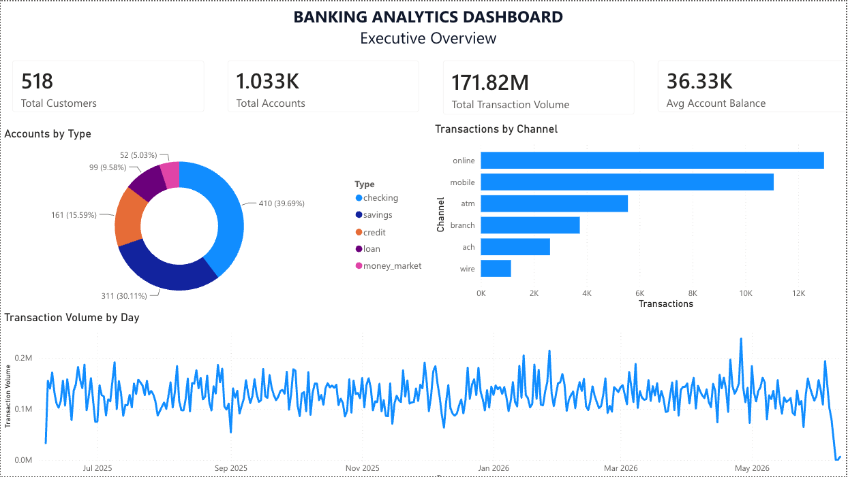
DASHBOARDS

Slide 10
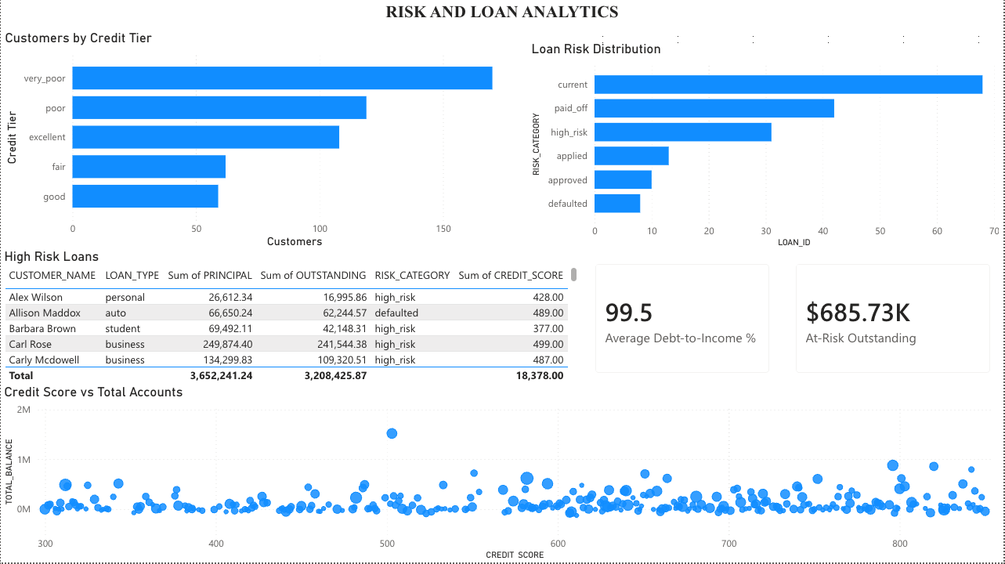
DASHBOARDS

Slide 11
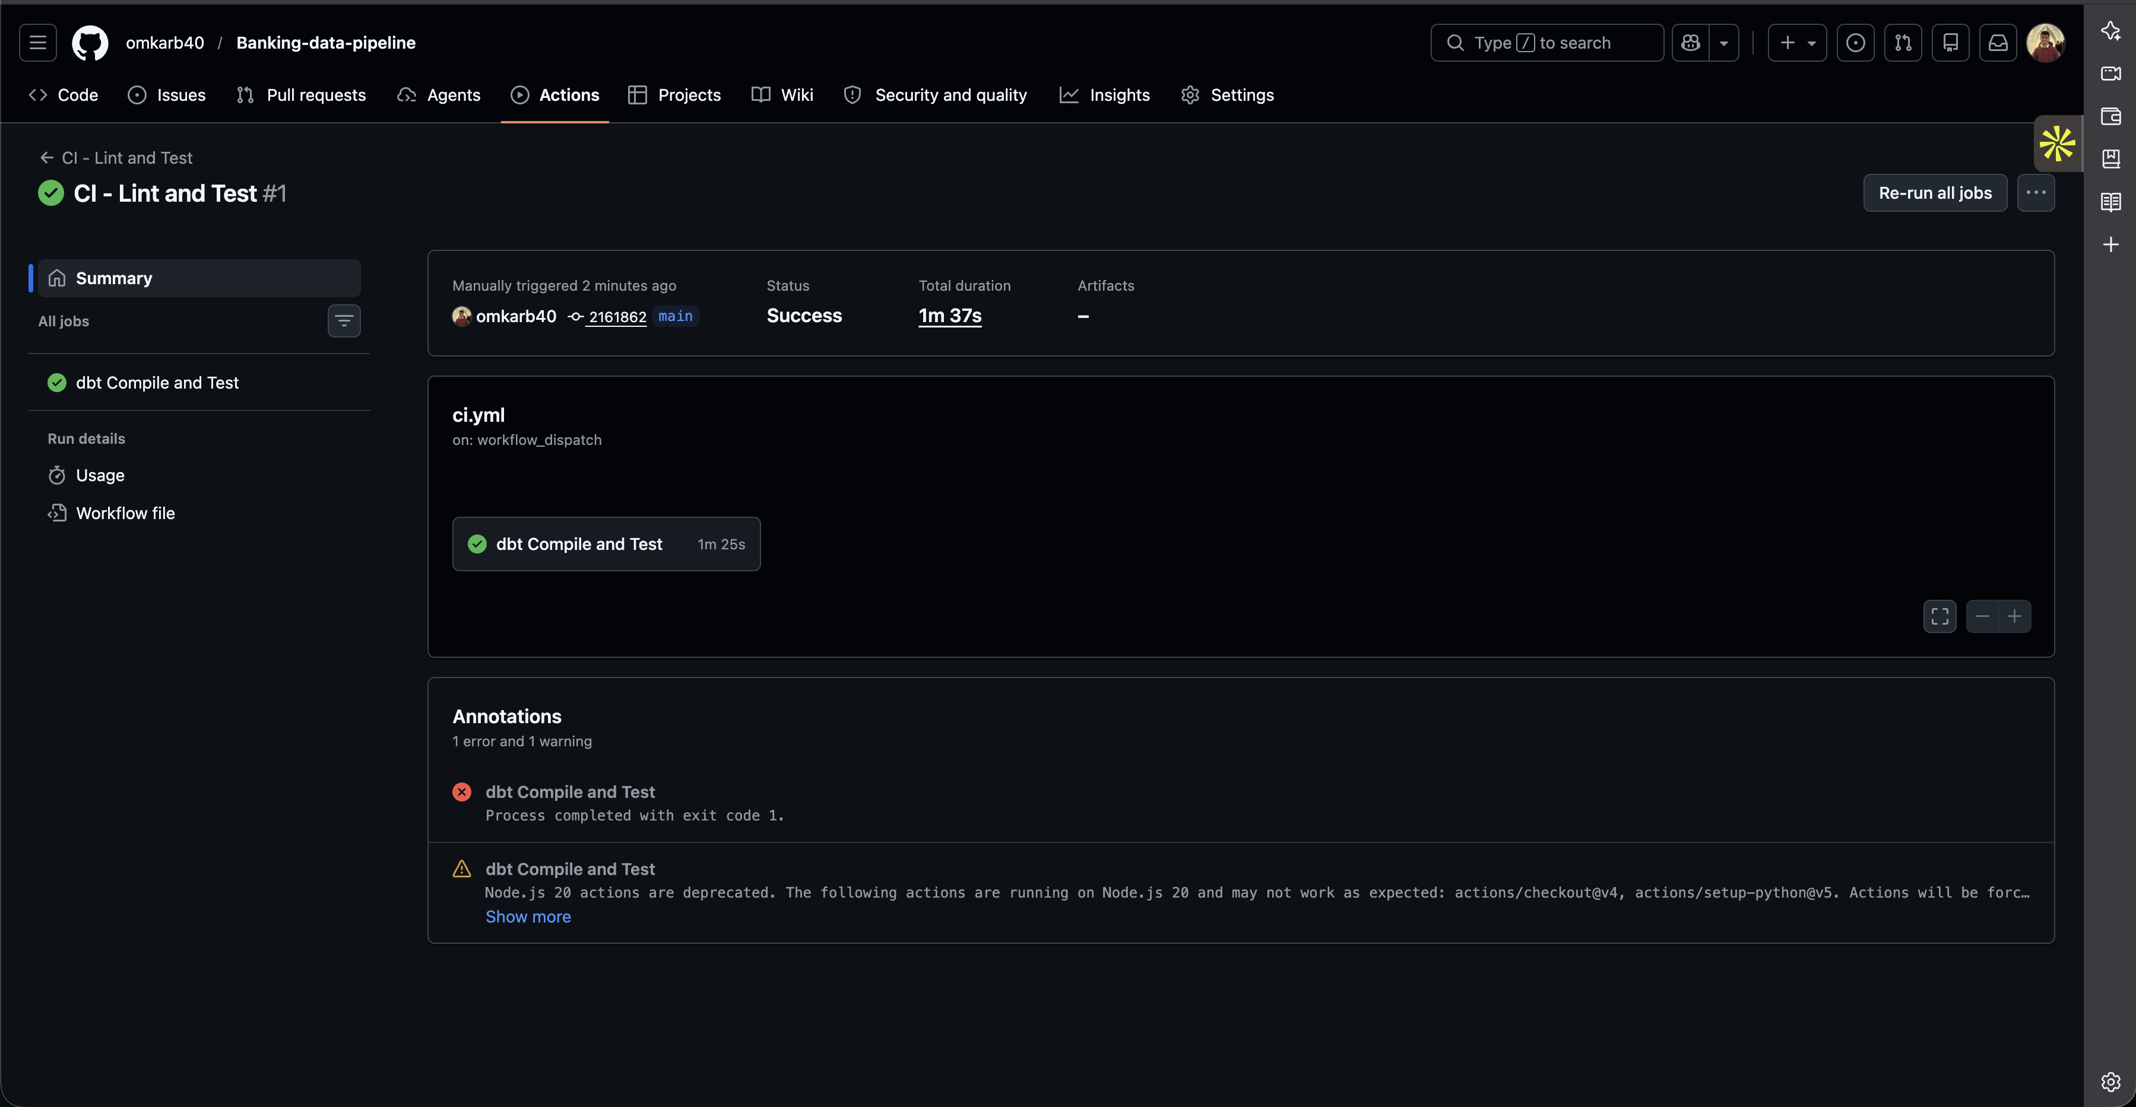
CI/CD WITH GITHUB ACTIONS
Every push triggers automated validation
CI — Pull Requests
CD — Merge to Main
✓ dbt compile
✓ dbt run (CI schema)
✓ dbt test
✓ Isolated CI_TEST schema
✓ dbt snapshot (SCD-2)
✓ dbt run (production)
✓ dbt test (validation)
✓ Path-filtered triggers
[ GitHub Actions Green Pipeline Screenshot ]

Slide 12

The full repo is
public on GitHub.
github.com/omkarb40/Banking-data-pipeline
If you're building a data engineering portfolio
or preparing for interviews, feel free to fork it,
break it and learn from the mistakes I made.
Omkar Badadale
MS Data Science
#DataEngineering #ApacheKafka #Snowflake
#dbt #Airflow #ModernDataStack #CDC

