Slide 1

Missed Appointments in Acute Outpatient Settings

Slide 2
Executive Summary
Modelling DNAs using Time Series Analyses performs best when modelling the ‘percentage missed’ rather than the ‘total number missed’.
After statistically proving that the data is stationary hyperparameter tuning is deployed to find the most suitable model for the circumstances.
Whilst the number of missed appointments is decreasing with time, seasonality still persists with reference to particular months of the year.

Slide 3
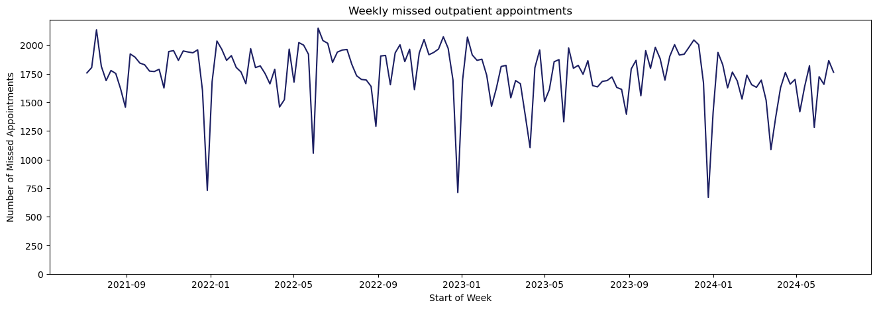
Predicting missed appointments: The Data, basic EDA
Deep troughs in the number of missed appointments which occur over the Christmas and Easter periods may not be indicative of the likelihood of those appointments being missed.

Slide 4
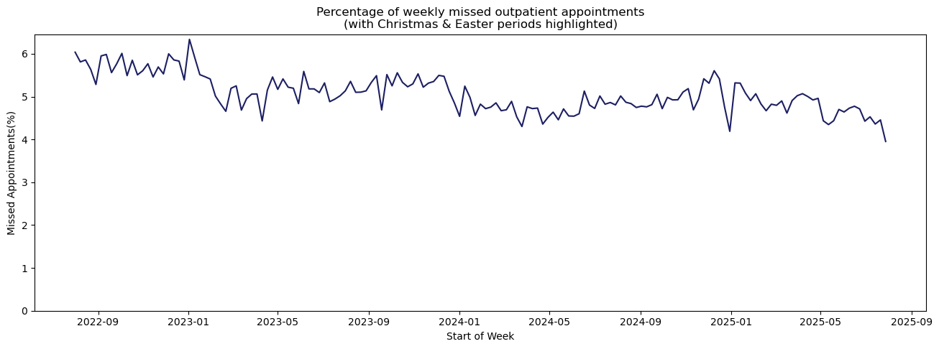
Predicting missed appointments: The Data, basic EDA
Converting to a ‘Percentage of total appointments’ will allow for a more accurate forecasting model.

Slide 5
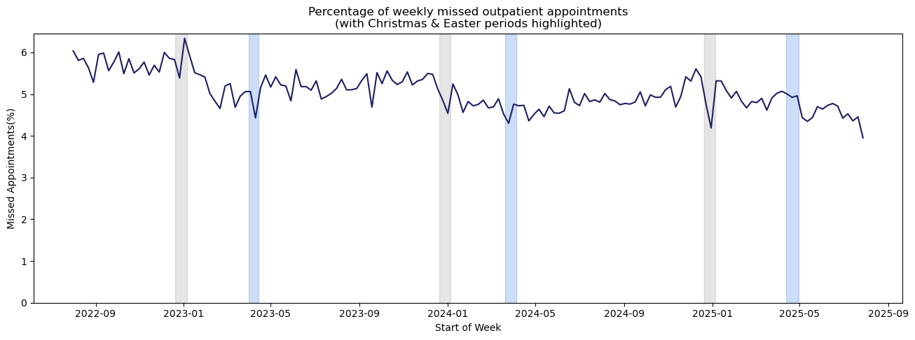
Predicting missed appointments: The Data, basic EDA
Missed appointment rates show recurring peaks around Christmas and Eater, although the impact is dampened when expressed as percentages rather than appointment counts.
Despite their predictability, Easter effects are more challenging to forecast because the date varies between years.

Slide 6
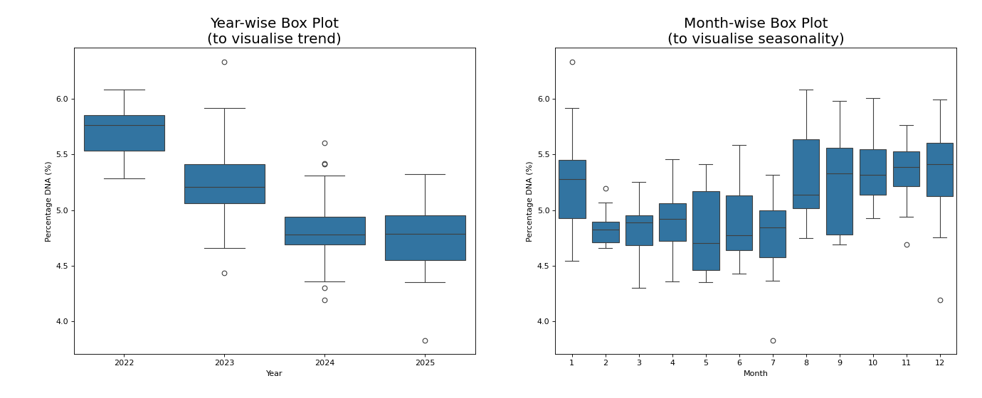
Yearly and Monthly Trends

Slide 7
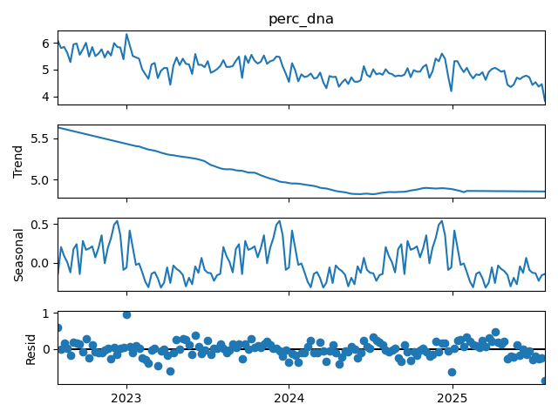
Testing whether the data is stationary. Null Hypothesis H₀: The data is non-stationary Alternative Hypothesis H₁: The data is stationary
Stationarity is checked to ensure that patterns learned form historical data remain consistent over time, supporting reliable forecasting.
Trend:
Reducing with time. But flat recently (likely following increased utilisation of digital communications).
Season:
Visual annual seasonality, probably based around public and school holidays.
Resid.:
Random scattering around zero (no obvious pattern).
Stationarity:
Performing an Adjusted Dickey-Fuller test on the reconstructed data gives a p-value of 0.002 which is <0.05
The null hypothesis is rejected (at 5% significance level)

Slide 8
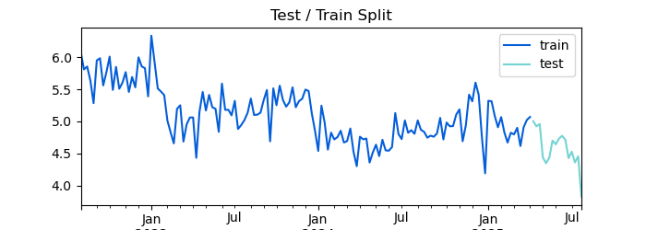
Building the Model
Latest 16 weeks data as ‘test’ data.
Split train:test = 141:16

Slide 9
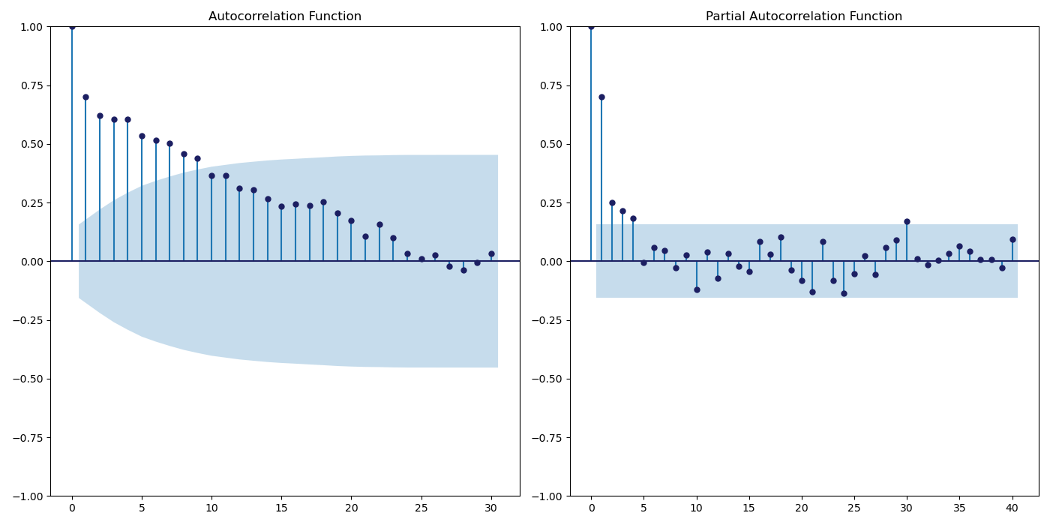
Hyperparameter Tuning (manual & auto)
Using a technic called grid search there were too many potential combinations and given the potential 52 week season it was not feasible to run this for all combinations.
Therefore, the range of values were reduced by viewing the ACF and P-ACF plots.

Slide 10
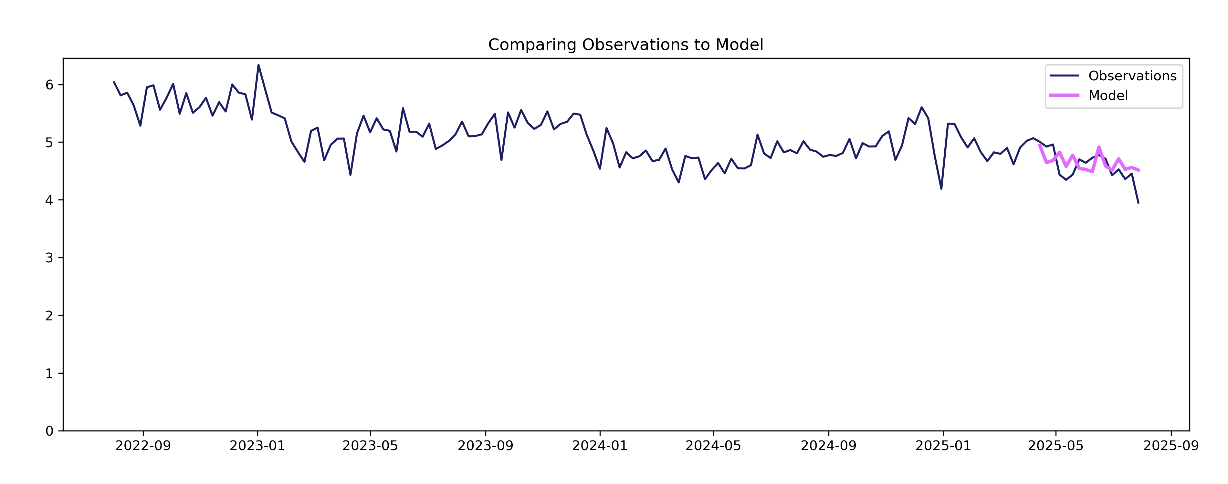
Results, no forecast
During the hyperparameter tuning stage, the results from grid search were not strictly followed. This is inpart because it relied solely on RMSE.
After analysing a range of metrics the best model was selected manually. This model produces a mean average percentage error (MAPE) of 0.05, meaning forecasts are on average 5% away from true values

Slide 11
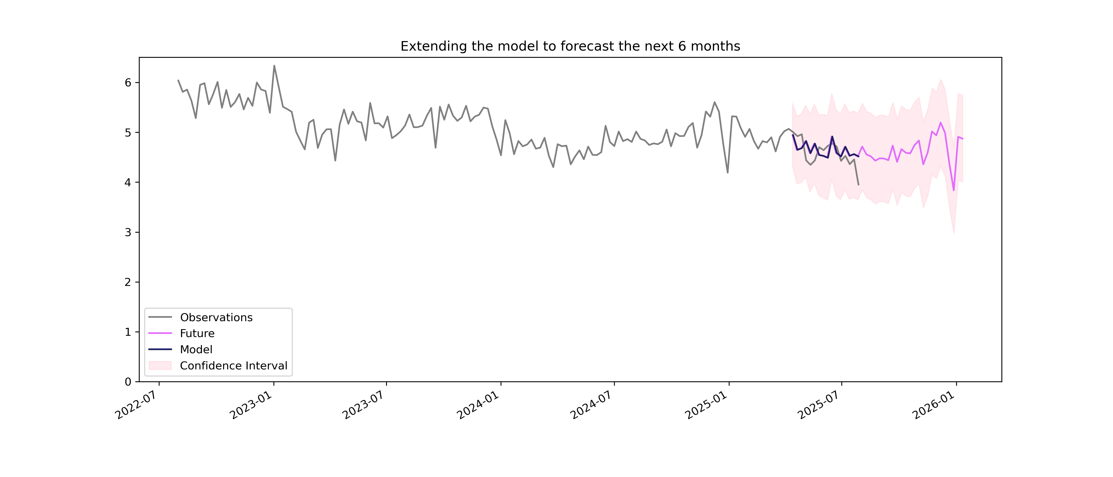
Results with forecast

Slide 12
Contact:
Fiona Thrupp
Fiona.thrupp@nhs.net

