Slide 1

Acute Multiple Disadvantage
PHM & Insights Team

Slide 2
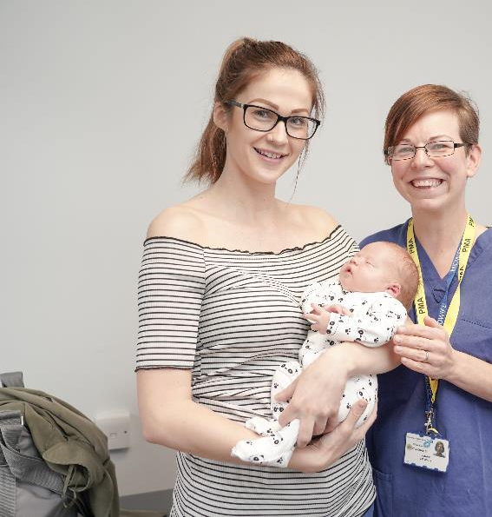
Introduction
This project analysed acute multiple disadvantage across BNSSG to identify a small but highly vulnerable group of adults experiencing overlapping health and social care needs.
Using linked system-wide data (as at April 2024), the analysis focused on people meeting at least three of four criteria:
homelessness or insecure housing
substance or alcohol dependence,
mental health conditions, and
contact with adult social care.

Slide 3
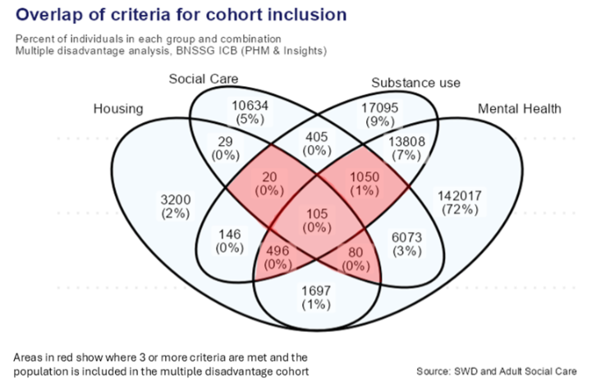
The cohort comprises 1,751 individuals, representing 0.22% of the BNSSG adult population (April 2024)
This Venn diagram shows the number of people in each criteria combination.
A person is only counted once
Where a person meets three or more of the criteria, they are shown in the segments highlighted in red - these are the Multiple Disadvantage cohort.
The percentage shown in each segment, is the number of people in the segment divided by the total number of people in all the segments. (A person is only counted once).

Slide 4
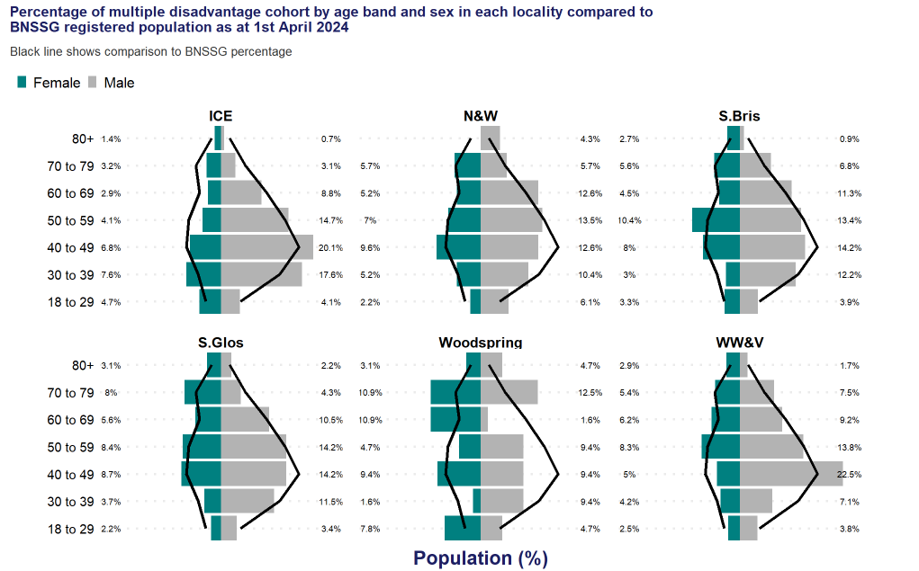
63% of the cohort live in Bristol
65% of the cohort are male
Predominantly middle-aged
Woodspring where the cohort is older, 70-79 yrs
ICE where its is younger 30-40 yrs

Slide 5
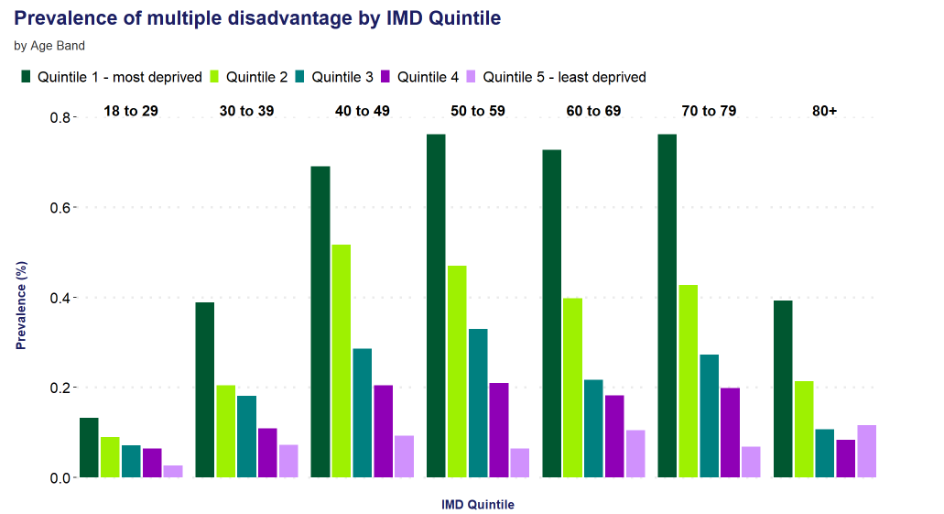
More prevalent in deprived areas
The top 3 MSOAs in BNSSG with the highest number of people are
Weston Town,
Temple Meads,
Bedminster,
by prevalence, the top 3 are
Weston Town,
Brislington,
Bedminster.
When indirectly standardised for age and sex, the MSOAs with the greatest ISRs are
Temple Meads,
Weston Town,
Brislington.
Deprivation and age profile

Slide 6
Vulnerabilities & Qualifying Criteria
60% (1,050 individuals) meet the three main criteria: known to social care, substance use, and mental health
28% (496 individuals) meet the three main criteria: housing, substance use, and mental health
105 individuals meet all four criteria.
Alcohol & substance use:
75% have an alcohol dependency, of these:
58% alcohol only
17% both alcohol and other substances (mainly cocaine and opioids).
Other vulnerabilities:
housebound (7.8%),
homeless (5.9%),
learning disability (4.5%),
ADHD (5.5%).
Smoking: 4 times more likely than the general population.

Slide 7
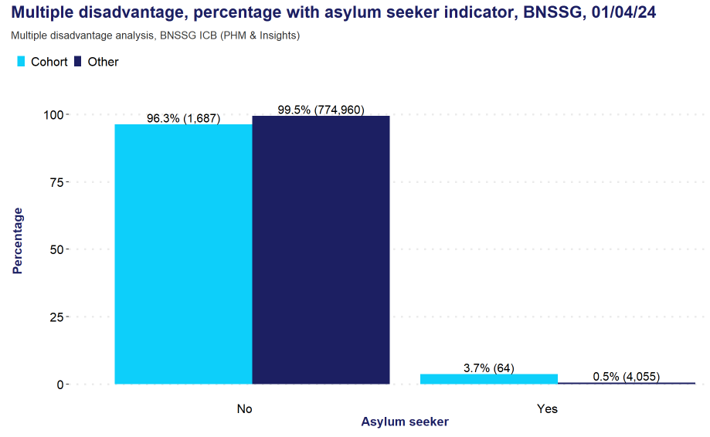
Prevalence of asylum seekers/refugees is 7 times higher in the multiple disadvantage cohort.

Slide 8
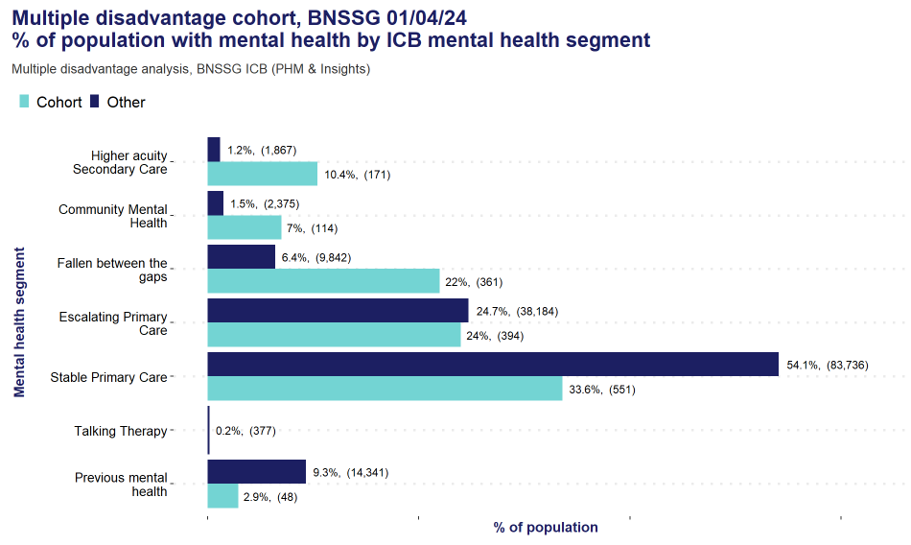
Health Complexity & Care Needs
68% are in CMS segments 4 & 5, indicating complex health needs.
Mental health support: 80% of the MD cohort with mental health are supported with their mental health in primary care,
Over half those are in ‘escalating’ or ‘fallen through the gaps’ categories, indicating a greater need for support. (Community MINT teams were not fully operational at the time of data collection).
Most mental health attributes are more prevalent in the MD cohort compared to the rest of BNSSG

Slide 9
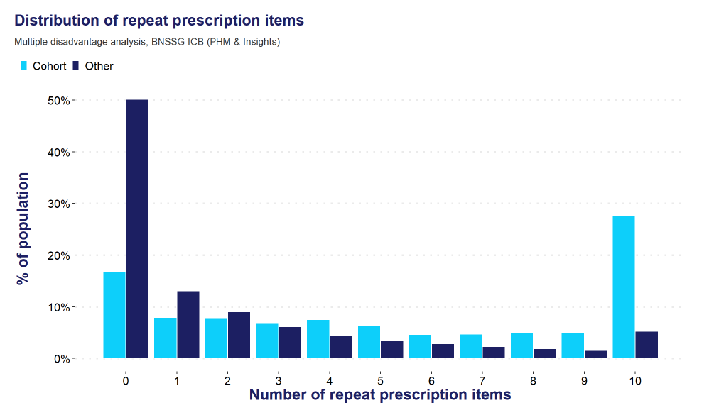
5 times more likely to have >10 repeat prescriptions
Average cost per person:
£829/year (2.4 times higher than the general population), despite lower per-prescription costs.

Slide 10
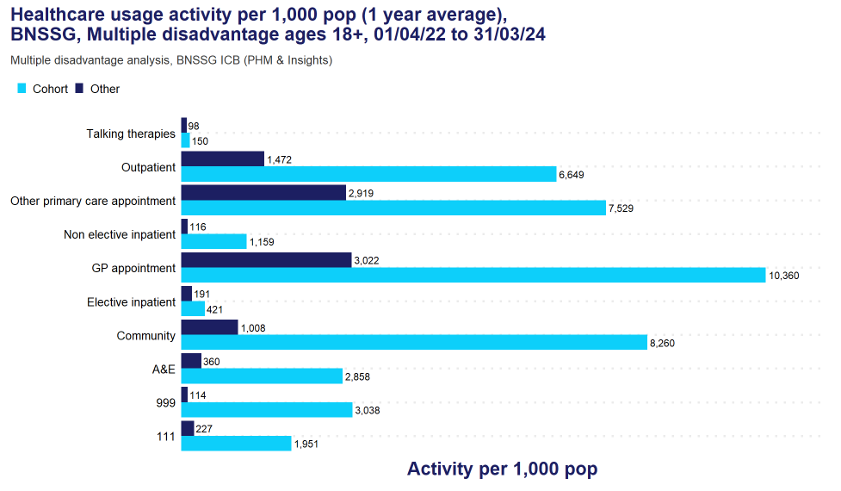
Emergency and urgent care usage
999 calls: 26.6 times higher
111 calls: 8.6 times higher
A&E attendances: 7.9 times higher
Non-elective admissions: 10 times higher, with costs 13 times higher (£2,471per admission v £1,889).
Frequent service users (~50% of cohort) contribute 87–90% of cohort activity, compared to 27–42% in the rest of BNSSG.

Slide 11
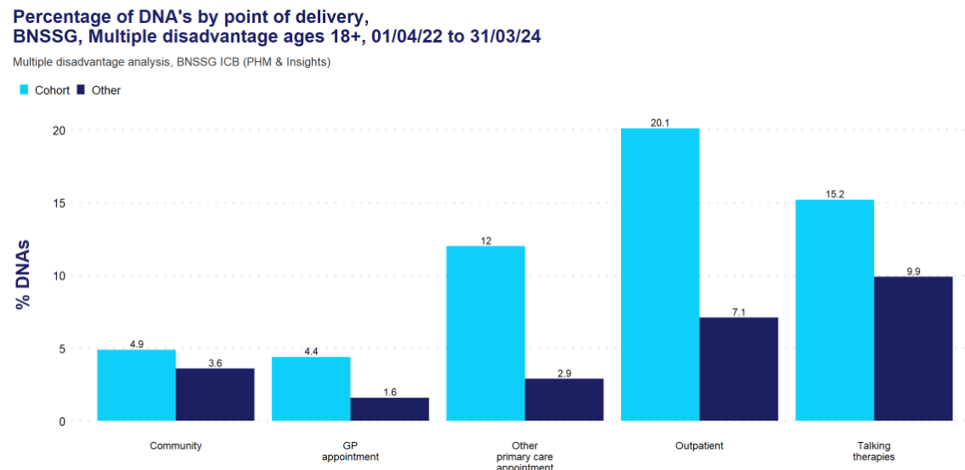
DNA’s are disproportionately high relative to the cohort size of 0.2% of BNSSG.
Did Not Attend (DNA) Patterns:
Outpatients: 20% cohort v 7% BNSSG
Other primary care: 4 times higher
DNA rates are 1.1 to 2.5 times higher across most mental health segments, except ‘Previous Mental Health’ (6.5 times higher).
‘GP and other primary care appointments’ show the most difference between the MD cohort and rest of BNSSG.

Slide 12
Key Insights
Small but highly complex and vulnerable cohort.
Higher use of Urgent care and primary care services.
High mental health and substance use needs, with large proportion having escalating needs or falling through the gaps (as at Apr 2024 prior to MINT teams).
Significant prescription volume and associated costs.
Key links to social deprivation, homelessness, and other vulnerabilities

Slide 13
Contact:
PHM & Insights Team
bnssg.phm@nhs.net

