Slide 1

LSOA Neighbourhood Clustering
PHM & Insights Team

Slide 2
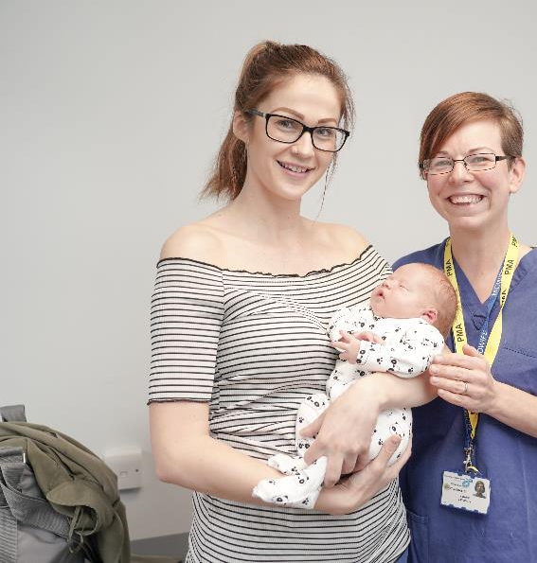
Introduction
Using the registered and resident BNSSG population and a machine learning clustering technique, the PHM team developed 26 proposed neighbourhoods across BNSSG, each serving around 50,000 people to inform consultation and local planning
Population as of Sept 2025
Notes:
Population as of Sept 2025

Slide 3
Methodology
Neighbourhood boundaries were created by clustering 581 Lower Super Output Areas (LSOAs), which are standard geographic units commonly used in NHS and local government planning. Clusters were designed to respect Locality Partnership boundaries, remain geographically contiguous, and achieve populations close to the target size.
An unsupervised machine learning method (k‑means clustering) was used to group LSOAs based on geographic location, population age structure, and key socioeconomic characteristics derived from Acorn data. The approach was applied separately within each locality to maintain place boundaries. The resulting neighbourhoods were largely contiguous, with only a very small number of manual adjustments (9 LSOAs) were made to address local outliers.

Slide 4
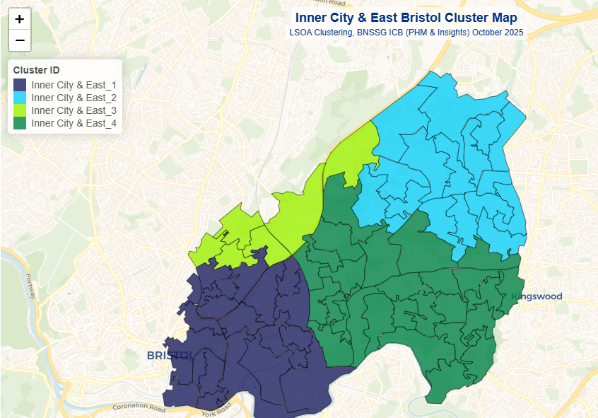
Inner City & East Clusters

Slide 5
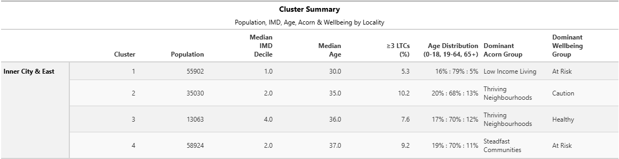
South Bristol Cluster Summary

Slide 6
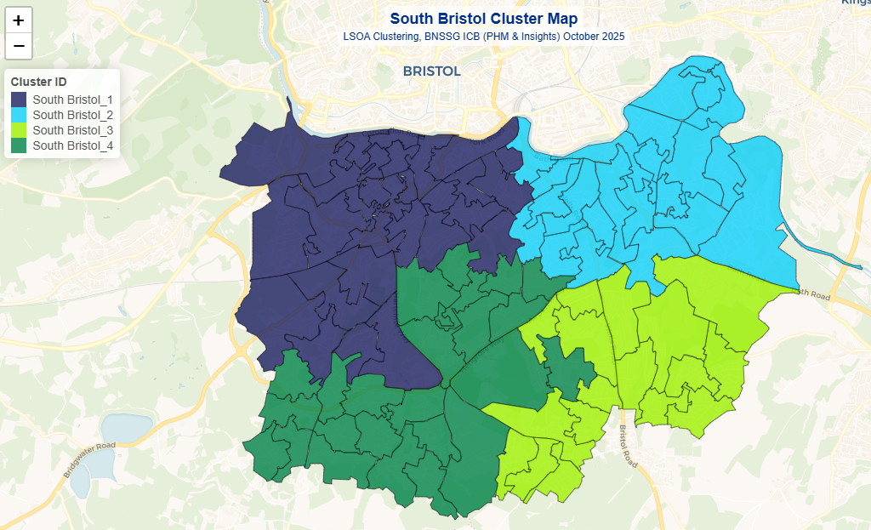
South Bristol Clusters

Slide 7
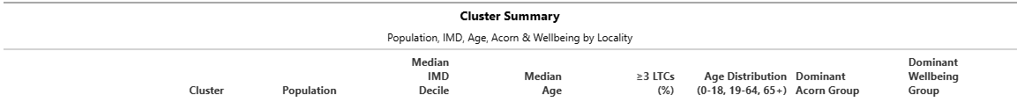
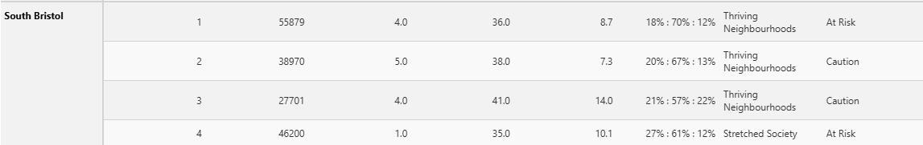
South Bristol Cluster Summary

Slide 8
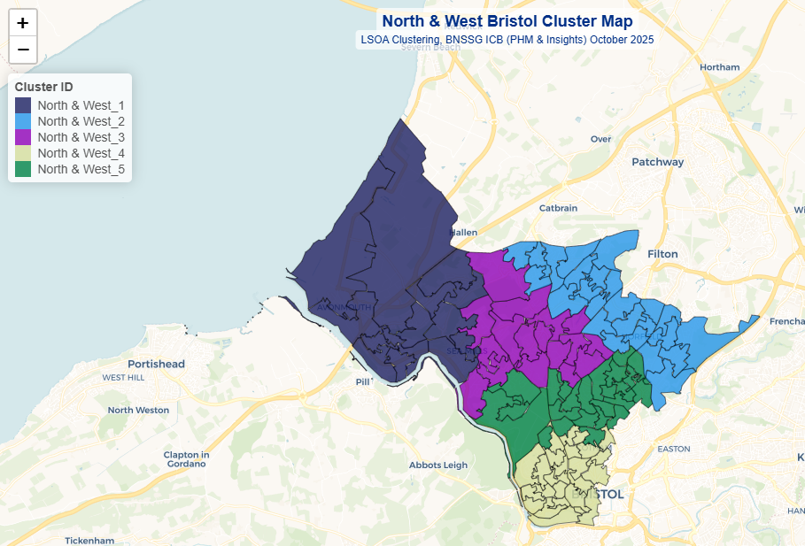
North & West Bristol Clusters

Slide 9
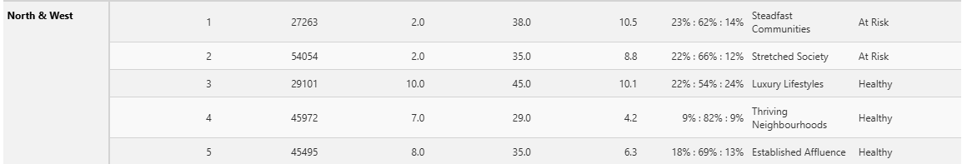
North & West Bristol Cluster Summary

Slide 10
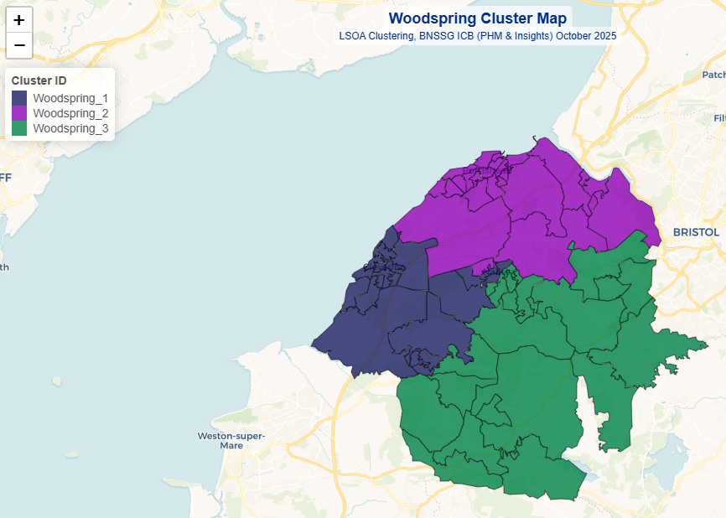
Woodspring Clusters

Slide 11
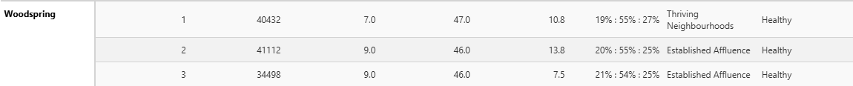
Woodspring Cluster Summary

Slide 12
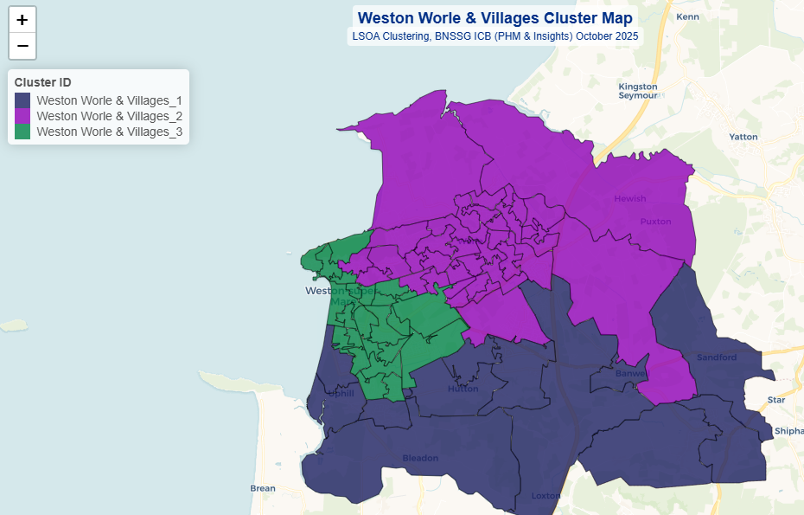
Weston Worle & Villages Clusters

Slide 13
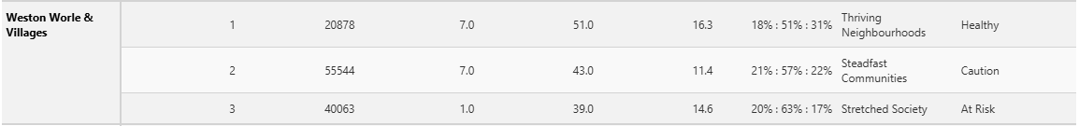
Weston Worle & Villages Cluster Summary

Slide 14
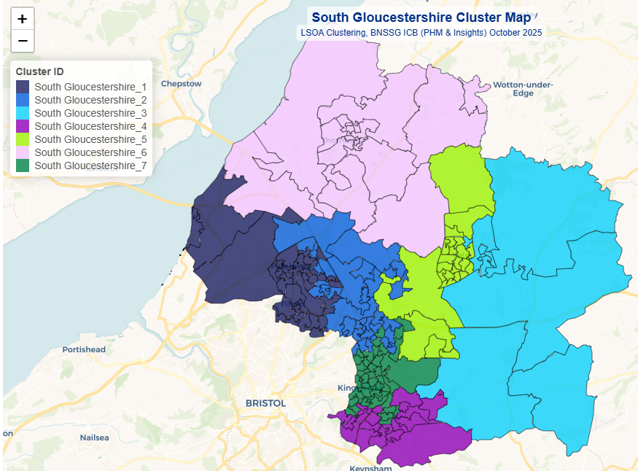
South Gloucestershire Clusters
Notes:
April 2024 data is shown on the map, and all data in this pack is a snapshot as at April 2024. All data is patients registered to BNSSG practices. The % relate to registered patients in that local authority area
The latest January 2026 population values are higher:
Bristol – 110,438, 21% of total population
North Somerset – 49,450, 21% of total population
South Gloucestershire – 70,810, 22% of total population

Slide 15
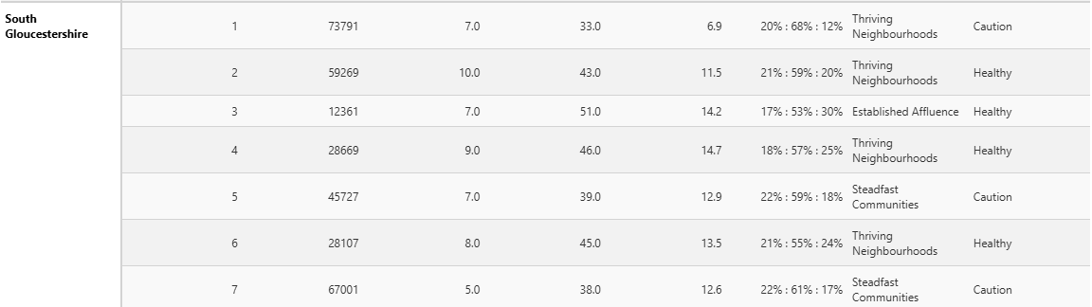
South Gloucestershire Cluster Summary

Slide 16
Key Insights
Small but highly complex and vulnerable cohort.
Higher use of Urgent care and primary care services.
High mental health and substance use needs, with large proportion having escalating needs or falling through the gaps (as at Apr 2024 prior to MINT teams).
Significant prescription volume and associated costs.
Key links to social deprivation, homelessness, and other vulnerabilities

Slide 17
Contact:
PHM & Insights Team
bnssg.phm@nhs.net

