Slide 1
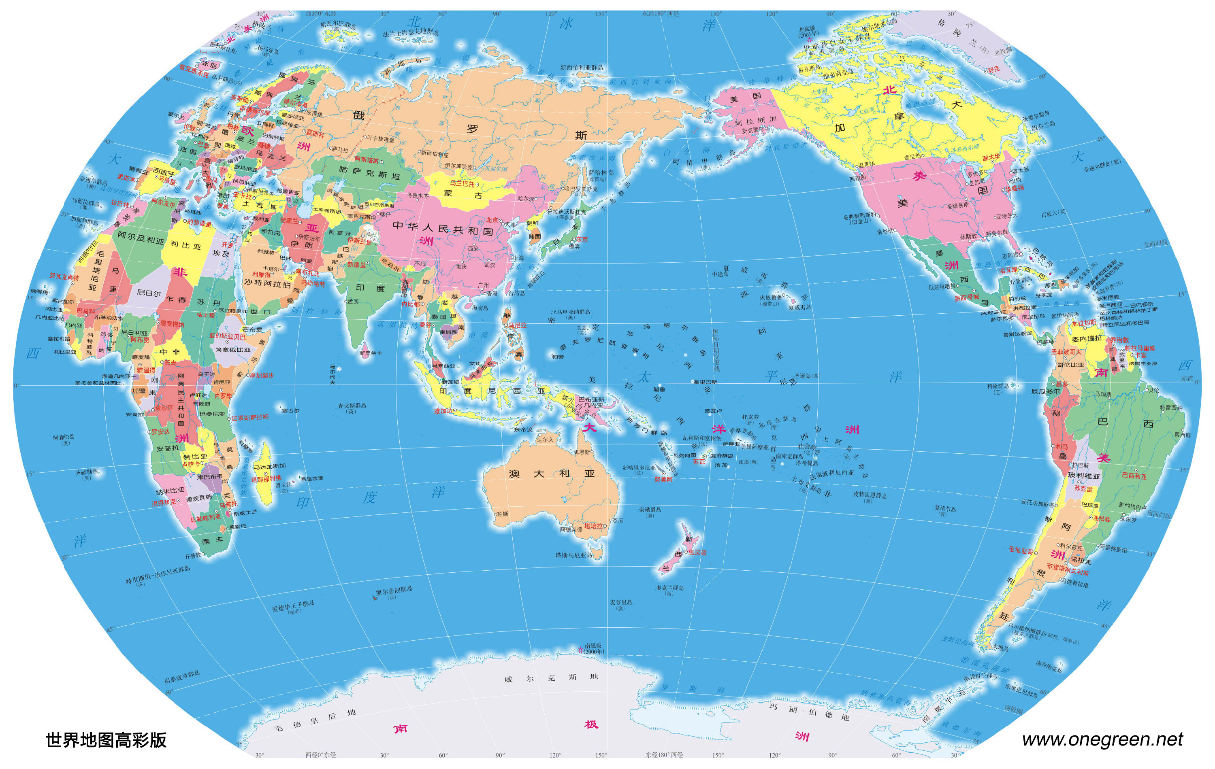
Haoyuan Jia:
University of Pennsylvania, Philadelphia, Pennsylvania, USA
Zhong-Wei Lu:
Cardiff University, Cardiff, Wales, UK
Shilong Su:
The Chinese University of Hong Kong, Shatin, New Territories, Hong Kong, China

Slide 2
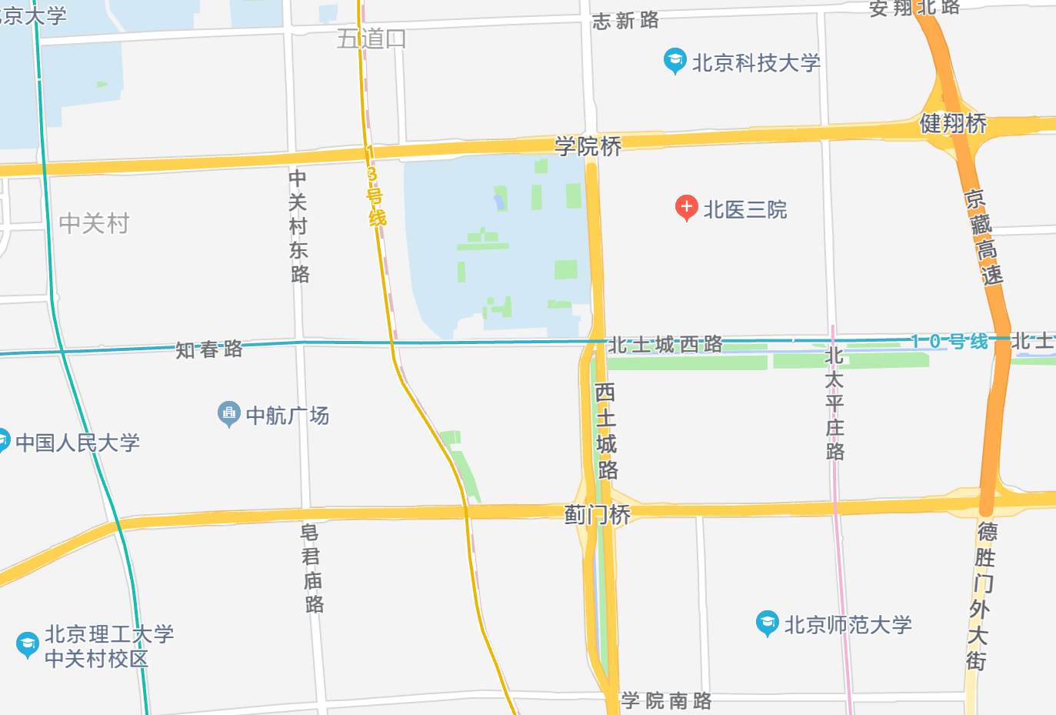
Hao Li:
TIPC, CAS, Haidian, Beijing, China
He Hao & Hangrui Wu:
Peking University, Haidian, Beijing, China
Yiran Liu:
ICCAS, Haidian, Beijing, China
Jing-dong Zhang:
Beijing Normal University, Haidian, Bejing, China

