Slide 1
Flight Delay and Cancellation Analysis (2015)
Presented by: BONDA NAVEEN KUMAR

Slide 2
Introduction
Delays and cancellations impact passenger satisfaction and airline efficiency.
Objective: Analyze 2015 flight data to identify root causes and performance trends.
Tools: SQL, Power BI, Excel

Slide 3
Data Sources & Tools
Data Sources: flights.csv, airlines.csv, airports.csv
Tools Used: PostgreSQL, Power BI, Excel

Slide 4
Methodology
Phase 1: Data Ingestion
Phase 2: Data Cleaning & Enrichment
Phase 3: KPI Definition & SQL Analysis
Phase 4: Dashboard Development in Power BI

Slide 5
Key Findings – Delay & Cancellation Reasons
Airline delay and late aircraft were major contributors.
Weather and NAS delays notable.
Cancellations driven by weather and airline policies.

Slide 6
Airline Performance Analysis
Alaska Airlines: Best On-Time Performance (OTP).
Frontier Airlines: High cancellation & delay rates.

Slide 7
Airport Performance
ORD (Chicago O'Hare) and ATL (Atlanta) had highest delays.
Smaller airports performed better proportionally.

Slide 8
Temporal Patterns
Evening hours (5–8 PM) saw peak delays.
June–August experienced most delays.

Slide 9
Dashboard Walkthrough – Page 1 (Overview)
KPI Cards: OTP Rate, Avg Delays, Cancellation Rate.
Pie Chart: Cancellation Reasons.
Stacked Column: Delay Type Contribution.

Slide 10
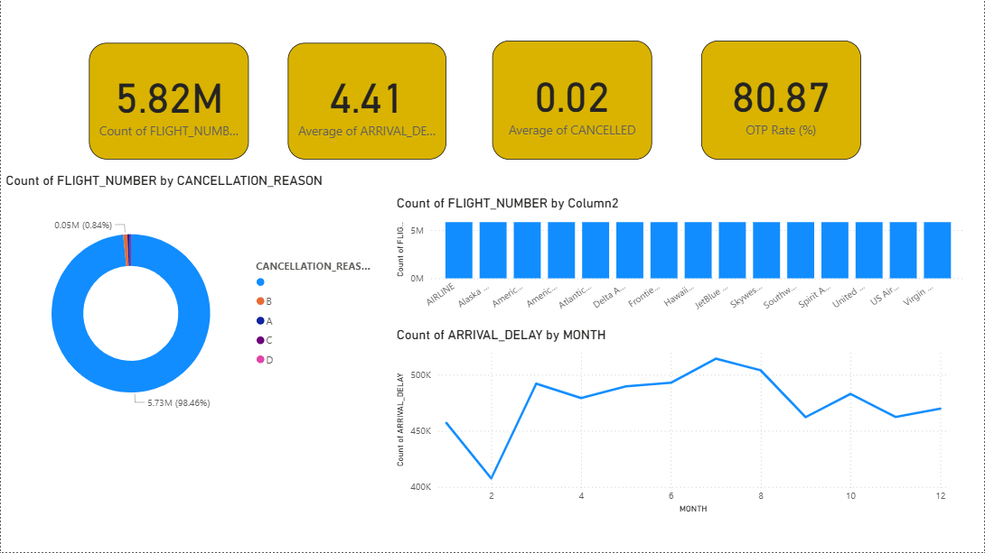
Dashboard Walkthrough – Page 1 (Overview)

Slide 11
Dashboard Walkthrough – Page 2 (Airline Performance)
Clustered Bar Chart: OTP, Delay, Cancellation by Airline.
Matrix Visual: Airline vs Delay Reasons.

Slide 12
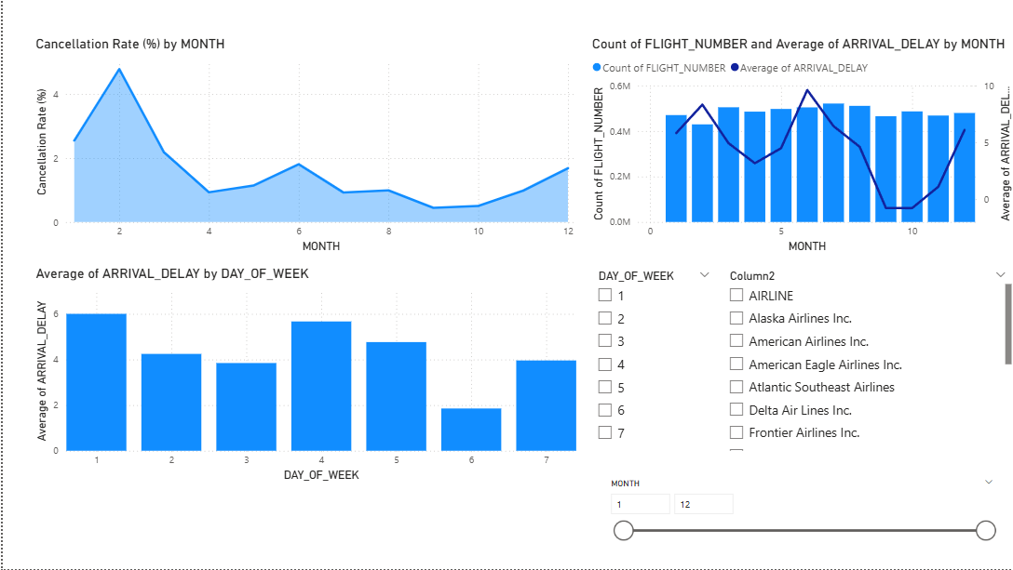
Dashboard Walkthrough – Page 2 (Airline Performance)

Slide 13
Recommendations
Improve Morning Operations.
Invest in Weather Resilience.
Optimize Airline Scheduling.

Slide 14
Conclusion
Key delay drivers and improvement areas identified.
Recommendations supported by data and dashboards.
Future scope: Predictive modeling using ML.

