Slide 1




Slide 2
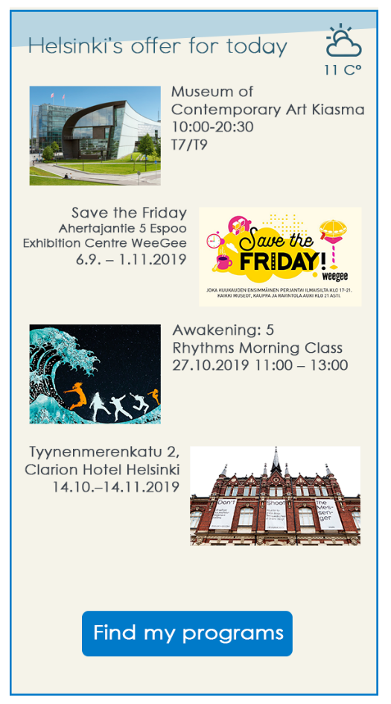

Event based data driven recommendation engine
Default recommendation

Slide 3
Event based data driven recommendation engine
Default recommendation
Do you have a favorite sport?
Did you come with your family?
What type of music do you like?
Would you like to spend your time outdoor?
What kind of art do you like?

Slide 4
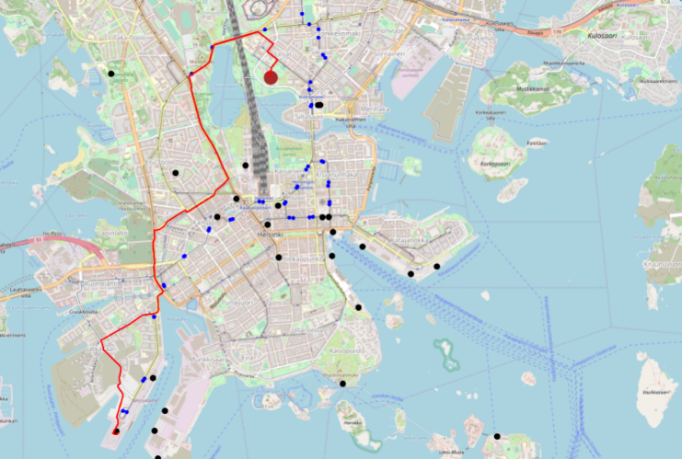
Event based data driven recommendation engine
Based on your answers you get the recommendations
Chose an option and we plan your route
Enjoy your trip ☺
Enjoy your Helsinki!

Slide 5
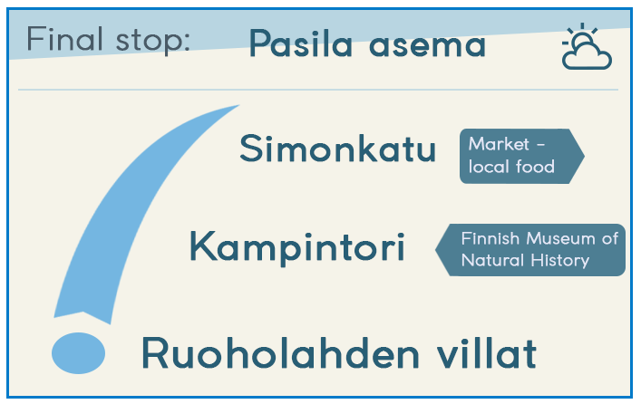
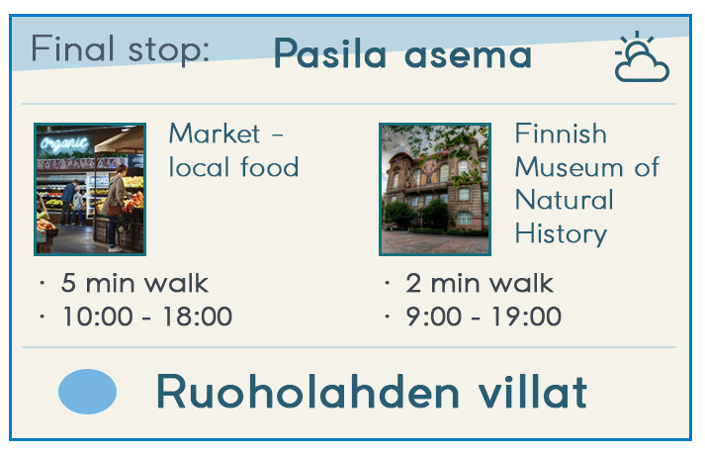
Recommending on the go

Slide 6
Proof of Concept

Slide 7
How the Recommendation engine works?
Event list (+tags)
Analyze dependencies among tags
Find best match to persons tag preference
Event list based on preferences
Correlation classical statistics
Variational autoencoders (neural networks)
Entropy (information theory
KNN
Advanced factorization

Slide 8
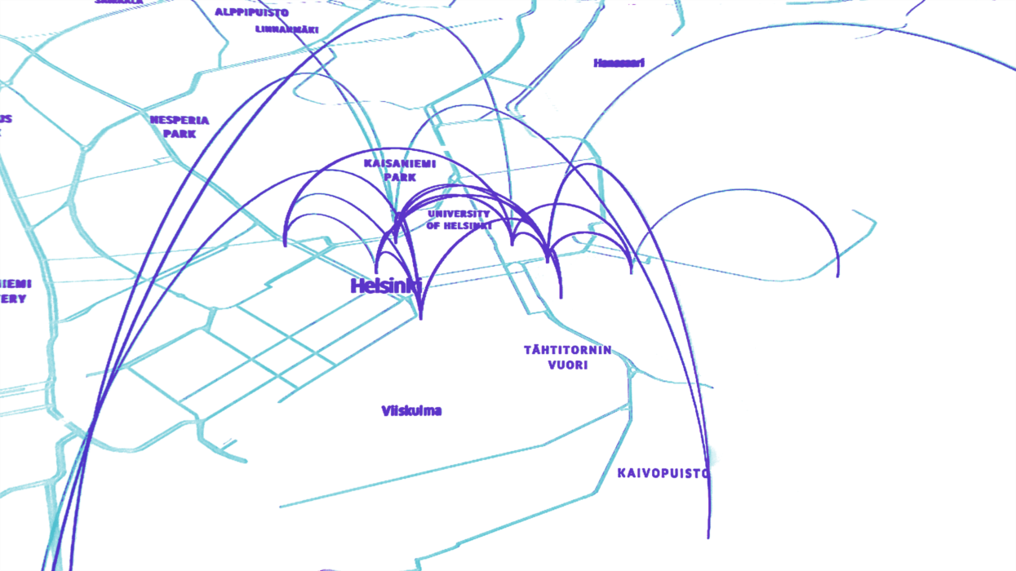
Next level of IoT in the city
Collect data from people
Connect measured data
Timeline analysis
Prediction models
on data of HelsinKEY
#machinelearning
#artificialintelligence

Slide 9
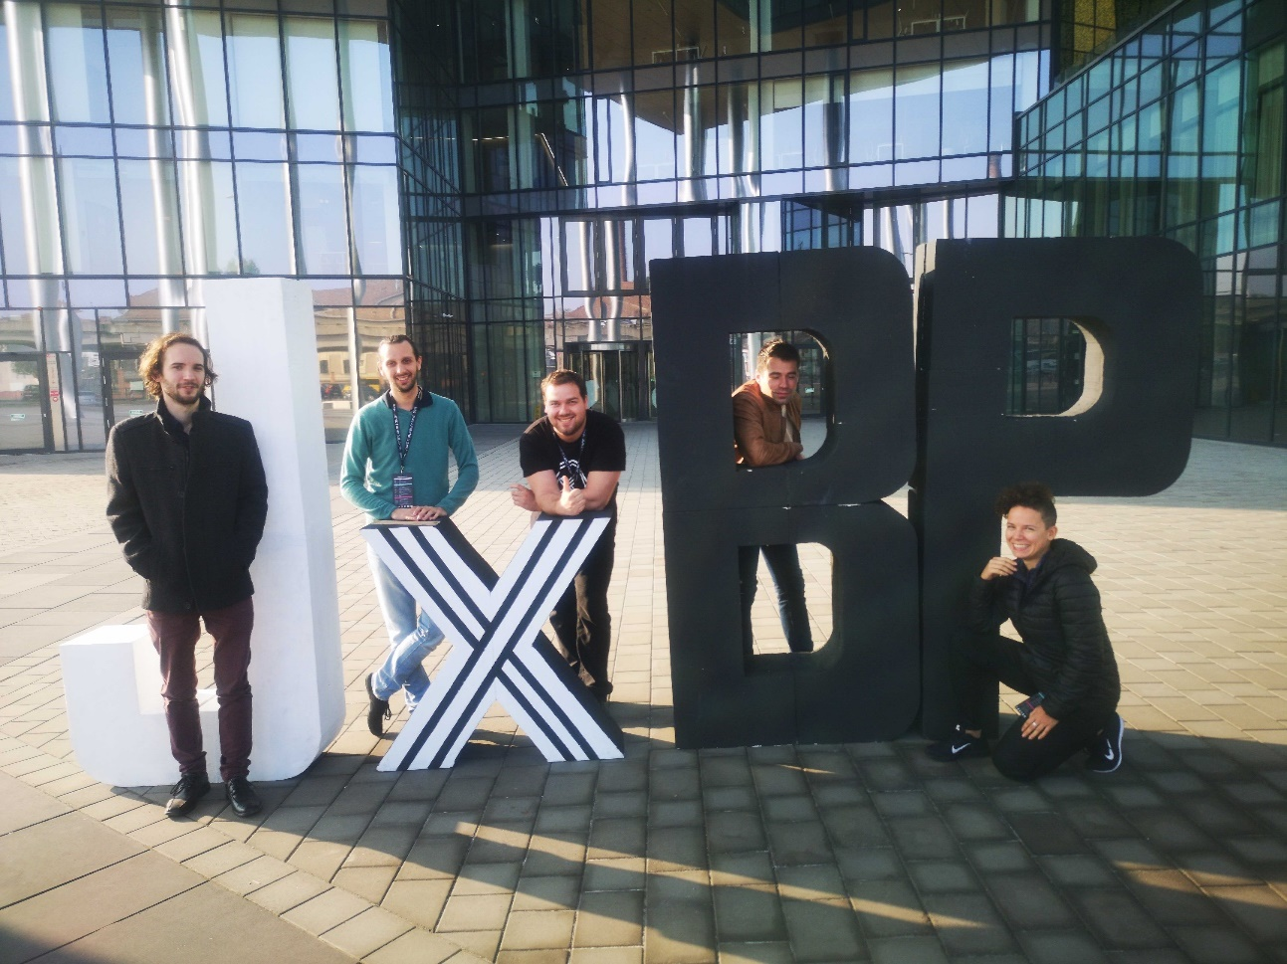

Thank you!
https://optai.hu

