Slide 1
Project 1.4.7
Kyle R. Olson and Brace Norton

Slide 2
Client
Our client asked for a photo editing software that manipulates images into a single image in a unique way.

Slide 3
Our Solution
Create a script that merges two images and alters the colors

Slide 4
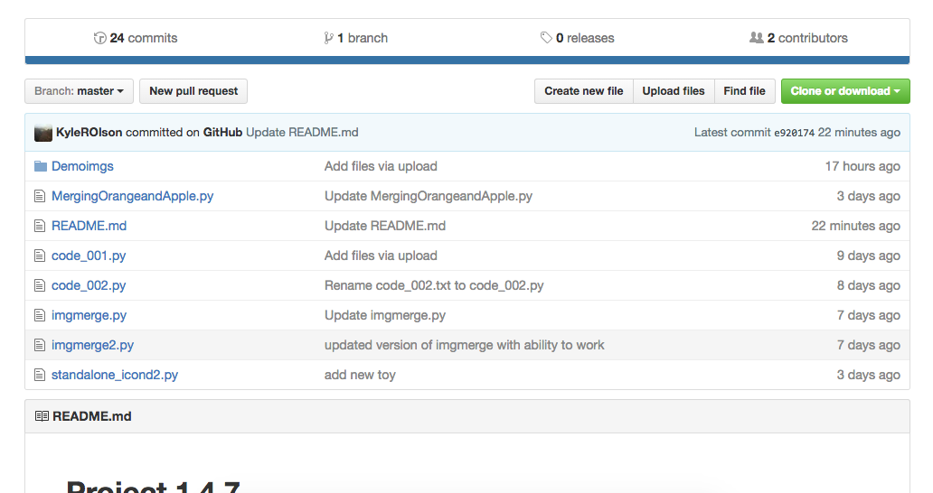
We Collaborated Over GitHub

Slide 5
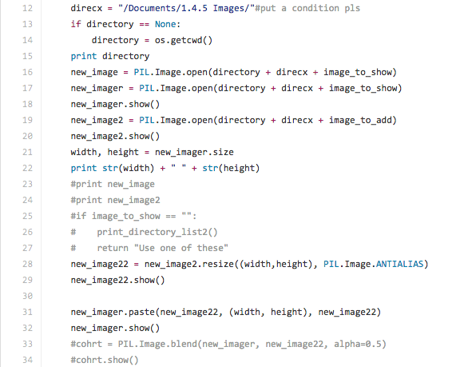
Required Many Lines of Code

Slide 6
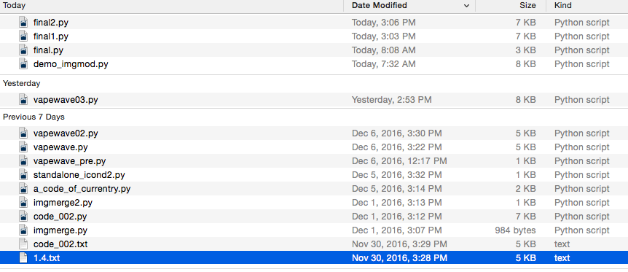
Any Many Different Attempts

Slide 7
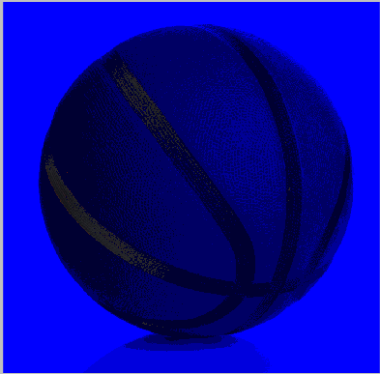
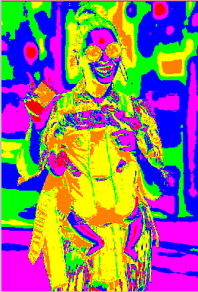
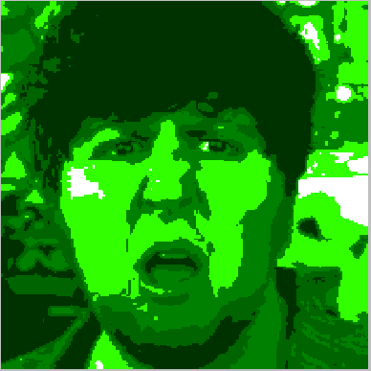
All Worth It In The End

