Slide 1

AZIZ SAIFEE
FOUNDER & CEO

Slide 2

WHAT IS wise BN ?
AN ORGANISATION WHO KEEPS SERVICE ABOVE SELF .
HELPS PEOPLE TO OVERCOME DEPRESSION .
HELPS IN SOLVING THE PERSONAL PROBLEMS OF THE MASSES .

Slide 3
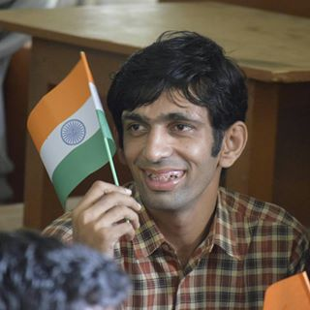
OBJECTIVE
A NATION IS NOT PROSPEROUS BECAUSE OF LONG BUILDINGS AND HIGHER GDP . A NATION IS PROSPEROUS BECAUSE OF ITS CITIZENS. WE MAKE PEOPLE HAPPY FOR THE GROWTH AND DEVELOPMENT OF THE NATION BY SOLVING THEIR PERSONAL PROBLEMS AND HELP THEM TO OVERCOME DEPRESSION .

Slide 4
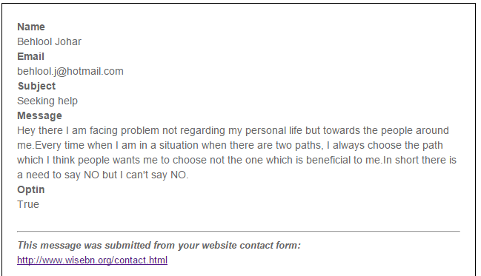
SAMPLE PROBLEM
Wise BN official answer
Hi,
Firstly we thank you for trusting us and sharing your problem with us. See I don’t know what sort of a person you are . There are two type of people. One who live life for others and the one who are self obsessed . A social person will take a path which is beneficial for the society and the who does for the betterment of self. Brother , always choose a path which your heart says and trust your gut feelings. Others can make you choose the path which helps in their greed . Please listen to your mind , in other words “THINK”.
This is a diplomatic answer which may satisfy you . Please write us back and please give your feedback about our solution .
Cheers
Wise BN

Slide 5
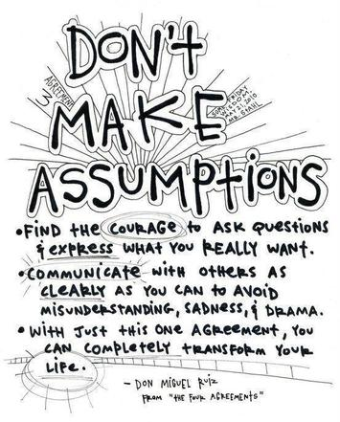
WHY wise BN ?
FASCINATED ABOUT MOOD AND HUMAN RELATIONS FROM CHILDHOOD.
ACCIDENT TOOK PLACE IN THE FAMILY WERE MY AUNT AND SMALL BROTHER EXPIRED.
HELPED THE FAMILY TO OVERCOME THE SHOCK AND DEPRESSION.
3 am IDEA – “IF I CAN HELP MY FAMILY THAN I CAN HELP THE WHOLE WORLD”.
FOUNDED wise BN .

Slide 6

MISSION PEACE
wise BN launches the mission PEACE with the objective of helping people to overcome depression , achieving peace and make the world a better place to live.
Be a Volunteer. Join our family and help the needy and contribute in our Mission PEACE.
Download Volunteer application form here - http://www.wisebn.org/about.html

Slide 7


@wisebn_aziz
@wisebn_aziz
THANK YOU

