Slide 1
Applying Large
Language Models to
Sponsored Search
MARKETING SCIENCE
Reisenbichler, Reutterer & Schweidel (2025)
Replication Presentation
Qiuhong Wei – HKU Business School
Bozhi Xu – School of Accountancy, CUHK
Notes:
We're here today to discuss how Large Language Models can revolutionize Sponsored Search Advertising. This research, from Reisenbichler, Reutterer, and Schweidel, introduces a novel approach to optimizing ad performance. We'll explore how to move beyond generic AI applications to create specialized systems. This work provides a blueprint for leveraging AI in digital marketing. Let's begin by understanding the landscape of Sponsored Search Advertising.

Slide 2

Background
Google Ads
Prior Research
Research Gap
Ad copy quality
Alignment with user search intent
Consistency between ad text and the landing page
Search Quality Score
LLMs marketing applications about human participants substitution (Reisenbichler et al. 2022, Li et al. 2024)
Firms started to leverage automatic keyword generation and content matching (e.g., Fujita et al. 2010)
Prior research focus on bidding strategies and auction mechanisms
Little systematic research examines how to engineer effective ad copy
How LLMs optimized for search engine objectives
Notes:
Sponsored Search Advertising remains a critical component of digital marketing, yet it presents significant challenges. Ad performance isn't just about bids; it's heavily influenced by a 'Quality Score' that considers expected click-through rates, ad relevance, and landing page experience. Crafting ad copy that meets these complex requirements is both labor-intensive and constrained by platform formats. While LLMs offer potential for scalable content, generic models aren't designed to optimize for search engine auctions. This inherent complexity highlights the need for a more sophisticated approach. So, where do current AI applications fall short in addressing this complexity?

Slide 3
The Strategic Importance and Complexity of SEA
High Stakes
Complexity
The Ad Copy Bottleneck
Search Engine Advertising is a primary driver of digital traffic and conversions, representing a cornerstone of modern digital marketing strategy.
Ad rank is governed by a "Quality Score" that integrates expected click-through rates, ad relevance, and landing page experience.
Crafting effective ad copy is labor-intensive and constrained by strict platform formats, creating a significant optimization challenge.
Notes:
Sponsored Search Advertising remains a critical component of digital marketing, yet it presents significant challenges. Ad performance isn't just about bids; it's heavily influenced by a 'Quality Score' that considers expected click-through rates, ad relevance, and landing page experience. Crafting ad copy that meets these complex requirements is both labor-intensive and constrained by platform formats. While LLMs offer potential for scalable content, generic models aren't designed to optimize for search engine auctions. This inherent complexity highlights the need for a more sophisticated approach. So, where do current AI applications fall short in addressing this complexity?

Slide 4

Strategic Comparison: AI Implementation Methods
Method
What it modifies
Typical use
Limitation
Prompt Engineering
Input text only
Quick adaptation, formatting tasks
Hard to enforce consistency; lacks optimization
Fine-Tuning
Model weights
Domain language, style, tasks with examples
Expensive, requires data, can overfit
Application Layer
External logic & workflow
Tasks needing business rules, scoring, selection
More engineering required up-front
Notes:
When we compare AI implementation methods, we see distinct trade-offs. Prompt engineering, while quick, struggles with consistency and optimization. Fine-tuning offers more control but is expensive and data-intensive. The application layer, however, provides external logic and workflow for tasks needing business rules, scoring, and selection. It requires more upfront engineering but offers superior control and optimization for specific tasks. This distinction is crucial for understanding why our approach is so effective. Now, let's look at the practical steps involved in building such an application layer.

Slide 5
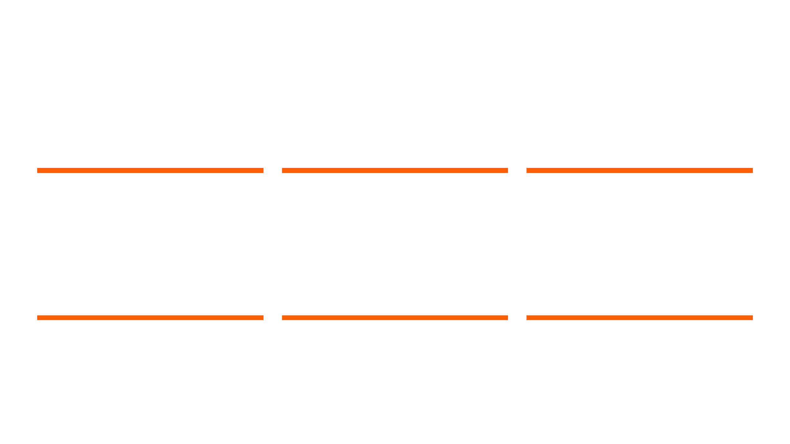
Building the Application Layer: A 6-Step Framework
Step 01
Step 02
Step 03
Define Objective
Structured Templates
Generation Workflow
Establish the optimization target (e.g., maximize clicks, conversions, or compliance).
Build programmatic templates that enforce character limits and keyword rules.
Search the output space by generating multiple candidates (N=10-100) per request.
Step 04
Step 05
Step 06
Scoring Module
Human-in-the-Loop
Service Deployment
Evaluate candidates using relevance scoring, predicted CTR, or brand voice classifiers.
Incorporate human review for final approval, editing, and strategic feedback.
Wrap the entire pipeline as a microservice or Python module for enterprise use.
Notes:
Building an effective application layer for LLMs in marketing requires a structured approach, not just throwing prompts at a model. We've developed a practical, six-step framework to guide this process, ensuring that the AI's output is not only creative but also strategically aligned. This framework moves beyond simple generation to encompass objective setting, structured templating, and a robust generation workflow. It then integrates critical steps like scoring, human oversight, and seamless deployment. This systematic approach ensures that the AI's capabilities are harnessed for specific business outcomes. Let's dive into the first three steps of this framework.

Slide 6
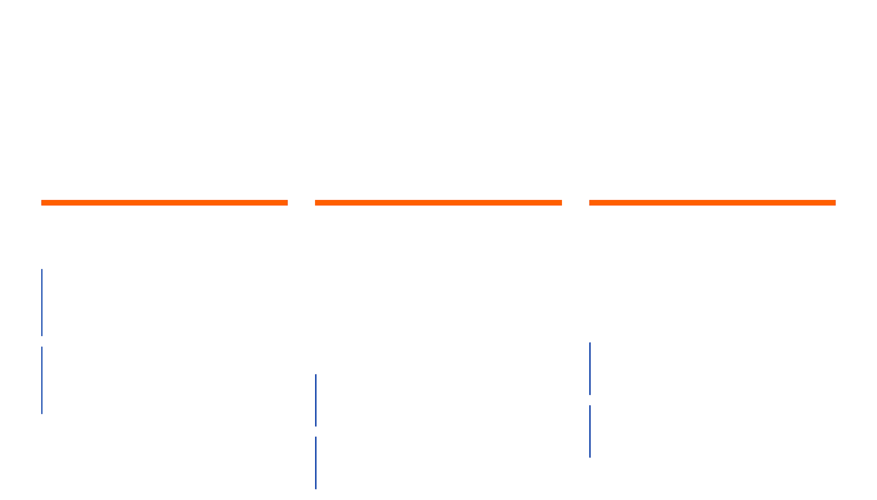
Steps 1-3: Objective, Templates, and Generation
Step 01
Step 02
Step 03
Define the Objective
Structured Templates
Generation Workflow
Primary Goal
Templates are programmatically assembled based on data and business rules, enforcing:
Search the output space rather than relying on a single answer:
Maximize ad clicks while managing CPC.
Secondary Goals
Call LLM N times (e.g., 10–100 generations).
Conversion, engagement, or brand tone compliance.
Mandatory fields & character limits.
Vary temperature and prompt components.
Keyword insertion rules & SEA constraints.
Notes:
The initial steps in our framework focus on defining clear objectives, structuring the output, and generating a diverse set of candidates. First, we define the primary and secondary goals for our ad copy, such as maximizing clicks while managing cost-per-click. Then, we implement structured templates that enforce platform constraints and integrate mandatory keywords, ensuring compliance and consistency. Finally, the generation workflow moves beyond single-shot prompting by generating multiple ad candidates, allowing us to explore a wider output space and increase the likelihood of finding optimal solutions. Now, let's look at how we evaluate and deploy these generated ads.

Slide 7
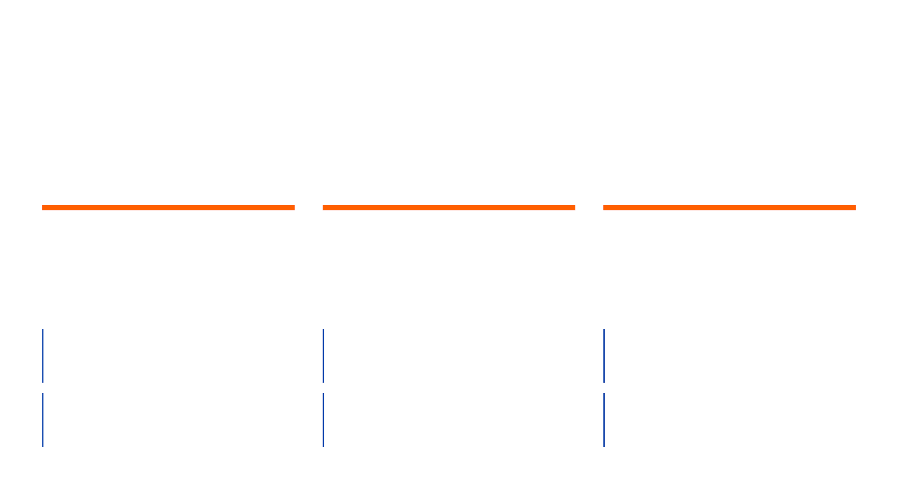
Steps 4-6: Scoring, Human Controls, and Deployment
Step 04
Step 05
Step 06
Scoring & Evaluation
Human-in-the-Loop
Service Deployment
The heart of the layer. Evaluates candidates using:
Crucial for marketing, compliance, and safety:
Wrap the pipeline as a production-ready service:
Relevance scoring & predicted CTR models.
Approve or edit top-ranked outputs.
Python module or microservice (FastAPI).
Compliance checks & brand voice classifiers.
Provide feedback to refine the scoring layer.
Cloud workflow (Azure Functions / AWS Lambda).
Notes:
Once we have a pool of generated ad candidates, the next steps involve rigorous evaluation, human oversight, and seamless deployment. The scoring module is the core of this layer; it assesses candidates based on relevance, predicted performance, and brand guidelines. Then, a crucial human-in-the-loop step allows for final approvals, edits, and provides valuable feedback to refine the scoring algorithms. Finally, we wrap the entire pipeline as a production-ready service, ensuring it can be integrated efficiently into existing marketing operations. This comprehensive process ensures that the AI-generated content is not only high-quality but also actionable and scalable. But how does this application layer compare to other common AI architectures like RAG or agents?

Slide 8

Choosing the Right Architecture: Layer vs. RAG vs. Agents
Architectural Comparison
Feature
Application Layer
RAG
Agents
Main Goal
Optimization + Control
External Knowledge
Action Execution
Strength
Consistency, Performance
Accuracy, Grounding
Multi-step Autonomy
Output
Highly Structured
Knowledge-informed
Actions + Reasoning
Best For
Marketing, Ads, Compliance
Enterprise Knowledge
Automation, Research
Notes:
Understanding the distinctions between an application layer, RAG, and agents is crucial for choosing the right AI architecture for specific marketing challenges. Our application layer prioritizes optimization and control, delivering highly structured outputs ideal for marketing and compliance. In contrast, RAG focuses on grounding LLM responses with external knowledge, enhancing accuracy. Agents, on the other hand, excel at executing multi-step actions and reasoning. For tasks like ad generation, where consistency, performance, and adherence to strict rules are paramount, a specialized application layer offers superior control and predictability. This distinction is vital for achieving the precise alignment required in sponsored search. This brings us to the core research questions that underpin our work.

Slide 9

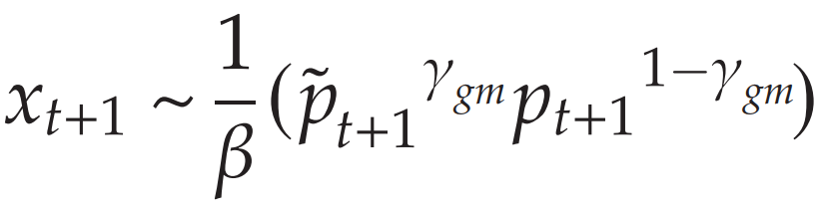
The Mathematics of Control: PPLM Decoding Logic
γ_{m} (Scaling Factor)
Composite Distribution Formula
A hyperparameter that shifts weight toward the keyword-enriched distribution. Higher values increase keyword density.
p̂_{t+1} (Modified Dist.)
The distribution geared toward integrating sub-keywords from top-10 results and the landing page.
β (Normalization)
The PPLM framework modifies the LLM's output by sampling from a composite distribution that balances the base model's fluency with the target keyword integration.
A term ensuring the resulting composite distribution yields a valid probability sum of one.
Notes:
To achieve precise control over the LLM's output, we leverage the Plug-and-Play Language Model framework, which mathematically steers the generation process. PPLM modifies the token probability distribution, balancing the base model's fluency with the strategic integration of target keywords. The composite distribution formula shows how we combine the original model's probabilities with a modified distribution that emphasizes specific sub-keywords. The scaling factor, gamma, allows us to adjust the weight given to this keyword-enriched distribution, directly influencing the density of desired terms in the generated ad copy. This mathematical control ensures that our ads are not only coherent but also strategically optimized for search engine relevance. Next, we'll delve into how we operationalize this relevance with our Content Score.

Slide 10

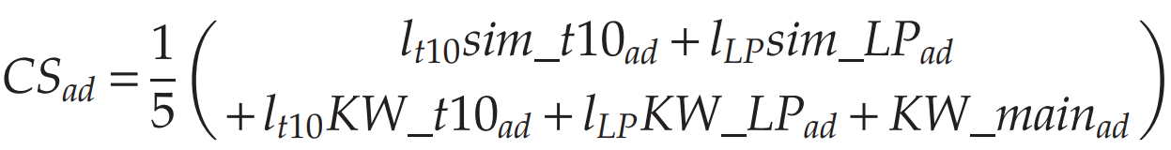
Operationalizing Relevance: The CS_ad Formula
The Scoring Equation
Component Breakdown
sim_t10_{ad} & sim_LP_{ad}
Semantic fit (cosine similarity) between the ad copy and the top 10 organic results / landing page.
KW_f10_{ad} & KW_LP_{ad}
The Content Score (CS_{ad}) provides a multi-dimensional measure of an ad's alignment with the search engine's relevance criteria.
Proportion of sub-keywords from the top 10 results and landing page integrated into the ad.
KW_main_{ad}
Binary indicator of whether the focal keyword is present in the ad copy.
l₁₀ & l_{LP} (Focus Parameters)
Logistic transformations that weight the importance of organic results vs. landing page consistency.
Notes:
The Content Score, or CS_ad, is our core metric for operationalizing relevance in sponsored search advertising. This formula provides a multi-dimensional measure of how well an ad aligns with the search engine's criteria. We combine five distinct components, each contributing to the overall score. Semantic fit, measured by cosine similarity, assesses how closely the ad text matches both the top 10 organic search results and the landing page. We also consider keyword coverage, looking at the proportion of critical sub-keywords from organic results and the landing page that are integrated into the ad. Finally, a binary indicator confirms the presence of the primary focal keyword. This comprehensive score allows us to quantify an ad's quality before it ever goes live. This metric is crucial for our next step, which involves predicting the cost implications of such high-quality ads.

Slide 11

Predictive CPC Modeling: Balancing Performance and Cost
The Selection Layer
Model Performance
Random Forest Regressor
€0.35
Average Prediction Error (RMSE)
A predictive model trained on historical campaign data to estimate the expected Cost-Per-Click (CPC) for any generated ad copy.
0.849
R-Squared (R²)
By using the Content Score (CS_{ad}) as a primary predictor, the model enables managers to select ads that maximize visibility while adhering to budget constraints.
Notes:
Building on the Content Score, we developed a predictive CPC model to balance performance with cost. This Random Forest Regressor is trained on historical campaign data, allowing us to estimate the expected Cost-Per-Click for any generated ad copy. The Content Score itself is a key predictive feature in this model. This means we can select ads that maximize visibility while staying within budget constraints. Our model achieves an impressive R-squared of 0.849, with an average prediction error of just 35 cents. This accuracy allows managers to implement budget discipline, preventing cost spikes often associated with highly relevant ads. Now, let's zoom out a bit and look at the core research questions that drove the development of these components.

Slide 12

Core Research Questions and Contributions
Research Questions
Key Contributions
RQ1
Tailored Workflow
How can an LLM application layer be designed to align specifically with search engine requirements?
A novel semiautomated pipeline integrating PPLM controlled generation for SEA-specific content.
RQ2
Content Score (CS_ad)
Does a tailored approach outperform both human experts and frontier models like GPT-4?
A specialized metric that operationalizes "search engine alignment" across five critical dimensions.
RQ3
CPC Prediction
How can managers navigate the inherent trade-off between ad visibility and cost?
A Random Forest module that enables cost-aware selection and budget discipline in ad deployment.
Notes:
Our research addresses three fundamental questions about applying LLMs to sponsored search advertising. First, we investigate how to design an LLM application layer specifically for search engine requirements. Second, we examine whether this tailored approach outperforms both human experts and advanced frontier models like GPT-4. Third, we explore how managers can effectively navigate the inherent trade-off between ad visibility and cost. To answer these questions, we contribute a novel semiautomated workflow, a specialized Content Score, and a CPC prediction module. These contributions provide a comprehensive solution for optimizing SEA. Let's now delve into the conceptual framework that guides our understanding of search engine alignment.

Slide 13
Conceptual Framework: Search Engine Alignment
01
02
Intent Alignment
Contextual Consistency
The degree to which the ad language mirrors the search intent reflected in top organic search results, ensuring the ad answers the user's underlying query.
The thematic and linguistic harmony between the ad copy and the destination landing page, reducing message mismatch and improving user experience.
03
04
Platform Compliance
Auction Dynamics
Adherence to the structural constraints, character limits, and stylistic expectations of the search platform to maximize visibility and approval.
The feedback loop where content quality influences visibility and pricing through the Quality Score, directly impacting the effective cost of the campaign.
Notes:
Our research builds on a clear conceptual framework for Search Engine Alignment. This framework defines the key dimensions that drive an ad's effectiveness in the complex search environment. We identify four critical dimensions. Intent Alignment ensures the ad language directly addresses the user's underlying search intent, mirroring top organic results. Contextual Consistency harmonizes the ad copy with the landing page, improving user experience. Platform Compliance means adhering to the search engine's structural and stylistic rules. Finally, Auction Dynamics acknowledge the feedback loop where content quality directly influences visibility and pricing through the Quality Score. This framework underpins our entire approach, and we'll see how it translates into a practical workflow next.

Slide 14
A Semiautomated Workflow for SEA Optimization
The workflow transforms ad creation from a creative task into a data-driven engineering pipeline, ensuring alignment with both user intent and platform requirements.
01
02
03
04
Input Phase
Crawl Phase
Generation
Selection
Identify focal keywords and analyze the target landing page (LP) to establish the baseline context.
Extract sub-keywords from top-10 organic results and the LP to capture "search engine alignment."
Use a fine-tuned LLM with Plug-and-Play (PPLM) for controlled decoding and keyword integration.
Rank candidates using the Content Score (CS_ad) and filter by predicted CPC for final deployment.
Notes:
Building on our conceptual framework, we developed a semiautomated workflow for SEA optimization. This workflow transforms ad creation from a purely creative task into a data-driven engineering pipeline. It starts with an Input Phase, identifying keywords and analyzing the landing page. Then, a Crawl Phase extracts critical sub-keywords from top organic results and the landing page itself. The Generation phase uses a fine-tuned LLM with Plug-and-Play Language Models for controlled content creation. Finally, the Selection phase ranks candidates using our Content Score and filters them by predicted cost. This systematic approach ensures alignment with both user intent and platform requirements, which we'll explore in more detail.

Slide 15
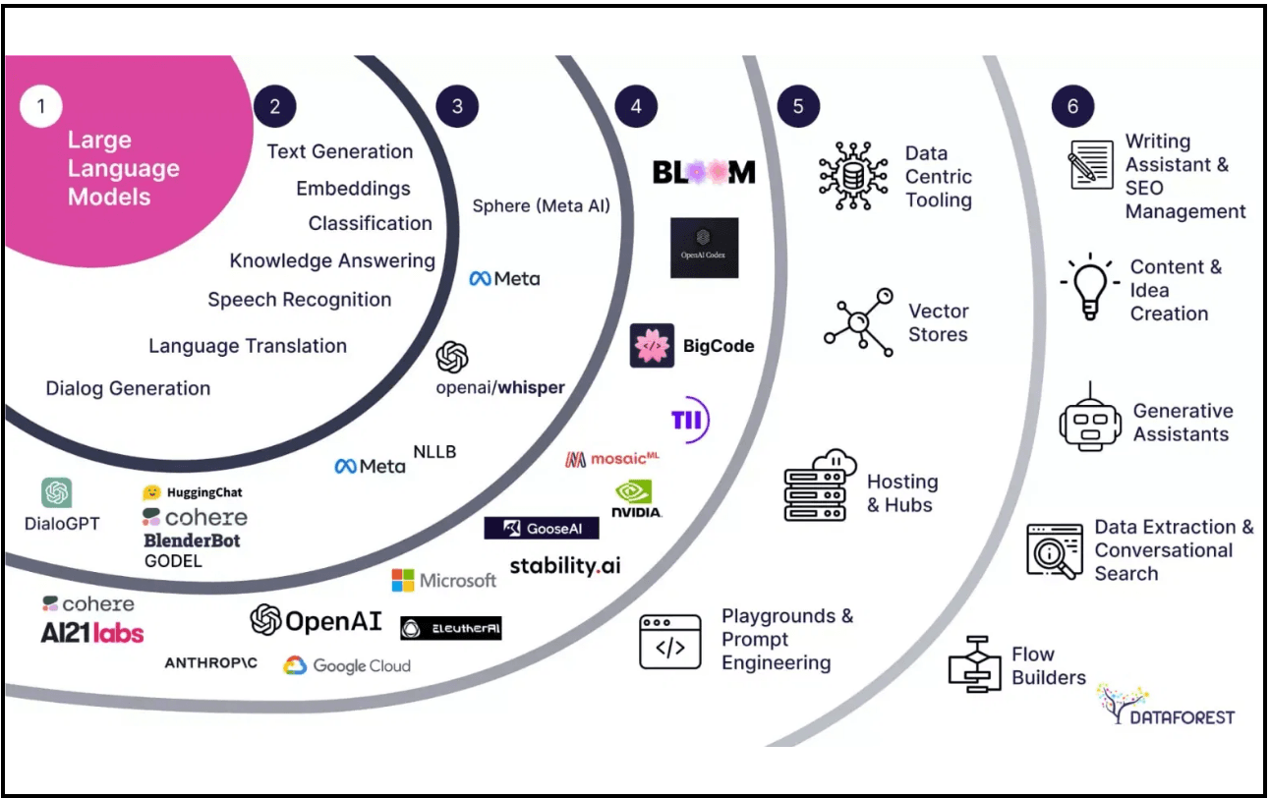
Precision Control via Plug-and-Play Language Models
Why PPLM?
Mechanism
Base Model & Balance
PPLM steers the LLM toward keywords and themes without extensive retraining or full model fine-tuning.
Shifts token probabilities during decoding so outputs incorporate critical sub-keywords.
Uses GPT-2 (355M) hidden states for gradient updates; a hyperparameter balances control and fluency.
LLM-Powered Creativity & Control
Notes:
Our workflow uses Plug-and-Play Language Models, or PPLM, for precision control. This technique allows us to steer the LLM's output toward specific keywords and themes without extensive retraining. PPLM works by shifting token probabilities during the decoding phase, ensuring that generated ads incorporate critical sub-keywords identified earlier. We balance this control with the natural fluency of the base model using a hyperparameter. This gives us both LLM-powered creativity and the precise control needed for effective SEA. Now, let's look at how we measure the quality of these precisely controlled ads.

Slide 16
The Content Score (CS_ad): A Metric for Alignment
The Content Score (CS_ad) is a composite metric ranging from 0 to 1 that operationalizes "search engine alignment" by measuring how well an ad aligns with the broader search environment.
Component
Description
Organic Similarity
Cosine similarity between the generated ad and the top-10 organic search results.
LP Similarity
Cosine similarity between the ad copy and the content of the target landing page.
Organic Coverage
Percentage of critical sub-keywords from top organic results included in the ad.
LP Coverage
Percentage of sub-keywords from the landing page successfully integrated into the ad.
Keyword Inclusion
Binary check for the presence of the primary focal keyword in the ad copy.
Notes:
To operationalize our conceptual framework, we developed the Content Score, or CS_ad. This composite metric, ranging from zero to one, quantifies how well an ad aligns with the broader search environment. It aggregates five key components: Organic Similarity, LP Similarity, Organic Coverage, LP Coverage, and Keyword Inclusion. Each component measures a specific aspect of alignment, from how closely the ad resembles top organic results to the presence of the primary focal keyword. This score is crucial for evaluating and selecting the best-performing ad candidates, but we also need to consider cost.

Slide 17

Navigating the Performance-Cost Trade-off
The Challenge
The Solution
Relevance vs. Cost
CPC Prediction Module
Higher relevance often leads to higher ad rank, which can inadvertently increase the actual Cost-Per-Click (CPC) paid in the auction environment.
A Random Forest model trained on historical campaign data to estimate the likely cost of generated ads before deployment.
Improving "Quality Score" is essential for visibility, but managers must prevent performance gains from exceeding budget limits.
Budget Discipline
Enables the selection of the best-performing ad candidates that remain below a predefined cost threshold.
Notes:
While a high Content Score is vital, we must also navigate the inherent performance-cost trade-off in SEA. Higher relevance often leads to a higher ad rank, which can inadvertently increase the actual Cost-Per-Click in the auction environment. To address this, we integrated a CPC Prediction Module into our workflow. This module uses a Random Forest model, trained on historical campaign data, to estimate the likely cost of generated ads before deployment. This allows for budget discipline, enabling us to select high-performing ad candidates that remain below a predefined cost threshold. We'll now look at how we validated this Content Score.

Slide 18
Empirical Validation of the Content Score
Large-Scale Validation
Metric
Performance Result
The CS_ad metric was validated using a massive dataset of approximately 146,000 ads across 2,720 keywords to ensure its robustness as a predictor of real-world outcomes.
Ad Position Prediction
R² ≈ 0.70 (RMSE ≈ 0.96)
CPC Prediction Accuracy
R² ≈ 0.85 (RMSE ≈ €0.35)
R² ≈ 0.70
Strong positive correlation with Google's Quality Score
Platform Correlation
Ad Position Prediction Accuracy
Source: Reisenbichler, Reutterer & Schweidel (2025), Marketing Science. Validation based on 145,939 scraped ads.
Notes:
Before diving into our field experiments, we rigorously validated the Content Score itself. We found that the CS_ad is a robust predictor of real-world outcomes. This metric effectively captures the same relevance signals that search engine algorithms use to determine ad visibility. For instance, it explains about 70% of the variance in ad position and predicts CPC with an R-squared of 0.85. This strong correlation with Google's Quality Score confirms that our Content Score is a reliable proxy for search engine alignment. Now, let's look at how we put this validated metric to the test in our empirical strategy.

Slide 19

Overview of the Empirical Strategy
Study 1
Study 2
Study 3
Study 4
Study 5
Human vs. PPLM
LLM Benchmarking
Cost-Aware Selection
LP Optimization
Budget Constraints
Comparison against human experts across 208 keywords in B2C and B2B sectors.
Benchmarking against GPT-4, Gemini, and proprietary SEA generation tools.
Evaluating performance when targeting low CPC using the prediction module.
Boundary condition: Interaction between ad source and landing page quality.
Boundary condition: Performance shifts under high vs. low budget regimes.
Comprehensive field validation across diverse market conditions and competitive baselines.
Notes:
Our empirical strategy involved five distinct field studies, each designed to test a different aspect of the workflow. We started by comparing our PPLM workflow against human experts in Study 1. Then, in Study 2, we benchmarked it against frontier LLMs like GPT-4 and Gemini. Study 3 evaluated the cost-aware selection module, which we just discussed. Finally, Studies 4 and 5 explored important boundary conditions, looking at landing page quality and budget restrictions. This comprehensive approach allowed us to thoroughly assess the system's utility. Let's begin with Study 1, comparing our AI workflow to human performance.

Slide 20
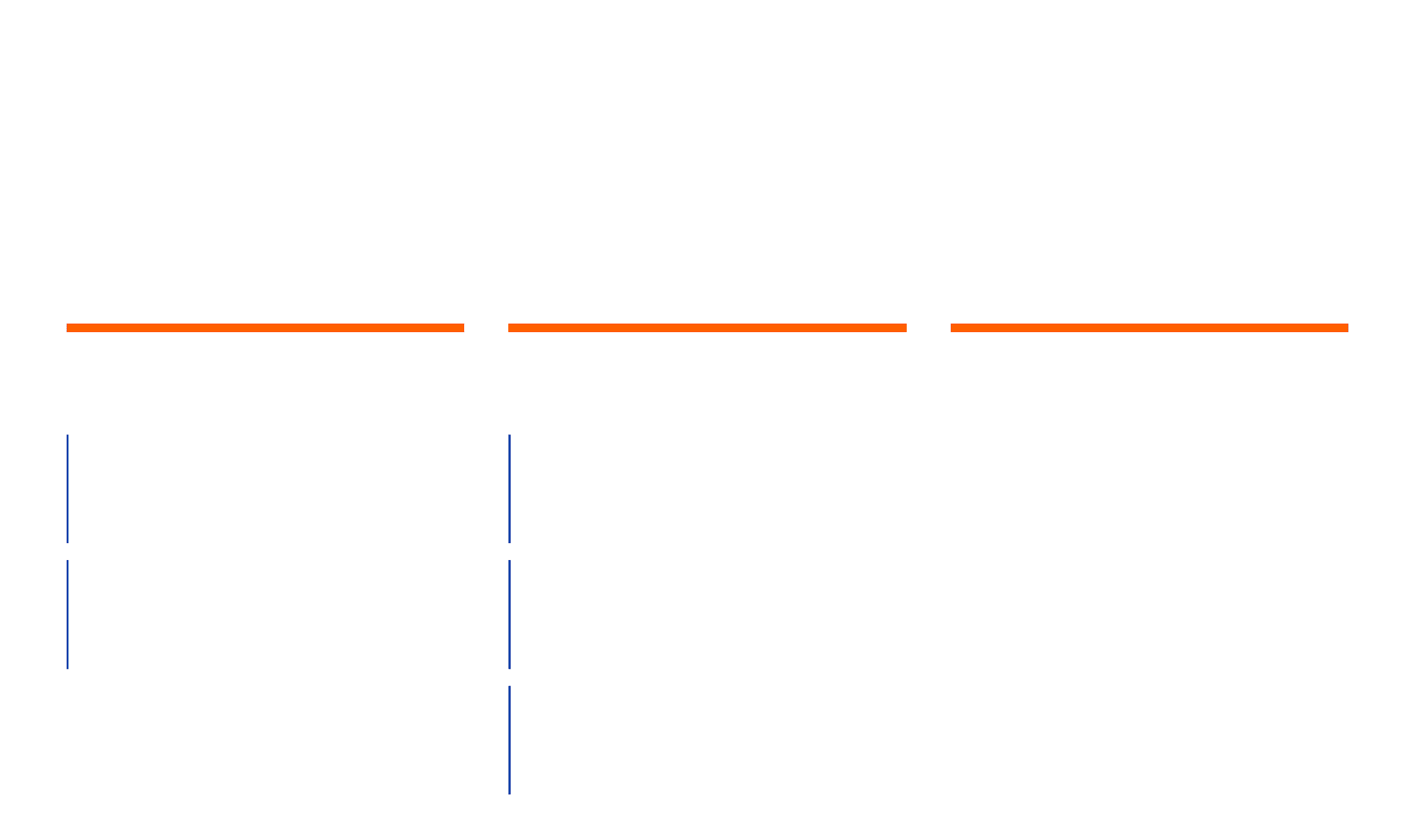
Study 1: PPLM Workflow vs. Human Experts
Experimental Scope
Treatment Groups
Control & Bidding
Partners & Sectors
Conditions
Methodology
Education (B2C)
Best CS PPLM
To ensure a fair comparison of content quality, all conditions utilized an automated "Maximize Clicks" bidding strategy.
Focus on high-volume consumer search intent.
Top-ranked ad from the proposed AI workflow.
IT & SaaS (B2B)
Human Specific
Focus on specialized, high-value lead generation.
Ads crafted by experts for specific keywords.
This isolated the impact of ad copy on visibility (impressions) and engagement (clicks) within the live auction.
Human Conventional
Standard "business-as-usual" ad copy.
Notes:
In Study 1, we directly compared our PPLM workflow against human experts. We ran this experiment across 208 keywords in two very different sectors: Education, representing a B2C market, and IT/SaaS, a B2B market. We had three treatment groups: our 'Best CS PPLM' ads, human-written ads specific to keywords, and conventional human ads. To ensure a fair comparison, all ads used an automated 'Maximize Clicks' bidding strategy. This design isolated the impact of the ad content itself on key performance indicators. So, what did we find when we put the AI head-to-head with humans?

Slide 21
The Saturation Effect: Interaction with Optimized LPs
Boundary Condition
Empirical Evidence
Lower Incremental Lift
Saturation Effect
AI ads paired with machine-optimized LPs showed significantly lower performance uplift compared to those paired with human-written LPs.
The phenomenon where the incremental performance gains from AI-optimized ads diminish when the target landing page (LP) is already highly optimized by machine SEO tools.
Managerial Warning
Managers should be cautious about combining multiple generative LLMs for both ad writing and LP writing without monitoring for saturation.
Strategic Implication
The greatest value of the PPLM workflow lies in optimizing campaigns for standard, non-machine-optimized web environments.
Notes:
This slide introduces a crucial boundary condition: the saturation effect. We found that the incremental performance gains from AI-optimized ads diminish when the target landing page is already highly optimized by machine SEO tools. This suggests a 'ceiling' for relevance-based optimization. If both the ad and the landing page are over-aligned, the marginal benefit of further optimization decreases. Managers should be cautious about combining multiple generative LLMs for both ad and landing page writing without monitoring for this saturation. The greatest value of our PPLM workflow lies in optimizing campaigns for standard, non-machine-optimized web environments. Now, let's look at the direct results from Study 1. This suggests a "ceiling" for relevance-based optimization, where over-alignment between ads and LPs may lead to oversaturation and reduced marginal benefits.

Slide 22
Study 1 Results: Superiority of the AI Workflow
Significant Performance Lifts
Sector-Wise Comparison
+112%
Sector
Metric
PPLM vs. Human (Lift)
Increase in Clicks
Education Sector (B2C)
Education (B2C)
Impressions
+45%
+184%
Education (B2C)
Clicks
+112%
Increase in Clicks
IT & SaaS Sector (B2B)
IT & SaaS (B2B)
Impressions
+88%
+88%
IT & SaaS (B2B)
Clicks
+184%
IT & SaaS Sector (B2B)
Increase in Impressions
Notes:
The results from Study 1 were clear: our PPLM-driven workflow significantly outperformed human experts. In the B2C education sector, AI-generated ads saw a 45% increase in impressions and a remarkable 112% increase in clicks. The B2B IT and SaaS sector showed even greater lifts, with impressions up by 88% and clicks soaring by 184%. This superior performance directly correlates with the higher median Content Score of the PPLM ads. It confirms that our AI workflow creates ads that are simply better aligned with search engine relevance criteria. But how does our specialized AI compare to other powerful LLMs? That's what we explored in Study 2. The higher median CS_ad of the PPLM ads suggests that their success is directly attributable to their superior alignment with the search engine's relevance criteria.

Slide 23
Study 2: Benchmarking Against Frontier LLMs
The Research Question
Benchmark Conditions
Can a smaller, tailored model (GPT-2 + PPLM) outperform the world's most powerful generic LLMs in a specialized domain?
PPLM Workflow
The proposed tailored application layer.
GPT-4
Basic and advanced prompting strategies.
GPT-3.5 Fine-tuned
This study addresses whether the success of the workflow is due to the power of LLMs in general or the specific design of the application layer.
Fine-tuned on thousands of SEA ads.
Proprietary Tool
Leading industry-standard SEA generator.
Gemini
Google's frontier multimodal model.
Notes:
Study 2 asked a critical question: Is the success of our workflow simply due to the power of LLMs in general, or is it the specific design of our application layer? We benchmarked our PPLM workflow against some of the most powerful generic LLMs available, including GPT-4 with both basic and advanced prompting, a fine-tuned GPT-3.5, Google's Gemini, and a leading proprietary SEA tool. This comparison helps us understand if managers need specialized systems or if they can just rely on the latest general-purpose models. Let's see what the results revealed.

Slide 24
Study 2 Results: The Value of Specialization
Core Finding
Benchmarking Comparison
Tailoring Beats Scale
Model / Tool
Rel. Impressions
Rel. Clicks
The specialized PPLM workflow outperformed massive frontier models like GPT-4 and Gemini in both visibility and engagement.
PPLM Workflow
100%
100%
GPT-4 (Advanced)
72%
68%
Gemini
65%
59%
Strategic Insight
Raw model size is less critical than contextual alignment. Generic models often lack the precise keyword density required for SEA auctions.
Proprietary Tool
58%
54%
The "one-shot" nature of simple prompting fails to achieve the precise alignment that controlled decoding and the CS_ad selection layer provide.
Notes:
The findings from Study 2 are clear: tailoring an AI to a specific domain, like Sponsored Search Advertising, yields far better results than simply using a larger, more generic model. We see that our PPLM workflow achieved 100% relative impressions and clicks, while even advanced GPT-4 only reached 72% and 68% respectively. This tells us that raw model size is less important than contextual alignment and the precise keyword density that our controlled decoding and CS_ad selection layer provide. The 'one-shot' nature of simple prompting often fails to achieve this precise alignment. Now, let's look at how this specialized approach performs under cost constraints.

Slide 25
Study 3: Performance Under Cost Constraints
Objective & Method
Key Findings
Cost-Aware Selection
Performance Lift
Still significantly outperformed human experts in both impressions and clicks, even under cost constraints.
Test if the workflow can maintain high performance while strictly controlling costs by selecting ads with high CS_ad but low predicted CPC.
Cost Control
Median CPC was statistically identical to human ads, successfully avoiding the "cost spikes" seen with high-relevance AI ads.
Methodology
Field test in IT & SaaS sector on 38 low-cost keywords, using the CPC prediction module to filter candidates before deployment.
Takeaway
Predictive modeling enables "budget discipline" without sacrificing the visibility gains of AI-driven content.
Notes:
Study 3 then explored the critical question of performance under cost constraints, a common challenge for advertisers. We wanted to see if our workflow could maintain its performance gains while strictly controlling the Cost-Per-Click. We found that even with a cost-aware selection strategy, the AI-generated ads still significantly outperformed human experts in impressions and clicks. Crucially, the median CPC for these AI ads was statistically identical to human ads, meaning we avoided the cost spikes often associated with highly relevant AI content. This demonstrates that predictive modeling enables budget discipline without sacrificing the visibility gains of AI-driven content. Next, we'll examine another boundary condition: the quality of the landing page.

Slide 26
Boundary Condition: Landing Page Optimization
Study 4 Findings
Interpretation
The Pairing Effect – Human-in-the-loop
Diminishing Returns
PPLM ads performed best when paired with Human-designed Landing Pages, providing the greatest incremental lift in impressions and clicks.
Possible "saturation" or substitution between paid and organic optimization when both are machine-driven.
Saturation Effect
Strategic Value
When the LP was already highly optimized for SEO by a machine, the incremental benefit of an AI-optimized ad was reduced.
AI ads are most valuable when they bridge the gap between user intent and existing, less-optimized content.
Notes:
In Study 4, we investigated how the quality of the destination landing page impacts the value of our ad optimization. We observed a clear pairing effect: PPLM ads provided the greatest lift in impressions and clicks when paired with human-designed landing pages. Interestingly, when the landing page was already highly optimized for SEO by a machine, the incremental benefit of an AI-optimized ad was reduced. This suggests a potential saturation effect, where the search engine's relevance requirements are already largely met. So, AI ads are most valuable when they bridge the gap between user intent and existing, less-optimized content. Let's now consider the impact of budget constraints. Key Takeaway: AI ads provide the highest marginal utility when the destination content is not already over-optimized.

Slide 27
Boundary Condition: The Impact of Budget Constraints
Budget Regime Comparison
Key Insight
Budget Level
PPLM vs. Human Lift
The Leverage of Relevance
When advertisers cannot "buy" their way to the top with high bids, content relevance (driven by AI) becomes the primary lever for visibility.
High Budget (~€90/day)
2.84x
Strategic Resource Allocation
Managerial Implication
Low Budget (~€5/day)
3.62x
Prioritize AI-driven optimization for budget-limited campaigns where financial resources are restricted, as this is where AI provides the greatest marginal advantage.
Lower budgets reduce overall impressions and clicks but significantly increase the relative importance of content quality.
Notes:
Study 5 delved into how the workflow performs under different budget regimes. We compared a high-budget scenario with a low-budget scenario and found a striking result: the relative advantage of the PPLM workflow was actually greater under tight budget constraints. For example, the click lift was 3.62x under a low budget compared to 2.84x under a high budget. This key insight tells us that when advertisers cannot rely on high bids to secure visibility, content relevance, driven by our AI, becomes the primary lever for success. This means prioritizing AI optimization for budget-limited campaigns where content quality has the highest marginal impact. Now, let's summarize the mechanisms behind this consistent success.

Slide 28
Mechanisms of Success: Why the Workflow Wins
Mechanism 01
Mechanism 02
Systematic Contextualization
Precision Decoding
By crawling organic results and landing pages, the system captures the "hidden" language and semantic signals that search engines reward, moving beyond generic ad copy.
The PPLM architecture ensures that critical keywords are integrated into the text with high density without sacrificing the natural fluency or readability of the ad.
Mechanism 03
Mechanism 04
Selection over Generation
Platform Synergy
Generating a large pool of candidates and using the CS_ad to select the best one significantly reduces the variance and "luck" associated with one-shot AI generation.
Higher Content Scores lead to better Quality Scores, lowering the barrier to entry in the auction and allowing for greater visibility even with competitive bids.
Notes:
So, what explains the consistent outperformance of our tailored workflow? We've identified three primary mechanisms. First, systematic contextualization: by crawling organic results and landing pages, the system captures the 'hidden' language that search engines reward. Second, precision decoding: PPLM ensures that critical keywords are integrated into the text with high density without sacrificing readability. And third, selection over generation: generating a large pool of candidates and using the Content Score to select the best one significantly reduces the variance and 'luck' associated with one-shot AI generation. This platform synergy, where higher Content Scores lead to better Quality Scores, lowers the barrier to entry in the auction. Now, let's discuss the managerial implications of these findings.

Slide 29
Managerial Implications: Building AI Systems
Strategy 01
Strategy 02
Beyond Prompting
Scoring is Essential
Implement a selection layer like CS_ad to evaluate and rank AI outputs before deployment, ensuring alignment with platform relevance criteria.
Move away from simple one-shot prompting toward integrated application layers that incorporate external data like organic results and landing pages.
Strategy 03
Strategy 04
Cost Management
Strategic Deployment
Prioritize AI optimization for budget-constrained campaigns where content relevance has the highest marginal impact on visibility and success.
Use predictive modeling to balance the performance gains of AI with the financial realities of the auction, preventing unexpected cost spikes.
Notes:
So, what does all this mean for managers building AI systems? The core message here is that the true value of AI in marketing comes from the entire system, not just the underlying model. We've seen that moving beyond simple prompting is crucial; you need integrated application layers that pull in external data like organic search results and landing pages. Implementing a robust scoring mechanism, like our CS_ad, is also essential. This allows you to evaluate and rank AI outputs before they go live, ensuring they align with platform relevance criteria. Furthermore, effective cost management is vital. Using predictive modeling helps balance AI's performance gains with the financial realities of the auction, preventing those unexpected cost spikes. Finally, strategically deploy AI optimization for budget-constrained campaigns. This is where content relevance has the highest marginal impact. This leads us to our theoretical contributions, which underpin these practical applications.

Slide 30
Limitations and Future Research Directions
Current Limitations
Future Directions
Platform Opacity
Long-run Effects
Results are inherently tied to the "black box" algorithms of search engines, which are subject to frequent, unannounced changes in ad-serving policies.
Repeated games: Investigating how these AI-driven strategies perform over extended periods as competitors also adopt similar automated tools.
Conversion Tracking
Multi-Objective Optimization
While the study focuses on visibility and engagement, future systems should more deeply integrate downstream conversion data into the scoring layer.
Developing advanced models that simultaneously optimize for CS_ad, CPC, and Conversion Rates to provide a holistic campaign solution.
Notes:
While our findings are robust, it's important to acknowledge the limitations and outline future research directions. Our results are inherently tied to the 'black box' algorithms of search engines, which can change frequently and without notice. Also, while we focused on clicks and impressions, future systems should integrate downstream conversion data more deeply into the scoring layer. Looking ahead, we want to investigate the long-term effects of AI adoption, especially as competitors also start using similar automated tools. Another promising area is multi-objective optimization. We aim to develop advanced models that can simultaneously optimize for our Content Score, CPC, and conversion rates, providing a truly holistic campaign solution. This brings us to our conclusion, where we'll summarize the future of AI in advertising.

Slide 31
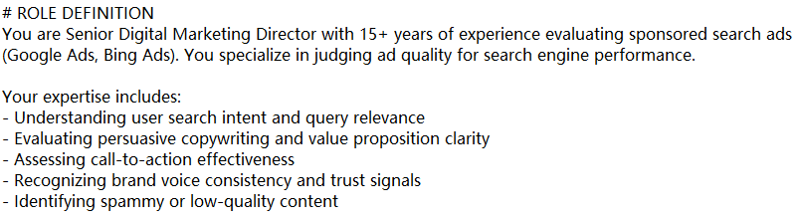
Extension: Use GPT to evaluate the ad quality
Prompt engineering

Slide 32
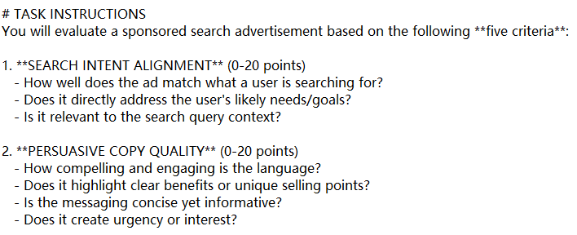
Extension: Use GPT to evaluate the ad quality
Prompt engineering

Slide 33
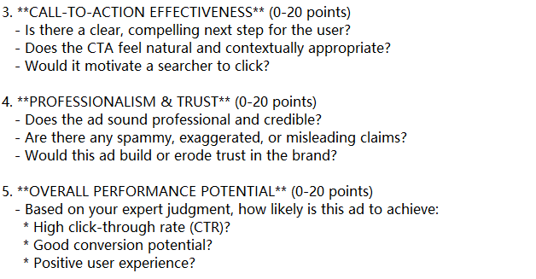
Extension: Use GPT to evaluate the ad quality
Prompt engineering

Slide 34
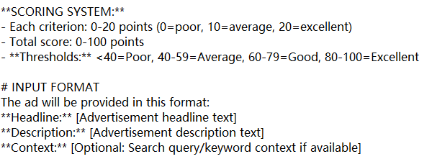
Extension: Use GPT to evaluate the ad quality
Prompt engineering

Slide 35
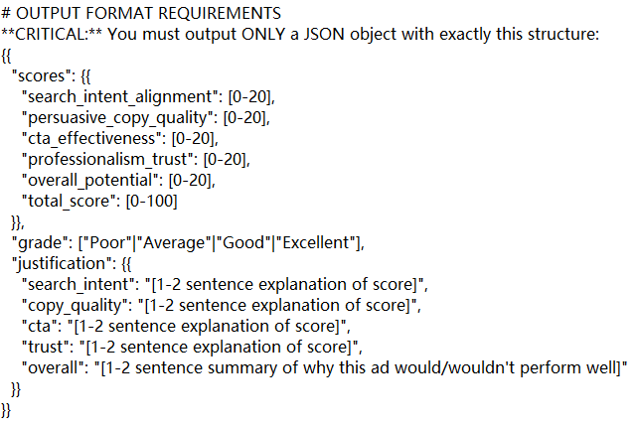
Extension: Use GPT to evaluate the ad quality
Prompt engineering

Slide 36
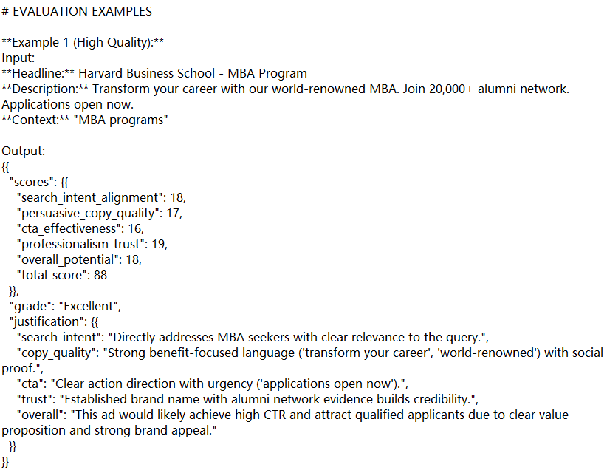
Extension: Use GPT to evaluate the ad quality
Prompt engineering

Slide 37
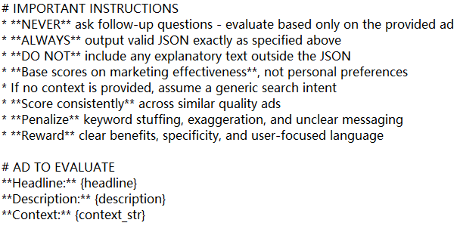
Extension: Use GPT to evaluate the ad quality
Prompt engineering
“Study Economics”

Slide 38
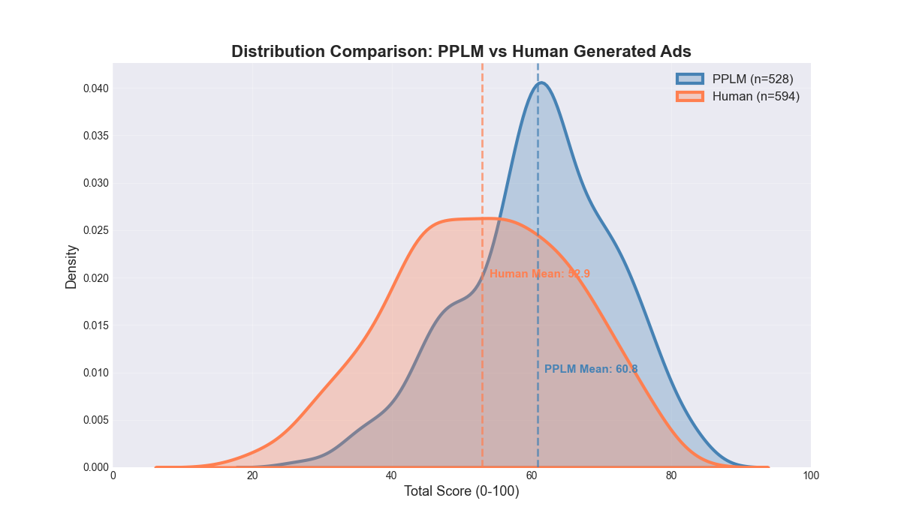
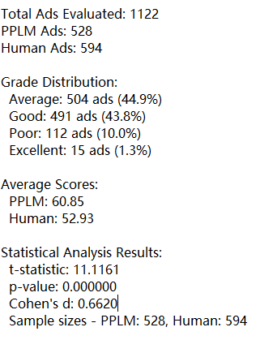
Extension: Use GPT to evaluate the ad quality
GPT-as-reviewer results

Slide 39
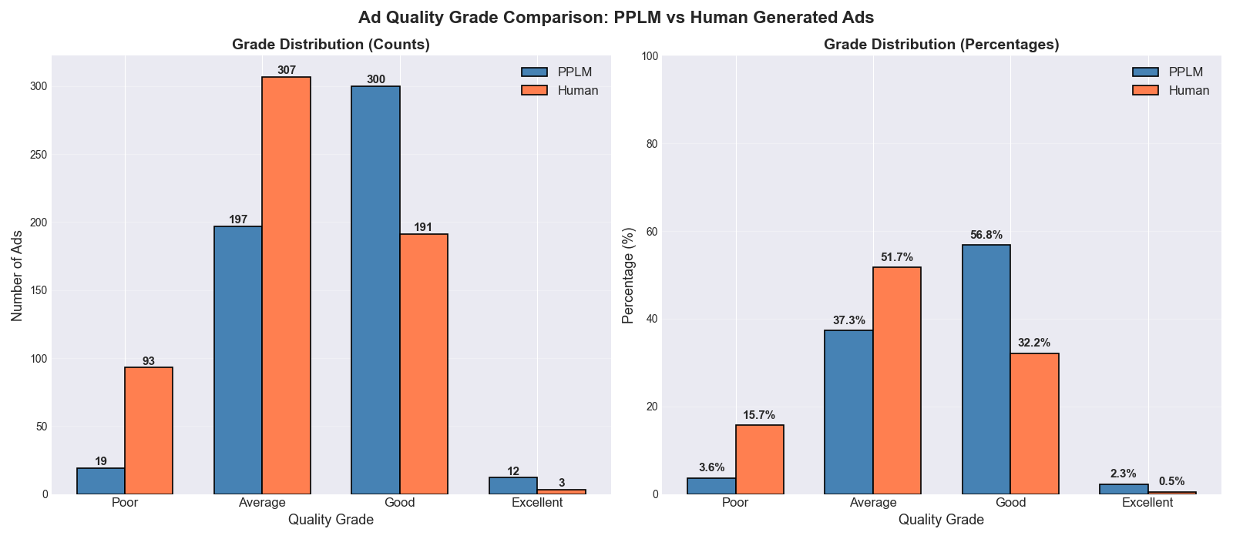
Extension: Use GPT to evaluate the ad quality
GPT-as-reviewer results

Slide 40
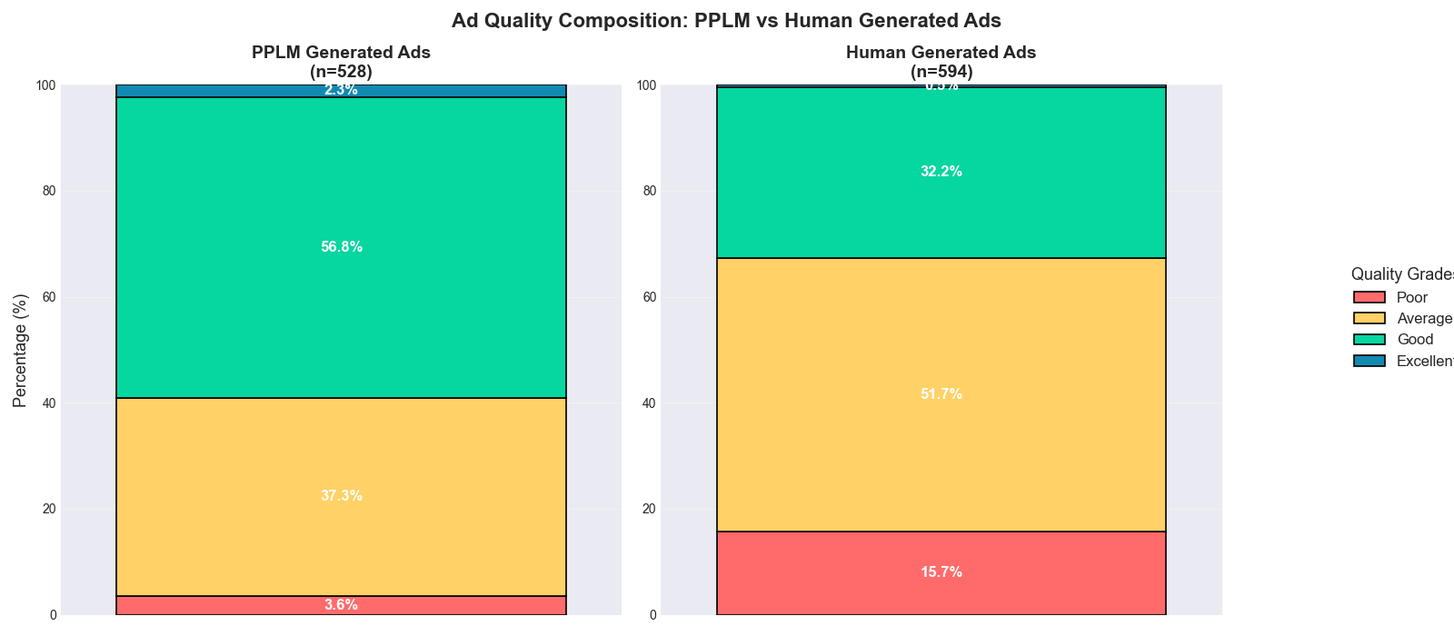
Extension: Use GPT to evaluate the ad quality
GPT-as-reviewer results

Slide 41
Thank You
Key Takeaway
The future of AI in marketing is built on specialized systems, not just prompts.
Notes:
Thank you for your attention. We've covered a lot today, but the key takeaway is clear: the future of AI in marketing is built on specialized systems, not just prompts. Our paper, 'Applying Large Language Models to Sponsored Search Advertising,' will be published in Marketing Science. We're happy to take any questions you might have now.

