Slide 1
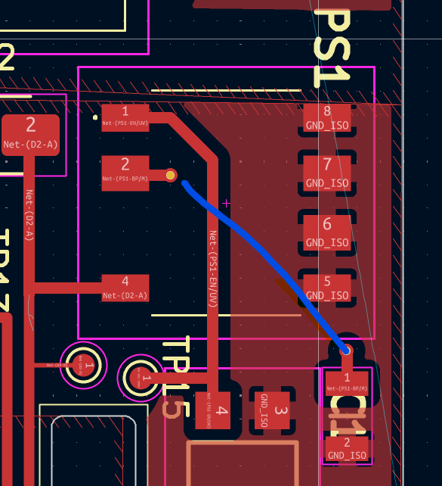
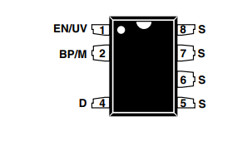
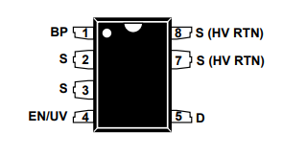




Tny_264
Tny_280
Tny_264 Flip
264 Rotat 180
One line only 180 fotat

Slide 2
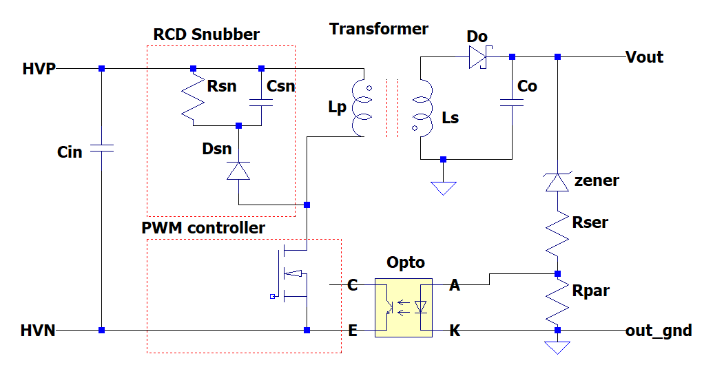
Is
Ip
Vs
Vsn
Vp
Vin
Vout
Vds

Slide 3
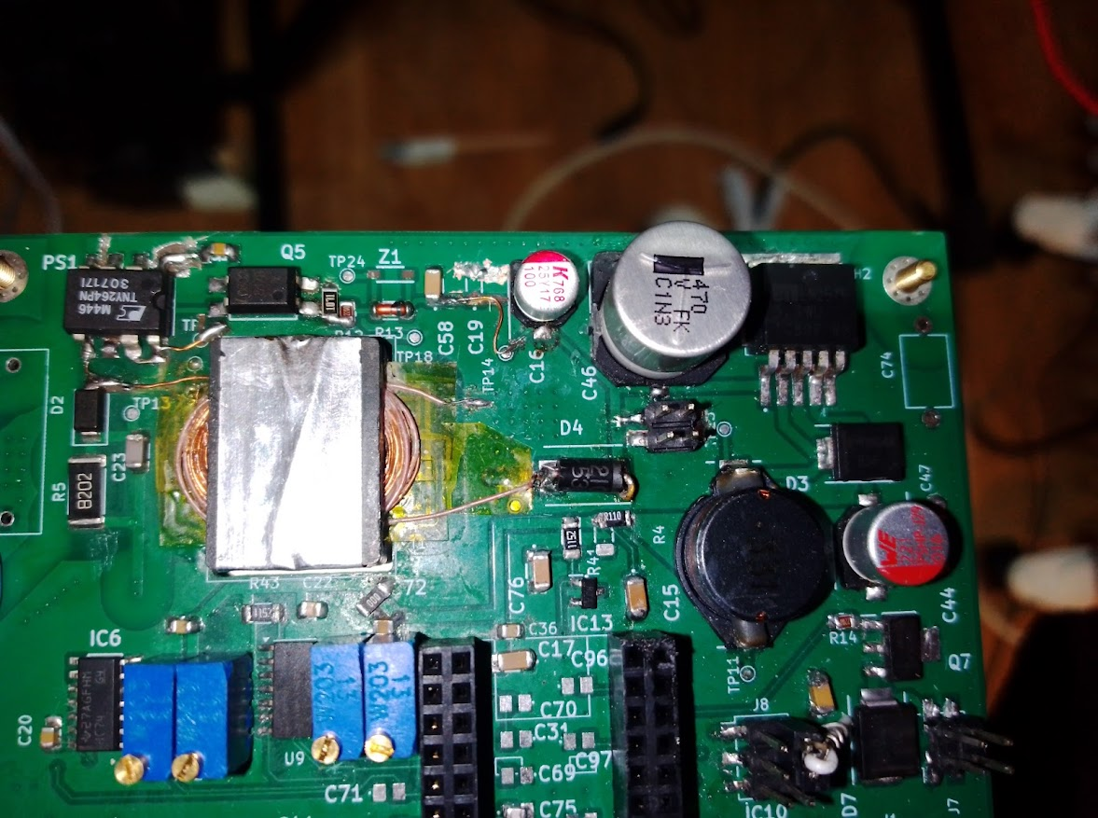
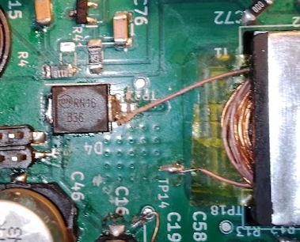

Slide 4
Tny264
BP capa
Ouput capas
Zener
& opto
Transfo
Snubber
The flyback circuit

Slide 5
