Slide 1
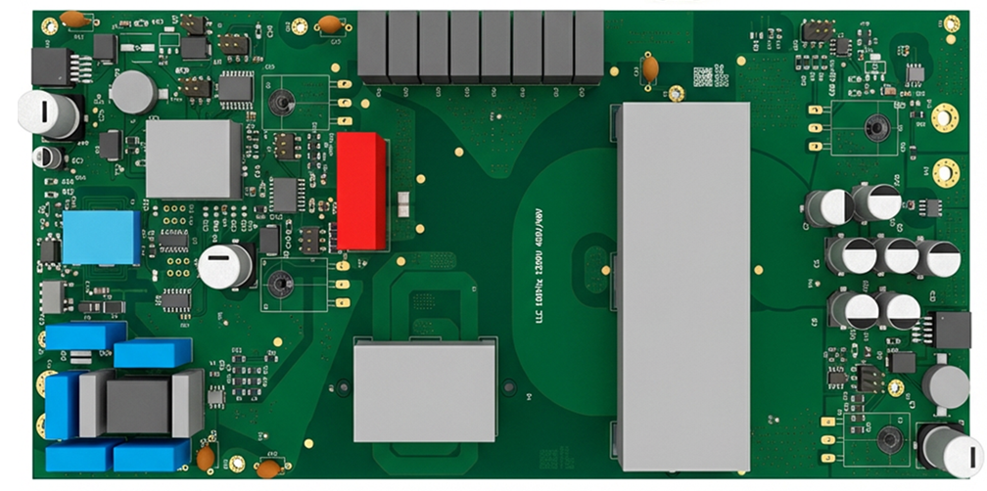
Communication-zone
Primary-zone
Secondary-zone

Slide 2


