Slide 1
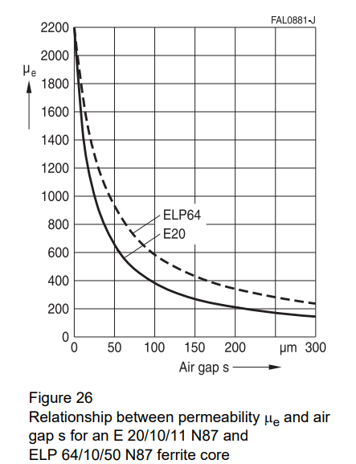
Air gap ~140µm
µe_target ~423

Slide 2

Magnetic core
The insulation material
The magnetic path

Slide 3
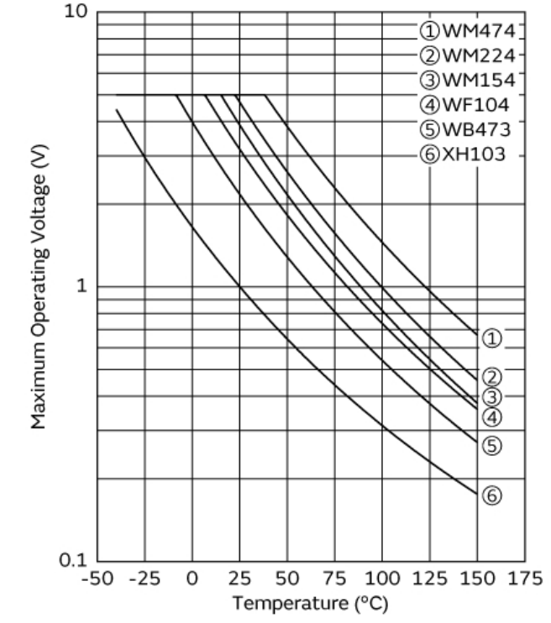

Slide 4
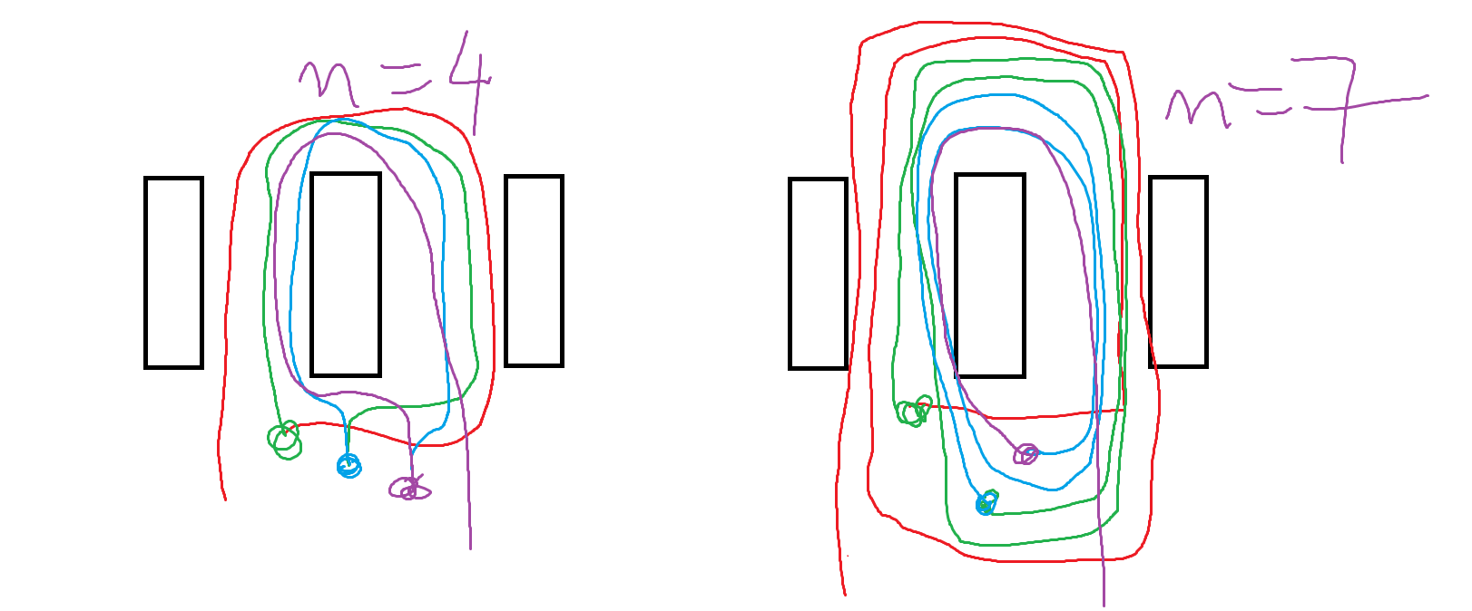
LR

Slide 5
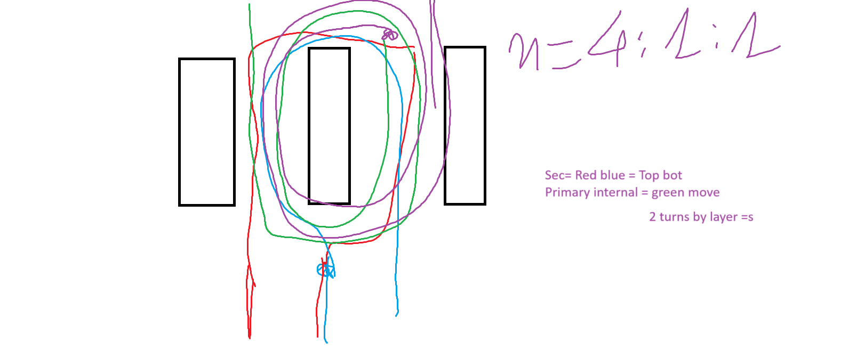

Slide 6
