Slide 1
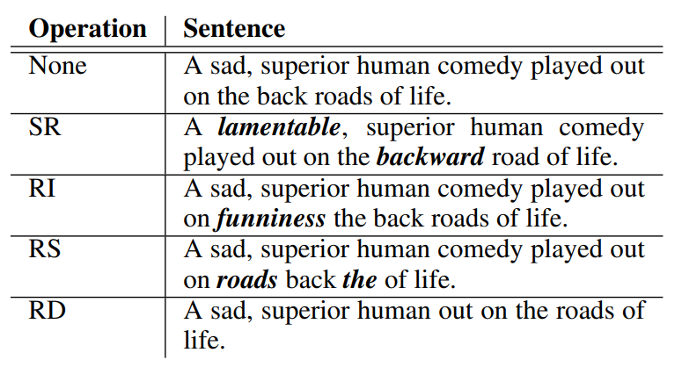
 | LGBM | XGB | RF
None
BT (en)
BT (jp)
SR
RI
RS
RD
Table1. Easy Data Augmentation Performance
Easy Data Augmentation Methods

