Slide 1
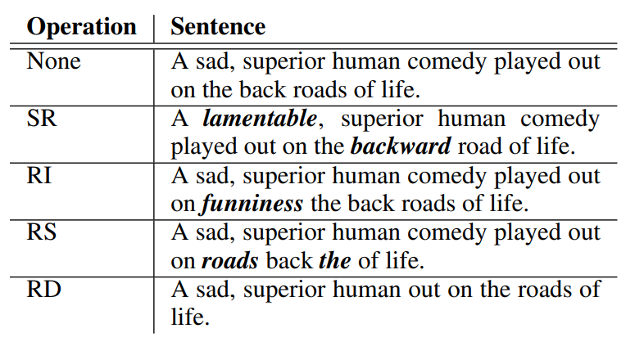
Performance of Easy Data Augmentation
 | LGBM | XGB | RF
None | 0.998246 / 0.952128 / 0.833376 | 0.99873 / 0.96614 / 0.87594 | 0.99678/ 0.90344/ 0.67857
BT (en) | 0.99857 / 0.96294 / 0. | 0.99853 / 0.96178 / 0.88656 | 0.99696/ 0.91069/ 0.70536
BT (jp) |  | 0.99835 / 0.95732 / 0.88483 | 0.99651/ 0.89484/ 0.66071
SR
RI
RS
RD
Easy Data Augmentation Methods
Table1. Performance of Easy Data Augmentation

Slide 2
LGBM
 | 1 | 2 | 3 | 4 | 5 | AVG
None | 0.99821 / 0.95147 / 0.83186 | 0.99812 / 0.9488 / 0.82301 | 0.99884 / 0.96919 / 0.88496 | 0.99758 / 0.93223 / 0.76991 | 0.99848 / 0.95895 / 0.85714 | 0.998246 / 0.952128 / 0.833376
BT (en) | 0.99821 / 0.9545 | 0.9983 / 0.95497 | 0.9983 / 0.95538 | 0.99785 / 0.94232 | 0.99857 / 0.96294 | 0.99857 / 0.96294
BT (jp)
BT (en, jp)
SR
RI
RS
RD
Table2. Performance of Easy Data Augmentation according to each KFold

Slide 3
XGB
 | 1 | 2 | 3 | 4 | 5 | AVG
None | 0.99857 / 0.96154 / 0.85841 | 0.99875 / 0.96666 / 0.87611 | 0.99866 / 0.96445 / 0.87611 | 0.99866 / 0.96412 / 0.86726 | 0.99902 / 0.97393 / 0.90179 | 0.99873 / 0.96614 / 0.87594
BT (en) | 0.99821 / 0.9545 / 0.89381 | 0.99848 / 0.96008 / 0.87611 | 0.99884 / 0.96947 / 0.89381 | 0.99857 / 0.9619 / 0.86726 | 0.99857 / 0.96294 / 0.90179 | 0.99853 / 0.96178 / 0.88656
BT (jp) | 0.99812 / 0.95244 / 0.89381 | 0.99866 / 0.9651 / 0.89381 | 0.99812 / 0.95069 / 0.85841 | 0.99812 / 0.95023 / 0.84956 | 0.99875 / 0.96815 / 0.92857 | 0.99835 / 0.95732 / 0.88483
BT (en, jp)
SR
RI
RS
RD
Table2. Performance of Easy Data Augmentation according to each KFold

Slide 4
RF
 | 1 | 2 | 3 | 4 | 5 | AVG
None | 0.99579/ 0.86766/ 0.58407 | 0.99553/ 0.85683/ 0.55752 | 0.9957/ 0.86409/ 0.57522 | 0.99472/ 0.82202/ 0.47788 | 0.99678/ 0.90344/ 0.67857 | 0.9957/ 0.86281/ 0.57465
BT (en) | 0.9957/ 0.87521/ 0.64602 | 0.99533/ 0.86151/ 0.58407 | 0.99606/ 0.88199/ 0.63717 | 0.99508/ 0.84162/ 0.53097 | 0.99696/ 0.91069/ 0.70536 | 0.99587/ 0.8742/ 0.562072
BT (jp) | 0.99553/ 0.86866/ 0.62832 | 0.99553/ 0.86151/ 0.58407 | 0.99606/ 0.88199/ 0.63717 | 0.99553/ 0.85998/ 0.57522 | 0.99651/ 0.89484/ 0.66071 | 0.99583/ 0.8734/ 0.6171
BT (en, jp)
SR
RI
RS
RD
Table2. Performance of Easy Data Augmentation according to each KFold

