Slide 1
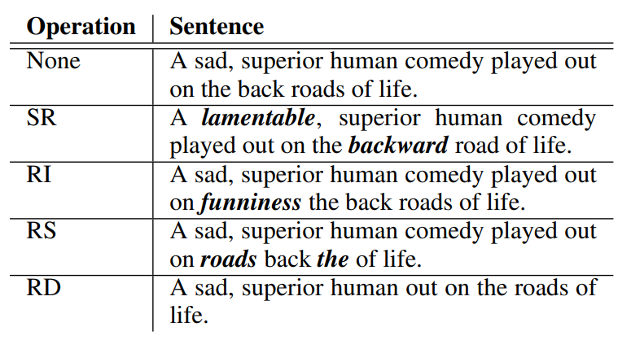
Performance of Easy Data Augmentation
 | LGBM | XGB | RF
None | 0.998246 / 0.952128 / 0.833376 | 0.99873 / 0.96614 / 0.87594
BT (en) | 0.99857 / 0.96294 / 0. | 0.99853 / 0.96178 / 0.88656
BT (jp) |  | 0.99835 / 0.95732 / 0.88483
SR
RI
RS
RD
Easy Data Augmentation Methods
Table1. Performance of Easy Data Augmentation

Slide 2
LGBM
 | 1 | 2 | 3 | 4 | 5 | AVG
None | 0.99821 / 0.95147 / 0.83186 | 0.99812 / 0.9488 / 0.82301 | 0.99884 / 0.96919 / 0.88496 | 0.99758 / 0.93223 / 0.76991 | 0.99848 / 0.95895 / 0.85714 | 0.998246 / 0.952128 / 0.833376
BT (en) | 0.99821 / 0.9545 | 0.9983 / 0.95497 | 0.9983 / 0.95538 | 0.99785 / 0.94232 | 0.99857 / 0.96294 | 0.99857 / 0.96294
BT (jp)
BT (en, jp)
SR
RI
RS
RD
Table2. Performance of Easy Data Augmentation according to each KFold

Slide 3
XGB
 | 1 | 2 | 3 | 4 | 5 | AVG
None | 0.99857 / 0.96154 / 0.85841 | 0.99875 / 0.96666 / 0.87611 | 0.99866 / 0.96445 / 0.87611 | 0.99866 / 0.96412 / 0.86726 | 0.99902 / 0.97393 / 0.90179 | 0.99873 / 0.96614 / 0.87594
BT (en) | 0.99821 / 0.9545 / 0.89381 | 0.99848 / 0.96008 / 0.87611 | 0.99884 / 0.96947 / 0.89381 | 0.99857 / 0.9619 / 0.86726 | 0.99857 / 0.96294 / 0.90179 | 0.99853 / 0.96178 / 0.88656
BT (jp) | 0.99812 / 0.95244 / 0.89381 | 0.99866 / 0.9651 / 0.89381 | 0.99812 / 0.95069 / 0.85841 | 0.99812 / 0.95023 / 0.84956 | 0.99875 / 0.96815 / 0.92857 | 0.99835 / 0.95732 / 0.88483
BT (en, jp)
SR
RI
RS
RD
Table2. Performance of Easy Data Augmentation according to each KFold

Slide 4
RF
 | 1 | 2 | 3 | 4 | 5 | AVG
None | 0. / 0. | 0. / 0.
BT (en) | 0. / 0. | 0. / 0.
BT (jp)
BT (en, jp)
SR
RI
RS
RD
Table2. Performance of Easy Data Augmentation according to each KFold

