Slide 1



Athena
Team 3

Slide 2
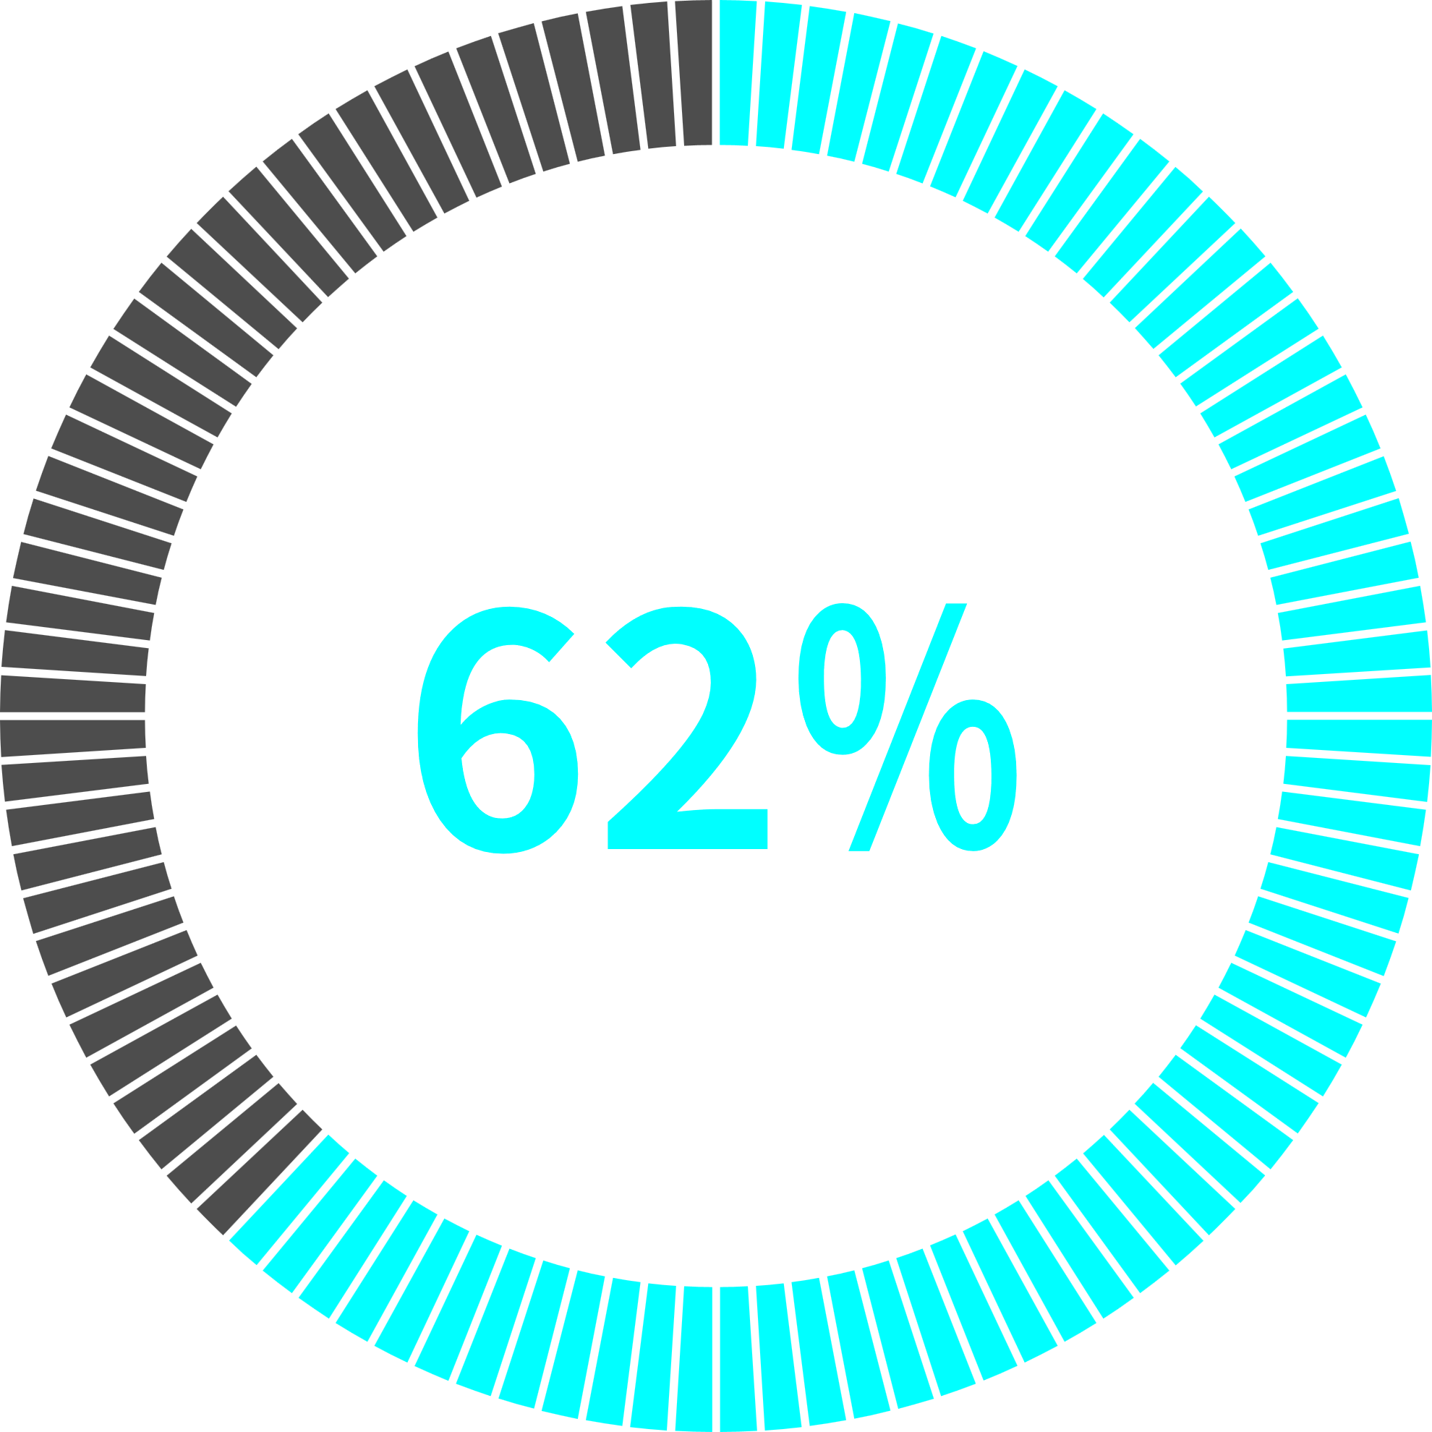
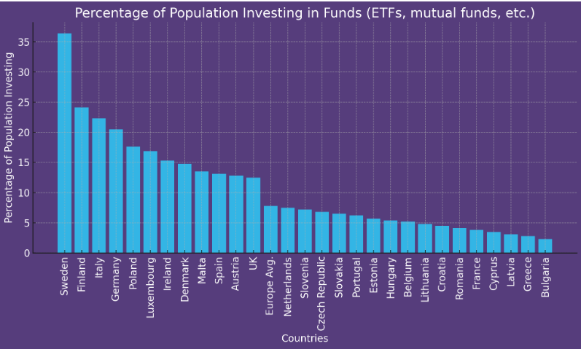
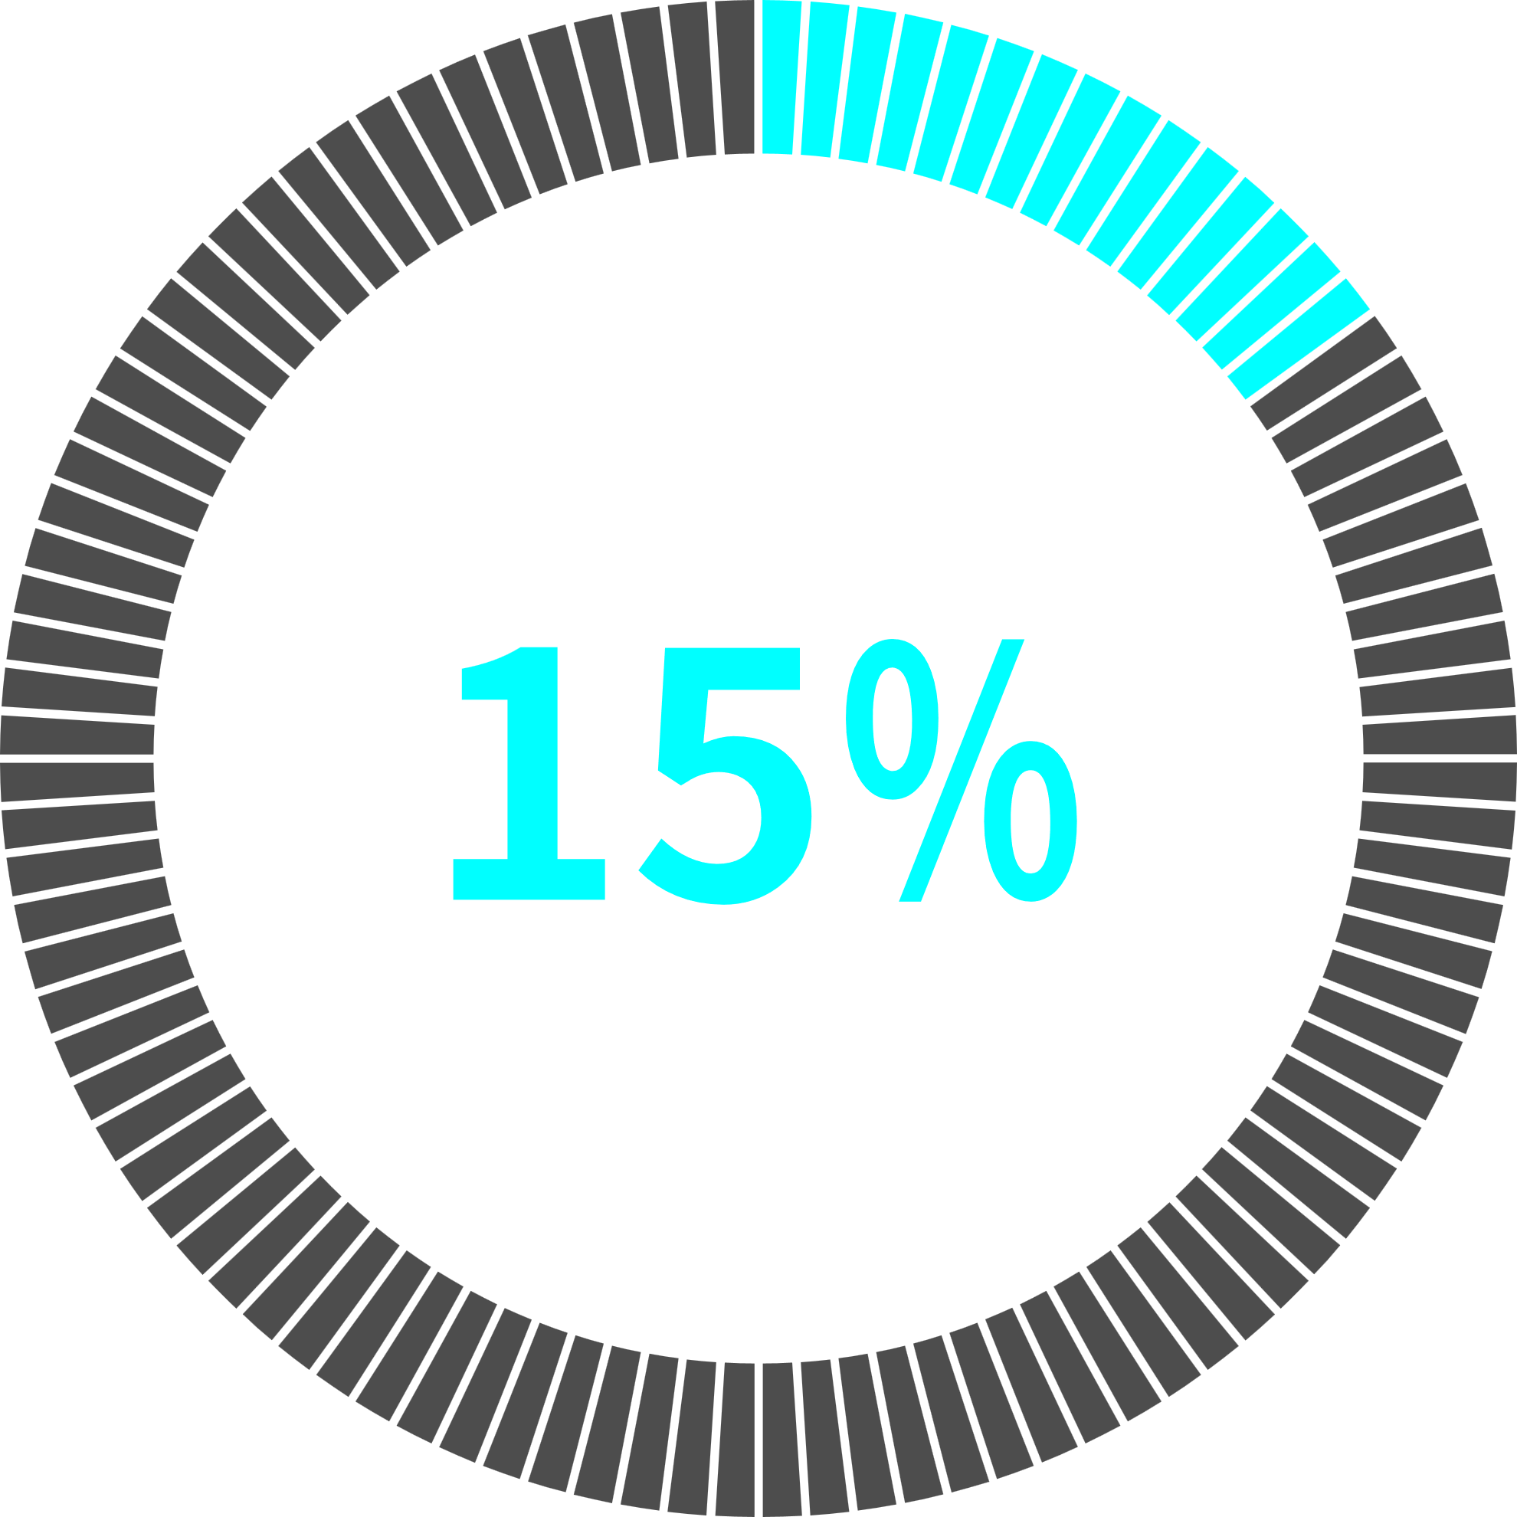
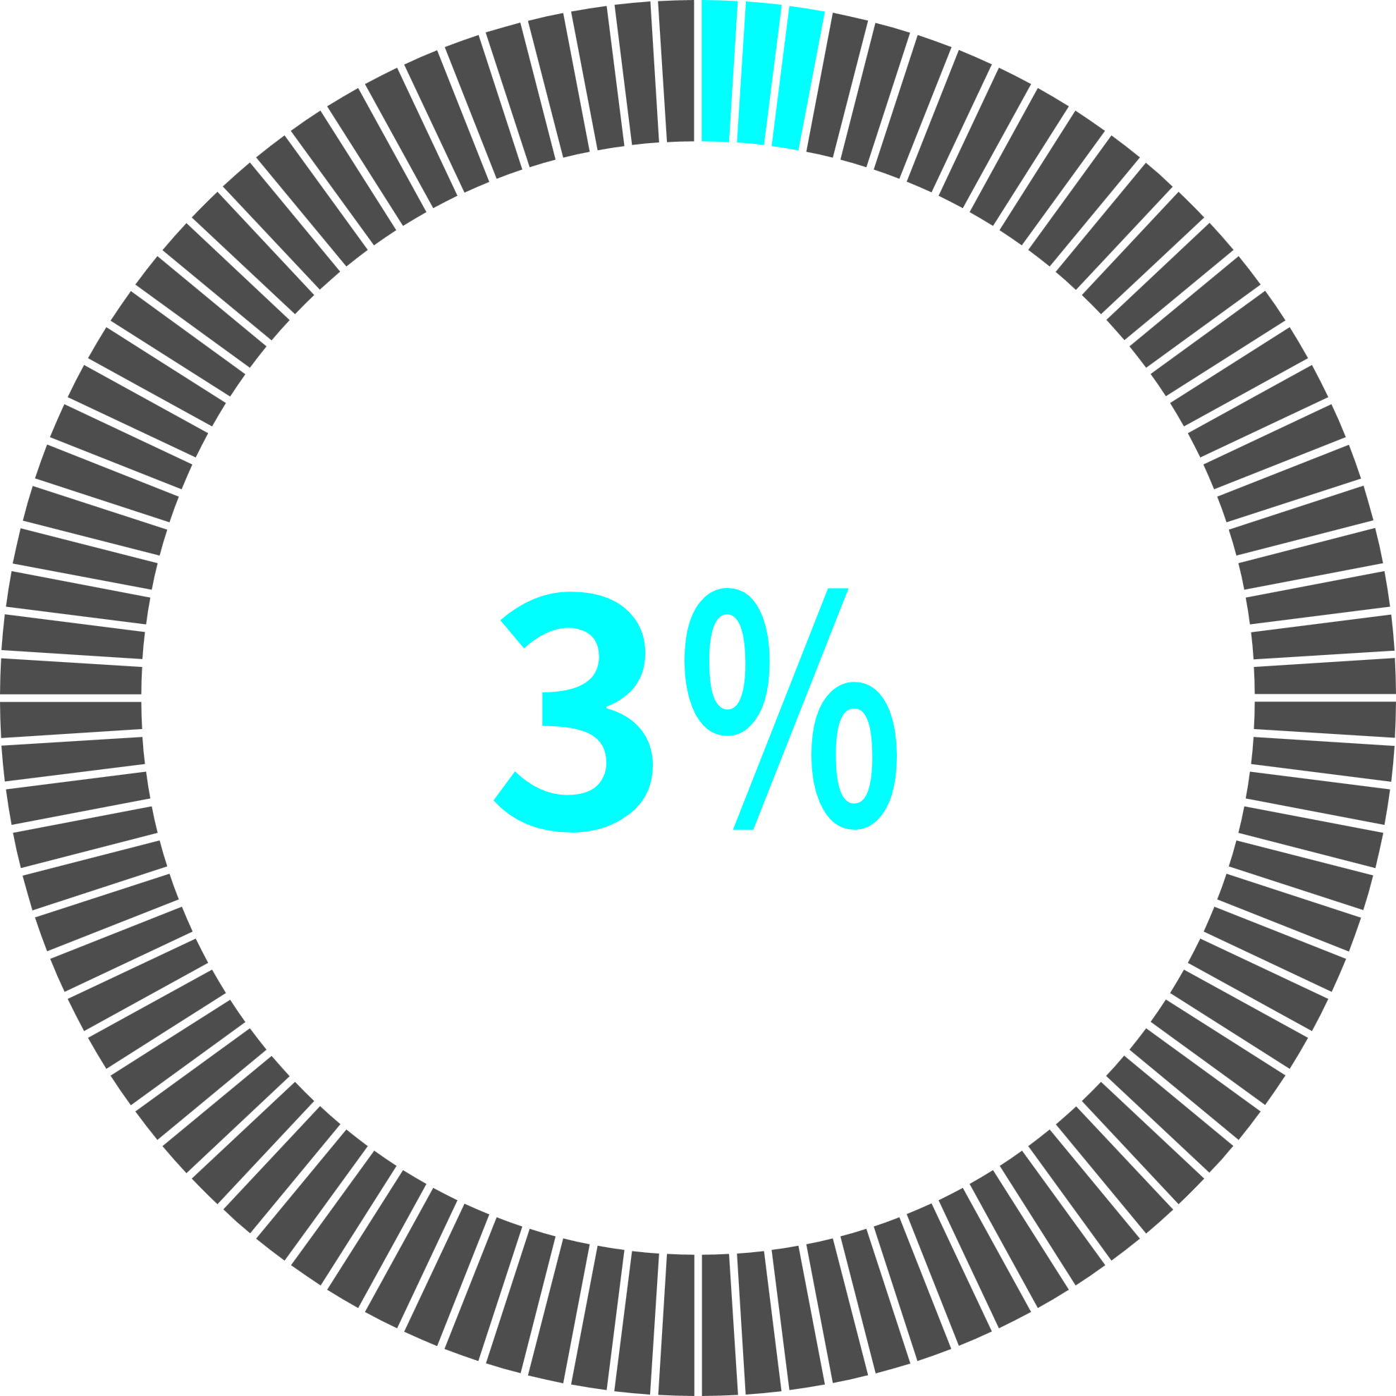
The Problem
Americans
invest in stocks
Europeans
invest in stocks
Cypriots
invest in stocks
Source: Gallop (2024), Euronerd (2023)

Slide 3
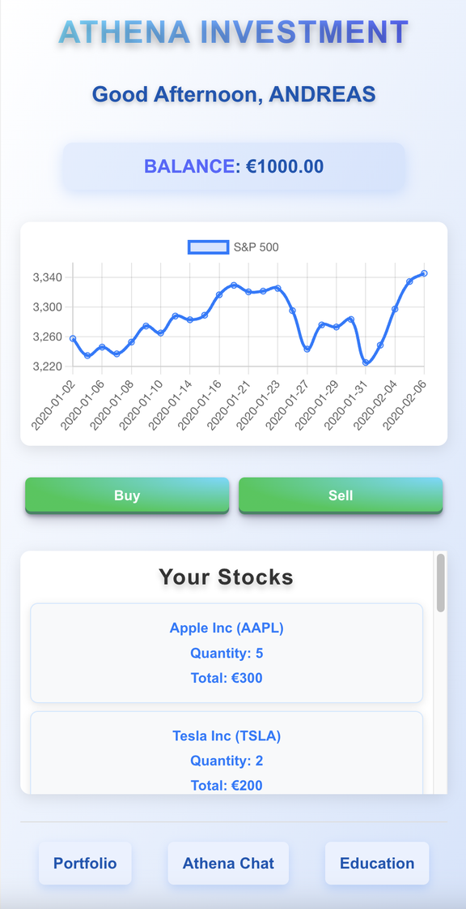

The Solution
User-Friendly
Financial Platform
AI-Driven
Personal Assistant
Educational Framework

Slide 4
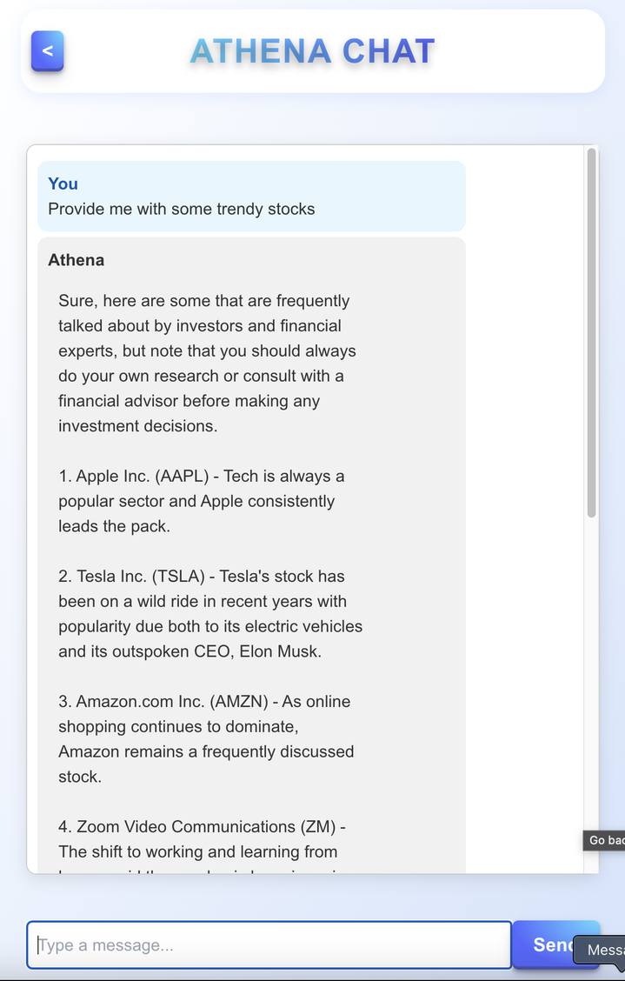
The Solution
User-Friendly
Financial Platform
AI-Driven
Personal Assistant
Educational Framework

Slide 5
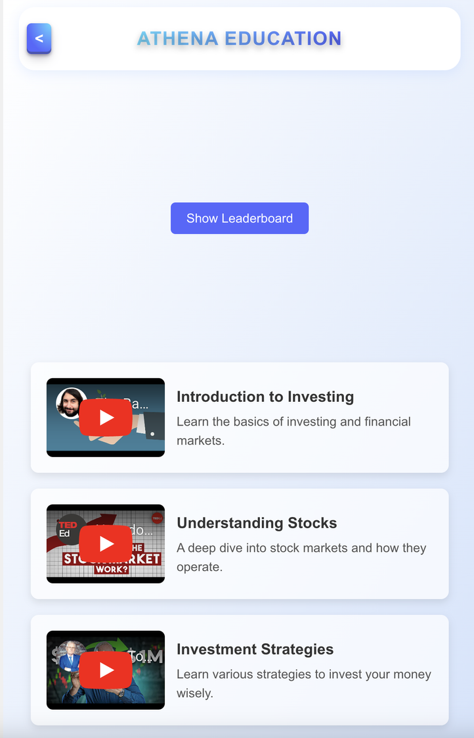

The Solution
User-Friendly
Financial Platform
AI-Driven
Personal Assistant
Educational Framework

Slide 6




Why?
Attract new
customers
Hot Topic
Features provide
competitive advantage
Commission on transaction

Slide 7










Our Hackathon Work
Ideation
API Integration
Deployment
Back End
Front End

Slide 8

Let’s check out
our live DEMO!

Slide 9

Thank You!

