Slide 1


Presentation of an Idea for the BOC Fintech Hackathon 5.0 Competition

Slide 2



Automated Consumer Loan Approval Platform
1. 2.
Consumers
Businesses

Slide 3


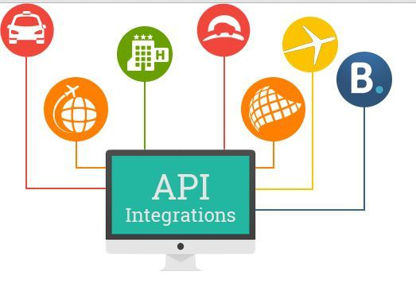




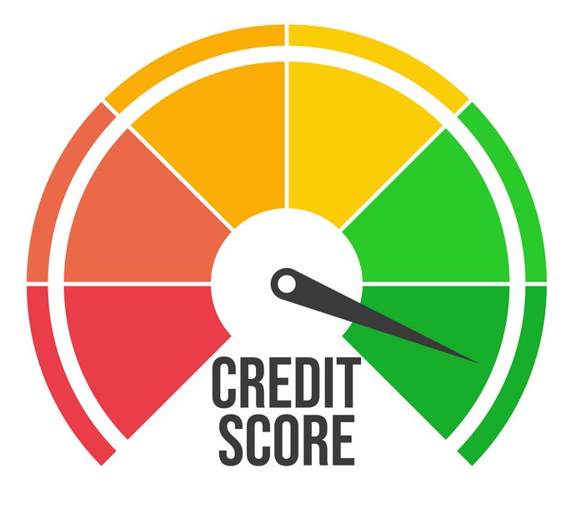


How the Use of APIs Can Verify the Credit Status of the Applicant
I accept to collect data
from third parties
Quick loan
Credit Score
Quick loan
Credit Score

Slide 4










Through API integration, the following organizations
can be included in the audit process

Slide 5





Fast consumer loan approval process
Amount Selection
50,000
Category:
Car Financing
Monthly Surplus Check
Quick loan
Credit Score
Quick loan
Credit Score
Quick loan
Credit Score

Slide 6
What will the platform offer to BOC?
Streamlined Automation
Risk Reduction
Lower Labor Costs
Time Savings
Faster Approvals
Increased Loan Volume

