Slide 1
Xamarin.UITest
Reporter:Jiaping
Date：2021/5/24

Slide 2
Agenda
PART 01
What is Xamarin.UITest?
PART 02
Local setup and configuration
PART 03
Using the REPL tool
PART 04
Test run in App Center

Slide 3
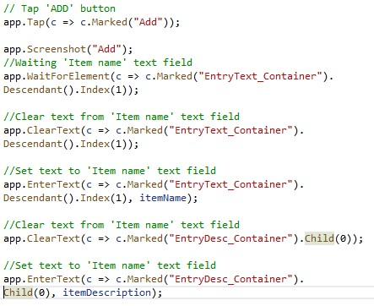
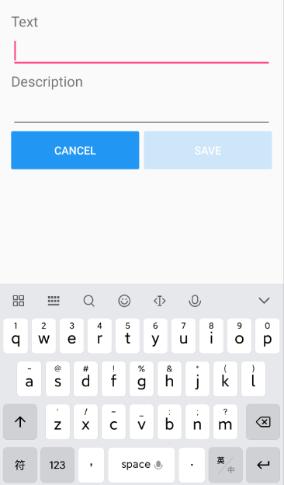
Xamarin.UITest is a C# testing framework using NUnit for UI Acceptance Tests on
iOS and Android apps. It integrates tightly with Xamarin.iOS and Xamarin.Android
projects, but it can also be used with native projects. It is an automated UI
acceptance testing framework that checks the behavior and functionality of UI.
PART 01

Slide 4
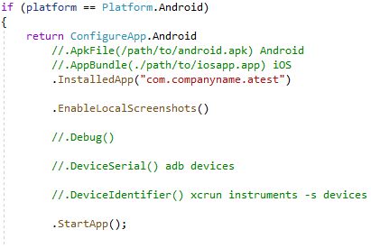
Configuring UITest
PART 02
ConfigureApp is used to initialize and configure UITest; this should be done prior to each test to keep tests independent.
Can specify the full path on the local disk to a built iOS or Android application
Pass the package name or bundle identifier
to specify the application
Enable screenshots when running tests locally. Screenshots are
always enabled when tests are running in the cloud.
Can use ADB command line tool to identify
all the connected devices
Last step in the configuration is the start the application, this will launch the
application on the simulator/emulator/device

Slide 5
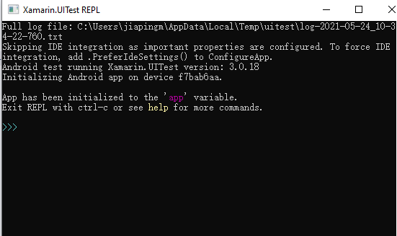
Using the REPL
PART 03
Built in REPL(Read-Evaluate-
Print-Loop) allows you to explore
and manipulate the running
application interactively through
a runtime shell.
app.Repl();

Slide 6
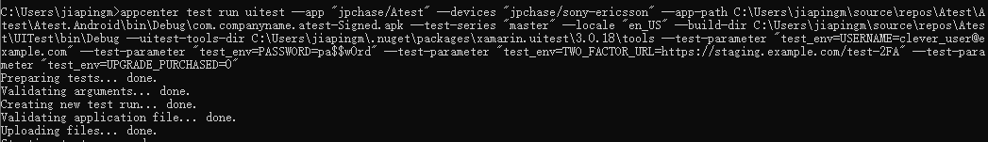
Test run in App Center
PART 04
Once a test suite is prepared, you can setup a test run to upload and run your
tests. That process will generate a prototype command line like this:
Command links:

Slide 7
Thank you!
Reporter:Jiaping
Date：2021/5/24

