Slide 1
RCS 112
L3

Slide 2
Connectivity
Many problems can be modelled with paths formed by traveling along the edges of graphs.
For instance, the problem of determining whether a message can be sent between two computers using intermediate links can be studied with a graph model.
Problems of efficiently planning routes for mail delivery, garbage pickup, diagnostics in computer networks, and so on can be solved using models that involve paths in graphs.

Slide 3
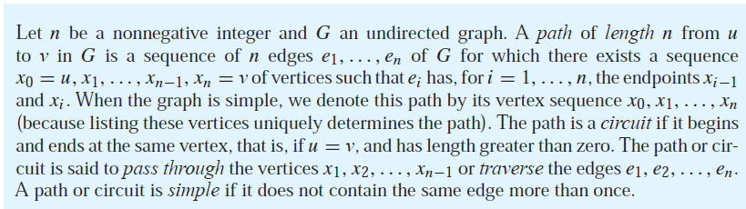
Paths/ walk
A path is a sequence of edges that begins at a vertex of a graph and travels from vertex to vertex along edges of the graph.
A formal definition of paths and related terminology is given here under.

Slide 4
In the simple graph shown in Figure below, a, d, c, f, e is a simple path of length 4, because {a, d},{d, c}, {c, f }, and {f, e} are all edges.
However, d, e, c, a is not a path, because {e, c} is not an edge.
Note that b, c, f, e, b is a circuit of length 4 because {b, c}, {c, f}, {f, e}, and {e, b} are edges, and this path begins and ends at b.
The path a, b, e, d, a, b, which is of length 5, is not simple because it contains the edge {a, b} twice.

Slide 5
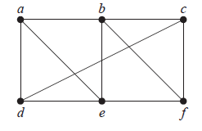

Slide 6
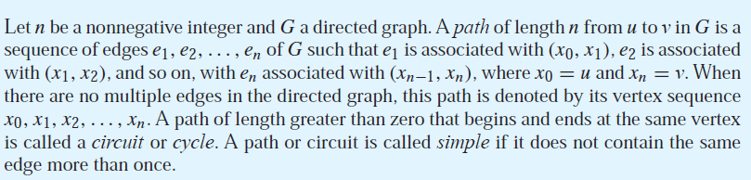

Slide 7
Walk
A walk is defined as a finite alternative sequence of vertices and edges, of the form
which begins and ends with vertices, such that (i) each edge in the sequence is incident on the vertices preceding and following it in the sequence. (ii) no edge appears more than once in the sequence, such a sequence is called a walk or a trial in G. The number of edges in a walk is called its length;

Slide 8
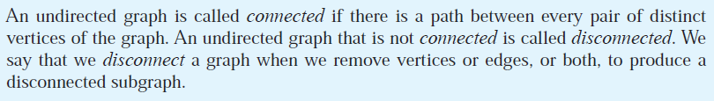
Connectedness in Undirected Graphs
Thus, any two computers in the network can communicate if and only if the graph of this network is connected

Slide 9
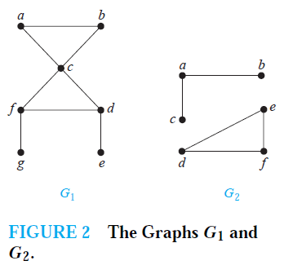
Example -The graph G1 in Figure 2 is connected, because for every pair of distinct vertices there is a path between them (the reader should verify this). However, the graph G2 in Figure 2 is not connected. For instance, there is no path in G2 between vertices a and d.

Slide 10
Connectedness in Directed Graphs
There are two notions of connectedness in directed graphs, depending on whether the directions of the edges are considered.
DEFINITION - A directed graph is strongly connected if there is a path from a to b and from b to a whenever a and b are vertices in the graph.
DEFINITION - A directed graph is weakly connected if there is a path between every two vertices in the underlying directed graph.

Slide 11
Counting Paths between Vertices
The number of paths between two vertices in a graph can be determined using its adjacency matrix.
THEOREM
Let G be a graph with adjacency matrix A with respect to the ordering v₁, v₂. . . v_{n} of the vertices of the graph (with directed or undirected edges, with multiple edges and loops allowed). The number of different paths of length r from vi to vj , where r is a positive integer, equals the (i, j )th entry of A^{r} .
The Theorem above can be used to find the length of the shortest path between two vertices of a graph, and it can also be used to determine whether a graph is connected or not.

Slide 12
Euler and Hamilton Paths/circuit
Can we travel along the edges of a graph starting at a vertex and returning to it by traversing each edge of the graph exactly once? Euler circuit,
Similarly, can we travel along the edges of a graph starting at a vertex and returning to it while visiting each vertex of the graph exactly once? Hamilton circuit

Slide 13
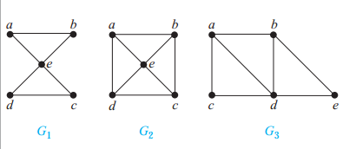
An Euler circuit in a graph G is a simple circuit containing every edge of G. An Euler path in G is a simple path containing every edge of G
Which of the undirected graphs in Figure shown below have an Euler circuit? Of those that do not, which have an Euler path?
Notes:
A directed multigraph has a closed Euler walk if and only if it is
connected, and the indegree ofevery vertex equals its outdegree.

Slide 14
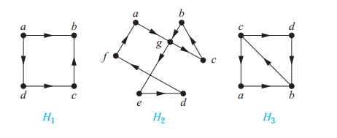
The graph G1 has an Euler circuit, for example, a, e, c, d, e, b, a. Neither of the graphs G2 or G3 has an Euler circuit ( verify this). However, G3 has an Euler path, namely, a, c, d, e, b, d, a, b. G2 does not have an Euler path
Try- Which of the directed graphs in Figure below have an Euler circuit? Of those that do not, which have an Euler path?
Notes:
Solution: The graph H2 has an Euler circuit, for example, a, g, c, b, g, e, d, f, a. Neither H1
nor H3 has an Euler circuit (as the reader should verify). H3 has an Euler path, namely,
c, a, b, c, d, b, but H1 does not (as the reader should verify).

Slide 15
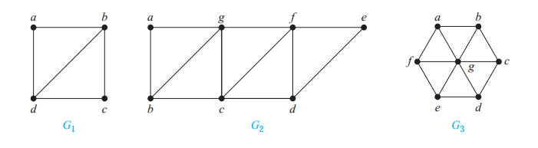
NECESSARY AND SUFFICIENT CONDITIONS FOR EULER CIRCUITS AND PATHS
A connected multigraph with at least two vertices has an Euler circuit if and only if each of its vertices has even degree
A connected multigraph has an Euler path but not an Euler circuit if and only if it has exactly two vertices of odd degree.
Notes:
G1 contains exactly two vertices of odd degree, namely, b and d. Hence, it has an Euler
path that must have b and d as its endpoints. One such Euler path is d, a, b, c, d, b. Similarly, G2
has exactly two vertices of odd degree, namely, b and d. So it has an Euler path that must have
b and d as endpoints. One such Euler path is b, a, g, f, e, d, c, g, b, c, f, d. G3 has no Euler
path because it has six vertices of odd degree.

Slide 16
APPLICATIONS OF EULER PATHS AND CIRCUITS
many applications ask for a path or circuit that traverses
each street in a neighborhood,
each road in a transportation network,
each connection in a utility grid, or
each link in a communications network exactly once.
Finding an Euler path or circuit in the appropriate graph model can solve such problems.
For example, if a postman can find an Euler path in the graph that represents the streets the postman needs to cover, this path produces a route that traverses each street of the route exactly once.

Slide 17
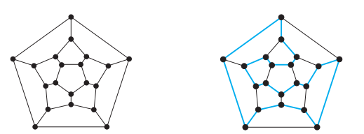
Hamilton Paths and Circuits
A simple path in a graph G that passes through every vertex exactly once is called a Hamilton path, and
a simple circuit in a graph G that passes through every vertex exactly once is called a Hamilton circuit.

Slide 18
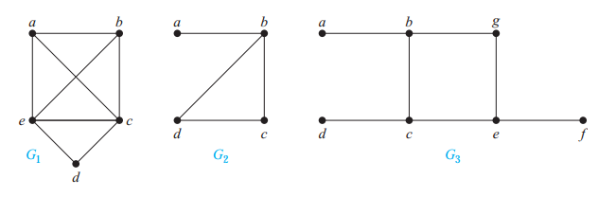
Example -Which of the simple graphs in Figure below have a Hamilton circuit or, if not, a Hamilton path?

Slide 19
Solution: G1 has a Hamilton circuit: a, b, c, d, e, a.
There is no Hamilton circuit in G2 (this can be seen by noting that any circuit containing every vertex must contain the edge {a, b} twice),
but G2 does have a Hamilton path, namely, a, b, c, d.
G3 has neither a Hamilton circuit nor a Hamilton path, because any path containing all vertices must contain one of the edges {a, b}, {e, f }, and {c, d} more than once.
Note that
an Eulerian circuit traverses every edge exactly once, but may repeat vertices, while a Hamiltonian circuit visists each vertex exactly once but may repeat edges.
While there is a criterion for determining whether or not a graph contains an Eulerian circuit, a similar criterion does not exist for Hamiltonian ciruits.

Slide 20
CONDITIONS FORTHE EXISTENCE OF HAMILTON CIRCUITS
DIRAC’S THEOREM- If G is a simple graph with n vertices with n ≥ 3 such that the degree of every vertex in G is at least n/2, then G has a Hamilton circuit.
ORE’S THEOREM If G is a simple graph with n vertices with n ≥ 3 such that deg(u) + deg(v) ≥ n for every pair of nonadjacent vertices u and v in G, then G has a Hamilton circuit.

Slide 21
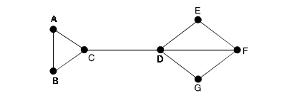
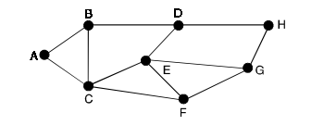
Determine whether a Hamiltonian path or circuit exists in the graph shown.
Notes:
At the end, only one node A is left with degree zero and π is ABDHGFECA.
This is a Hamiltonian cycle.

Slide 22
Applications of Hamilton Circuits
Hamilton paths and circuits can be used to solve practical problems. For example, many applications ask for a path or circuit that visits
each road intersection in a city,
each place pipelines intersect in a utility grid, or
each node in a communications network exactly once.
The famous traveling salesperson problem or TSP (also known in older literature as the traveling salesman problem) asks for the shortest route a traveling salesperson should take to visit a set of cities.

Slide 23
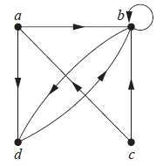
Representing Relations Using Digraphs
The directed graph with vertices a, b, c, and d, and edges (a, b), (a, d), (b, b), (b, d), (c, a),(c, b), and (d, b) is displayed

Slide 24
The relation R on a set A is represented by the directed graph that has the elements of A as its vertices and the ordered pairs (a, b), where (a, b) ∈ R, as edges.
This assignment sets up a one-to-one correspondence between the relations on a set A and the directed graphs with A as their set of vertices.

Slide 25
Thus, every statement about relations corresponds to a statement about directed graphs, and vice versa.
Directed graphs give a visual display of information about relations. As such, they are often used to study relations and their properties.
EXAMPLE The directed graph of the relation R = {(1, 1), (1, 3), (2, 1), (2, 3), (2, 4), (3, 1), (3, 2), (4, 1)} on the set {1, 2, 3, 4}

Slide 26
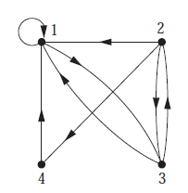

Slide 27
Trees
A tree is a connected undirected graph with no simple circuits.
Or A tree is a connected simple graph with no cycles.
-a tree cannot contain multiple edges or loops.
Therefore any tree must be a simple graph.
Example
Which of the graphs shown in Figure below are trees?

Slide 28
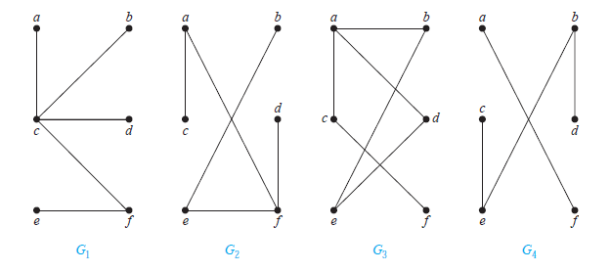

Slide 29
Solution: G1 and G2 are trees, because both are connected graphs with no simple circuits.
G3 is not a tree because e, b, a, d, e is a simple circuit in this graph.
Finally, G4 is not a tree because it is not connected.
THEOREM 1 An undirected graph is a tree if and only if there is a unique simple path between any two of its vertices.

Slide 30
Rooted Trees
A rooted tree is a tree in which one vertex has been designated as the root and every edge is directed away from the root.
We usually draw a rooted tree with its root at the top of the graph.
The arrows indicating the directions of the edges in a rooted tree can be omitted, because the choice of root determines the directions of the edges.

Slide 31
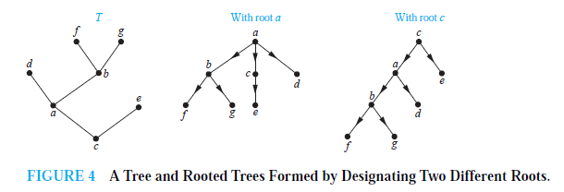

Slide 32
Terminology
Suppose that T is a rooted tree.
If v is a vertex in T other than the root, the parent of v is the unique vertex u such that there is a directed edge from u to v (the reader should show that such a vertex is unique).
When u is the parent of v, v is called a child of u.
Vertices with the same parent are called siblings.

Slide 33
Terminology
The ancestors of a vertex other than the root are the vertices in the path from the root to this vertex, excluding the vertex itself and including the root (that is, its parent, its parent’s parent, and so on, until the root is reached).
The descendants of a vertex v are those vertices that have v as an ancestor.
A vertex of a rooted tree is called a leaf if it has no children.
Vertices that have children are called internal vertices.
The root is an internal vertex unless it is the only vertex in the graph, in which case it is a leaf.

Slide 34
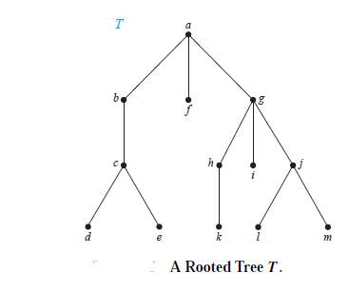
Example
In the rooted tree T (with root a) shown in Figure below, find the parent of c, the children of g, the siblings of h, all ancestors of e, all descendants of b, all internal vertices, and all leaves.
What is the subtree rooted at g?

Slide 35
Solution: The parent of c is b.
The children of g are h, i, and j .
The siblings of h are i and j .
The ancestors of e are c, b, and a.
The descendants of b are c, d, and e.
The internal vertices are a, b, c, g, h, and j .
The leaves are d, e, f , i, k, l, and m.
The subtree rooted at g is shown in Figure below

Slide 36
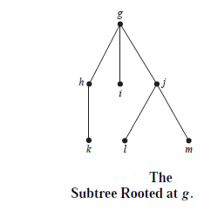

Slide 37
A rooted tree is called an m-ary tree if every internal vertex has no more than m children.
The tree is called a full m-ary tree if every internal vertex has exactly m children. An m-ary tree with m = 2 is called a binary tree.

Slide 38
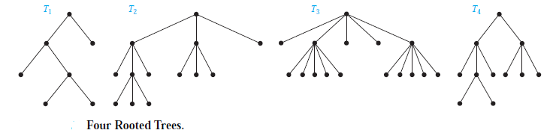
Example
Are the rooted trees in Figure below full m-ary trees for some positive integer m?

Slide 39
Solution: T1 is a full binary tree because each of its internal vertices has two children.
T2 is a full 3-ary tree because each of its internal vertices has three children.
In T3 each internal vertex has five children, so T3 is a full 5-ary tree.
T4 is not a full m-ary tree for any m because some of its internal vertices have two children and others have three children.

Slide 40
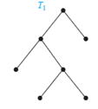
ORDERED ROOTED TREES
An ordered rooted tree is a rooted tree where the children of each internal vertex are ordered.
In an ordered binary tree, if an internal vertex has two children, the first child is called the left child and the second child is called the right child.

Slide 41
The tree rooted at the left child of a vertex is called the left subtree of this vertex, and the tree rooted at the right child of a vertex is called the right subtree of the vertex.

Slide 42
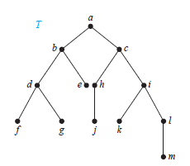
EXAMPLE 4 What are the left and right children of d in the binary tree T shown in Figure below (where the order is that implied by the drawing)? What are the left and right subtrees of c?

Slide 43
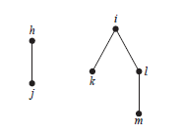
Solution: The left child of d is f and the right child is g.
The left and right subtrees of c are as follows

Slide 44
Trees as Models
Tree can be used to model different situation in real life
Example
Representing Organizations The structure of a large organization can be modeled using a rooted tree.
Each vertex in this tree represents a position in the organization.
An edge from one vertex to another indicates that the person represented by the initial vertex is the (direct) boss of the person represented by the terminal vertex.

Slide 45
Trees as Models
Computer File Systems Files in computer memory can be organized into directories.
A directory can contain both files and subdirectories.
The root directory contains the entire file

Slide 46
Properties of Trees
THEOREM A tree with n vertices has n − 1 edges. Verfy!!!
THEOREM A full m-ary tree with i internal vertices contains n = mi + 1 vertices.
Proof
Every vertex, except the root, is the child of an internal vertex.
Because each of the I internal vertices has m children, there are mi vertices in the tree other than the root.
Therefore, the tree contains n = mi + 1 vertices.

Slide 47
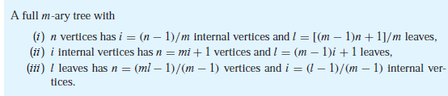
Theorem

Slide 48
Proof: Let n represent the number of vertices, i the number of internal vertices, and l the number of leaves.
The three parts of the theorem can all be proved using the equality given in Theorem 3, that is, n = mi + 1, together with the equality n = l + i, which is true because each vertex is either a leaf or an internal vertex. We will prove part (i)

Slide 49
Example
Suppose that someone starts a chain letter.
Each person who receives the letter is asked to send it on to four other people.
Some people do this, but others do not send any letters.
How many people have seen the letter, including the first person, if no one receives more than one letter and if the chain letter ends after there have been 100 people who read it but did not send it out?
How many people sent out the letter?

Slide 50
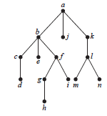

Slide 51
The chain letter can be represented using a 4-ary tree.
The internal vertices correspond to people who sent out the letter, and the leaves correspond to people who did not send it out.
Because 100 people did not send out the letter, the number of leaves in this rooted tree is l = 100.
Hence, part (iii) of Theorem 4 shows that the number of people who have seen the letter is n = (4 · 100 − 1)/(4 − 1) = 133.
Also, the number of internal vertices is 133 − 100 = 33, so 33 people sent out the letter.

Slide 52
The level of a vertex v in a rooted tree is the length of the unique path from the root to this vertex.
The level of the root is defined to be zero.
The height of a rooted tree is the maximum of the levels of vertices or the height of a rooted tree is the length of the longest path from the root to any vertex.

Slide 53
BALANCED m-ARY TREES It is often desirable to use rooted trees that are “balanced” so that the subtrees at each vertex contain paths of approximately the same length
A rooted m-ary tree of height h is balanced if all leaves are at levels h or h − 1.

Slide 54
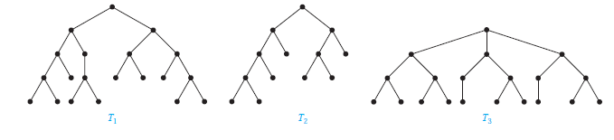

Slide 55

Traversal Algorithms
Procedures for systematically visiting every vertex of an ordered rooted tree are called traversal algorithms
Preorder traversal, inorder traversal, and postorder traversal
Preorder traversal

Slide 56
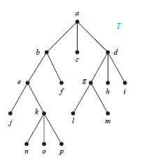


Slide 57

Traversal Algorithms
inorder traversal

Slide 58
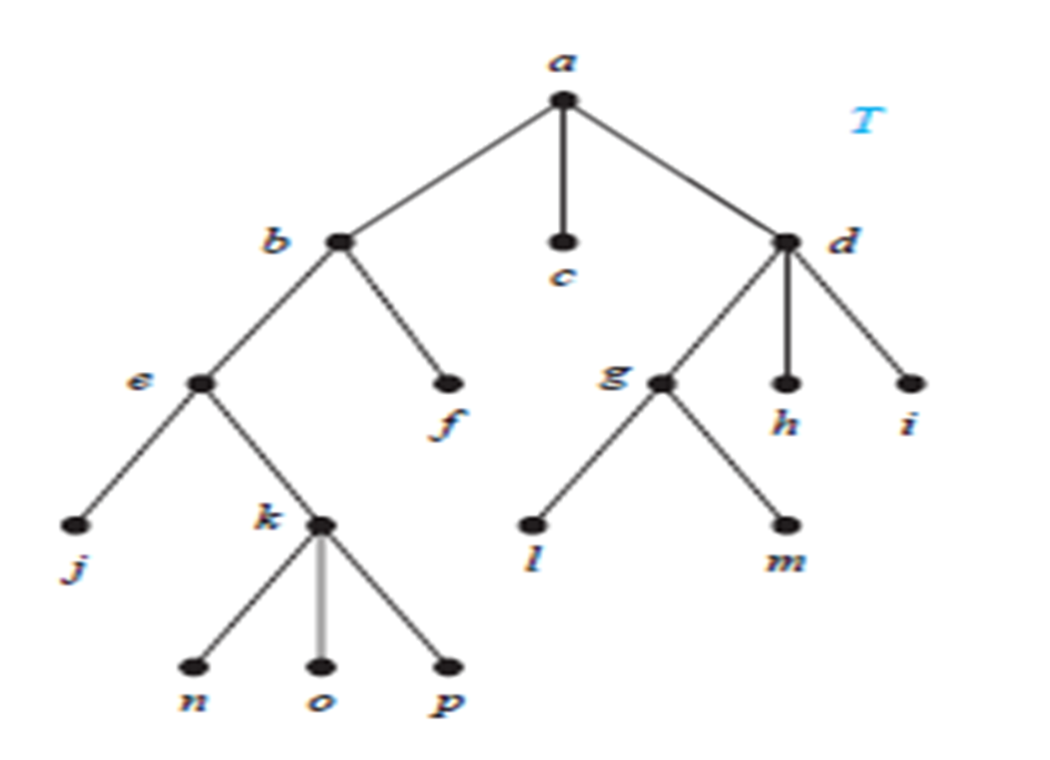
Inorder traversal: Visit leftmost subtree, visit root, visit other subtrees left to right

Slide 59

Traversal Algorithms
Postorder traversal

Slide 60


Postorder traversal: Visit subtrees left to right; visit root

Slide 61
Spanning Trees
Suppose that a connected graph represents a railway system, the vertices representing the towns and the edges the rail tracks.
Suppose also that the government wishes to get rid of as much track as possible, nevertheless retaining a rail system which connects all the towns.
What is required is a tree which is a subgraph of the given graph, containing all the vertices .
A spanning tree of a connected graph G is a tree which contains all the vertices of G and which is a subgraph of G.

Slide 62
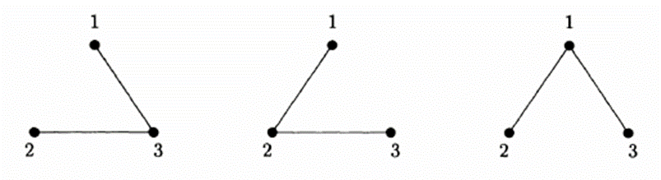
Example
K3 has three spanning trees
K4 has 16 spanning trees. Draw them

Slide 63
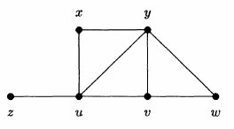
In the graph of figure shown below, the edges zu, xu, uy, yv, yw form a spanning tree.
THEOREM 1 A simple graph is connected if and only if it has a spanning tree.

Slide 64
Depth-First Search
We can build a spanning tree for a connected simple graph using depth-first search.
Procedure
Arbitrarily choose a vertex of the graph as the root.
Form a path starting at this vertex by successively adding vertices and edges, where each new edge is incident with the last vertex in the path and a vertex not already in the path.
Continue adding vertices and edges to this path as long as possible.
If the path goes through all vertices of the graph, the tree consisting of this path is a spanning tree.
However, if the path does not go through all vertices, more vertices and edges must be added

Slide 65
Depth-First Search…
Move back to the next to last vertex in the path, and, if possible, form a new path starting at this vertex passing through vertices that were not already visited.
If this cannot be done, move back another vertex in the path, that is, two vertices back in the path, and try again.
Repeat this procedure, beginning at the last vertex visited, moving back up the path one vertex at a time, forming new paths that are as long as possible until no more edges can be added.
Because the graph has a finite number of edges and is connected, this process ends with the production of a spanning tree.

Slide 66
Depth-First Search…
Each vertex that ends a path at a stage of the algorithm will be a leaf in the rooted tree, and each vertex where a path is constructed starting at this vertex will be an internal vertex.

Slide 67
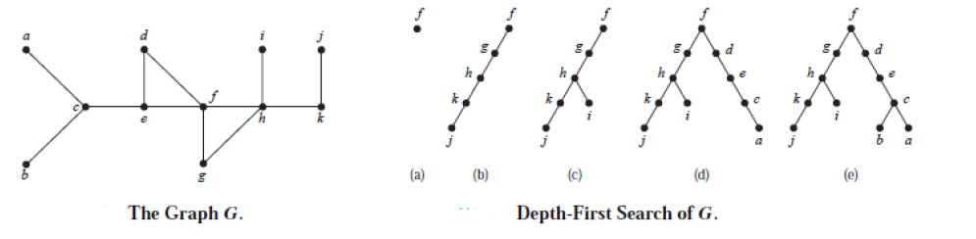
Depth-First Search…
EXAMPLE 3 Use depth-first search to find a spanning tree for the graph G shown

Slide 68
Breadth-First Search
We can also produce a spanning tree of a simple graph by the use of breadth-first search
Arbitrarily choose a root from the vertices of the graph.
Then add all edges incident to this vertex. The new vertices added at this stage become the vertices at level 1 in the spanning tree.
Arbitrarily order them. Next, for each vertex at level 1, visited in order, add each edge incident to this vertex to the tree as long as it does not produce a simple circuit.
Arbitrarily order the children of each vertex at level 1. This produces the vertices at level 2 in the tree.
Follow the same procedure until all the vertices in the tree have been added.
The procedure ends because there are only a finite number of edges in the graph.
A spanning tree is produced because we have produced a tree containing every vertex of the graph

Slide 69
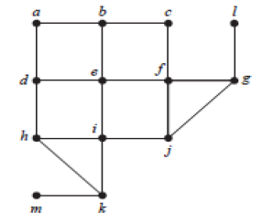
Breadth-First Search…
Example -Use breadth-first search to find a spanning tree for the graph shown

Slide 70
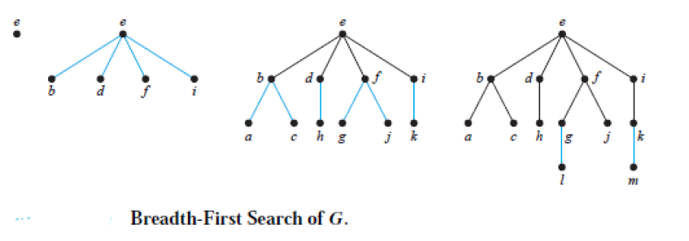
.

Slide 71
Depth-First Search in Directed Graphs
We can easily modify both depth-first search and breadth-first search so that they can run given a directed graph as input.
However, the output will not necessarily be a spanning tree, but rather a spanning forest.
In both algorithms we can add an edge only when it is directed away from the vertex that is being visited and to a vertex not yet added.
If at a stage of either algorithm we find that no edge exists starting at a vertex already added to one not yet added, the next vertex added by the algorithm becomes the root of a new tree in the spanning forest.

Slide 72
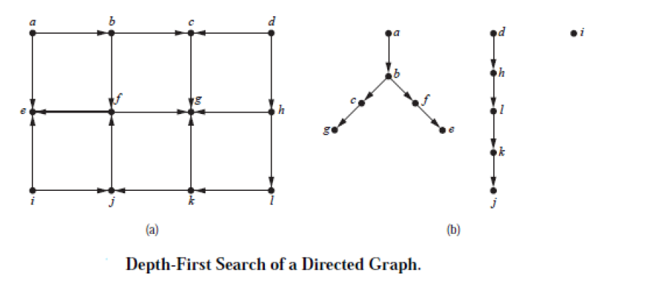
.

Slide 73
Minimum Spanning Trees
A minimum spanning tree in a connected weighted graph is a spanning tree that has the smallest possible sum of weights of its edges.
Algorithms for Minimum Spanning Trees
In the case of a weighted graph G, i.e. when each edge e of G has a weight w( e) assigned to it, where w(e) is a positive number such as the length of e, then it may be desired to find a spanning tree of smallest possible total weight.

Slide 74
The greedy algorithm.
This is often known as Kruskal's algorithm.
Procedure
(i) Choose an edge of smallest weight.
(ii) At each stage, choose from the edges not yet chosen the edge of smallest weight whose inclusion will not create a cycle.
(iii) Continue until a spanning tree is obtained.
(If the given graph has p vertices, the algorithm will terminate after p-1 edges have been chosen.)

Slide 75
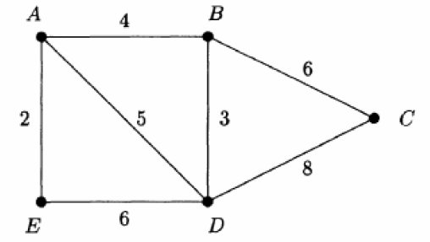
The greedy algorithm…
Example
Apply the greedy algorithm to the graph

Slide 76
Solution
First choose AE (weight 2).
Then choose BD(3), then AB(4) .
We cannot now choose AD(5) since its inclusion would create a cycle ABDA.
Similarly we cannot choose DE. So choose BC(6).
The edges AE, AB, BD, BC then form a minimum weight spanning tree of weight 2 +3 +4 +6 = 15.

Slide 77
Prim's algorithm
(i) Select any vertex, and choose the edge of smallest weight from it .
(ii) At each stage, choose the edge of smallest weight joining a vertex already included to a vertex not yet included.
(iii) Continue until all vertices are included.
NB
The weight of a minimal spanning tree is unique, but the minimal spanning tree itself is not.
Different minimal spanning trees can occur when two or more edges have the same weight

Slide 78
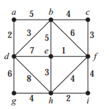
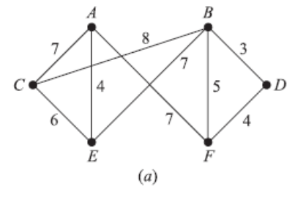
Try. Use Prim's algorithm

Slide 79
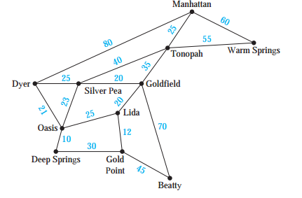
The roads represented by this graph are all unpaved. The lengths of the roads between pairs of towns are represented by edge weights. Which roads should be paved so that there is a path of paved roads d between each pair of towns so that a minimum road length is paved?

Slide 80
Combinatorial games on graphs
Game is called a combinatorial game if
• there is a set of possible positions - usually finite
• there are two players who alternate moves,
• there are rules for each player that describe available moves
• both players have complete information
• it ends in a finite number of moves

Slide 81
Combinatorial games on graphs
Under normal play player who cannot move loses.
Under misère(a player undertakes to win no tricks.) play player who does the last possible move loses
Combinatorial game is called impartial when rules are the same for both players, otherwise we call it partial
We say that position in a game is a terminal position if no moves from it are possible.
Well-known examples of combinatorial games are Tic-tac-toe, checkers(Draughts (British English) or checkers (American English)), chess, Go, Dots and Boxes, and Nim.

Slide 82
END

