Slide 1
Counting principle
L-7 RCS 112

Slide 2
The Basics of Counting-Introduction
Suppose that a password on a computer system consists of six, seven, or eight characters.
Each of these characters must be a digit or a letter of the alphabet.
Each password must contain at least one digit.
How many such passwords are there? The techniques needed to answer this question and a wide variety of other counting problems will be introduced in this topic
Counting problems arise throughout mathematics and computer science.
For example, we must count the successful outcomes of experiments and all the possible outcomes of these experiments to determine probabilities of discrete events.
We need to count the number of operations used by an algorithm to study its time complexity.

Slide 3
The sum rule:
If a task can be done in n₁ ways and a second task in n₂ ways, and if these two tasks cannot be done at the same time, then there are n₁ + n₂ ways to do either task.
Example:
The department will award a free computer to either a CS student or a CS professor. How many different choices are there, if there are 530 students and 15 professors?
There are 530 + 15 = 545 choices.

Slide 4
Generalized sum rule:
If we have tasks T₁, T₂, …, T_{m} that can be done in n₁, n₂, …, n_{m} ways, respectively, and no two of these tasks can be done at the same time, then there are n₁ + n₂ + … + n_{m} ways to do one of these tasks.

Slide 5
The product rule:
Suppose that a procedure can be broken down into two successive tasks. If there are n₁ ways to do the first task and n₂ ways to do the second task after the first task has been done, then there are n₁n₂ ways to do the procedure.

Slide 6
Example:
How many different license plates are there that containing exactly three English letters ?
Solution:
There are 26 possibilities to pick the first letter, then 26 possibilities for the second one, and 26 for the last one.
So there are 26⋅26⋅26 = 17576 different license plates.

Slide 7
Try
1. How many different license plates can be made if each plate contains a sequence of three uppercase English letters followed by three digits (and no sequences of letters are prohibited, even if they are obscene)?
2 The Telephone Numbering Plan The North American numbering plan (NANP) specifies the format of telephone numbers in the U.S., Canada, and many other parts of North America. A telephone number in this plan consists of 10 digits, which are split into a three-digit area code, a three-digit office code, and a four-digit station code. Because of signaling considerations, there are certain restrictions on some of these digits. To specify the allowable format, let X denote a digit that can take any of the values 0 through 9, let N denote a digit that can take any of the values 2 through 9, and let Y denote a digit that must be a 0 or a 1. Two numbering plans, which will be called the old plan, and the new plan, will be discussed. (The old plan, in use in the 1960s, has been replaced by the new plan, but the recent rapid growth in demand for new numbers for mobile phones and devices will eventually make even this new plan obsolete. In this example, the letters used to represent digits follow the conventions of the North American Numbering Plan.) As will be shown, the new plan allows the use of more numbers. In the old plan, the formats of the area code, office code, and station code are NYX, NNX, and XXXX, respectively, so that telephone numbers had the form NYX-NNX-XXXX. In the new plan, the formats of these codes are NXX, NXX, and XXXX, respectively, so that telephone numbers have the form NXX-NXX-XXXX. How many different North American telephone numbers are possible under the old plan and under the new plan?

Slide 8
Generalized product rule:
If we have a procedure consisting of sequential tasks T₁, T₂, …, T_{m} that can be done in n₁, n₂, …, n_{m} ways, respectively, then there are n₁ ⋅ n₂ ⋅ … ⋅ n_{m} ways to carry out the procedure.

Slide 9
Try
Each user on a computer system has a password, which is six to eight characters long, where each character is an uppercase letter or a digit. Each password must contain at least one digit. How many possible passwords are there?
How many bit strings of length ten both begin and end with a 1?

Slide 10
The Subtraction Rule -The Principle of Inclusion-Exclusion
Suppose that a task can be done in one of two ways, but some of the ways to do it are common to both ways.
In this situation, we cannot use the sum rule to count the number of ways to do the task.
If we add the number of ways to do the tasks in these two ways, we get an over count of the total number of ways to do it, because the ways to do the task that are common to the two ways are counted twice.
To correctly count the number of ways to do the two tasks, we must subtract the number of ways that are counted twice.

Slide 11
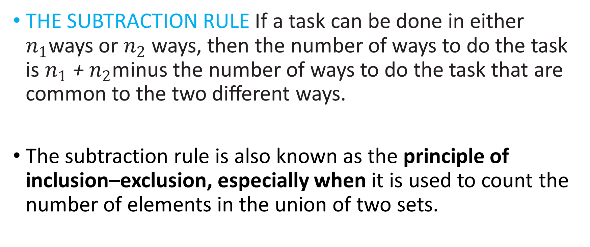
THE SUBTRACTION RULE If a task can be done in either $n_{1}$ways or $n_{2}$ ways, then the number of ways to do the task is $n_{1}$ + $n_{2}$minus the number of ways to do the task that are common to the two diﬀerent ways.
The subtraction rule is also known as the principle of inclusion–exclusion, especially when it is used to count the number of elements in the union of two sets.

Slide 12
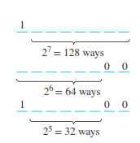
The Principle of Inclusion-Exclusion
Example .How many bit strings of length 8 either start with a 1 or end with 00?
Task 1: Construct a string of length 8 that starts with a 1.
There is one way to pick the first bit (1),
two ways to pick the second bit (0 or 1),
two ways to pick the third bit (0 or 1),
.
.
.
two ways to pick the eighth bit (0 or 1).
Product rule: Task 1 can be done in 1⋅2⁷ = 128 ways.

Slide 13
The Principle of Inclusion-Exclusion
Task 2: Construct a string of length 8 that ends with 00.
There are two ways to pick the first bit (0 or 1),
two ways to pick the second bit (0 or 1),
.
.
.
two ways to pick the sixth bit (0 or 1),
one way to pick the seventh bit (0), and
one way to pick the eighth bit (0).
Product rule: Task 2 can be done in 2⁶ = 64 ways.

Slide 14
The Principle of Inclusion-Exclusion
Since there are 128 ways to do Task 1 and 64 ways to do Task 2, does this mean that there are 192 bit strings either starting with 1 or ending with 00 ?
No, because here Task 1 and Task 2 can be done at the same time.
When we carry out Task 1 and create strings starting with 1, some of these strings end with 00.
Therefore, we sometimes do Tasks 1 and 2 at the same time, so the sum rule does not apply.

Slide 15
The Principle of Inclusion-Exclusion
If we want to use the sum rule in such a case, we have to subtract the cases when Tasks 1 and 2 are done at the same time.
How many cases are there, that is, how many strings start with 1 and end with 00?
There is one way to pick the first bit (1),
two ways for the second, …, sixth bit (0 or 1),
one way for the seventh, eighth bit (0).
Product rule: In 2⁵ = 32 cases, Tasks 1 and 2 are carried out at the same time.

Slide 16
The Principle of Inclusion-Exclusion
Since there are 128 ways to complete Task 1 and 64 ways to complete Task 2, and in 32 of these cases Tasks 1 and 2 are completed at the same time, there are
128 + 64 – 32 = 160 ways to do either task.
In set theory, this corresponds to sets A₁ and A₂ that are not disjoint. Then we have:
|A₁ ∪ A₂| = |A₁| + |A₂| - |A₁ ∩ A₂|
This is called the principle of inclusion-exclusion.

Slide 17
The Principle of Inclusion-Exclusion
EXAMPLE
In a discrete mathematics class every student is a major in computer science or mathematics, or both. The number of students having computer science as a major (possibly along with mathematics) is 25; the number of students having mathematics as a major (possibly along with computer science) is 13; and the number of students majoring in both computer science and mathematics is 8. How many students are in this class?

Slide 18
The Principle of Inclusion-Exclusion
Solution: Let A be the set of students in the class majoring in computer science and B be the set of students in the class majoring in mathematics. Then A n B is the set of students in the class who are joint mathematics and computer science majors. Because every student in the class is majoring in either computer science or mathematics (or both), it follows that the number of students in the class is I A U B I . Therefore,
I A U B I = I A I + I B I - I A n B I
= 25 + 13 - 8
= 30.
Therefore, there are 30 students in the class.

Slide 19
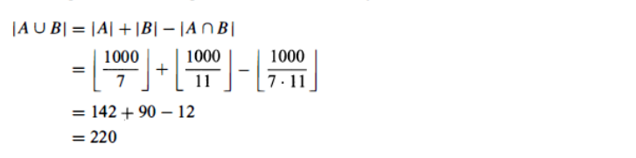
The Principle of Inclusion-Exclusion
How many positive integers not exceeding 1 000 are divisible by 7 or 11 ?

Slide 20
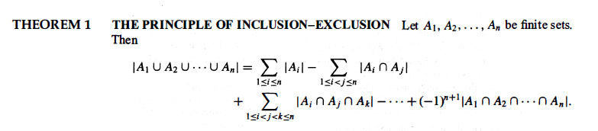

Slide 21
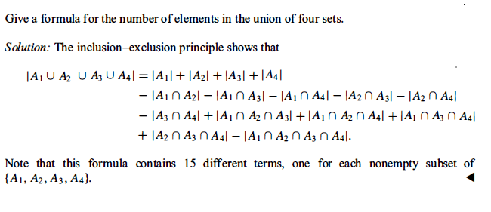

Slide 22
TRY
Example -A total of 1232 students have taken a course in Spanish, 879 have taken a course in French, and 114 have taken a course in Russian. Further, 103 have taken courses in both Spanish and French, 23 have taken courses in both Spanish and Russian, and 14 have taken courses in both French and Russian. If 2092 students have taken at least one of Spanish, French, and Russian, how many students have taken a course in all three languages?

Slide 23
TRY
A computer company receives 350 applications from college graduates for a job planning a line of new web servers. Suppose that 220 of these applicants majored in computer science, 147 majored in business, and 51 majored both in computer science and in business. How many of these applicants majored neither in computer science nor in business?

Slide 24
The Division Rule
THE DIVISION RULE There are n/d ways to do a task if it can be done using a procedure that can be carried out in n ways, and for every way w, exactly d of the n ways correspond to way w
The division rule comes in handy when it appears that a task can be done in n diﬀerent ways, but it turns out that for each way of doing the task, there are d equivalent ways of doing it.
Under these circumstances, we can conclude that there are n/d inequivalent ways of doing the task

Slide 25
EXAMPLE
Suppose that an automated system has been developed that counts the legs of cows in a pasture. Suppose that this system has determined that in a farmer’s pasture there are exactly 572 legs.
How many cows are there is this pasture, assuming that each cow has four legs and that there are no other animals present?

Slide 26
Solution:
Let n be the number of cow legs counted in a pasture. Because each cow has four legs, by the division rule we know that the pasture contains n/4 cows.
Consequently, the pasture with 572 cow legs has 572/4 = 143 cows in it.

Slide 27
Try
How many diﬀerent ways are there to seat four people around a circular table, where two seat-ings are considered the same when each person has the same left neighbor and the same right neighbor?

Slide 28
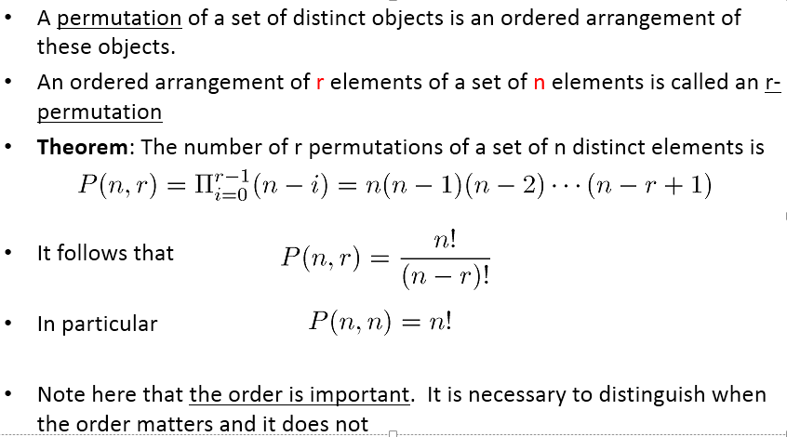
Permutation

Slide 29
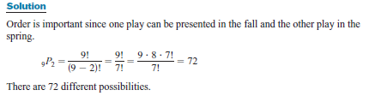
Permutation
Example -A school musical director can select 2 musical plays to present next year. One will be presented in the fall, and one will be presented in the spring. If she has 9 to pick from, how many different possibilities are there?

Slide 30
Permutation
TRY
How many ways are there to select a first-prize winner, a second-prize winner, and a third-prize winner from 100 different people who have entered a contest?
2. In how many ways can 4 people be arranged in a row for a photo?

Slide 31
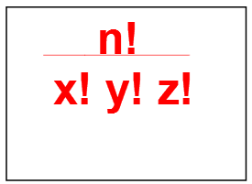
Arrangements with Repetitions
If we have n elements of which x are alike of one kind, y are alike of another kind, z are alike of another kind, ............ then the number of ordered selections or permutations is given by:

Slide 32
Example
How many different arrangements of the word PARRAMATTA are possible?

Slide 33
Combinations
A selection of distinct objects without regard to order is called a combination.
The difference between a permutation and a combination is that in a combination, the order or arrangement of the objects is not important; by contrast, order is important in a permutation.
Permutations are for lists (order matters) and combinations are for groups (order doesn't matter).
How many different committees of three students can be formed from a group of four students?

Slide 34
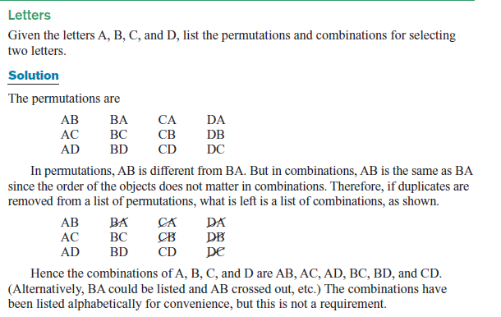

Slide 35
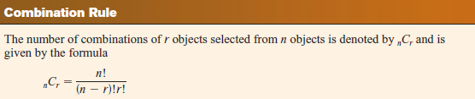
We see that C(4, 2) = 6, because the 2-combinations of {a, b, c, d} are the six subsets {a, b},{a, c}, {a, d}, {b, c}, {b, d}, and {c, d}.
How many ways are there to select five players from a 10-member tennis team to make a trip to a match at another school?

Slide 36
Example:
A soccer club has 8 female and 7 male members. For today’s match, the coach wants to have 6 female and 5 male players on the grass. How many possible configurations are there?
C(8, 6) ⋅ C(7, 5) = 8!/(6!⋅2!) ⋅ 7!/(5!⋅2!)
= 28⋅21
= 588

Slide 37
END

