Slide 1
RCS 122 OBJECT ORIENTED PROGRAMMING I
Lecture 10: Access Modifiers

Slide 2
Access Modifiers
Access level modifiers determine whether other classes can use a particular field or invoke a particular method.
There are two levels of access control:
At the top level :
public
package-private (no explicit modifier).
At the member level –
public
private
protected
package-private (no explicit modifier).

Slide 3
Access Modifiers
A class may be declared with the modifier public, in which case that class is visible to all classes everywhere.
If a class has no modifier (the default, also known as package-private), it is visible only within its own package.
Note: Packages are named groups of related classes.

Slide 4
Access Modifiers
At the member level, you can also use the public modifier or no modifier (package-private) just as with top-level classes, and with the same meaning.
However, for members, there are two additional access modifiers:
private
protected.
The private modifier specifies that the member can only be accessed in its own class.
The protected modifier specifies that the member can only be accessed within its own package (as with package-private) and, in addition, by a subclass of its class in another package.

Slide 5
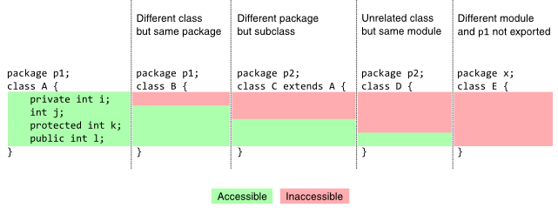
Access Modifiers
The following figure shows the access to members permitted by each modifier.

Slide 6
Access Modifiers
Access levels affect you in two ways.
First, when you use classes that come from another source, such as the classes in the Java platform, access levels determine which members of those classes your own classes can use.
Second, when you write a class, you need to decide what access level every member variable and every method in your class should have.

Slide 7
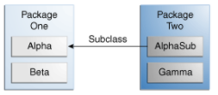
Access Modifiers
Let's look at a collection of classes and see how access levels affect visibility. The following figure shows four different classes and how they are related.

Slide 8
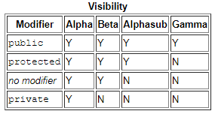
Access Modifiers
The following table shows where the members of the Alpha class are visible for each of the access modifiers that can be applied to them.

Slide 9
Access Modifiers Tips on Choosing an Access Level
If other programmers use your class, you want to ensure that errors from misuse cannot happen. Access levels can help you do this.
Use the most restrictive access level that makes sense for a particular member. Use private unless you have a good reason not to.
Avoid public fields except for constants. (Many of the examples in most tutorials use public fields. This may help to illustrate some points concisely, but is not recommended for production code.) Public fields tend to link you to a particular implementation and limit your flexibility in changing your code.

Slide 10
Access Modifiers Examples
Ex1: Simple example of private access modifier
class A{
private int data=40;
private void msg(){System.out.println("Hello java");}
}
public class Simple{
public static void main(String args[]){
A obj=new A();
System.out.println(obj.data); //Compile Time Error
obj.msg();//Compile Time Error
}
}
In this example, we have created two classes A and Simple. “A” class contains private data member and private method. We are accessing these private members from outside the class, so there is compile time error.

Slide 11
Access Modifiers Examples
Ex2: Role of private Constructor
If you make any class constructor private, you cannot create the instance of that class from outside the class. For example:
class A{
private A(){} //private constructor
void msg(){System.out.println("Hello java");}
}
public class Simple{
public static void main(String args[]){
A obj=new A();//Compile Time Error
}
}

Slide 12
Access Modifiers Examples
Ex3: Example of default access modifier
Reminder : If you don't use any modifier, it is treated as default bydefault. The default modifier is accessible only within package.
In the example in the next slide, we have created two packages pack and mypack. We are accessing the A class from outside its package, since A class is not public, it cannot be accessed from outside the package.

Slide 13
Access Modifiers Examples
Ex3: Example of default access modifier
//save by B.java
package mypack;
import pack.*;
class B{
public static void main(String args[]){
A obj = new A();//Compile Time Error
obj.msg();//Compile Time Error
}
}
//save by A.java
package pack;
class A{
void msg(){System.out.println("Hello");}
}
In the above example, the scope of class A and its method msg() is default so it cannot be accessed from outside the package.

Slide 14
Access Modifiers Examples
Ex4: Example of protected access modifier
Reminder :The protected access modifier is accessible within package and outside the package but through inheritance only.
The protected access modifier can be applied on the data member, method and constructor. It can't be applied on a class.

Slide 15
Access Modifiers Examples
Ex4: Example of protected access modifier (Cont.)
//save by B.java
package mypack;
import pack.*;
class B extends A{
public static void main(String args[]){
B obj = new B();
obj.msg();
}
}
//save by A.java
package pack;
public class A{
protected void msg() {
System.out.println("Hello");
}
}
In this example, we have created the two packages pack and mypack. The A class of pack package is public, so can be accessed from outside the package. But msg method of this package is declared protected, so it can be accessed from outside the class only through inheritance.

Slide 16
Access Modifiers Examples
Ex5: Example of public access modifier
Reminder : The public access modifier is accessible everywhere. It has the widest scope among all other modifiers.

Slide 17
Access Modifiers Examples
Ex5: Example of public access modifier (Cont.)
//save by B.java
package mypack;
import pack.*;
class B{
public static void main(String args[]){
A obj = new A();
obj.msg();
}
}
//save by A.java
package pack;
public class A{
public void msg(){
System.out.println("Hello");
}
}

Slide 18
Access Modifiers
A top level class cannot be declared protected or private.
You can declare nested classes (including inner classes) as protected or private, though.
What are top level classes?
What is a nested class? What is an inner class?
--> See the next slide.

Slide 19
Access Modifiers
Java allows you to define a class within another class. Such a class is called a nested class (i.e. a nested class is any class whose declaration occurs within the body of another class or interface).
Structure of a nested class:
class OuterClass {
...
class NestedClass {
...
}
}
An inner class is a nested class that is not explicitly or implicitly declared static.
A top level class is a class that is not a nested class.
https://docs.oracle.com/javase/specs/jls/se6/html/classes.html

Slide 20
Access Modifiers
Exercise
Study the following program written in two java files:
//code in “Two.java” file:
package package2;
import package1.*;
class Two{
public static void main(String args[]){
One myobject = new One();
myobject. displayMsg();
}
}
//code in ”One.java” file:
package package1;
class One{
void displayMsg(){
System.out.println(“Masalakulangwa”);
}
}
Task:
Is there any problem in the above code?
If so, rewrite the program so that it displays “Masalakulangwa” when executed.

Slide 21
End

