Slide 1
RCS 122
OBJECT ORIENTED PROGRAMMING I
Lecture 05: Methods

Slide 2
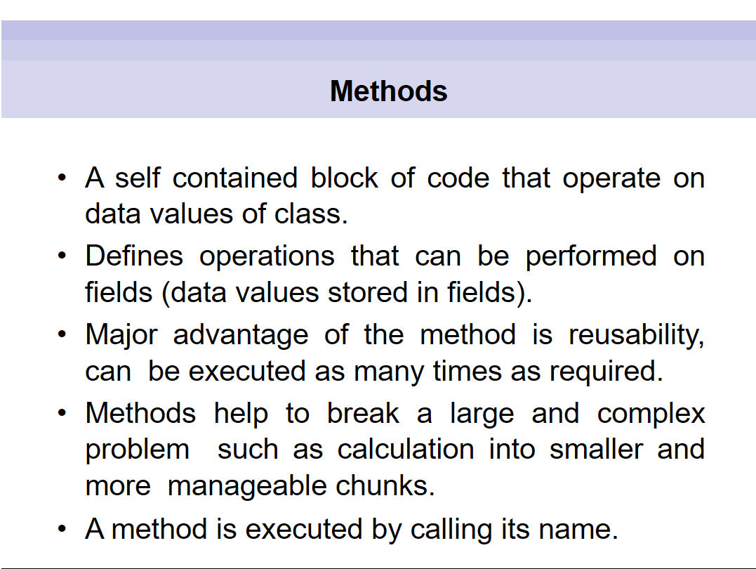

Slide 3
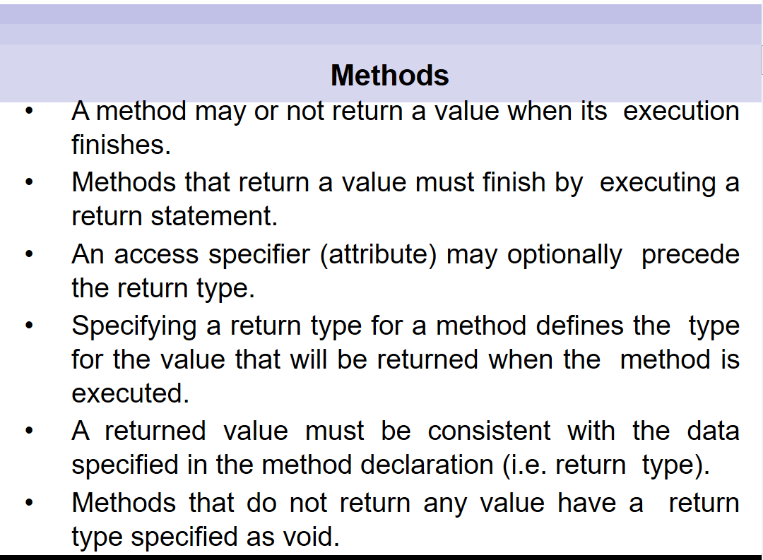


Slide 4
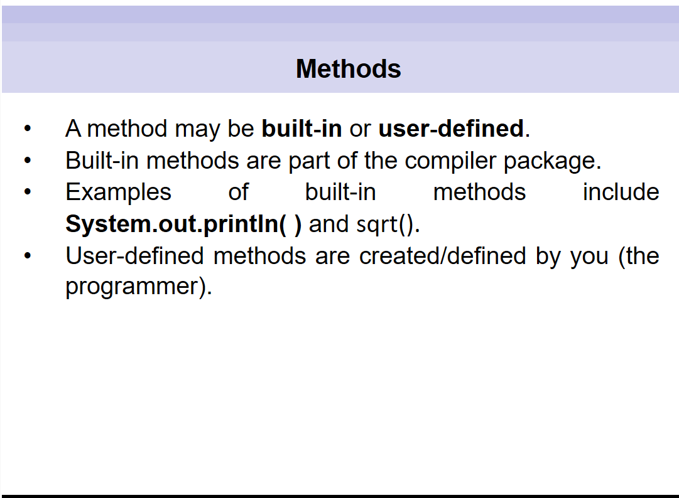

Slide 5
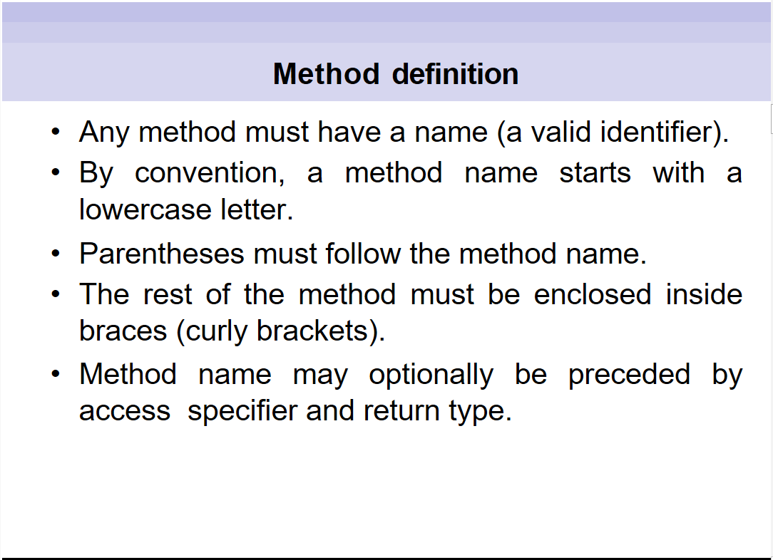

Slide 6
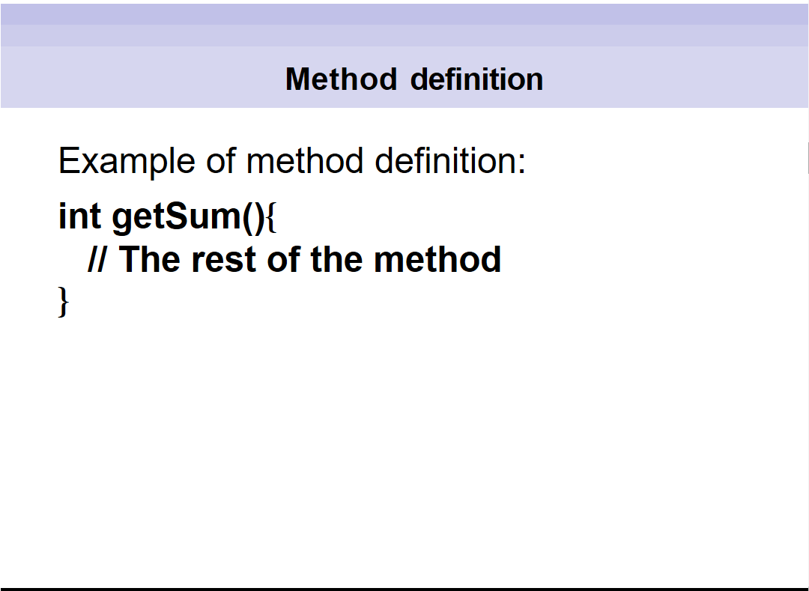

Slide 7
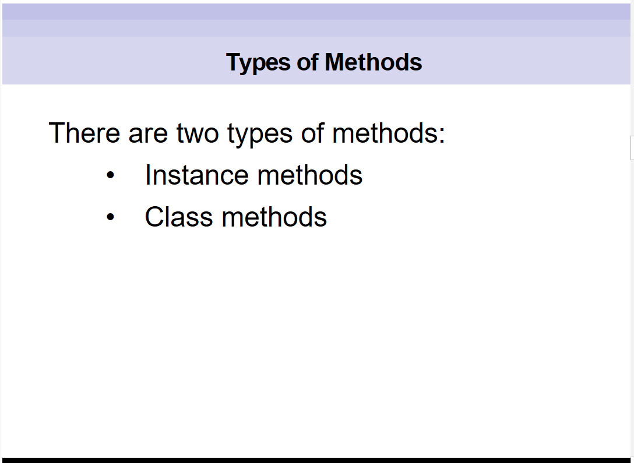

Slide 8
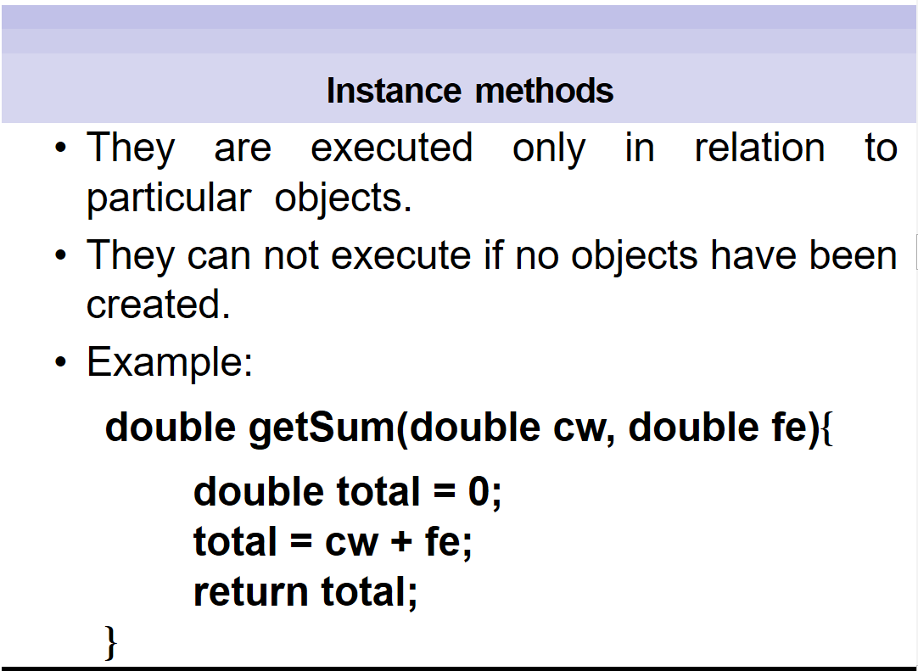
`

Slide 9
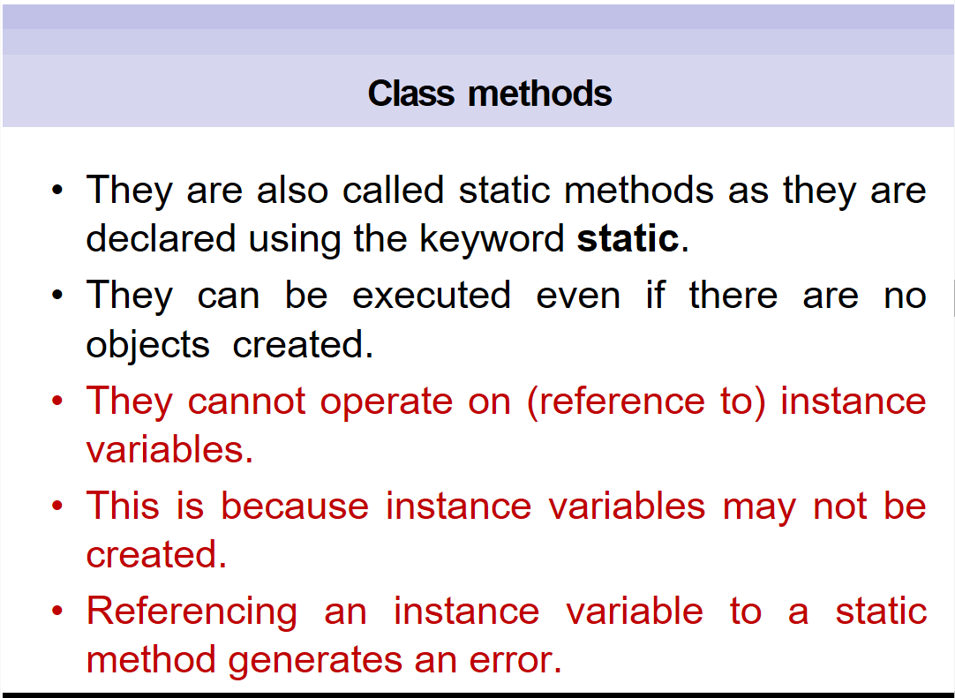

Slide 10
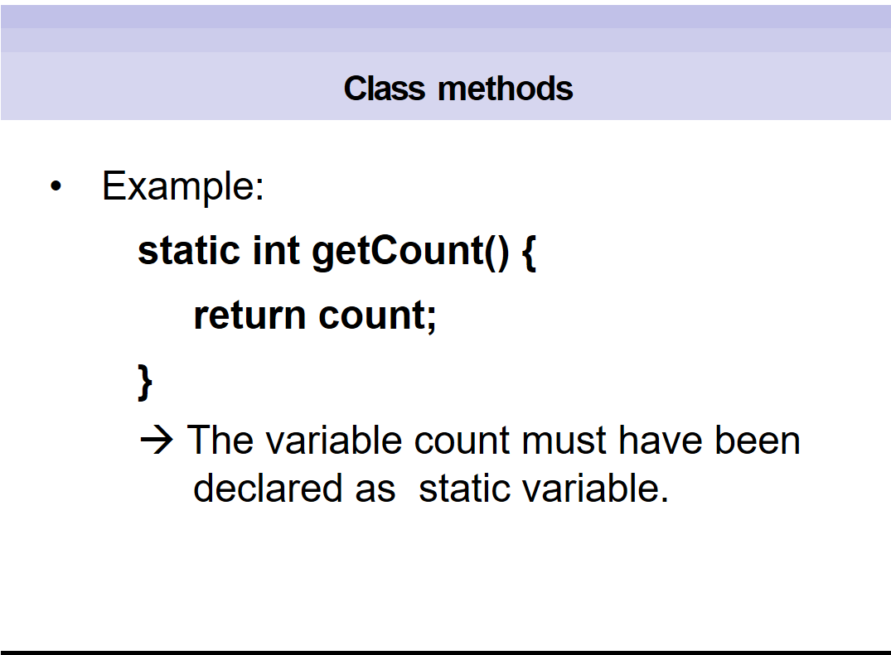

Slide 11
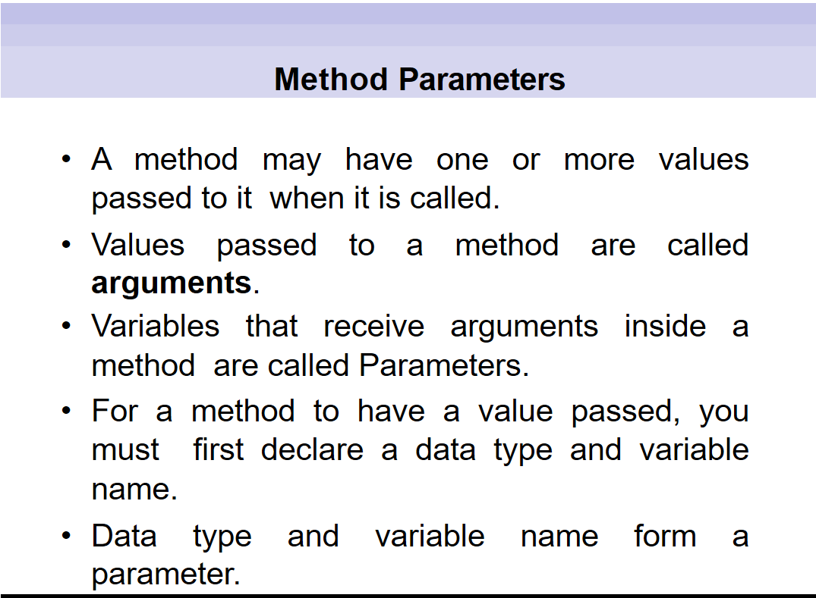

Slide 12
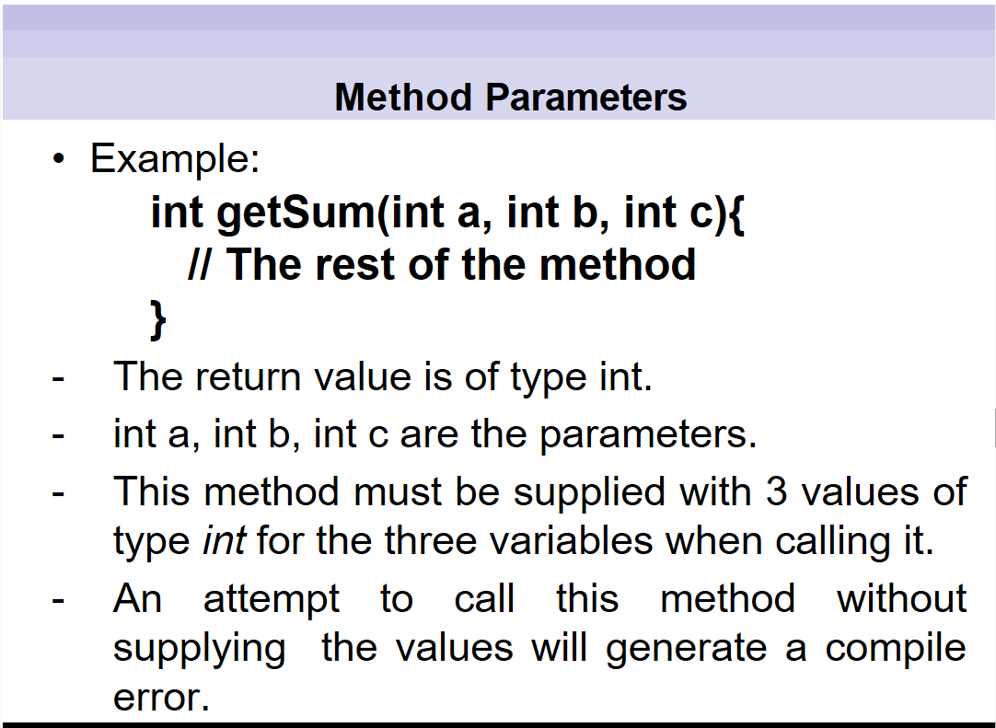

Slide 13
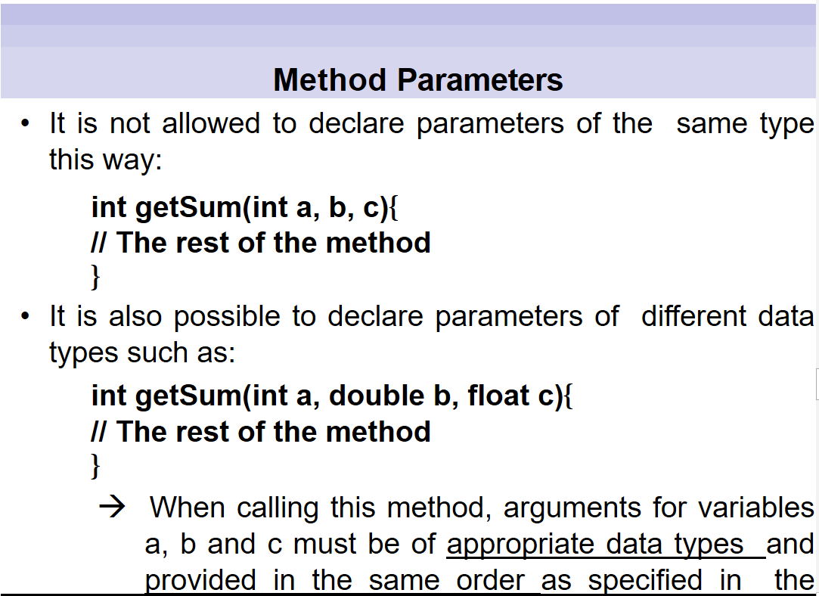

Slide 14
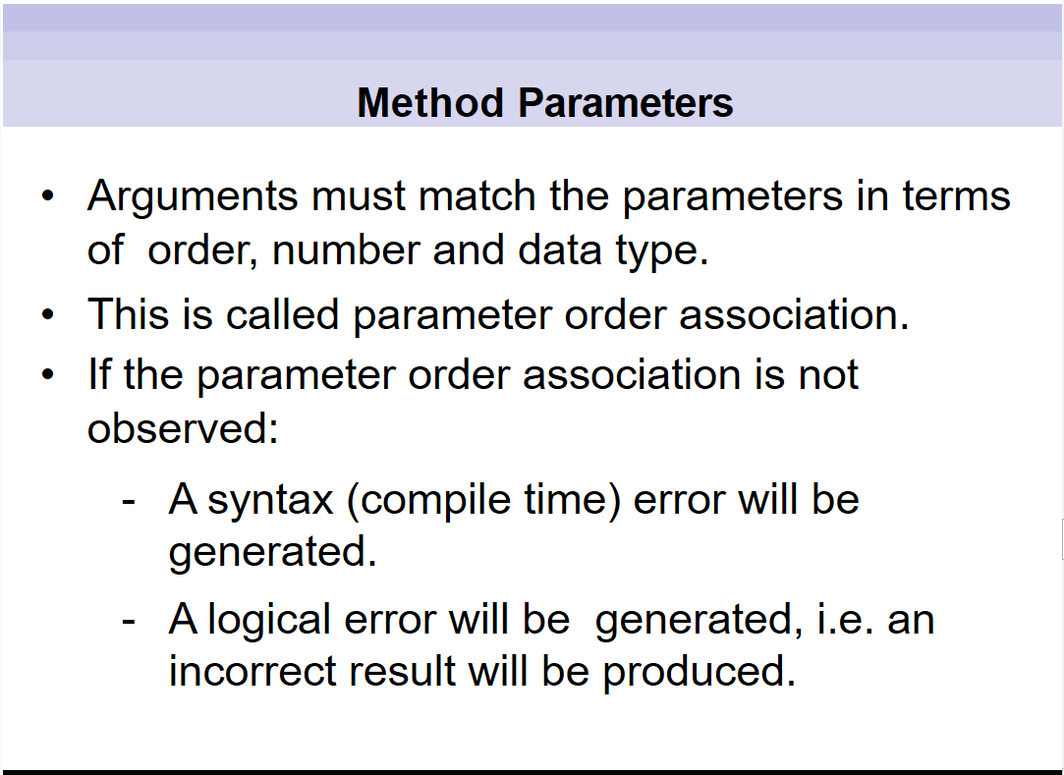

Slide 15
Examples
public class SquareMain {
public static void main(String[] args) {
int result;
result = square();
System.out.println("Squared value of 10 is: " + result);
}
public static int square() {
return 10 * 10;
}
}
public class SquareMain {
public static void main(String[] args) {
System.out.println("Squared value of 10 is: " + square() );
}
public static int square() {
return 10 * 10;
}
}

Slide 16
Examples
public class SquareMain {
public static void main(String[] args) {
int result, n;
n = 3;
result = square(n);
System.out.println("Square of 3 is: " + result);
n = 4;
result = square(n);
System.out.println("Square of 4 is: " + result);
}
static int square(int i) {
return i * i;
}
}

Slide 17
Examples
public class ArithematicMain {
public static int getIntegerSum (int i, int j) {
return i + j;
}
public static int multiplyInteger (int x, int y) {
return x * y;
}
public static void main(String[] args) {
System.out.println("10 + 20 = " + getIntegerSum(10, 20));
System.out.println("20 x 40 = " + multiplyInteger(20, 40));
}
}

Slide 18
Examples
public class Test {
  public void pupAge () {
  int age = 0;
  age = age + 7;
  System.out.println(“Puppy age is: “+ age);
  }
  public static void main(String args[]) {
  Test test = new Test ();
  test.pupAge();
  }
}

Slide 19
End

