Slide 1
RCS 122 OBJECT ORIENTED PROGRAMMING I
Lecture 09: Control Structures

Slide 2
Control Structures
A block of code that dictates the flow of statements in a program.
The order in which statements in a program are executed is called flow of control.
Normally statements in a Java program, are executed one after the other in the order in which they are written, a process called sequential execution.
Java provides constructs which enable programmers to specify the next statement to execute, which is not necessary to be the next one in the sequence.

Slide 3
Control Structures
A procedure for solving a problem in terms of actions to execute and the order in which these actions are executed is called an algorithm.
There are three types of control structures namely:
Sequential control structure
Selection control structure
Repetition control structure

Slide 4
Sequence
A default control structure in Java if no any other control structure is specified.
With sequential control structure, program statements are executed one after another in the order they occur from top to bottom.
A program can contain any number of statements.
Consider statements in the main () method, they are usually executed in the order in which they are placed from top to bottom.
The following diagram depicts the execution flow of four statements in sequential control structure.

Slide 5
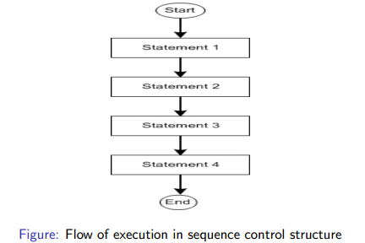
Sequence

Slide 6
Sequence
In this case, statement 1 will execute first, followed by statement 2, then statement 3 and finally statement 4.
The statements must be logically placed so as to avoid compile time errors or logic errors that may arise if they are wrongly ordered.
You do not have to add any other code to make sequential execution occur.

Slide 7
Selection
Selection control structures are used by programs to choose among alternative courses of action.
They contain a condition which is evaluated to either true or false.
If the condition is true, a statement linked to the condition is executed.
If the condition is false, a statement linked to the condition is ignored (i.e. not executed).

Slide 8
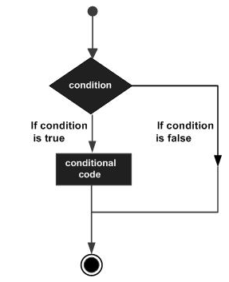
Selection

Slide 9
Selection
Java provides following types of decision making statements :
if statement
if … else statement
nested if statement
switch statement

Slide 10
Selection : if statement
An if statement consists of a Boolean expression followed by one or more statements.
Syntax:
if(Boolean_expression) {
// Statements will execute if the Boolean expression is true
}
If the Boolean expression evaluates to true then the block of code inside the if statement will be executed. If not, the first set of code after the end of the if statement (after the closing curly brace) will be executed.

Slide 11
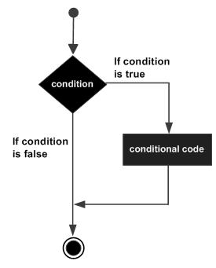
Selection : if statement
Flow Diagram for an if statement

Slide 12
Selection : if statement : Example
public class MyClass {
public static void main(String args[]) {
int x = 10;
if( x < 20 ) {
System.out.print("This is if statement");
}
}
}
Output??

Slide 13
Selection : if…else statement
An if statement can be followed by an optional else statement, which executes when the boolean expression is false.
Syntax:
if(Boolean_expression) {
// Executes when the Boolean expression is true
}else {
// Executes when the Boolean expression is false
}
If the boolean expression evaluates to true, then the if block of code will be executed, otherwise else block of code will be executed.

Slide 14
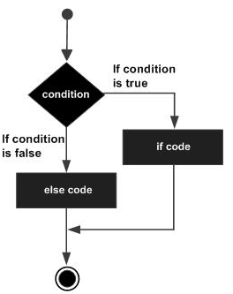
Selection : if…else statement
Flow Diagram for an if…else statement

Slide 15
Selection : if…else statement : Example
public class MyClass {
public static void main(String args[]) {
int x = 30;
if( x < 20 ) {
System.out.print("This is if statement");
}else {
System.out.print("This is else statement");
}
}
}
Output??

Slide 16
Selection : if…else statement : The if...else if...else Statement
An if statement can be followed by an optional else if...elsestatement, which is very useful to test various conditions using single if...else if statement.
When using if, else if, else statements there are a few points to keep in mind.
An if can have zero or one else's and it must come after any else if's.
An if can have zero to many else if's and they must come before the else.
Once an else if succeeds, none of the remaining else if's or else's will be tested.

Slide 17
Selection : if…else statement : The if...else if...else Statement
Syntax:
if(Boolean_expression 1) {
// Executes when the Boolean expression 1 is true
}else if(Boolean_expression 2) {
// Executes when the Boolean expression 2 is true
}else if(Boolean_expression 3) {
// Executes when the Boolean expression 3 is true
}else {
// Executes when the none of the above condition is true.
}

Slide 18
Selection : if…else statement : The if...else if...else Statement: Example
public class MyClass {
public static void main(String args[]) {
int x = 30;
if( x == 10 ) {
System.out.print("Value of X is 10");
}else if( x == 20 ) {
System.out.print("Value of X is 20");
}else if( x == 30 ) {
System.out.print("Value of X is 10");
}else {
System.out.print("This is else statement");
}
}
}
Output??

Slide 19
Selection : nested if statement
It is always legal to nest if-else statements which means you can use one if or else if statement inside another if or else if statement.
Syntax:
if(Boolean_expression 1) {
// Executes when the Boolean expression 1 is true
if(Boolean_expression 2) {
// Executes when the Boolean expression 2 is true
}
}
You can nest else if...else in the similar way as we have nested if statement.

Slide 20
Selection : nested if statement : Example
public class MyClass {
public static void main(String args[]) {
int x = 30;
int y = 10;
if( x == 30 ) {
if( y == 10 ) {
System.out.print("X = 30 and Y = 10");
}
}
}
}
Output??

Slide 21
Selection : switch statement
A switch statement allows a variable to be tested for equality against a list of values. Each value is called a case, and the variable being switched on is checked for each case.
Syntax:
switch(expression) {
case value :
// Statements
break; // optional
case value :
// Statements
break; // optional
// You can have any number of case statements.
default : // Optional
// Statements
}

Slide 22
Selection : switch statement : Rules
The following rules apply to a switch statement −
The variable used in a switch statement can only be integers, convertable integers (byte, short, char), strings and enums.
You can have any number of case statements within a switch. Each case is followed by the value to be compared to and a colon.
The value for a case must be the same data type as the variable in the switch and it must be a constant or a literal.
When the variable being switched on is equal to a case, the statements following that case will execute until a break statement is reached.
When a break statement is reached, the switch terminates, and the flow of control jumps to the next line following the switch statement.
Not every case needs to contain a break. If no break appears, the flow of control will fall through to subsequent cases until a break is reached.
A switch statement can have an optional default case, which must appear at the end of the switch. The default case can be used for performing a task when none of the cases is true. No break is needed in the default case.

Slide 23
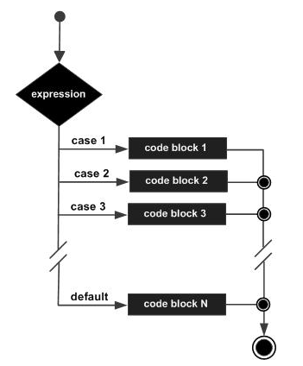
Selection : switch statement
Flow Diagram for a switch statement

Slide 24
Selection : switch statement : Example I
public class MyClass {
public static void main(String args[]) {
int x = 2;
switch(x) {
case 1 :
System.out.println("One!");
break;
case 2 :
System.out.println("Two!");
break;
case 3 :
System.out.println("Three!");
break;
default :
System.out.println("Value not found");
}
System.out.println("Your value is " + x);
}
}
Output??

Slide 25
Selection : switch statement
What if we remove the break statements ?
See Examples in the next slides

Slide 26
Selection : switch statement : Example II
public class MyClass {
public static void main(String args[]) {
int x = 2;
switch(x) {
case 1 :
System.out.println("One!");
case 2 :
System.out.println("Two!");
case 3 :
System.out.println("Three!");
default :
System.out.println("Value not found");
}
System.out.println("Your value is " + x);
}
}
Output??

Slide 27
Selection : switch statement
You can see that the execution of statements continues to the next case statements until a break statement is reached; if there is no break statement, all the remaining case statements will be executed (plus the default statement).

Slide 28
Selection : switch statement : Example III & IV
public class MyClass {
public static void main(String args[]) {
int x = 2;
switch(x) {
case 1 :
System.out.println("One!");
break;
case 2 :
System.out.println("Two!");
case 3 :
System.out.println("Three!");
default :
System.out.println("Value not found");
}
System.out.println("Your value is " + x);
}
}
public class MyClass {
public static void main(String args[]) {
int x = 2;
switch(x) {
case 1 :
System.out.println("One!");
case 2 :
System.out.println("Two!");
case 3 :
System.out.println("Three!");
break;
default :
System.out.println("Value not found");
}
System.out.println("Your value is " + x);
}
}
Output??
Output??

Slide 29
Selection : switch statement : Example V
public class MyClass {
public static void main(String args[]) {
char grade = 'C';
switch(grade) {
case 'A' :
System.out.println("Excellent!");
break;
case 'B' :
case 'C' :
System.out.println("Well done");
break;
case 'D' :
System.out.println("You passed");
case 'F' :
System.out.println("Better try again");
break;
default :
System.out.println("Invalid grade");
}
System.out.println("Your grade is " + grade);
}
}
Output??

Slide 30
Selection : switch statement : Example VI
public class MyClass {
public static void main(String args[]) {
char grade = 'F';
switch(grade) {
case 'A' :
System.out.println("Excellent!");
break;
case 'B' :
case 'C' :
System.out.println("Well done");
break;
case 'D' :
System.out.println("You passed");
case 'F' :
System.out.println("Better try again");
default :
System.out.println("Invalid grade");
}
System.out.println("Your grade is " + grade);
}
}
Output??

Slide 31
Selection : The Conditional Operator ( ? : )
The conditional operator (? :) is also known as the ternary operator.
It can be used to replace if...else statements.
It has the following general form −
Exp1 ? Exp2 : Exp3;
Where Exp1, Exp2, and Exp3 are expressions.
Notice the use and placement of the colon.

Slide 32
Selection : The Conditional Operator ( ? : )
To determine the value of the whole expression, initially exp1 is evaluated.
If the value of exp1 is true, then the value of Exp2 will be the value of the whole expression.
If the value of exp1 is false, then Exp3 is evaluated and its value becomes the value of the entire expression.
In short, the operator is written as :
variable x = (expression) ? value if true : value if false;

Slide 33
Selection : The Conditional Operator ( ? : ) : Example
public class MyClass {
public static void main(String args[]) {
int a, b;
a = 10;
b = (a == 1) ? 20: 30;
System.out.println( "Value of b is : " + b );
b = (a == 10) ? 20: 30;
System.out.println( "Value of b is : " + b );
}
}
Output??

Slide 34
Repetition
These are the control structures that enable programs to execute statements repeatedly as long as a condition called the loop-continuation condition remains true.

Slide 35
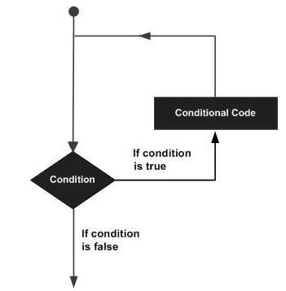
Repetition
Figure: The general form of a loop statement

Slide 36
Repetition
Java provides the following types of loop to handle looping requirements:
while loop
for loop
do...while loop

Slide 37
Repetition : The while loop
The while loop repeats a statement or group of statements while a given condition is true.
It tests the condition before executing the loop body.
Syntax
while(Boolean_expression) {
// Statement(s)
}

Slide 38
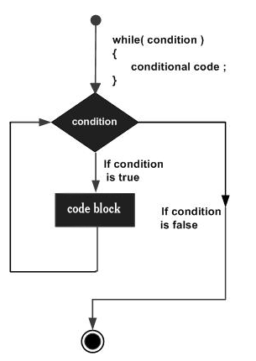
Repetition : The while loop: Flow Diagram

Slide 39
Repetition : The while loop
The key point of the while loop is that the loop might not ever run. When the expression is tested and the result is false, the loop body will be skipped and the first statement after the while loop will be executed.

Slide 40
Repetition : The while loop: Example
public class MyClass {
public static void main(String args[]) {
int x = 10;
while( x < 20 ) {
System.out.print("value of x : " + x );
x++;
System.out.print("\n");
}
}
}
Output??

Slide 41
Repetition : The for loop
The for loop executes a sequence of statements multiple times and abbreviates the code that manages the loop variable.
It allows you to efficiently write a loop that needs to be executed a specific number of times.
A for loop is useful when you know how many times a task is to be repeated.

Slide 42
Repetition : The for loop
Syntax
for(initialization; Boolean_expression; update) {
// Statements
}

Slide 43
Repetition : The for loop
Here is the flow of control in a for loop
The initialization step is executed first, and only once. This step allows you to declare and initialize any loop control variables and this step ends with a semi colon (;).
Next, the Boolean expression is evaluated. If it is true, the body of the loop is executed. If it is false, the body of the loop will not be executed and control jumps to the next statement past the for loop.
After the body of the for loop gets executed, the control jumps back up to the update statement. This statement allows you to update any loop control variables. This statement can be left blank with a semicolon at the end.
The Boolean expression is now evaluated again. If it is true, the loop executes and the process repeats (body of loop, then update step, then Boolean expression). After the Boolean expression is false, the for loop terminates.

Slide 44
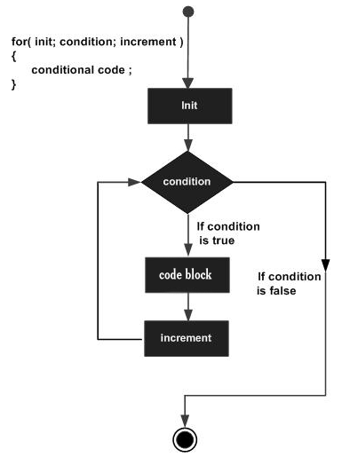
Repetition : The for loop: Flow Diagram

Slide 45
Repetition : The for loop: Example
public class MyClass {
public static void main(String args[]) {
for(int x = 10; x < 20; x = x + 1) { //OR for(int x = 10; x < 20; x++) {
System.out.print("value of x : " + x );
System.out.print("\n");
}
}
}
Output??

Slide 46
Repetition : The do...while loop
The do...while loop is similar to the while loop, except that it tests the condition at the end of the loop body and therefore it is guaranteed to execute at least once.
Syntax
do {
// Statements
}while(Boolean_expression);
Notice that the Boolean expression appears at the end of the loop, so the statements in the loop execute once before the Boolean is tested.
If the Boolean expression is true, the control jumps back up to do statement, and the statements in the loop execute again. This process repeats until the Boolean expression is false.

Slide 47
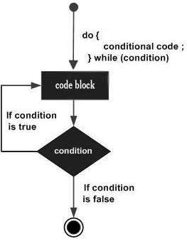
Repetition : The do...while loop : Flow Diagram

Slide 48
Repetition : The do...while loop : Example
public class MyClass {
public static void main(String args[]) {
int x = 10;
do {
System.out.print("value of x : " + x );
x++;
System.out.print("\n");
}while( x < 20 );
}
}
Output??

Slide 49
Repetition : The do...while loop : Example II
public class MyClass {
public static void main(String args[]) {
int x = 10;
do {
System.out.print("value of x : " + x );
x++;
System.out.print("\n");
}while( x < 5 );
}
}
Output??

Slide 50
Repetition : The do...while loop : Example III
public class MyClass {
public static void main(String args[]) {
int x = 10;
do {
x++;
}while( x < 5 );
System.out.println(x);
}
}
Output??

Slide 51
Repetition : The do...while loop : Example IV
public class MyClass {
public static void main(String args[]) {
int x = 10;
do {
x++;
}while( x < 13 );
System.out.println(x);
}
}
Output??

Slide 52
Repetition : Loop Control Statements
Loop control statements change execution from its normal sequence. When execution leaves a scope, all automatic objects that were created in that scope are destroyed.
Java supports the following control statements.
break statement
continue statement

Slide 53
Repetition : Loop Control Statements : break statement
We have seen how a break statement I used in a switch statement in the selection control structure.
In loops, the break statement terminates the loop statement and transfers execution to the statement immediately following the loop.

Slide 54
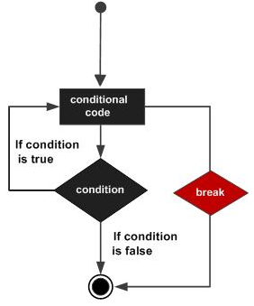
Repetition : Loop Control Statements: break statement : Flow Diagram

Slide 55
Repetition : Loop Control Statements: break statement : Example
public class MyClass {
public static void main(String args[]) {
int [] numbers = {10, 20, 30, 40, 50};
for(int x : numbers ) {
if( x == 30 ) {
break;
}
System.out.print( x );
System.out.print("\n");
}
}
}
Output??

Slide 56
Repetition : Loop Control Statements: continue statement
The continue keyword causes the loop to skip the remainder of its body and immediately retest its condition prior to reiterating (i.e. It causes the loop to immediately jump to the next iteration of the loop).
In a for loop, the continue keyword causes control to immediately jump to the update statement.
In a while loop or do/while loop, control immediately jumps to the Boolean expression.

Slide 57
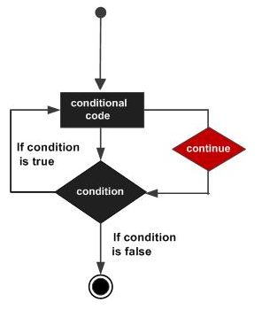
Repetition : Loop Control Statements : continue statement : Flow Diagram

Slide 58
Repetition : Loop Control Statements: continue statement : Example
public class MyClass {
public static void main(String args[]) {
int [] numbers = {10, 20, 30, 40, 50};
for(int x : numbers ) {
if( x == 30 ) {
continue;
}
System.out.print( x );
System.out.print("\n");
}
}
}
Output??

Slide 59
Repetition : The enhanced for loop
The enhanced for loop was introduced in Java 5. It is mainly used to traverse collection of elements including arrays.
Syntax
for(declaration : expression) {
// Statements
}
Declaration − The newly declared block variable, is of a type compatible with the elements of the array you are accessing. The variable will be available within the for block and its value would be the same as the current array element.
Expression − This evaluates to the array you need to loop through. The expression can be an array variable or method call that returns an array.

Slide 60
Repetition : The enhanced for loop: Example
public class MyClass {
public static void main(String args[]) {
int [] numbers = {10, 20, 30, 40, 50};
for(int x : numbers ) {
System.out.print( x );
System.out.print(",");
}
System.out.print("\n");
String [] names = {"James", "Larry", "Tom", "Lacy"};
for( String name : names ) {
System.out.print( name );
System.out.print(",");
}
}
}
Output??

Slide 61
Repetition : The enhanced for loop: Example
public class MyClass {
public static void main(String args[]) {
int [] numbers = {10, 20, 30, 40, 50};
for(int x : numbers ) {
System.out.print( x );
System.out.print(",");
}
System.out.print("\n");
String [] names = {"James", "Larry", "Tom", "Lacy"};
for( String name : names ) {
System.out.print( name );
System.out.print(",");
}
}
}
Output??

Slide 62
Assignment I Qn 8:
a) Write any Java program with a loop inside another loop.
b) Write any Java program with a conditional statement inside a loop.
c) Write any Java program with a loop inside a conditional statement.
d) Write any Java program with a conditional statement inside another conditional statement .

Slide 63
End

