Slide 1
RCS 112
L6

Slide 2
Finite State Machines (FSM) OR Finite State Automation (FSA)
Defn- are models of the behaviors of a system or a complex object, with a limited number of defined conditions or modes, where mode transitions change with circumstance.
Finite state machines consist of 4 main elements:
states which define behavior and may produce actions.
state transitions which are movement from one state to another.
rules or conditions which must be met to allow a state transition.
input events which are either externally or internally generated, which may possibly trigger rules and lead to state transitions.

Slide 3
FSM-Definition
A finite-state machine M = (S, I,O, f, g, s0) consists of
a finite set S of states,
a finite input alphabet I,
a finite output alphabet O,
a transition function f that assigns to each state and input pair a new state,
an output function g that assigns to each state and input pair an output, and
an initial state s0.

Slide 4
Finite State Machines (FSM)…
A finite state machine must have
an initial state which provides a starting point, and
a current state which remembers the product of the last state transition.
Received input events act as triggers, which cause an evaluation of some kind of the rules that govern the transitions from the current state to other states.
The best way to visualize a FSM is to think of it as
a directed graph of states OR
a flow chart
accurate abstract modeling techniques.

Slide 5
Sequential circuit
Digital logic systems can be classified as combinational or sequential.
Combinational circuits can be completely described by the truth table.
Sequential systems contain state stored in memory elements internal to the system.
Their behavior depends both on the set of inputs supplied and on the contents of the internal memory, or state of the system.
Thus, a sequential system cannot be described with a truth table. Instead, a sequential system is described as a finite-state machine (or often just state machine).

Slide 6
Finite State Machines
A finite state machine has a set of states and two functions called the next-state function and the output function
The set of states correspond to all the possible combinations of the internal storage
If there are n bits of storage, there are 2^{n} possible states
The next state function is a combinational logic function that given the inputs and the current state, determines the next state of the system

Slide 7
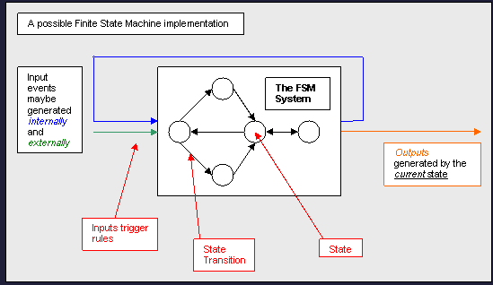

Slide 8
Finite State Machines (FSM)…
FSM is typically used as a type of control system where knowledge is represented in the states, and actions are constrained by rules.
FSMs design techniques can be used for designing
Visual Basic programs,
logic circuits or firmware for a microcontroller.
Thus Many computers and microprocessor chips have, at their hearts, a FSM.

Slide 9
Finite State Machines (FSM)…
Finite-state machines are used extensively in applications in computer science and data networking.
For example, finite-state machines are the basis for
programs for spell checking,
grammar checking,
indexing or searching large bodies of text,
recognizing speech,
Transforming text using markup languages such as XML and HTML, and
network protocols that specify how computers communicate.

Slide 10
Similar model to FSM
Finite state machines are an adopted artificial intelligence technique which originated in the field of mathematics, initially used for language representation.
It is closely related to other fundamental knowledge representation techniques.
such as semantic networks and
an extension of semantic networks called state space
Semantic networks were proposed to represent meaning and relationships of English words.
A graph is constructed where nodes represent concepts and edges the relationships.
State space is an extension on the idea of semantic networks, where a node denotes a valid state and the edges transitions between states.

Slide 11
Similar model to FSM…
State space, unlike FSM, requires both an
initial state and
a goal state,
State space are typically used in problem solving domains where a sequence of actions is required for solving the overall problem (sequence from initial to goal states).
Like FSM, state space has rules which constrain state transitions, and are triggered by input events.
Notes:
Constrain-to force somebody to do something or behave in a particular way

Slide 12
TWO MAIN TYPES OF FSM.
Deterministic-given an input and the current state, the state transition can be predicted.
Non-deterministic finite state machine-
given the current state; the state transition is not predictable.
Or the transition from the current state to another state cannot be known until the inputs are received (event driven).
It may be the case that multiple inputs are received at various times.
One of these non-deterministic approaches involves the application of another proven artificial intelligence technique; Fuzzy Logic, called Fuzzy State Machines (FuSM).

Slide 13
Deterministic FSM into a non-deterministic FSM
An approach for converting a deterministic FSM into a non-deterministic FSM would be to simply use a random number generator to select a triggered rule.
state and an action
When designing a computer program, larger functionality are decomposed into a number of smaller actions or activities.
This is done so that each can be defined in a function, making the overall solution modular, and easier to maintain.
FSM is similar in that it’s a decomposition of the behaviors of a system or object, and even a state can be decomposed into sub-states.
The difference is a state may involve one or more actions.
Example : a moveUnit() action may be used by both the evadeEnemy state and the attackEnemy state.

Slide 14
Action and state
an action is an activity that accomplishes something like an evaluation or a movement and
a state is a collection of actions that are used when in a particular mode.
Or
A state is the circumstance of a thing and its condition.
The actions are the attributes of that state.
It provides the ability to limit the scope of actions or the amount of knowledge to only that required for the current state.

Slide 15
Moore Machine and Mealy Machine
Are methods for handling where to generate the outputs for a finite state machine.
A Moore Machine is a type of finite state machine where the outputs are generated as products of the states. Or , the output only depends on the current state
In the below example the states define what to do; such as apply power to the light globe.

Slide 16
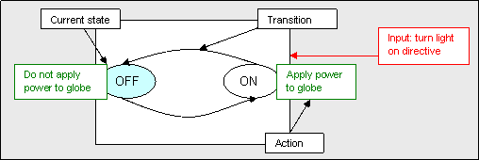
Moore Machine…
A light system example of a Moore Machine

Slide 17
Mealy Machine
A Mealy Machine, is a type of finite state machine where the outputs are generated as products of the transition between states.
Or the output depends both on the current state and the current input
Example- In below example the light is affected by the process of changing states.

Slide 18
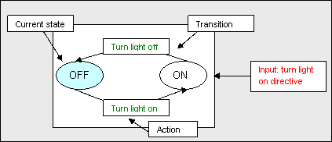
Mealy Machine
A light system example of a Mealy Machine

Slide 19
Abstract modeling techniques in FSM
There are a number of abstract modeling techniques that may help or spark understanding in the definition and design of a finite state machine.
State Transition Diagram: also called a bubble diagram, shows the relationships between states and inputs that cause state transitions
State-Action-Decision Diagram: simply a flow diagram with the addition of bubbles that show waiting for external inputs
Statechart Diagrams: a form of UML notation used to show behavior of an individual object as a number of states, and transitions between those states.
Hierarchical Task Analysis (HTA): though it does not look at states, HTA is a task decomposition technique that looks at the way a task can be split into subtasks, and the order in which they are performed

Slide 20
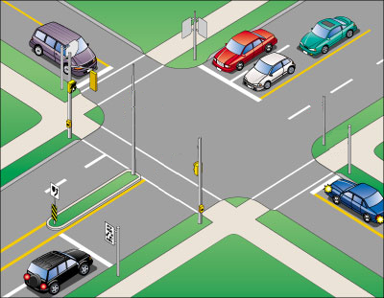
Intelligent Traffic Controller
We want to use a finite state machine to control the traffic lights at an intersection of a north-south route and an east-west route
We consider only the green and red lights
We want the lights to change no faster than 30 seconds in each direction
So we use a 0.033 Hz clock

Slide 21
Intelligent Traffic Controller
There are two output signals
NSlite: When the signal is asserted, the light on the north-south route is green; otherwise, it should be red
EWlite: When the signal is asserted, the light on the east-west route is green; otherwise, it should be red

Slide 22
Intelligent Traffic Controller
There are two inputs
NScar: Indicates that there is at least one car that is over the detectors placed in the roadbed in the north-south road
EWcar: Indicates that there is at least one car that is over the detectors placed in the roadbed in the east-west road

Slide 23
Intelligent Traffic Controller
The traffic lights should only change from one direction to the other only if there is a car waiting in the other direction
Otherwise, the light should continue to show green in the same direction

Slide 24
Intelligent Traffic Controller
Here we need two states
NSgreen: The traffic light is green in the north-south direction
EWgreen: The traffic light is green in the east-west direction

Slide 25
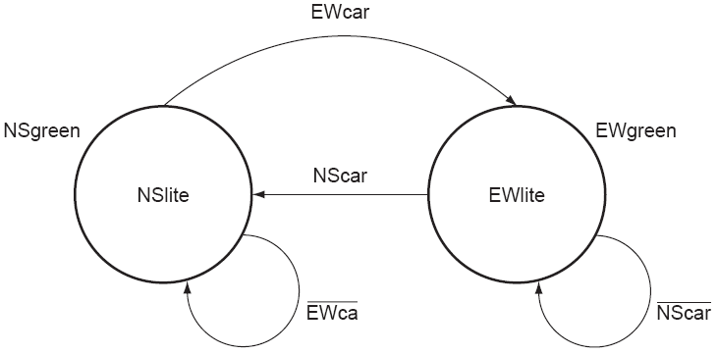
Graphical Representation

Slide 26
State Assignment
We need to assign state numbers to the states
In this case, we can assign NSgreen to state 0 and EWgreen to state 1
Therefore we only need 1 bit in the state register

Slide 27
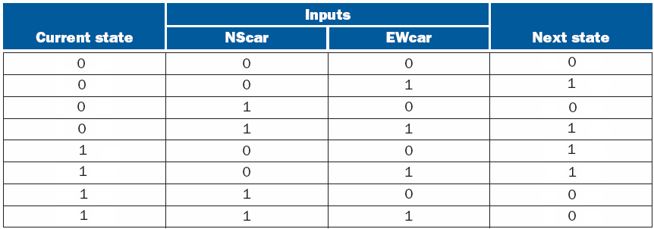
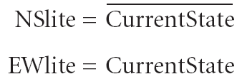
Combinational Logic for Next State Function

Slide 28
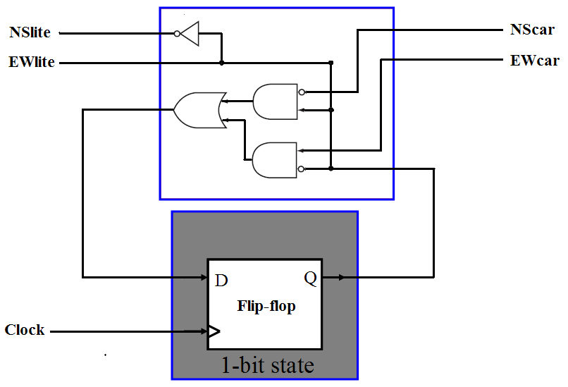
Implementing Intelligent Traffic Controller

Slide 29
Advantages of FSM
Their simplicity make it easy for inexperienced developers to implement with little to no extra knowledge .
Predictability (in deterministic FSM), given a set of inputs and a known current state, the state transition can be predicted, allowing for easy testing.
Due to their simplicity, FSMs are quick to design, quick to implement and quick in execution.
FSM is an old knowledge representation and system modeling technique, and its been around for a long time, as such it is well proven even as an artificial intelligence technique, with lots of examples to learn from.

Slide 30
Advantages of FSM…
FSMs are relatively flexible. There are a number of ways to implement a FSM based system in terms of topology, and it is easy to incorporate many other techniques.
Easy to transfer from a meaningful abstract representation to a coded implementation
Low processor overhead; well suited to domains where execution time is shared between modules or subsystems. Only the code for the current state need be executed, and perhaps a small amount of logic to determine the current state.
Easy determination of reachability of a state, when represented in an abstract form, it is immediately obvious whether a state is achievable from another state, and what is required to achieve the state

Slide 31
Disadvantages of FSM
The predictable nature of deterministic FSMs can be unwanted in some domains such as computer games (solution may be non-deterministic FSM).
Larger systems implemented using a FSM can be difficult to manage and maintain without a well thought out design.
The state transitions can cause a fair degree of "spaghetti- factor" when trying to follow the line of execution
Not suited to all problem domains, should only be used when a systems behavior can be decomposed into separate states with well defined conditions for state transitions.
This means that all states, transitions and conditions need to be known up front and be well defined
The conditions for state transitions are ridged, meaning they are fixed (this can be over come by using a Fuzzy State Machine (FuSM))

Slide 32
Have a good day

