Slide 1
Used car details
Resale company

Slide 2
Data Description
We have seen lot of changes in the car market. Now some cars are in demand hence making them costly and some are not in demand hence cheaper.
One of our clients works with small traders, who sell used cars. With the change in market due to covid 19 impact, our client is facing problems with their previous car price valuation machine learning models. So, they are looking for new machine learning models from new data. We have to make carprice valuation mode.

Slide 3
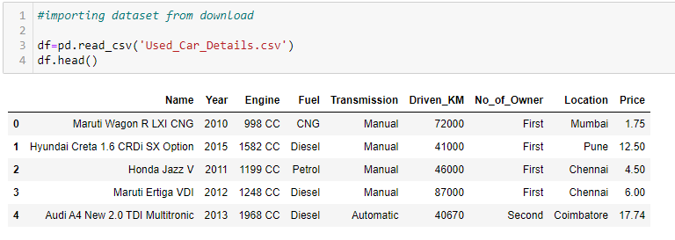
Data STRUCTURE

Slide 4
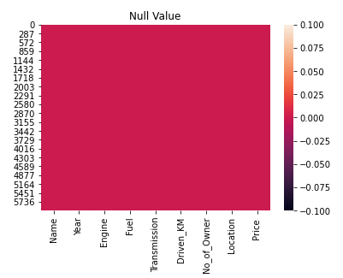
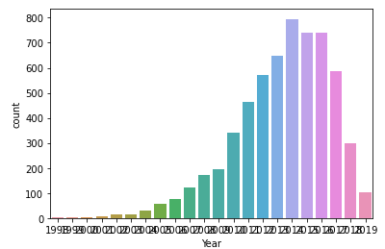
DATA VISUALIZATION

Slide 5
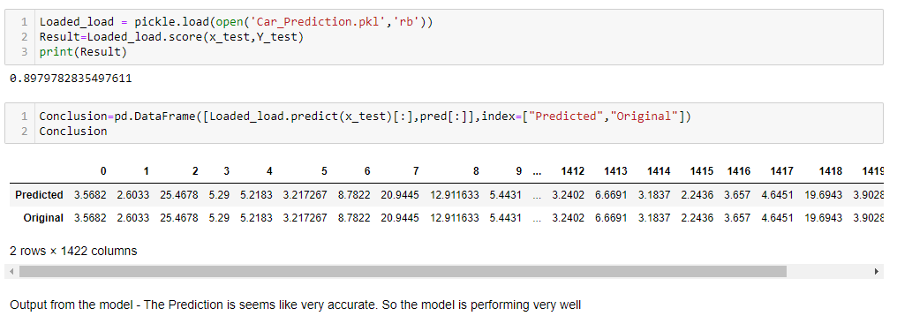
conclusion

