Slide 1

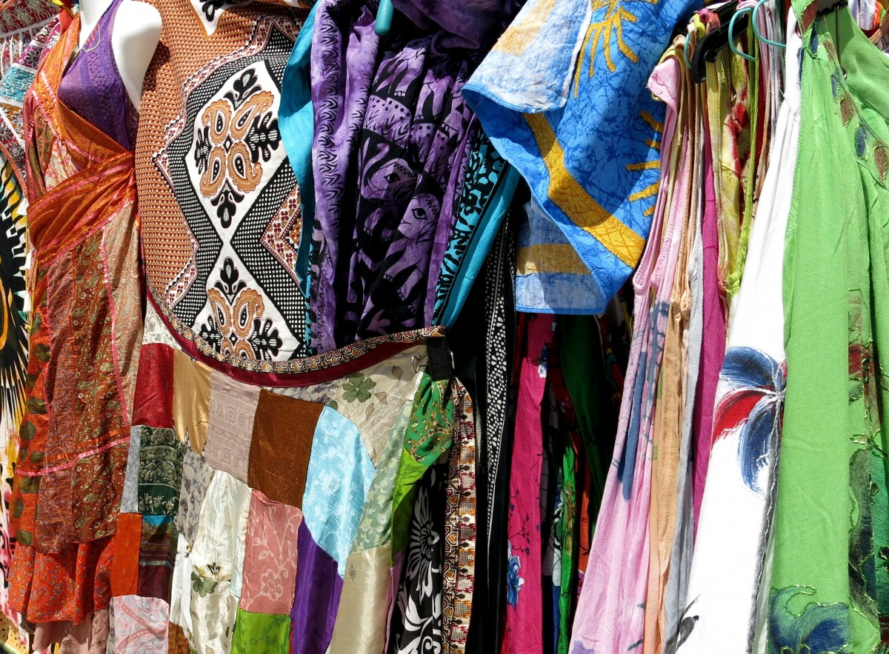
EasyTech Fashion Sales Performance
Key Insights & Recommendations
Prepared by: [Your Name/Team]
EASYTECH FASHION SALES OVERALL PERFORMANCE

Slide 2
Executive Summary
💰 Total Sales Revenue: $3,834,810.13
🎯 Average Discount: 14.50%
👗 Top 3 Products Impact: 37% of total sales
🔥 High-Discount Sales Conversion: 40.63%
🏅 Top Sales Rep Share: 20% of total sales

Slide 3
Key Performance Observations
📈 Sales Trend: Monthly fluctuations, peak in April, dip in May
🛍️ Product Contribution: Dresses > Accessories > Outerwear
👖 Top Sellers: Maxi Skirt, Flannel Dress, Raincoat
👤 Top Sales Rep: David Muna – 20% of sales
🎟️ Discounting: Strategic use, high discounts effective
📆 Peak Day: Saturdays

Slide 4
Strategic Recommendations
📦 Optimize Inventory & Marketing: Focus on top product categories (Dresses, Accessories) and Saturdays
💡 Refine Discount Strategy: Analyze high-discount profitability, promote upselling on slow days
🧑‍🏫 Enhance Sales Training: Implement best practices from David Muna across the team

Slide 5
Conclusion
🔍 Focus on top products (37% revenue from top 3)
🗂️ Optimize inventory and pricing strategies
🧠 Implement sales training and marketing pilots

