Slide 1

Parallelization using OpenMP
Rijish Ganguly
MS Exam

Slide 2

OpenMP
An API supporting multi-platform shared memory multiprocessing programming
Supports C, C++ and Fortran

Slide 3
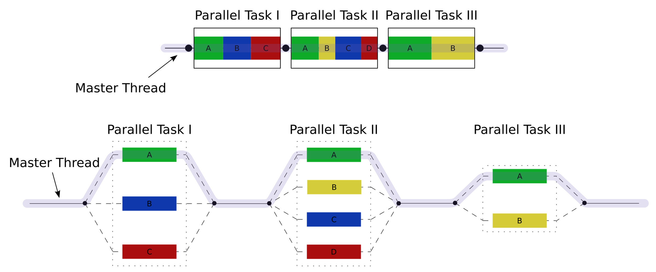
OpenMP
Multithreading is implemented with a master thread forking a specified number of thread slaves
Threads run concurrently
Runtime environment allocates threads to different processors
Notes:
Image from https://upload.wikimedia.org/wikipedia/commons/f/f1/Fork_join.svg

Slide 4
OpenMP
The parallel section of code is marked with compiler directive
After the execution of the parallelized code, the threads join back into the master thread
Each thread executes the parallelized section of code independently
Notes:
Image from https://upload.wikimedia.org/wikipedia/commons/f/f1/Fork_join.svg

Slide 5
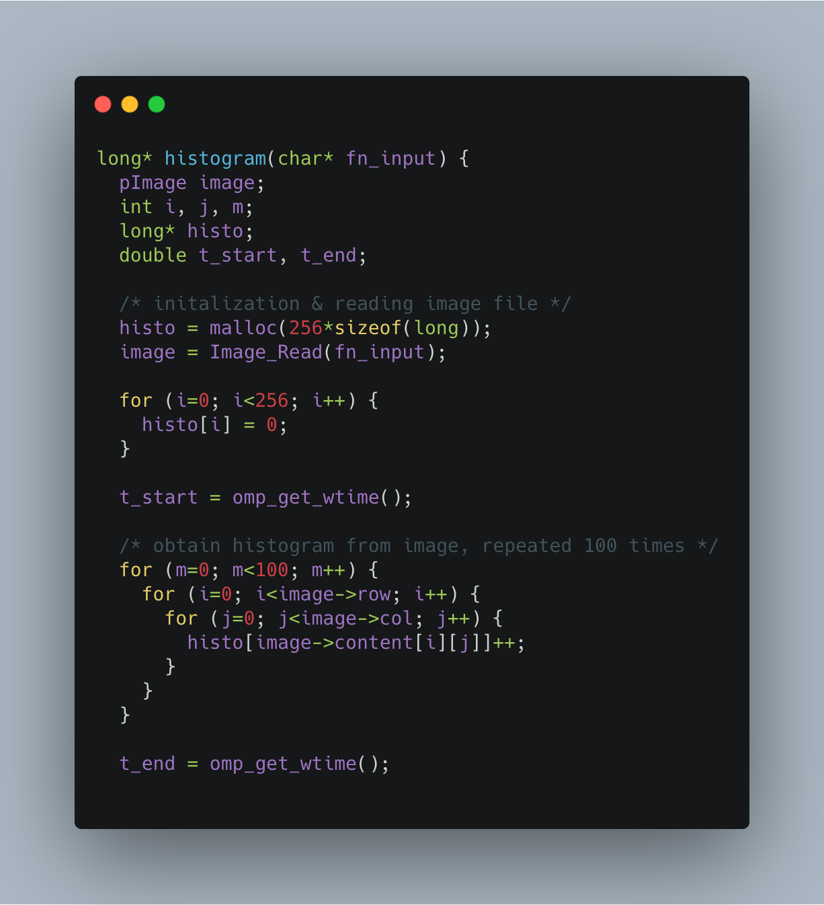
Objective
In the included source code, within the loop nest inside the histogram function, there is a loop carried dependence. Our objective is to remove parallelization limitation caused by loop carried dependence.
We try to obtain histogram from two images:
uiuc.pgm – small, used for testing our code
uiuc-large.pgm – large, used for performance experiments

Slide 6
Objective
To remove the parallelization limitation imposed by the loop-carried dependence, we implement three different approaches:
Use an array of locks
Use atomic operations
Reduction like approach

Slide 7
Objective
For each of the three versions:
We verify results against the sequential version
Record the execution time reported by the program when running with 2, 4, and 8 threads

Slide 8
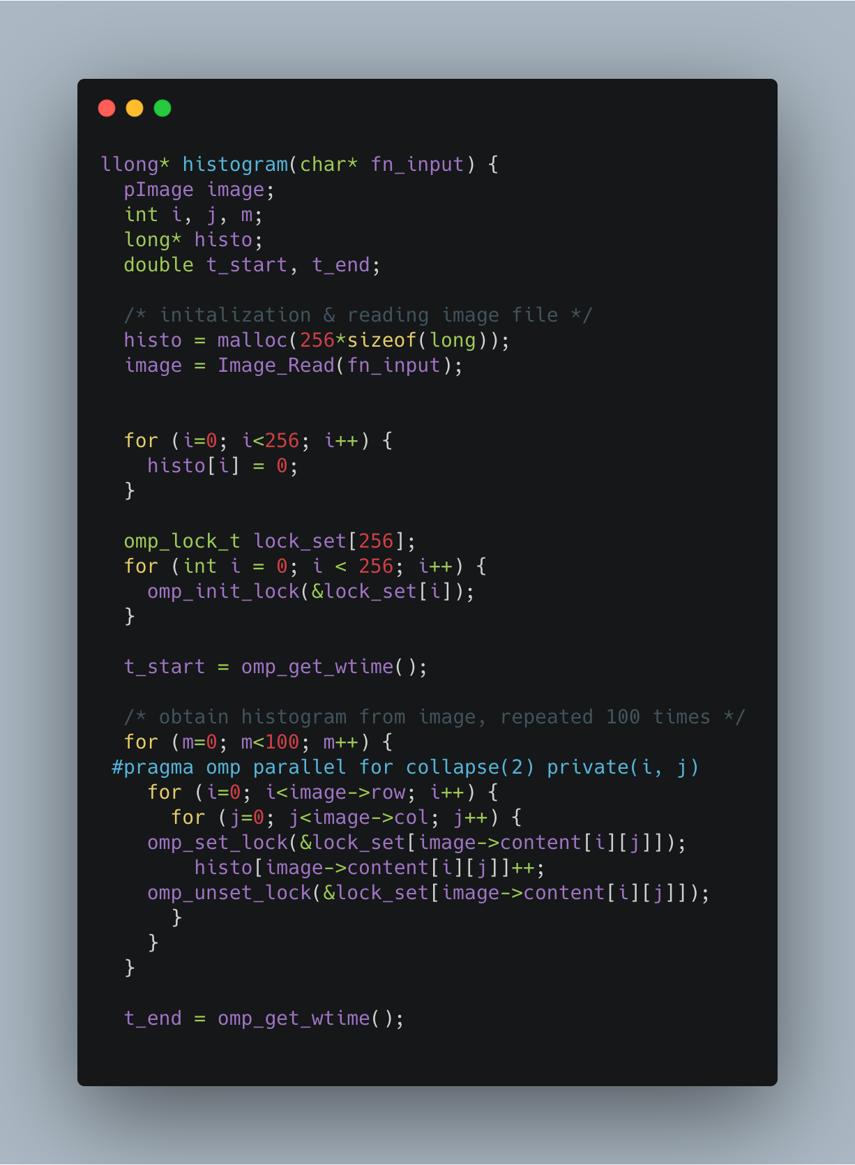
Array Locks
Important functions:
1. void opm_init_lock( omp_lock_t * lock): Initialize a simple lock, lock is in unlocked state after initialization
2. void omp_set_lock(omp_lock_t * lock): The calling thread is blocked until the lock is available
3. void omp_unset_lock(omp_lock_t *lock): Unlocks the lock

Slide 9
Array Locks
collapse(): We use the OpenMP collapse-clause to increase the total number of iterations that will be partitioned across the available number of OMP threads by reducing the granularity of work to be done by each thread. If the amount of work to be done by each thread is non-trivial (after collapsing is applied), this may improve the parallel scalability of the OMP application. (Intel Developer Zone)
private(): A variable in an OpenMP parallel region can be either shared or private. If a variable is shared, then there exists one instance of this variable which is shared among all threads. If a variable is private, then each thread in a team of threads has its own local copy of the private variable.
Notes:
From

Slide 10

Atomic Operations
Atomic operations in concurrent programming are program operations that run completely independently of any other processes
During an atomic operation, a processor can read and write a location during the same data transmission. In this way, another input/output mechanism or processor cannot perform memory reading or writing tasks until the atomic operation has finished
Mutex Locks suspend thread execution, freeing up CPU resources for other tasks, but incurs context-switching overhead when stopping/restarting the thread. On the contrary, threads attempting atomic operations don't wait and keep trying until success, so they don't incur context-switching overhead

Slide 11
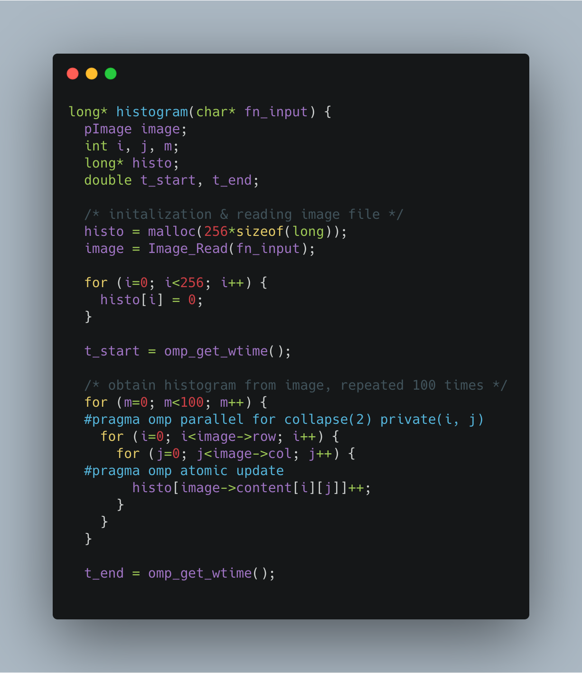
Atomic Update
atomic () - The omp atomic directive allows access of a specific memory location atomically. It ensures that race conditions are avoided through direct control of concurrent threads that might read or write to or from the particular memory location.

Slide 12
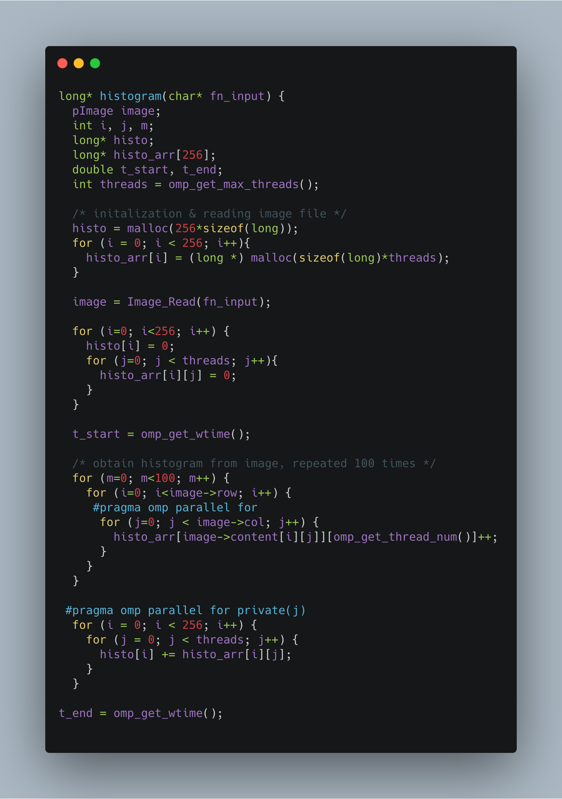
Creative Method
This method uses an idea like reduction where we use a two-dimensional array. We make copies of the original histogram array per thread and perform the updates per thread.
The final histogram array is the resulting sum of the thread-wise histogram arrays.

Slide 13
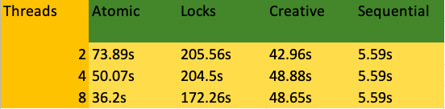
Performance Results

Slide 14
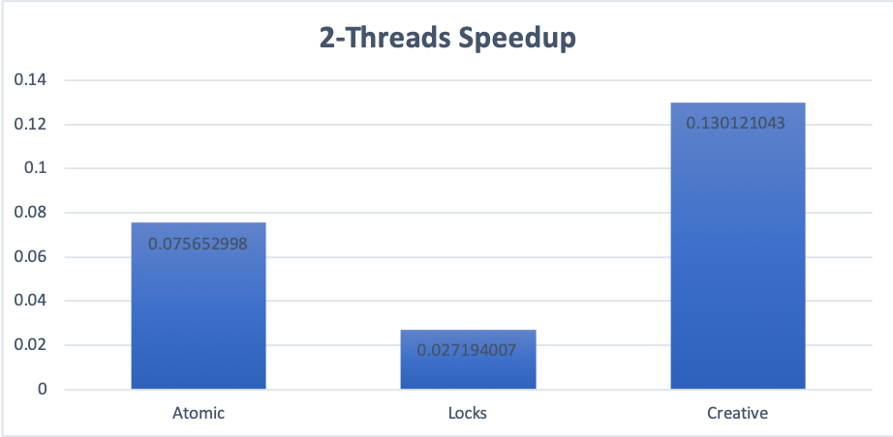
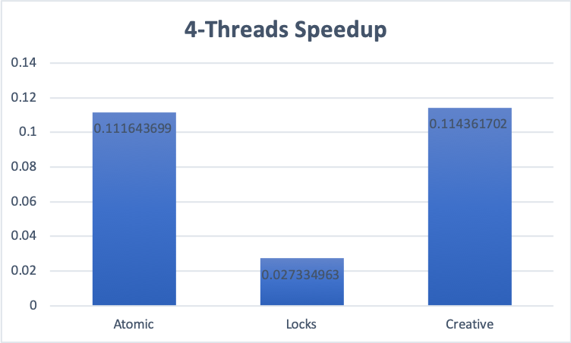
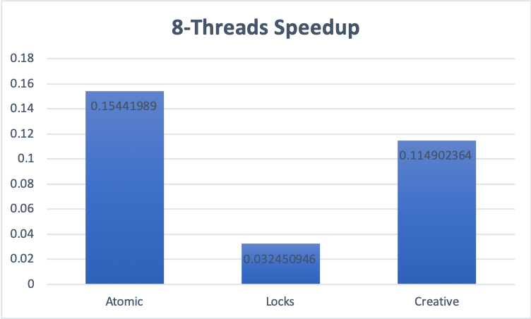
Speedup
The sequential version of the program is much faster than the parallel implementations as the time spent doing operations on each iteration in our program is very small and there is a significant overhead involved with creating and managing multiple threads.

Slide 15
Conclusion
Among all the parallelized code version, our creative version had the best performance
For both the locks and atomic update version, the program takes a considerable amount of time to execute, as the threads stall when the other threads are in the critical section which penalizes the performance significantly
For the lock version some time is lost in synchronization overhead as each thread must acquire a lock before entering the critical section and release it afterwards
With increase in number of threads, there is a trade-off between resource contention and increased communication latency

