Slide 1
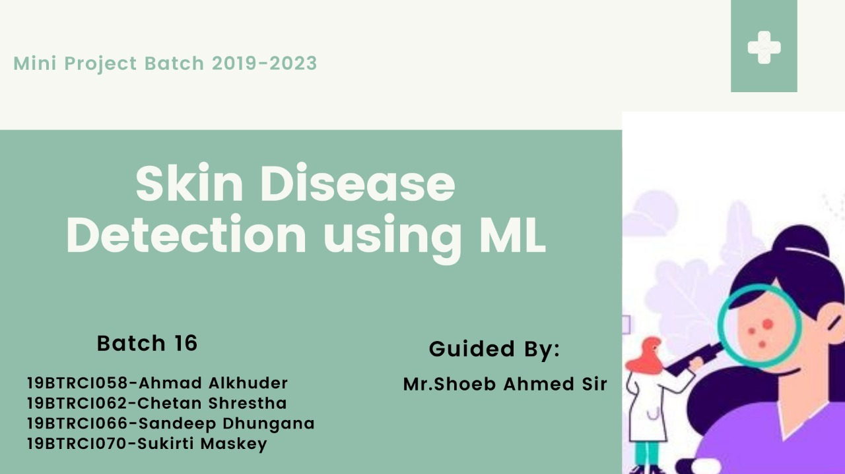
Batch 15
19BTRCR069 - Shivam Kasaudhan
19BTRCR067 - Saurabh Mishra
19BTRCR071 - Sunny Kumar Yadav
19BTRCR062 - Manish Kumar Sah
Guide:
Dr. M Sivaram

Slide 2

Abstract
Skin disease is the major problem nowadays. People need to spend a lot of money in minor cases. When we go to the hospital, doctors have to do a lot of diagnosis to determine the patterns of diseases. To avoid all these processes and expenditures, ML helps in prior recognition of the diseases and it first measures to control the diseases. This ML model helps doctors also to know the diseases without doing a lot of check-ups.

Slide 3
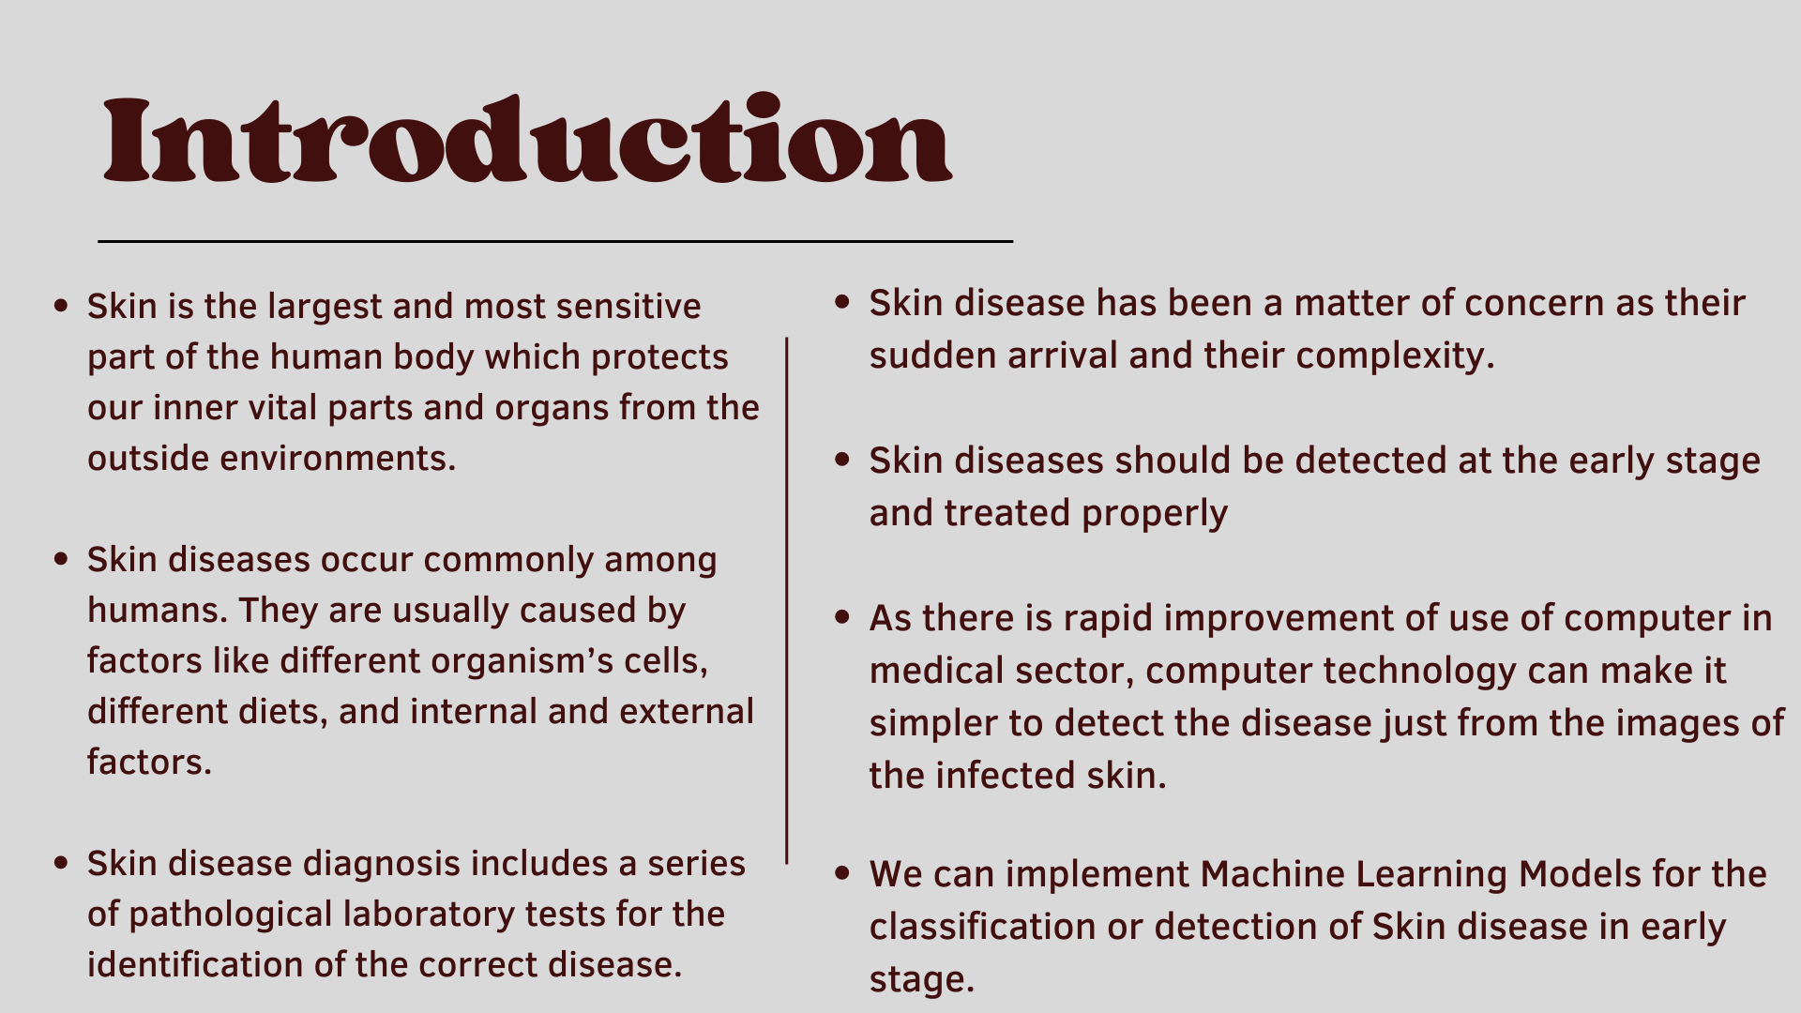

Slide 4
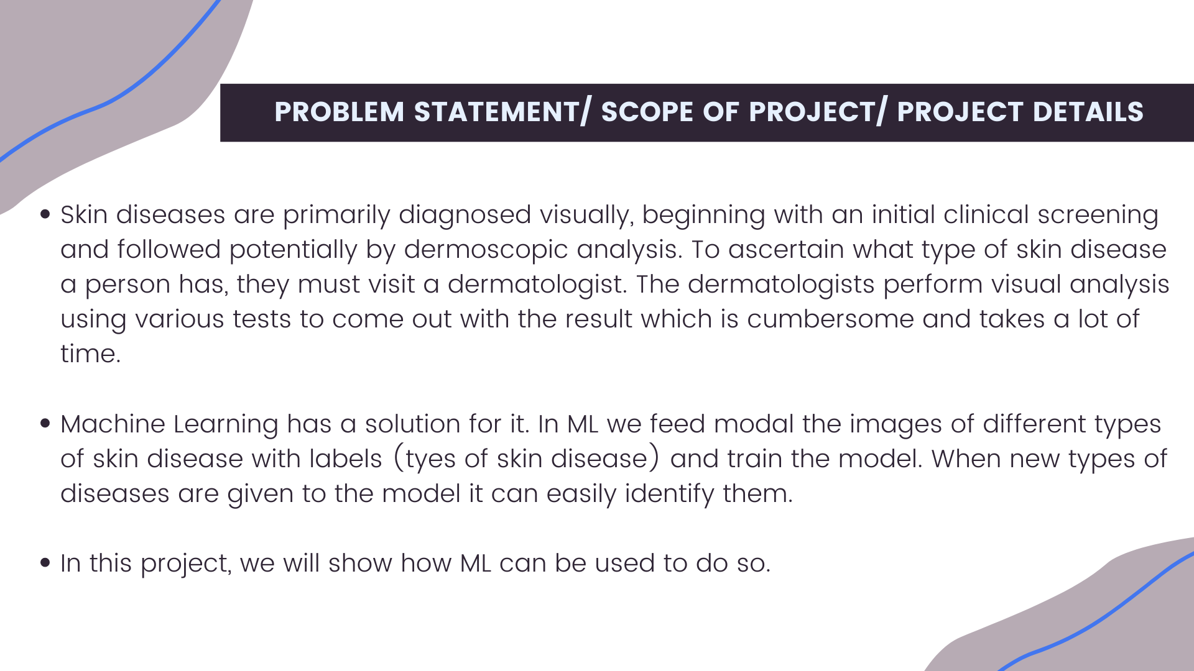

Slide 5
Literature Survey
`Method a | Overview | Accuracy | Future Scope
Nasr-Esfahmi et al | Two layered CNN is used for melanoma classification Illumination correction mask generation , gaussian filter is applied to remove noise issues. Cropping and rotation is used for data augmentation. | 81% | Deep layered network may be used for increased results. Training will get improved by collecting more data
Khryashcheve at al | CNN u-Net based algorithm is used proposed for medical image segmentation at expert level AlexNet based algorithm is used for automatic markup of image database. | Not defined | The algorithm is not used in real time analysis due to more time complexity
Sahu et al | Classification of benign and malignant skin lesions. Hybrid deep learning mobile mobileNet , domain specific knowledge and features suggested by dermatologists are used to improve the accuracy of the classifier. | 78% to 80% | Detection of cancer with raspberry pi is not good option because to analyse image high level camera is required

Slide 6
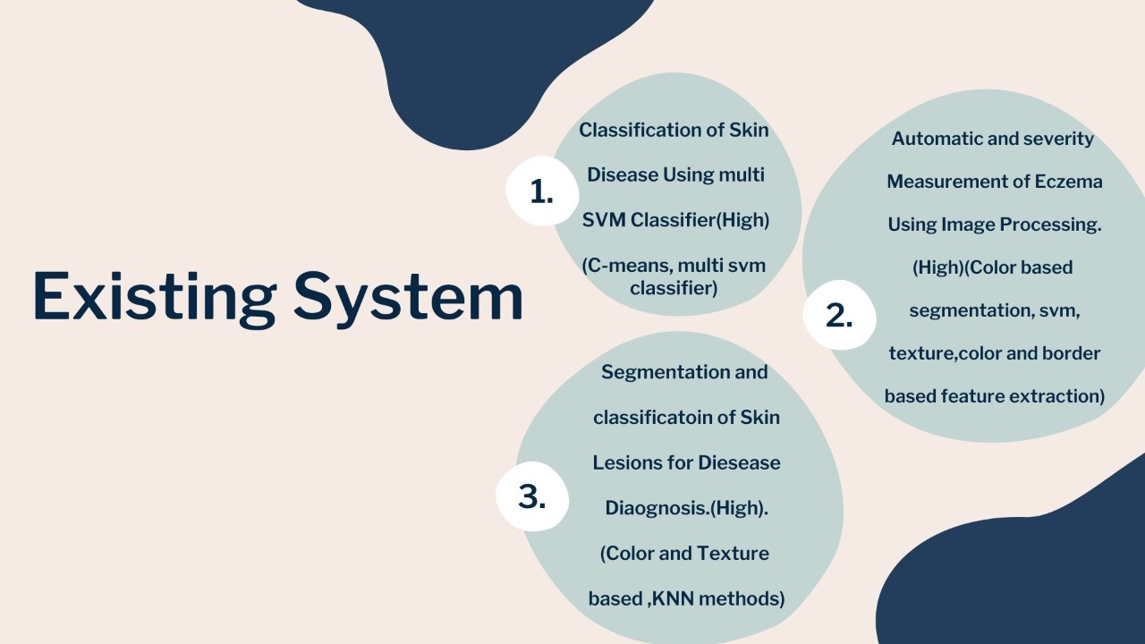

Slide 7
Proposed Model
In base paper, they have used SVM as their main classifier. Using SVM, the accuracy we get is around 70-80%.
In this experiment we are replacing the SVM classification part with ANN to classify the data into cancerous cell or non-cancerous cell.
ANN, or Artificial Neural Network, is a machine learning technique based on the working of human brain. It has input layers, hidden layers and output layer. Computation is done in hidden layers. It can be used to solve all the problems that can be expressed as a linear function.

Slide 8
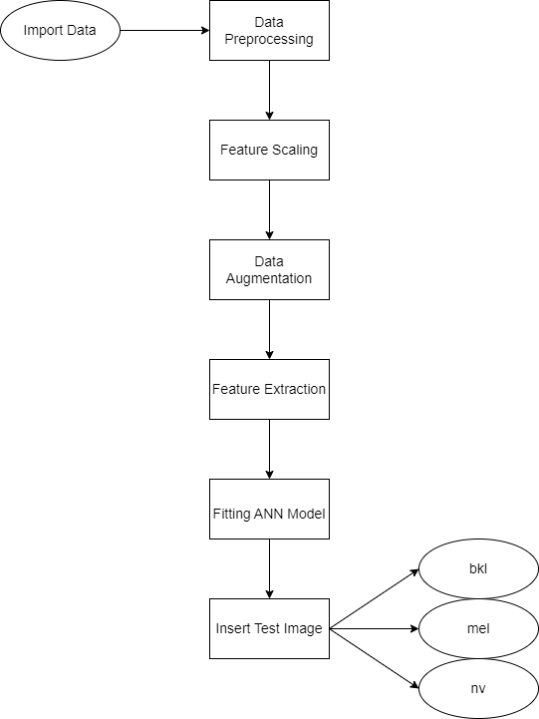
Methodology

Slide 9
Methodology
Get the HAM10000 data set from the Kaggle.
The dataset contains the different value of the picture pixel in it.
The images are passed through the model CNN through the different layers of CNN for the feature extraction.
Different dense layers and conv2D layers are used and activation function are used to boost the model.
Batch sizes differ in different iteration for the model evaluation.
Different samples are taken to learn the feature from the picture along with alternative activation and maxpooling layer.
At last ANN is used through which the extracted feature are passed from ANN for the classification of the images of different skin diseases.
After this the model will predict the label of the skin diseases

Slide 10
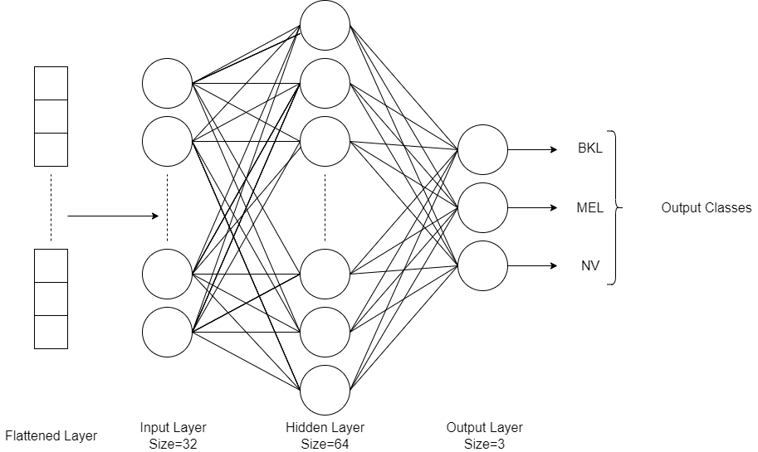
Working of ANN

Slide 11
Working of ANN
In this project, we are using ANN technique to build the model. Previously, SVM was used as the classifier. So, we are experimenting with an artificial Neural Network as classifier.
The features extracted from the CNN are passed as input to the ANN model.
The different hidden layers of ANN are used to classify the disease.
The no. of hidden layers are chosen according to the requirement of the project.

Slide 12
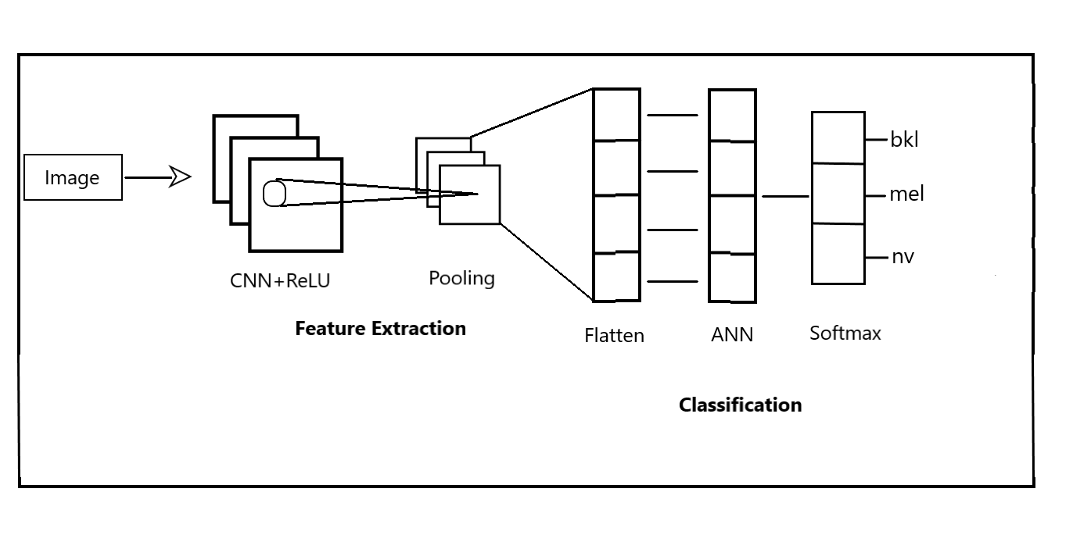
Feature Extraction using CNN
Technically, deep learning CNN models to train and test, each input image will pass it through a series of convolution layers with filters, Pooling, ANN and apply softmax to classify an object with probabilistic value between 0 and 1.
The given figure of complete flow of CNN and ANN to process an input image and classify image based on the value.

Slide 13
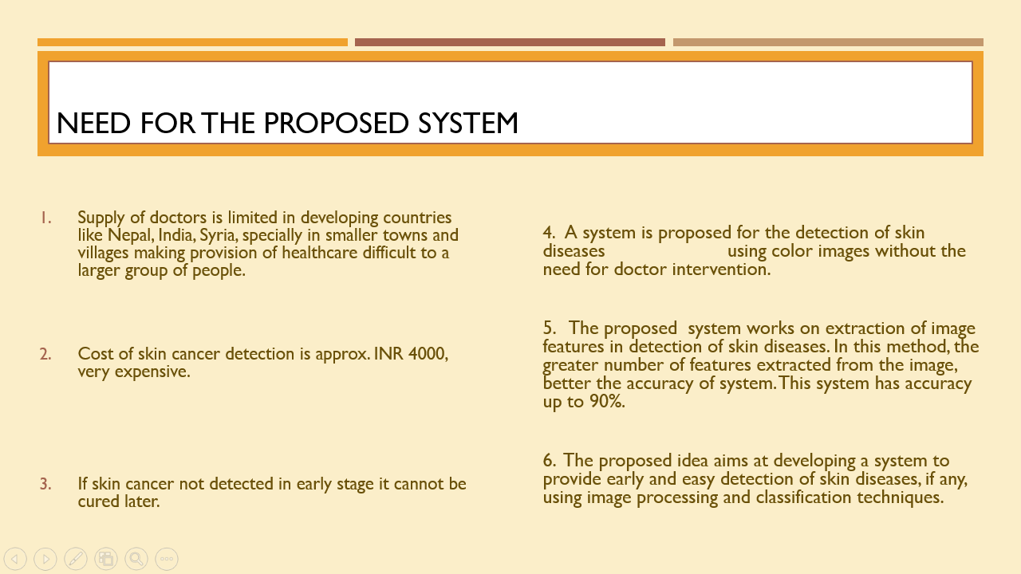

Slide 14
Software Requirements
Python 3.x
TensorFlow 2.10.0 and above
Keras 2.10.0 and above
Python modules – NumPy, Pandas, matplotlib, math, os, glob, scikit-learn
Jupyter Notebook
Hardware requirements – Google Colab Nvidia K80/T4 GPU of 12GB memory

Slide 15
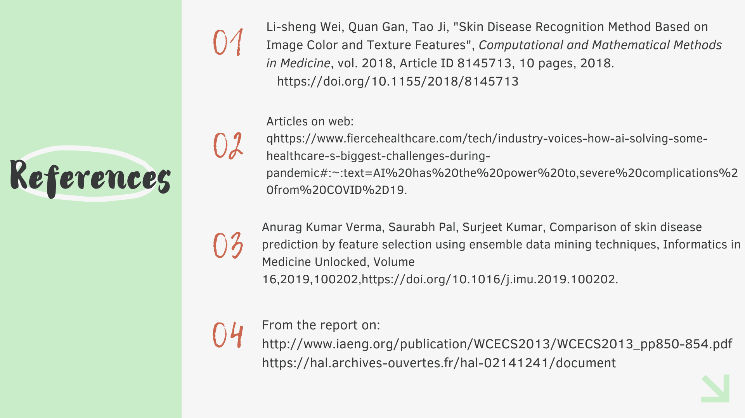

Slide 16
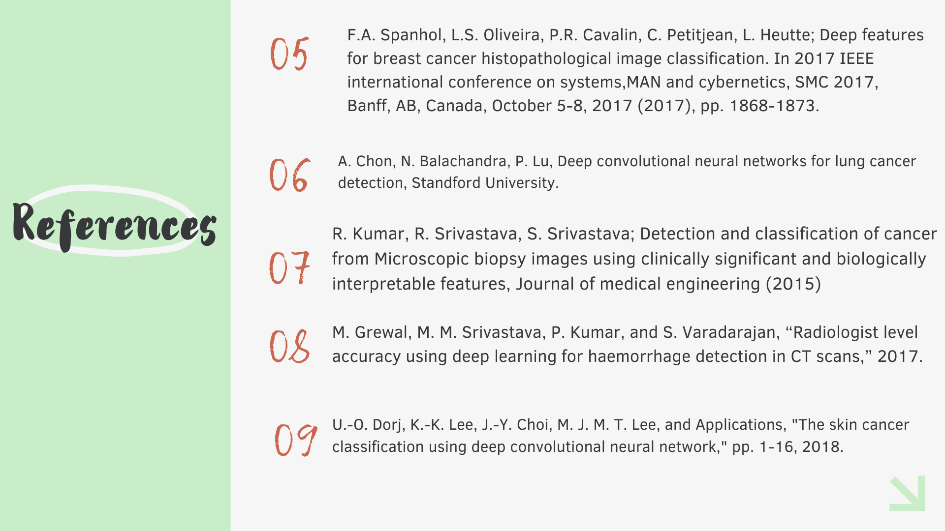

Slide 17


