Slide 1
ω_{b}
r_{b}
v_{w}
v_{b}
ϖ_{ω}
Θ = 40°
120°

Slide 2
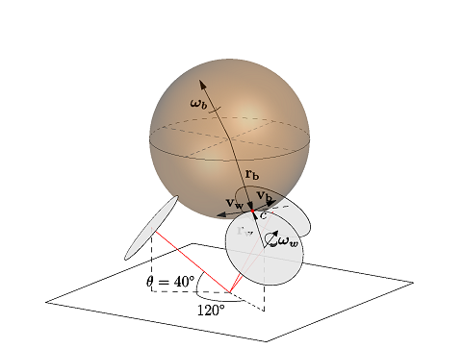

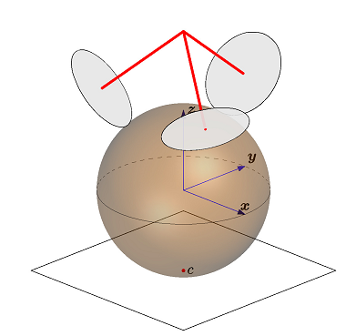
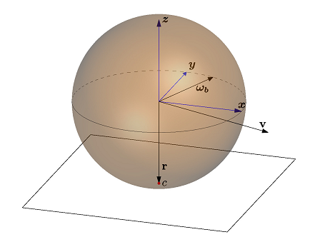


Tilt correcton:
R^{T} = inverse rotation matrix

Slide 3
schematics - sketch
Balance Controller
Main Controller
Led Controller
Motordriver 1
Motor Controller
PWM/encoder AB
I2C
Atmega 644
Balance Controller
XBee
Remote Receiver
I2C LED Driver
Motordriver 2
Motor Controller
Atmega 644
Main Controller
16 Kanal LED
UART
Motordriver 3
Motor Controller
Emic-2
Dectalk Controller
UART
I2C LED Driver
16 Kanal LED
MPU6050
Loudspeaker

Slide 4
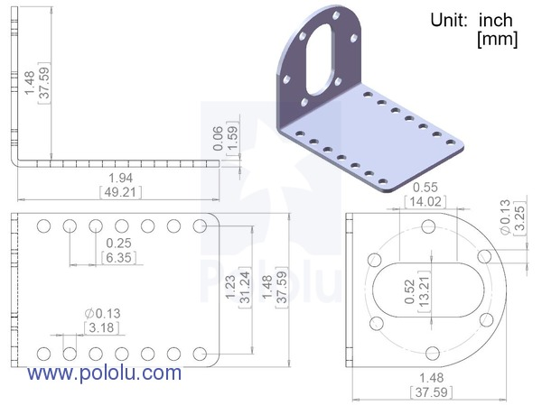
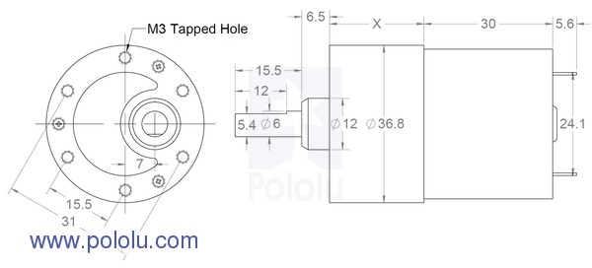
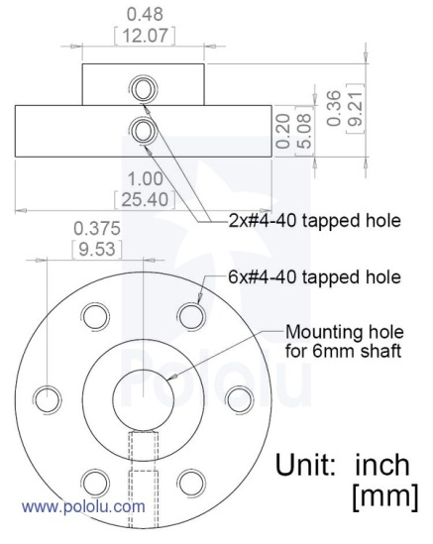
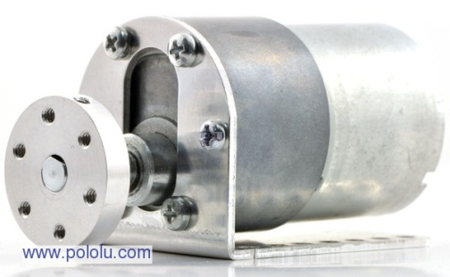
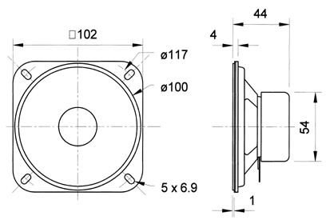
25mm
7mm
7mm
20,5mm
27,5mm
7mm
Visaton R 10 SC - 8 Ohm
14,5mm
http://www.visaton.de/de/chassis_zubehoer/breitband/f8sc_8.html

Slide 5
140mm
A=95,7
26mm
6+3mm
30mm
b=57mm
1mm
4mm
B =48,4+ 9 + cos(40°)*(120+24+30mm)+sin(40°)*(21mm)
21mm
40°
b=195,1mm
147mm
48mm
sin(40°)*120mm
24+30mm
40°
R=120 mm
sin(40°)*(120mm+24mm)
A = sin(40°)*(120mm+24mm+30) - cos(40)*(21mm)=
sin(40)* (174)-cos(40)*21

Slide 6
r=11,5/90 mm
r=80mm / 80mm
3 mm
38,6 mm
45,6 mm
71,6 mm
3 mm
17 mm
3 mm
27mm
10 mm
3 mm
6 mm
3 mm
40 mm
9mm
6mm
37mm
52mm

Slide 7
200mm
70mm
200mm
80mm
130mm
240mm

Slide 8
Motor platform with 40° angle II
Draw that line

Slide 9
Motor platform with 40° angle II

Slide 10
Motor platform stabilization cross
3
1
2
1
1
1

Slide 11
Motor platform stabilization cross
4
6
5

Slide 12
Motor platform II –bottom side
6mm birch

Slide 13
mill
1mm depth
Motor platform II -upper side
3mm birch

Slide 14
middle body platform
3mm

Slide 15
Dalek body
side panel
3mm

Slide 16
top body platform – bottom side
6mm
Visaton F-8 SC
mill
1mm depth
Visaton
R 10 SC
8 Ohm

Slide 17
head platform
1x 3mm
1x 6mm

Slide 18
Hat bracket
1x 6mm

Slide 19
housing
3mm

Slide 20
Dress I
3mm
2x

Slide 21
3x Kegel
Innen 20cm*pi= 62,8cm
Aussen 28cm*pi= 87,9cm
Kante 6,9cm
R1+Sqrt(5,7cm²+4²cm)=r2
R1*2PI*f=62,8
R2 *2PI*f= 87,9
f = 62,8/(2*PI*r1) = 87,9/(2*pi*r2)
R1 = 2,8c/87,9*r2
R2 = r1/62,8*29,32 = r1+6,9
R1*(87,9/62,8 -1) = 6,9
R1 =6,2/(87,9/62,8-1) = 15,51cm
R2 = 22,41
F= 0,644= 231°
231/3 = 77,33

Slide 22
Dress I-1
3mm
Circles
1x
r_{out} =10,18cm
r_{inner}=8,0cm
2x Circle
r_{out} =14cm
r_{inner}=12,0cm
1x circle
r_{out} =14cm
r_{inner}=13,0cm
6x Part 1
12x Part 2
P2
P2
Part 1
P2
6x Part 3
6x Part 4
6x Part 5

Slide 23
Dress I-2
3mm

Slide 24
IMU bracket
10*PI

Slide 25
3
1
2

Slide 26
6mm
5
LED Head
6mm
4
6

Slide 27
Klappe
PAUL
MOTOR
UPRIGHT
ERROR
NO IDEA
uC MAIN
uC BOT

Slide 28
Panel

