Slide 1
Exploring Gaussian
Louis, Albert

Slide 2
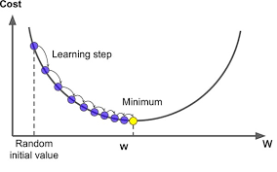
Description
Find the maximum of a Gaussian function in a 3D model
Initial measurement: gradient search

Slide 3
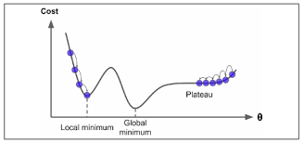
Challenge
Gradient search crashes in noisy Gaussian function
Noisy Gaussian contains two part: Gaussian, and random noise
Why?------local maximum

Slide 4
How to do?
Swarm intelligence
Optimizations on Gradient search
Reinforcement learning
Supervised learning
SA(simulated annealing)

Slide 5
Swarm intelligence
Particles are generated randomly over the whole domain
Particles will not only make contact with each other, but also move to a better position

Slide 6
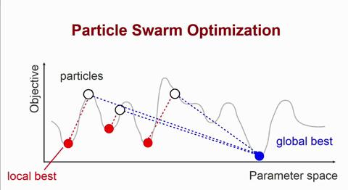
Why Swarm Intelligence works?
PSO could avoid local best
What’s more, PSO costs not too much.
Need at least 100 searches to get good performance even in noisy Gaussian function

Slide 7
PSO Code

Slide 8
Advantages and Disadvantages
Advantages:
PSO could search over whole domain and has a high precision even in noisy Gaussian
PSO have a higher robustness. More adaptable.
Disadvantages:
PSO needs camera to move. It might cost time
PSO is popular in CS last century. Not attractive in paper. (Although it works)

Slide 9
Optimizations on Gradient search
Let’s look back at the reason why Gradient search crash.
Stuck in local best!
We could change learning rate to let it jump out of local minimum

Slide 10
How to change learning rate?
Supervised:
Input: location( x, y, z), gradients history
Output: learning rate
Drawbacks:
one situation, one model. Not adaptable as PSO
Need to use Bayes, or we have to generate huge amount of training and test data.
Unsupervised:
Use CNN to find

Slide 11
Why we need Bayes
Process:
Let it search randomly to collect data
Split data into training and testing
Learn from training dataset and form model
Put the testing dataset into the model and get the maximum of test data
Assume the maximum is the maximum of the test data
Why it works?
The process of testing data doesn’t need any real operation, all on computer
Big problem. One situation, huge data
We need to use Bayes to change the dataset

Slide 12
CNN code

Slide 13
Reinforcement learning
Not complete
From DQN

Slide 14
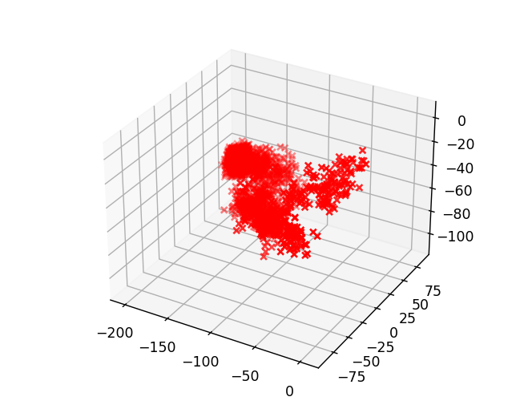
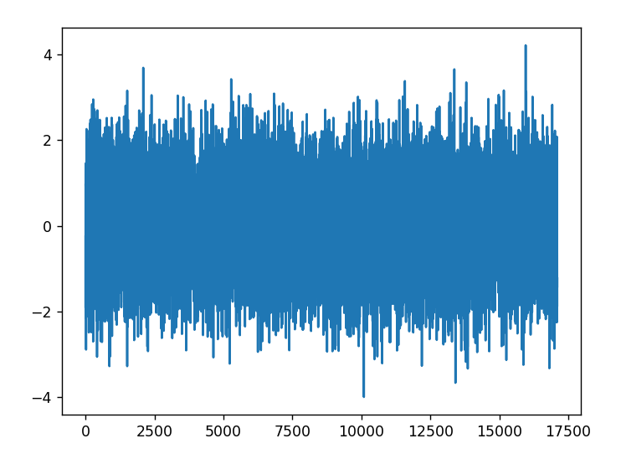
SA(simulated annealing)

