Slide 1


COMPUTER SCIENCE
XPath

Slide 2
COMPUTER SCIENCE
XPath is a language to navigate through the DOM tree of an XML document, to retrieve subtrees and single nodes.
Main use: Navigation for Stylesheet Transformations (see later)
The basic syntax uses paths from one node (preferrably the root node) to a particular node in the tree.

Slide 3
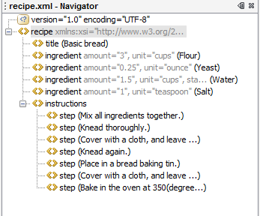
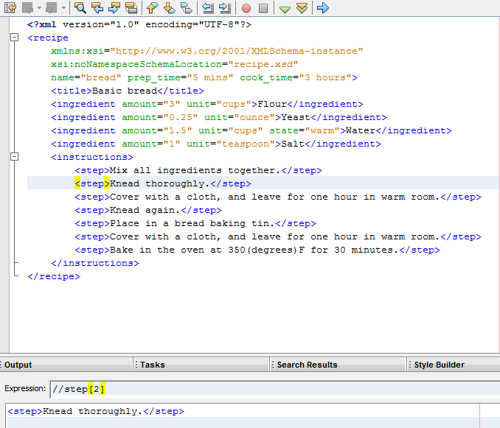
XPath in NetBeans
COMPUTER SCIENCE
Plugin available in eLearning!

Slide 4
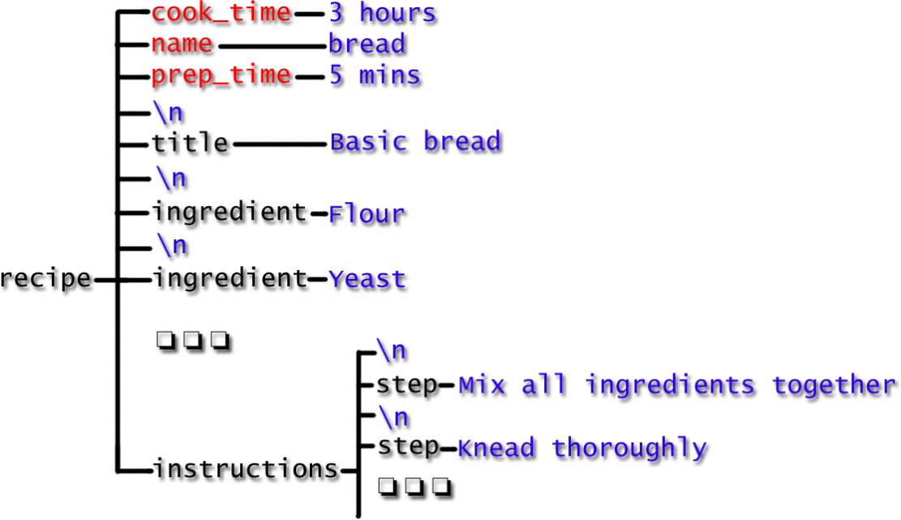
Based on the DOM tree
COMPUTER SCIENCE
Elements – black Attributes – red Text – blue

Slide 5
COMPUTER SCIENCE
Path
Main navigational element in XPath.
A sequence of opening tags that lead from the root element to the desired element node(s).
The result of evaluating an XPath expression is (mostly) a node set.
Paths are specified (a la unix) by enumerating the nodes on this path, separated by a “/”
/recipe
locates the recipe element, i. e. the whole DOM tree
/recipe/title
locates the title element: <title>Basic bread</title

Slide 6
COMPUTER SCIENCE
Element Locators: Double slash “//” locates all elements with a given name
More than one match: Accessed by index positions.
//ingredient
locates all ingredient elements
//ingredient[1]
locates the first ingredient element – And yes, numbering starts with 1!
//ingredient[last()]
locates the last ingredient element
//instructions/step[3]
locates the third step of the instructions “Cover with a cloth...”

Slide 7
COMPUTER SCIENCE
Attribute Locators: Ampersand “@” prefix and square brackets
//ingredient[@state="warm"]
locates all ingredients (ingredient elements!) with the state attribute having the value “warm”
//ingredient[@unit]
locates all ingredients with a unit attribute
//ingredient[@*]
locates all ingredients with any attribute
//*[@*]
locates WHAT?

Slide 8
COMPUTER SCIENCE
Attribute Locators: Ampersand “@” prefix and square brackets
//ingredient[@state="warm"]
locates all ingredients (ingredient elements!) with the state attribute having the value “warm”
//ingredient[@unit]
locates all ingredients with a unit attribute
//ingredient[@*]
locates all ingredients with any attribute
//*[@*]
locates WHAT?

Slide 9
Wildcards and union
COMPUTER SCIENCE
* any element node
@* any attribute node
node() any node whatsoever
Union of two node sets: |
//@amount | //step ???
@* | node() ???

Slide 10
COMPUTER SCIENCE
Axes: Select DOM tree nodes relative to a given element (not only by going down!).
AxisName Result
ancestor Selects all ancestors (parent, grandparent, etc.) of the current node
ancestor-or-self Selects all ancestors (parent, grandparent, etc.) of the current node and the
current node itself
attribute Selects all attributes of the current node
child Selects all children of the current node
descendant Selects all descendants (children, grandchildren, etc.) of the current node
descendant-or-self Selects all descendants (children, grandchildren, etc.) of the current node and the current node itself
following Selects everything in the document after the closing tag of the current node
following-sibling Selects all siblings after the current node
namespace Selects all namespace nodes of the current node
parent Selects the parent of the current node
preceding Selects everything in the document that is before the start tag of the current node
preceding-sibling Selects all siblings before the current node
self Selects the current node

