Slide 1


COMPUTER SCIENCE
DB-Based Systems:
Basics & SQL [deleted]
Transactions & Concurrency Control

Slide 2
COMPUTER SCIENCE
Transactions
DB operations lead the DB from one consistent state into another.
Why could this be tricky??

Slide 3
COMPUTER SCIENCE
The Need for Transactions 1
To transfer a given amount from one account to another, the software
Deducts the amount from one
account
Deposits this amount on the other
account

Slide 4
COMPUTER SCIENCE
The Need for Transactions 1
If these operations are not executed completely, the account balances are wrong!
Hardware Failure
Program Errors
Exceptions,
User intervention, ...

Slide 5
COMPUTER SCIENCE
The Need for Transactions 2
To deduct a given amount from an account, the software
Reads the old balance
Subtracts the deduction amount
Stores the balance back

Slide 6
COMPUTER SCIENCE
The Need for Transactions 2
Two users modify this account
independently -->
multiple outcomes

Slide 7
COMPUTER SCIENCE
Transaction principles:
Atomicity: All operations in the transaction are
performed or none at all
Consistency: If the DB is consistent before the
transaction is executed, it's also
consistent afterwards.
Isolation: Transactions can't see/modify the data of another transaction
Durability: If the transaction was executed
successfully, its effect is permanent.

Slide 8
COMPUTER SCIENCE
Operations
Read/write DB items
Begin transaction
Commit transaction
Abort transaction

Slide 9
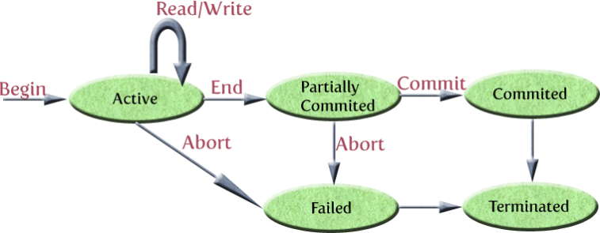
COMPUTER SCIENCE
Transaction Diagram

Slide 10
COMPUTER SCIENCE
What about “abort”?
Transaction is “rolled back”
Operations executed go into a log
On abort, they are undone from
this log

Slide 11
COMPUTER SCIENCE
Concurrency Control
More than one transaction accesses a DB item:
rn(x): transaction n reads the value of x
wn(x): transaction n writes a new value of x
abortn: transaction n is aborted
commitn: transaction n is committed

Slide 12
COMPUTER SCIENCE
Concurrency problems
Lost Update: r₁(x) → r₂(x) → w₁(x) → w₂(x)
T₁ and T₂ read the same value, T₁ writes the modified value back first, then T₂ – the update made by T₁ is lost.
Unrepeatable Read: r₁(x) → r₂(x) → w₂(x) → r₁(x)
T₁ and T₂ read the same value, T₂ writes the modified value back and T₁ – assuming it could just read the old value back - reads the new value instead.
Dirty Read: r₁(x) → w₁(x) → r₂(x) → abort₁
T₁ stores a value in the database and later aborts (and rolls back); in the meantime T₂ reads this invalid value.

Slide 13
COMPUTER SCIENCE
Locking
Keep another transaction from accessing the same DB item
Read (“shared”) or write (“exclusive”) locks

Slide 14
COMPUTER SCIENCE
Lock policy:
1. A transaction must set a read (write) lock on x before
executing a read (write) operation on x.
2. A transaction must not lock an item twice.
3. A transaction must unlock x after all read/write
operations on x are performed.
4. A transaction will only unlock items it has locked
before.

Slide 15
COMPUTER SCIENCE
Locking procedure
If a transaction holds a read lock on an item, other
transactions can acquire a read lock for this item,
but no write lock.
If a transaction holds a write lock on an item no
other transaction can acquire a lock on it, neither
read or write.

Slide 16
COMPUTER SCIENCE
But still...
A transaction can release a lock “too early” (see notes)
Generally:
No lock after the first unlock!

Slide 17
COMPUTER SCIENCE
Two-Phase Lock Protocol (2PL)
All locking operations (either read or write) must precede the first unlock operation.
Two Phases:
1. Acquire all locks: Number of locks increases
2. Release all locks: Number of locks decreases

Slide 18
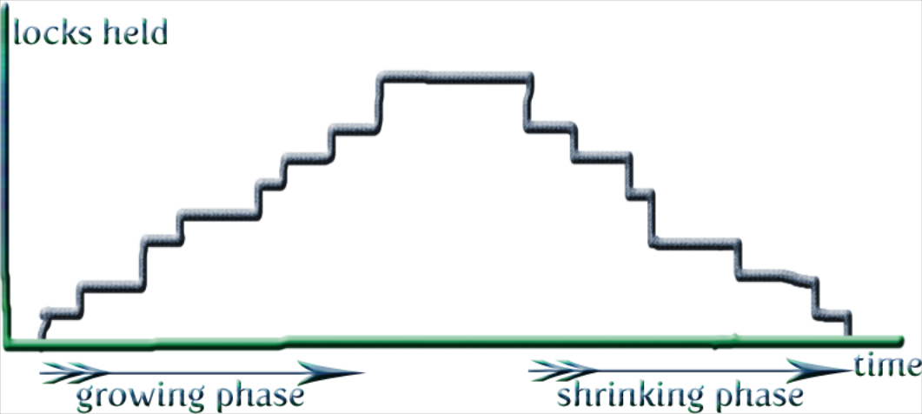
COMPUTER SCIENCE
2PL in action

Slide 19
COMPUTER SCIENCE
Deadlocks
Two transactions are waiting for each other because one transaction has to release a lock the other one wants to acquire and vice versa.
Avoidance is Costly
Detection & removal in modern DBMS

Slide 20
COMPUTER SCIENCE
Starvation
A transaction might have to wait for a lock for an indefinite amount of time, while other transactions are processed normally.
→ DBMS Scheduling algorithms

Slide 21
COMPUTER SCIENCE
P1 P2
Lock A Lock B
Lock B Lock A
Unlock A&B Unlock A&B

