Slide 1


COMPUTER SCIENCE
Part 1: XML

Slide 2
COMPUTER SCIENCE
XML?
XML: an acronym for eXtensible Markup Language
XML is NOT a language!
XML is a metalanguage used to write other languages
These other languages are called XML vocabularies
XML is a recommendation of the World Wide Web
Consortium (W3C)
It is a general means for representing structured data

Slide 3
Brief History
COMPUTER SCIENCE
XML came into being in 1998
It is based upon SGML (Standard Generalized Markup Language)
XML owes much of its existence to SGML's
complexity and to HTML
XML is meant to address many of the shortcomings of HTML
XHTML is an XML vocabulary specifying more precise rules for web page markup (now superseded by HMTL 5)

Slide 4
Goals of XML
COMPUTER SCIENCE
Easy to use across platforms and machines
Supports a variety of applications
Designed to make it easy to write programs to parse XML documents
Minimize optional features (optimally none)
XML documents should be human-readable
XML documents should be easy to create
Terseness is not a goal

Slide 5
XML as a “language”
COMPUTER SCIENCE
XML documents carry no meaning at all. This is probably the most important idea; any meaning ascribed to an XML document rests solely in the application that works on it. All there is to an XML document are the concepts of “well-formedness” and “validity”.
XML defines just a flexible and non-committing syntactical framework. It was the goal of the XML development to not specify any committing implementation aspects for XML constructs. This is most obvious in the very abstract – but very flexible – notions of URIs and Namespaces.

Slide 6
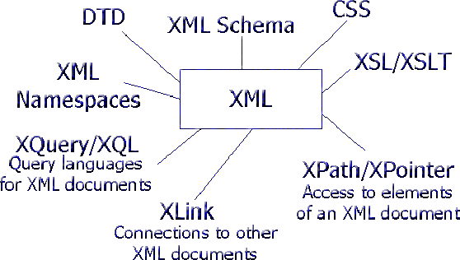
XML: More than just XML
COMPUTER SCIENCE

Slide 7
XML Syntax
COMPUTER SCIENCE
Documents must be well-formed – adhering to a clearly specified syntax
Well-formed document – an document adhering to the specified format
A means to specify content and to validate correctness of documents are available.

Slide 8
An Example XML Document
COMPUTER SCIENCE
<?xml version="1.0" encoding="UTF-8" ?>
<!-- This XML document describes a DVD library -->
<library>
<dvd id="1">
<title>Breakfast at Tiffany's</title>
<format>Movie</format>
<genre>Classic</genre>
</dvd>
<dvd id="2">
<title>Contact</title>
<format>Movie</format>
<genre>Science fiction</genre>
</dvd>
<dvd id="3">
<title>Little Britain</title>
<format>TV Series</format>
<genre>Comedy</genre>
</dvd>
</library>

Slide 9
COMPUTER SCIENCE
<recipe name="bread" prep_time="5 mins" cook_time="3 hours">
<title>Basic bread</title>
<ingredient amount="3" unit="cups">Flour</ingredient>
<ingredient amount="0.25" unit="ounce">Yeast</ingredient>
<ingredient amount="1.5" unit="cups"
state="warm">Water</ingredient>
<ingredient amount="1" unit="teaspoon">Salt</ingredient>
<instructions>
<step>Mix all ingredients together.</step>
<step>Knead thoroughly.</step>
<step>Cover with a cloth, and leave for one hour in warm
room.</step>
<step>Knead again.</step>
<step>Place in a bread baking tin.</step>
<step>Cover with a cloth, and leave for one hour in warm
room.</step>
<step>Bake in the oven at 350(degrees)F for 30 minutes.</step>
</instructions>
</recipe>

Slide 10
Well-formed Documents
COMPUTER SCIENCE
Contain one or more elements
Contain a single document element which might contain other elements (root)
Each element closes correctly
Elements are case-sensitive
Elements may include attributes
Attribute values are enclosed in quotation marks and cannot be empty

Slide 11
Tags vs. Elements
COMPUTER SCIENCE
Start tag End tag
<format>Movie</format>
Element

Slide 12
Tags vs. Elements
COMPUTER SCIENCE
A tag: <atag>
An element:
<atag attribute="1"> other text <tag2>more</tag2> </atag>
Sections of an element
- open and close tags
- may be empty <emptyone/>
- may only have text
- may contain child elements
- may contain attributes (complex elements)
= CDATA (Character Data):
<title><!CDATA[ the cdata 8 < 10 ]</title>
= Entities:
&amp; &nbsp; &apos; &q

Slide 13
XML Document Structure:
COMPUTER SCIENCE
Prolog
  - XML declaration
  - comments
  - processing instructions
  - DTDs or XML Schemas
Body
  - root element
  - elements
  - attributes
  - text
  - CDATA, PCDATA
  - Entities
  - Comments

Slide 14
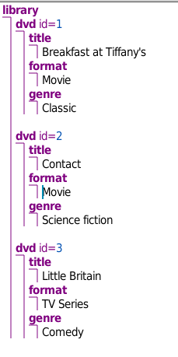
COMPUTER SCIENCE
Document Data Structure
Document Object Model Tree
DOM Tree
Produced with Amaya @ http://www.w3.org/Amaya/

Slide 15
Some XML Vocabularies
COMPUTER SCIENCE
- XHTML – rigorously specified version of html
- MathML – for mathematical expressions, symbols
- SVG – Scalable Vector Graphics (the name says it all)
- ADML - Architecture Description Markup Language
- CML - Chemical Markup Language
- CPXe - Common Picture Exchange Environment
- ebXML - Electronic Business XML
- FITSML - Flexible Image Transport System Markup Language
- MDDL - Market Data Definition Language
- SMIL - Synchronized Multimedia Integration Language
- XBRL - Extensible Business Reporting language
- SOAP – just SOAP now
- BPEL – Business Process Exe

Slide 16
Other Aspects of XML
COMPUTER SCIENCE
Names
  - no spaces
  - start with letter
  - can't have colon
  case-sensitive
  Also camelCase
Processing Instructions (PIs):
  <?xml-stylesheet type="text/xsl" href="stylesheetl.xsl"?>
Comments
  <-- a comment -->

Slide 17
COMPUTER SCIENCE
Summary
XML provides a platform-independent means to represent and structure information that is to be moved around between machines.
It is general purpose, although hierarchical (this fact has implications for connections to relational databases)
It cleanly separates content from presentation in web browsers
It is very broadly used in many different applications
It is verbose and has competitors (→ JSON)

Slide 18
COMPUTER SCIENCE

