Slide 1


COMPUTER SCIENCE
Java DB Connectivity
Via JDBC
Via ORM and JPA

Slide 2
COMPUTER SCIENCE
JDBC
Java Database Connectivity
Connect a Java program to a RDB
Implemented as a JAVA API
Uses java.sql package

Slide 3
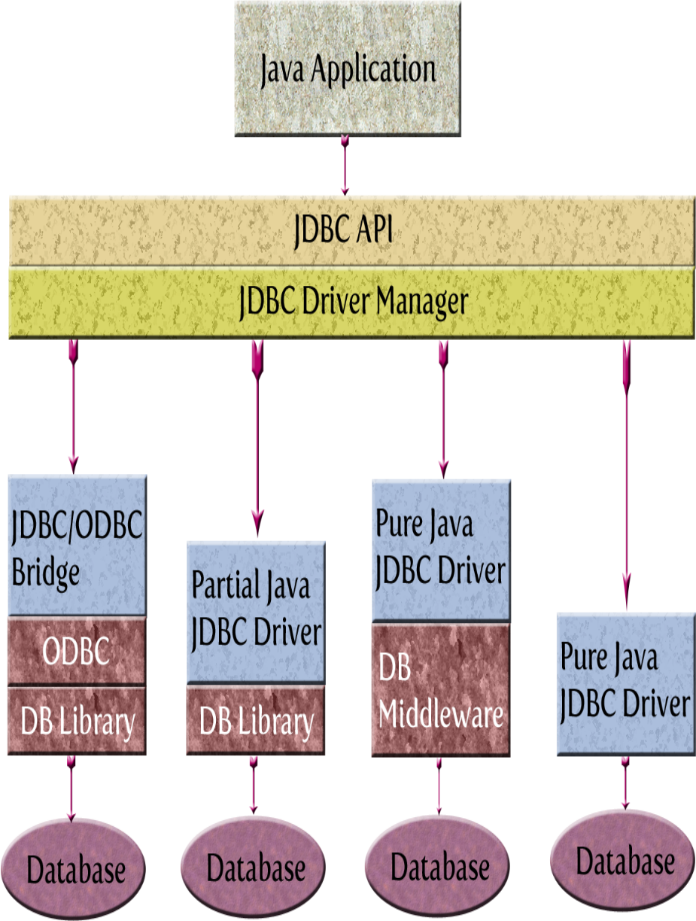
COMPUTER SCIENCE
JDBC
Type 1 Type 2 Type 3 Type 4

Slide 4
COMPUTER SCIENCE
Programming with JDBC
Assuming, you have a DB...
1. Find the correct driver for your database
system.
2. Set up a connection to a particular database.
3. Execute a series of SQL statements.
4. Close the connection (and whatever else might be open.

Slide 5
COMPUTER SCIENCE
Important JDBC classes/interfaces
Interface Driver
Class DriverManager
Interface Connection
Interface Statement
Interface ResultSet
Class SQLException
Interface PreparedStatement

Slide 6
COMPUTER SCIENCE
So many interfaces, so little classes!
Implementations are DB/platform
dependent!
Will be provided dynamically!
Programmer should not be concerned!

Slide 7
COMPUTER SCIENCE
JDBC Drivers
Implement java.sql.Driver
For MySQL: com.mysql.cj.jdbc.Driver
Distribution:
  As stand-alone .jar
  Via maven

Slide 8
COMPUTER SCIENCE
MySQL JDBC Driver (maven)
<dependency>
<groupId>mysql</groupId>
<artifactId>mysql-connector-java</artifactId>
<version>8.0.17</version>
</dependency>

Slide 9
COMPUTER SCIENCE
The DriverManager class
Keeps a (static) list of driver instances
A specific class implementing
java.sql.Driver places an instance
into this list (“register a driver”)
Receives a DB URL
Returns a Connection instance using
the appropriate driver (instance)

Slide 10
COMPUTER SCIENCE
Registering the MySQL driver
try {
Class.forName(“com.mysql.cj.jdbc.Driver”);
} catch (ClassNotFoundException e) { ... }

Slide 11
COMPUTER SCIENCE
JDBC Database URLs
jdbc:subprotocol:description
jdbc:mysql://host:port/db?
user=xxxx&password=yyyy

Slide 12
COMPUTER SCIENCE
Obtaining a Connection instance
import java.sql.Connection;
...
String dbURL = “jdbc:mysql://localhost:3306/library?user=user1&password=user1pw”;
try {
Connection conn =
DriverManager.getConnection(dbURL);
...
} catch (SQLException e) {...}

Slide 13
COMPUTER SCIENCE
The Statement interface
Represents an SQL statement
Is created by a Connection instance
Can execute queries
Returns query results
Can execute updates
Returns confirmation

Slide 14
COMPUTER SCIENCE
Statement methods
executeQuery(String sqlStatement)
returning a ResultSet instance
executeUpdate(String sqlStatement)
returning an int; the sqlStatement
arguments could be an INSERT, UPDATE or DELETE statement or a DDL statement.

Slide 15
COMPUTER SCIENCE
Statement example
Statement stmt = conn.createStatement();
ResultSet rs = stmt.executeQuery
("SELECT * from Student");

Slide 16
COMPUTER SCIENCE
ResultSets are used to give access to the result of the query:
“A ResultSet object maintains a cursor pointing to its current row of data. Initially the cursor is positioned before the first row. The next method moves the cursor to the next row, and because it returns false when there are no more rows in the ResultSet object, it can be used in a while loop to iterate through the result set.”
[http://java.sun.com/j2se/1.4.2/docs/api/java/sql/ResultSet.html]

Slide 17
COMPUTER SCIENCE
getXYZ methods access attribute values in a row
columns are accessed by attribute name or column number
while (rs.next()) {
System.out.print(rs.getInt("StudentID")); System.out.print(" " +
rs.getString("Name"));
System.out.print(" " + rs.getString(3)); System.out.print(" " + rs.getInt(4)); System.out.println(" " +
rs.getString(“Major));
}

Slide 18
COMPUTER SCIENCE
Producing a list of books and who borrowed them:
rs = stmt.executeQuery("SELECT CatalogNumber, Title, UwfID, Name
FROM Book, Student
WHERE Book.BorrowerID = Student.StudentID");
while (rs.next()) {
System.out.print(rs.getString(1));
System.out.print(" " + rs.getString(2));
System.out.print(" " + rs.getString(3));
System.out.println(" " + rs.getString(4));
}

Slide 19
COMPUTER SCIENCE
Result:
TK4412 War and Peace 555-19224 Jane Doe

Slide 20
COMPUTER SCIENCE
Updates and transactions
Example:
Look up a student by name
Looks up a book by catalog number
Place the StudentID of this student as a foreign key
into the BorrowerID column of the book

Slide 21
COMPUTER SCIENCE
Also:
Provide Exception classes
Provide Transaction protection

Slide 22
COMPUTER SCIENCE
private static void borrowBook(Connection conn,
String studentName, String catNum)
throws SQLException,
StudentNotFoundException,
BookNotFoundException {
conn.setAutoCommit(false); // BEGIN transaction
Statement stmt = conn.createStatement();
// Grab the ID (primary key) of the student with the given name
ResultSet rs = stmt.executeQuery(
"SELECT StudentID from Student ” +
“WHERE Name = \"" + studentName + "\"");
// Is there such a student?
if (!rs.next()) { // Nope! Do something sensible...
conn.rollback(); // like rolling back and throwing
conn.setAutoCommit(true); // an exception
throw new StudentNotFoundException("Student name " +
studentName + " not found");
}

Slide 23
COMPUTER SCIENCE
// Update the foreign key in the Book relation
int rowsAffected = stmt.executeUpdate(
"UPDATE Book" +
" SET BorrowerId = " + rs.getString(1) +
" WHERE CatalogNumber = \"" + catNum + "\"");
// Did it work?
if (rowsAffected == 0) { // Nope! Not our day, it seems...
conn.rollback();
conn.setAutoCommit(true);
throw new BookNotFoundException("Book catalogNumber " +
catNum + " not found");
}
// Gotcha!
conn.commit();
}

Slide 24
COMPUTER SCIENCE
Prepared Statements:
Are “pre-optimzed” for fast execution
Need parameters to run
Good for repeated similar queries

Slide 25
COMPUTER SCIENCE
ResultSet rs = stmt.executeQuery(
"SELECT StudentID from Student " +
"WHERE Name = \"" + studentName + "\"");
becomes
PreparedStatement pStmt =
conn.prepareStatement(
"SELECT StudentId from
Student WHERE Name = ?");
pStmt.setString(1,studentName);
ResultSet rs = pStmt.executeQuery();

Slide 26
COMPUTER SCIENCE
int rowsAffected = stmt.executeUpdate(
"UPDATE Book" +
" SET BorrowerId = " + rs.getString(1) +
" WHERE CatalogNumber = \"" + catNum + "\"");
becomes
pStmt = conn.prepareStatement(
"UPDATE Book SET BorrowerId = ?
WHERE CatalogNumber = ?");
pStmt.setString(1,rs.getString(1));
pStmt.setString(2,catNum);
int rowsAffected = pStmt.executeUpdate();

