Slide 1


COMPUTER SCIENCE
Technology 1: Maven
Assumption: Some familiarity with
  Build tools (make, ant)
  Java packages
  Jar files (?)

Slide 2
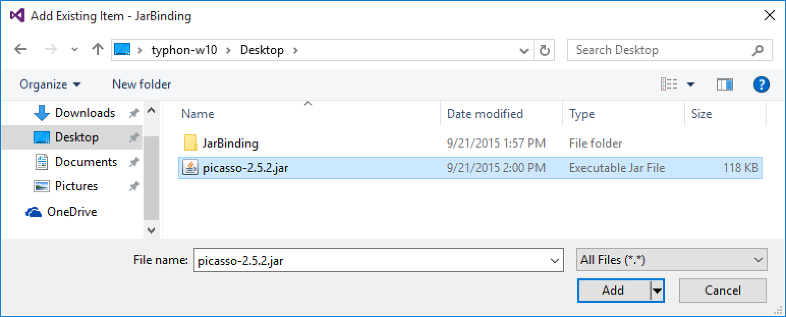
COMPUTER SCIENCE
JAR files
A JAR (Java ARchive) is a package file format typically used to aggregate many Java class files and associated metadata and resources (text, images, etc.) into one file for distribution. – Wikipedia

Slide 3
COMPUTER SCIENCE
JAR files
Main use: Supply Java classes (mostly) to be used as third-party software in a Java project.
Also: All packaged Java RT libraries are supplied as one or more JARs.

Slide 4
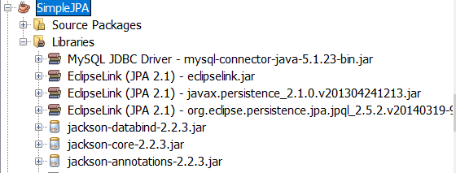
COMPUTER SCIENCE
JAR files
Problem: Mixing different libraries requires a lot of (matching) JARs.
MySQL JDBC
EclipseLink JPA
Jackson JSON API

Slide 5

COMPUTER SCIENCE
→ JAR Hell
Jars needed for
compiling
running
Jars are missing
One Jar too many
a class is not visible where it should be

Slide 6
COMPUTER SCIENCE
→ Dependency Management
Dependency management is a technique for declaring, resolving and using dependencies required by the project in an automated fashion – gradle.org

Slide 7
COMPUTER SCIENCE
Candidates specific to Java
Gradle & Maven
https://dzone.com/articles/gradle-vs-maven
Why Maven here? More uniform availability over platforms, IDEs, artifacts and versions, but this will disappear in time.

Slide 8

COMPUTER SCIENCE
Apache Maven
Project in ASF: https://maven.apache.org/
Maven allows a project to build using its project object model (POM) and a set of plugins that are shared by all projects using Maven, providing a uniform build system. – Apache Maven

Slide 9
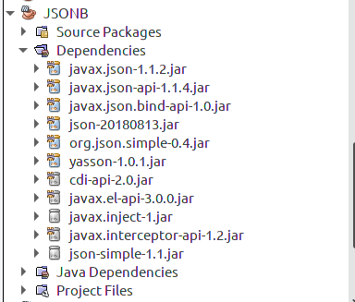
COMPUTER SCIENCE
Use of Maven
Over CLI: pretty flexible
IDE integration:
both Eclipse and NB

Slide 10
COMPUTER SCIENCE
Idea (simplified)
Project contains a description of dependencies
During the build phase:
Maven checks a local repository for present JARs (mostly)
If a dependency isn’t local the global
Maven repo is contacted and the dependency is downloaded

Slide 11
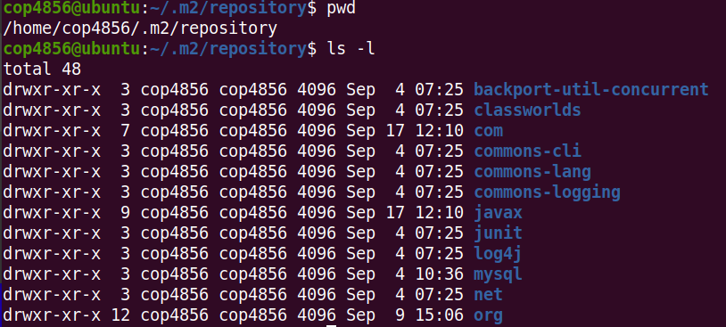
COMPUTER SCIENCE
Local Maven repo (usually ~/.m2)

Slide 12
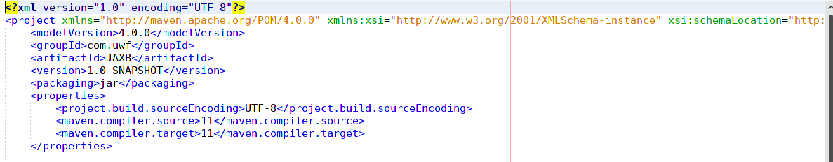
COMPUTER SCIENCE
POM (Project Object Model)
Part one: General project properties

Slide 13
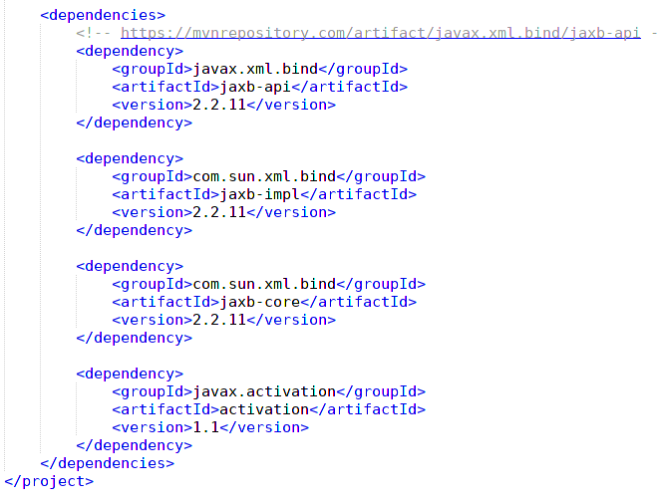
COMPUTER SCIENCE
POM (Project Object Model)
Part two:
Dependencies
Finding dependencies
is a little easier than
finding all JARs

