Slide 1


COMPUTER SCIENCE
Part 4: Web-based Systems
3-Tier Architecture
Servers, http, ...
Servlets
(Java Server Pages)
(Java Server Faces)

Slide 2
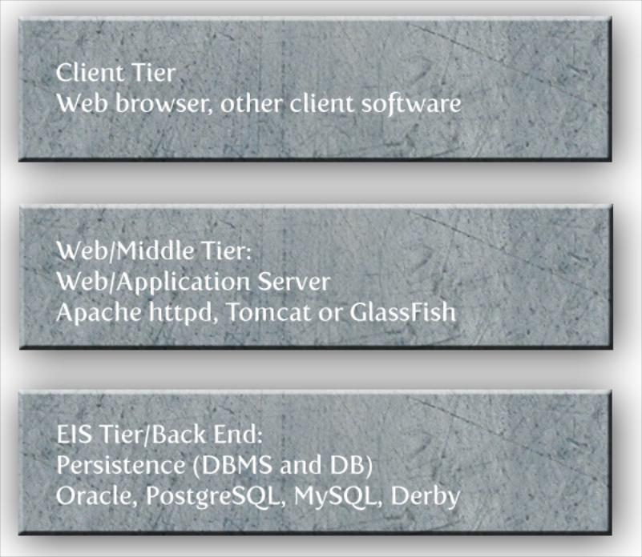
COMPUTER SCIENCE
3-Tier Architecture

Slide 3
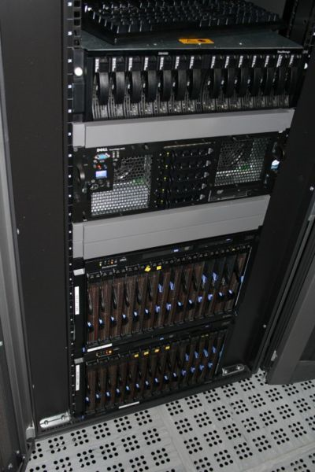
COMPUTER SCIENCE
Web Servers
Static content (mostly)
depending on MIME type
Running server software
Apache httpd, MS IIS, ...
In general: port 80

Slide 4
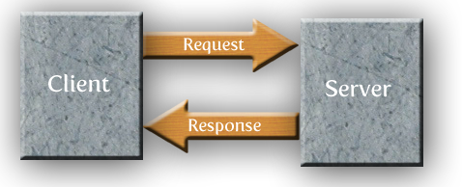
COMPUTER SCIENCE
Client/Server Communication
Client requests a service – i. e. a document
Server responds with the result or an error

Slide 5
COMPUTER SCIENCE
Finding Things...
How can a client describe a resource?
URIs(, URNs) and URLs!

Slide 6
COMPUTER SCIENCE
URI (Uniform Resource Identifier)
Source: RFC 2396
RFC? Request for Comments (IETF/W3C).
Description of a mostly technical issue
– normative (standard) or non-normative.
See RFC 2026.
Idea: Identify any (!) kind of resource on a network

Slide 7
COMPUTER SCIENCE
More about URIs [RFC 2396]
General syntax:
<scheme>:<scheme-specific-part>
More frequently
<scheme>://<authority><path>?<query>

Slide 8
COMPUTER SCIENCE
Examples for general syntax
urn:issn:1535-3613
rdfs:ConstraintResource
tel:+1-816-555-1212
Examples for specific syntax
http://www.example.org
jdbc:mysql://...
feed:https://example.com/rss.xml

Slide 9
COMPUTER SCIENCE
URI schemes --> Wikipedia/IANA
about, dns, fax, feed, file, ftp, gopher, (s)http(s), mailto, file, news, nfs, nmtp, pop, secondlife, telnet, ...
Technically:
Not even a need to consider a networked
environment!
URIs could serve as general identifiers
--> RDF

Slide 10
COMPUTER SCIENCE
URLs: URIs which also tell you where this resource is!
"...a URL is a type of URI that identifies a resource via a representation of its primary access mechanism (e.g., its network "location"), rather than by some other attributes it may have. Thus as we noted, "http:" is a URI scheme. An http URI is a URL. The phrase "URL scheme" is now used infrequently, usually to refer to some subclass of URI schemes..."
[http://www.w3.org/TR/uri-clarification/]

Slide 11
COMPUTER SCIENCE
URLs: URIs which also tell you where this resource is!
foo://example.com:8042/over/there?name=ferret#nose
\_/ \______________/\_________/ \_________/ \__/
| | | | |
scheme authority path query fragment
| _____________________|__
/ \ / \
urn:example:animal:ferret:nose
[RFC 3986]

Slide 12
COMPUTER SCIENCE
The Query String
Used to transmit more information from the client to the server
Example: Form fields (name + value)
User/Session identification
http://server/path/program?field1=value1&field2=value2&...

Slide 13
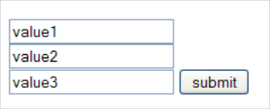
COMPUTER SCIENCE
GET vs. POST
Assume an HTML form:
Input values must be transmitted to the server – maybe after local “client-side” testing...
Client-side example needed?

Slide 14
COMPUTER SCIENCE
Parameter transfer via GET
“URL encoded” using the query string:
http://path?param1=value1&param2=value2&...
Pro: Can be entered manually into the browser
Can be bookmarked
Con: Information is visible
Can be manipulated/modified (security/stability!)

Slide 15
COMPUTER SCIENCE
Parameter transfer via POST
“URL encoded” in the message body
http://path...
param1=value1&param2=value2&...
Pro: Information invisible
Difficult to modify
Con: No chance to bookmark it

Slide 16
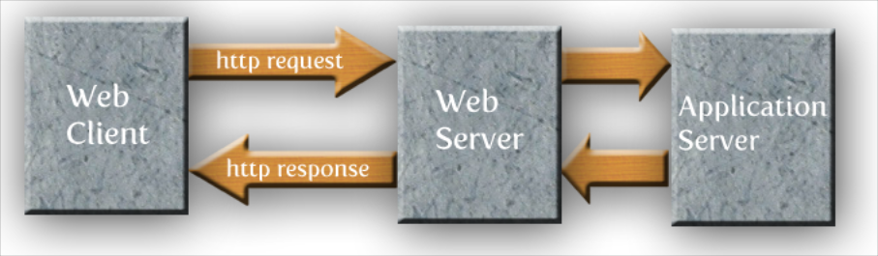
COMPUTER SCIENCE
Middle Tier revisited
For Dynamic Web Applications: Another server type required

Slide 17
COMPUTER SCIENCE
Application Servers
Incorporate
Run-time platform (e. g. Java EE, .NET,...)
Web connectivity: Servlets, JSP
JCA (Java Connector Architecture)
  DB connectivity, Transactions, ...
JMS (Java Messaging Service)
EJB (Enterprise Java Beans)

Slide 18
COMPUTER SCIENCE
Why Web Servers at all?
Application Servers can deliver static content – true!
For high-load web sites, ASs are simply overkill!
http server can do this much better

Slide 19
COMPUTER SCIENCE
Coexistence between Web and App Servers
App Servers use a different port than the Web Server!
Requests for the Web Server are directed to it via the port number.
Same for App Server requests!

Slide 20
COMPUTER SCIENCE
The common architecture
The Web Server “fronts”
the App Server
Serves static requests
Directs specific requests to the App Server

Slide 21
COMPUTER SCIENCE
J2EE Application Servers
[http://en.wikipedia.org/wiki/Application_server#Java_application_servers]
WebLogic (Oracle)
JBoss (Red Hat)
WebSphere (IBM)
Apache Geronimo & TomEE (Apache Software Foundation)
Glassfish (Oracle)
Payara (Glassfish fork)

