Slide 1


COMPUTER SCIENCE
Injection Attacks
The #1 vulnerablity for DB applications
Based on careless use of SQL statements
Functioning by incorporating malicious SQL code
into input fields → Change in semantics!

Slide 2
COMPUTER SCIENCE
Injection Attacks
Trivial Example: Password check 1
CREATE DATABASE IF NOT EXISTS Users;
USE Users;
DROP TABLE IF EXISTS Users;
CREATE TABLE Users (
Id INTEGER UNSIGNED NOT NULL,
UName VARCHAR(45) NOT NULL,
Passwd VARCHAR(45) NOT NULL,
PRIMARY KEY (Id)
);
INSERT INTO Users VALUES (1,"Paul","pass");
INSERT INTO Users VALUES (2,"Ringo","s3cr3t");

Slide 3
COMPUTER SCIENCE
Injection Attacks
Trivial Example: Password check 2
public static boolean validate(String user, String password) {
...
try {
String sql = "SELECT * from Users WHERE Uname = \"" + user + "\" AND
Passwd = \"" + password + "\"";
rs = stmt.executeQuery(sql);
if (rs.next()) {
return true;
}
} catch (Exception ex) {
return false;
}
return false;
}
}

Slide 4
COMPUTER SCIENCE
Injection Attacks
Trivial Example: Password check 3
Password.validate("Ringo","s3cr3t");
→ SELECT * from Users WHERE UName = "Ringo" AND Passwd = "s3cr3t"
Returns true
// Assume both inputs " or ""="
String inject = "\" or \"\"=\"";
Password.validate(inject,inject);
→ SELECT * from Users WHERE Uname = "" or ""="" AND Passwd = "" or ""=""
true

Slide 5
COMPUTER SCIENCE
Injection Attacks
SELECT * from Users WHERE UName = "" or ""="" AND Passwd = "" or ""=""
| | | |
F T F T
\ / \ /
T T
→ NEVER FAILS!

Slide 6
COMPUTER SCIENCE
Injection Attacks
SQL injection is a code injection technique, used to attack data-driven applications, in which nefarious SQL statements are inserted into an entry field for execution [...] SQL injection must exploit a security vulnerability in an application's software, for example, when user input is either incorrectly filtered for string literal escape characters embedded in SQL statements or user input is not strongly typed and unexpectedly executed. SQL injection is mostly known as an attack vector for websites but can be used to attack any type of SQL database.
SQL injection attacks allow attackers to spoof identity, tamper with existing data, cause repudiation issues such as voiding transactions or changing balances, allow the complete disclosure of all data on the system, destroy the data or make it otherwise unavailable, and become administrators of the database server. [Wikipedia]

Slide 7
COMPUTER SCIENCE
Injection Attacks
It can get worse...
String sql = "SELECT * from Users WHERE Uname = \"" + user +"\" AND Passwd = \"" + password + "\"";
ResultSet rs = stmt.executeQuery(sql);
if (rs.next()) {
// The second attribute is the user name
// Generally used to establish identity
// Injection: it’s the first coming back from the DB
return true;
}
} catch (ClassNotFoundException ex) {

Slide 8
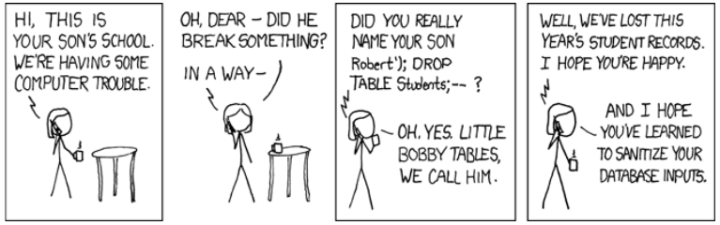
COMPUTER SCIENCE
Injection Attacks
https://xkcd.com/327/
User name: Robert\"; DROP TABLE USERS; -- ← Space at the end!
Password: pass
→ SELECT * from Users WHERE Uname = "Robert"; DROP TABLE USERS; -- " AND Passwd = "pass"

Slide 9
COMPUTER SCIENCE
Injection Attacks
Defense methods 1
String sanitizing
= Remove/reject spaces, quotes, …
= Escaping dangerous symbols, esp “”
“foo” → \”foo\”

Slide 10
COMPUTER SCIENCE
Injection Attacks
Defense 2: Prepared Statements (recommended)
Just be clear: USE PREPARED STATEMENTS!
BEST FORGET ABOUT EVERYTHING ELSE!
In database management systems (DBMS), a prepared statement or parameterized statement is a feature used to execute the same or similar database statements repeatedly with high efficiency.
Typically used with SQL statements such as queries or updates, the prepared statement takes the form of a template into which certain constant values are substituted during each execution.

Slide 11
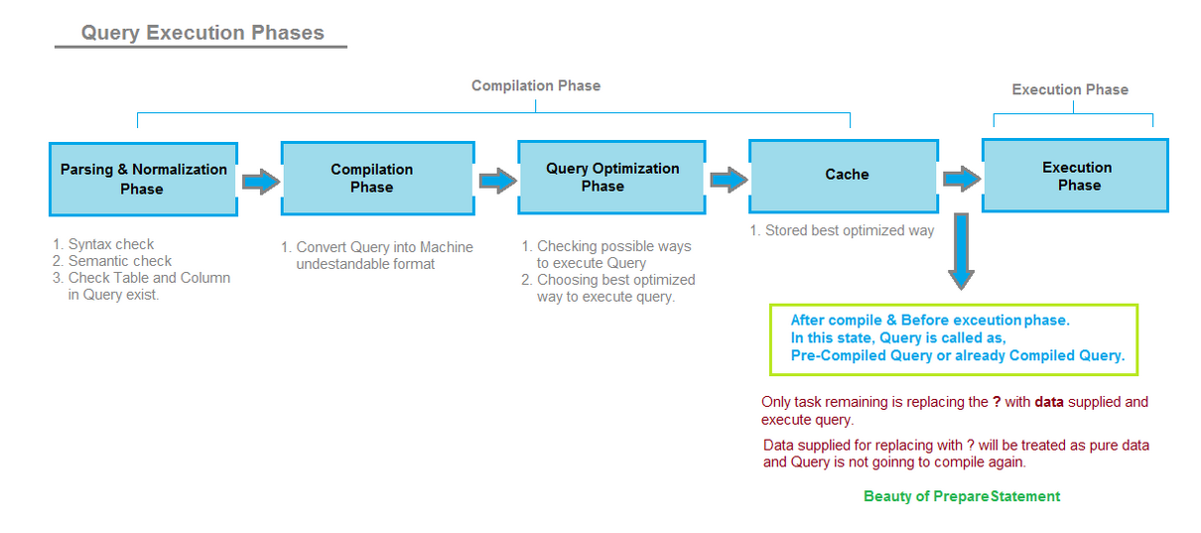
COMPUTER SCIENCE
Prepared Statements

Slide 12
COMPUTER SCIENCE
Why Prepared Statements?
1. Efficiency of repeated operations
2. Protection against SQL Injection (if done right!)
User data cannot change the semantics of the
compiled SQL statement.

Slide 13
COMPUTER SCIENCE
Injection Attacks
Defense 2: Prepared Statements (recommended)
PreparedStatement pstmt = null;
try {
String sql = "SELECT * from Users WHERE Uname = ? AND Passwd = ?";
pstmt = conn.prepareStatement(sql);
pstmt.setString(1, user);
pstmt.setString(2, password);
rs = pstmt.executeQuery();
if (rs.next()) {
return true;
}
} catch (Exception ex) {
return false;
}
return false;

Slide 14
COMPUTER SCIENCE
Injection Attacks
Executing a SQL Injection Attack
Requires knowledge about the structure of the SQL Query
Can be obtained experimentally by studying the behavior of the program,
especially results and error messages (DB “fingerprinting”)
Demonstrated: https://www.youtube.com/watch?v=ciNHn38EyRc

