Slide 1
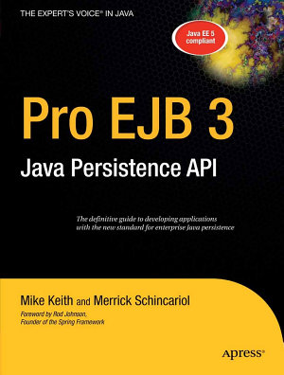
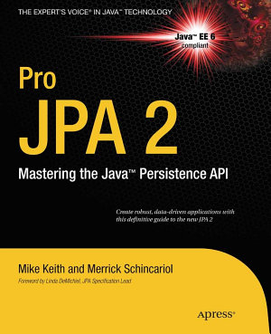
ORM & JPA
Considerations

Slide 2
JDBC
Essentially “procedural”
API is portable
SQL is not
SQL can be attacked (SQL injection)
Use prepared statements!
Embedding into OO architecture?
Pedestrian
Lots of “boilerplate” code

Slide 3
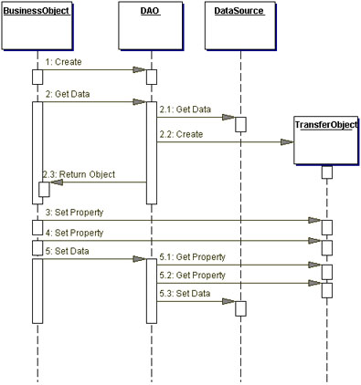
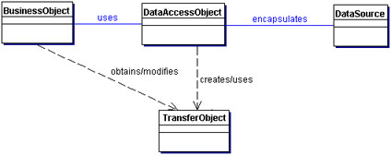
Alternatives 1
Data Access Objects (DAOs)
A “Design Pattern”

Slide 4
Alternatives 2
Java Data Objects (JDOs)
POJOs made “persistable” by an external process
A special class deals with the persistence
Requires “Object-Relational Mapping” ORM

Slide 5
ORM
Ideas
1. The domain model has classes
2. The DB has tables
3. They look pretty similar
4. Shouldn't be an issue

Slide 6
ORM
Principles
Objects, not tables. Applications should be written in terms of the domain model and not be bound to the relational model. It must be possible to operate on and query against the domain model without having to express it in the relational language of tables, columns, and foreign keys.
[Mike Keith, Merrick Schincariol: Pro EJB 3: Java Persistence API, APress, 2006]

Slide 7
ORM
Principles
Legacy data, new objects. It is far more likely that an application will target an existing relational database schema instead of creating a new one. Support for legacy schemas is one of the most relevant use cases that will arise, and it is quite possible that such databases will outlive every one of us.
[Mike Keith, Merrick Schincariol: Pro EJB 3: Java Persistence API, APress, 2006]

Slide 8
ORM
Principles
Local, but mobile. A persistent representation of data does not need to be modeled as a full-fledged remote object. Distribution is something that exists as part of the application, not part of the persistence layer. The entities that contain the persistent state, however, must be able to travel to whichever layer needs them.
[Mike Keith, Merrick Schincariol: Pro EJB 3: Java Persistence API, APress, 2006]

Slide 9
ORM: Impedance Mismatch
The primitives modeling the DB and the primitives modeling the domain might not be compatible!

Slide 10
ORM: Impedance Mismatch public class Employee { private int id; private String name; private Date startDate; private long salary;
}

Slide 11
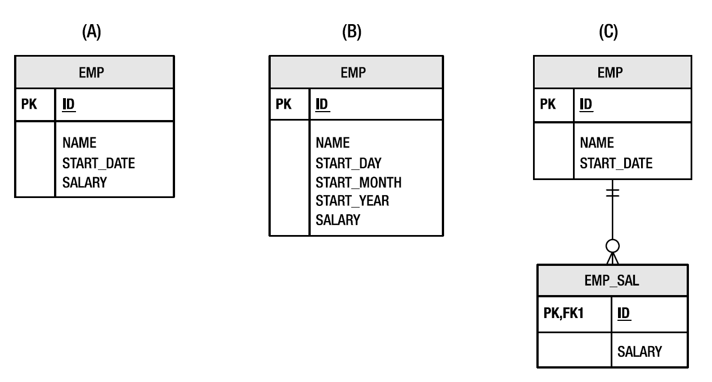
ORM: Impedance Mismatch

Slide 12
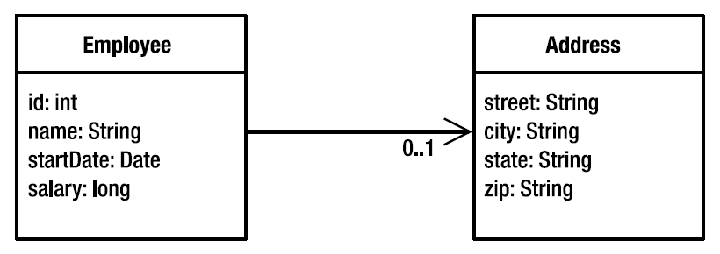
ORM: Impedance Mismatch

Slide 13
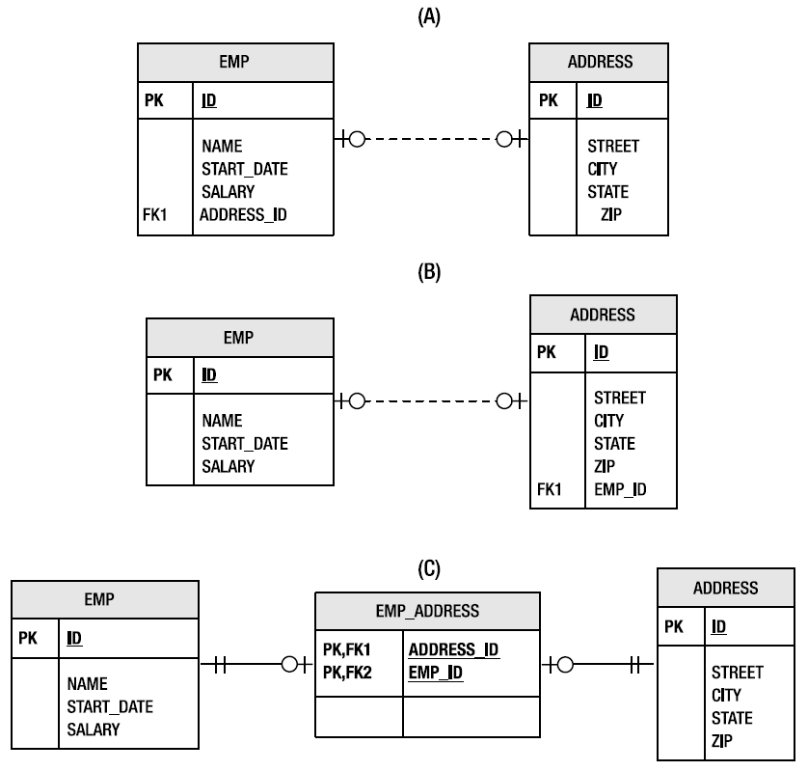
ORM: Impedance Mismatch

Slide 14
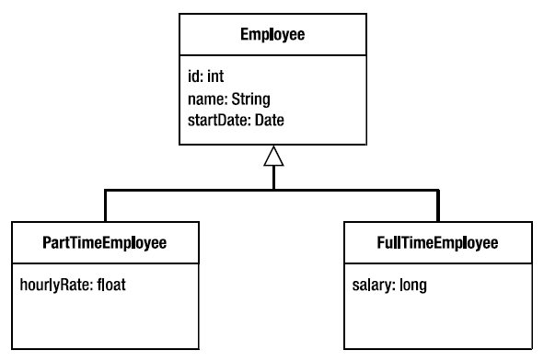
ORM: Impedance Mismatch

Slide 15
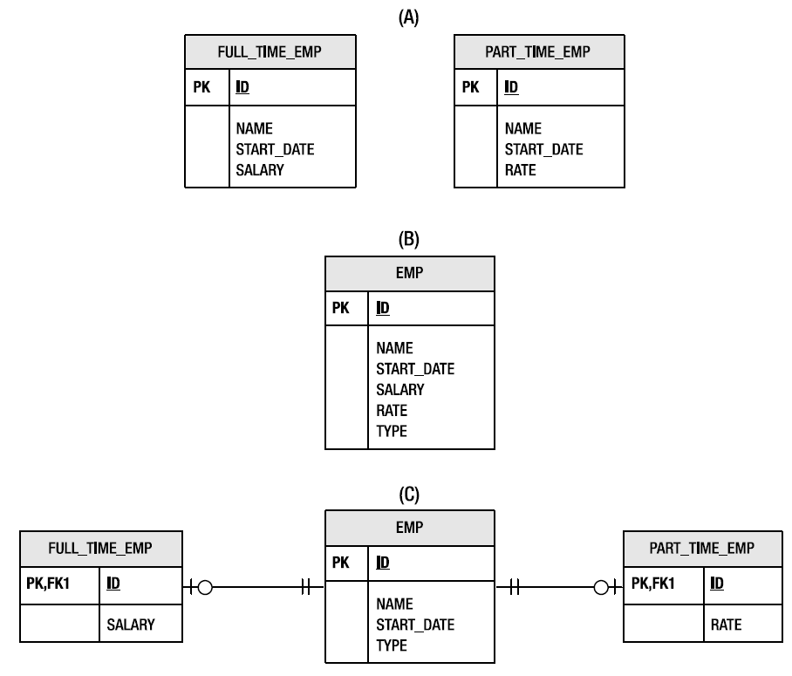
ORM: Impedance Mismatch

