Slide 1
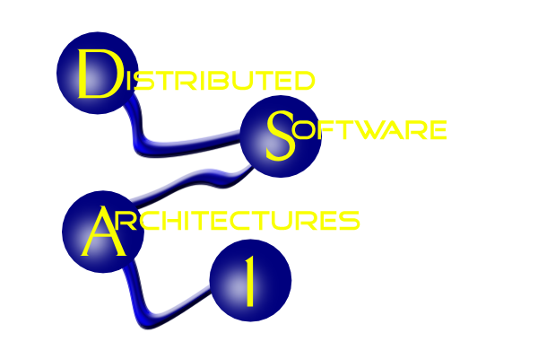

COMPUTER SCIENCE
JSON
JavaScript Object Notation
basic JSON syntax
use of JSON in Javascript
use of JSON in Java.

Slide 2
COMPUTER SCIENCE
JSON http://www.w3schools.com/json/json_intro.asp
<!DOCTYPE html>
<html>
<body>
<h2>JSON Object Creation in JavaScript</h2>
<p>
Name: <span id="jname"></span><br />
Age: <span id="jage"></span><br />
Address: <span id="jstreet"></span><br />
Phone: <span id="jphone"></span><br />
</p>

Slide 3
COMPUTER SCIENCE
JSON http://www.w3schools.com/json/json_intro.asp
<script>
var JSONObject = {
"name": "John Johnson",
"street": "Oslo West 555",
"age": 33,
"phone": "555 1234567"};
document.getElementById("jname").innerHTML = JSONObject.name;
document.getElementById("jage").innerHTML = JSONObject.age;
document.getElementById("jstreet").innerHTML = JSONObject.street;
document.getElementById("jphone").innerHTML = JSONObject.phone;
</script>
</body>
</html>

Slide 4
COMPUTER SCIENCE
JSON
Similar to XML - differences:
No tags, JSON uses key/value associations
Types supported: strings, numbers, booleans, arrays, objects and null
Also: Arrays as a means of grouping repeating elements

Slide 5
COMPUTER SCIENCE
JSON
<script type="text/javascript">
$(document).ready(function() {
$('#room').html(room.description);
$('#video').html("<iframe width=\"560\" height=\"315\"
src=\"http://www.youtube.com/embed/" + room.media.youtubeId +
"\"frameborder=\"0\" allowfullscreen></iframe>");
});
var room = {"id": "scavenger://uwf.edu/location/r435",
"is-a": {"id": "scavenger://uwf.edu/ontology/locations#room"},
"located-in": {"id": "scavenger://uwf.edu/location/bldg4"},
"contains": {"id": "scavenger://uwf.edu/actor/berndok"},
"description": "Room 435 in Building 4",
"media": {"youtubeId": "fvW6OE7WVB0"}
};
</script>
<h1 id="room"></h1> <div id="video"></div>

Slide 6
COMPUTER SCIENCE
JSON (Arrays – start with 0)
<p>Original name: <span id="origname"></span></p>
<p>New name: <span id="newname"></span></p>
<script>
var employees = [
{"firstName": "John", "lastName": "Doe"},
{"firstName": "Anna", "lastName": "Smith"},
{"firstName": "Peter", "lastName": "Jones"}, ];
document.getElementById("origname").innerHTML = employees[0].firstName +
" " + employees[0].lastName;
employees[0].firstName = "Gilbert";
document.getElementById("newname").innerHTML = employees[0].firstName +
" " + employees[0].lastName;
</script>

Slide 7
COMPUTER SCIENCE
JSON & JS “eval”
First Name: <span id="fname"></span><br>
Last Name: <span id="lname"></span><br>
<script>
var txt = '{"employees":[' +
'{"firstName":"John","lastName":"Doe" },' +
'{"firstName":"Anna","lastName":"Smith" },' +
'{"firstName":"Peter","lastName":"Jones" }]}'; // that's a String!
var obj = eval("(" + txt + ")");
document.getElementById("fname").innerHTML = obj.employees[1].firstName;
document.getElementById("lname").innerHTML = obj.employees[1].lastName;
</script>

Slide 8
COMPUTER SCIENCE
JSON for AJAX (AJAJ?)
Works just like with XML, just use json data type!
Example → NetBeans

Slide 9
COMPUTER SCIENCE
JSON & Java
Pretty much in flux – many APIs:
org.json
javax.json JSONP (Java API for JSON Processing)
com.fasterxml.jackson the Jackson parser project
com.mongodb

Slide 10
COMPUTER SCIENCE
JSON
JSONP similar to JAXP
The Java API for JSON Processing (JSR-353) does not explicitly support JSON binding in Java. A future JSR (JSON Binding) that is similar to JAXB for XML is under consideration for a future release of Java EE.
[the “Java EE 7 Tutorial” http://docs.oracle.com/javaee/7/tutorial/doc/jsonp005.htm]

Slide 11
COMPUTER SCIENCE
JSON: JSONP Object Model
import javax.json...;
JsonObjectBuilder builder = Json.createObjectBuilder();
JsonObject o = builder.add("firstName", "Duke")
.add("lastName", "Java")
.add("age", 18)
.add("streetAddress", "100 Internet Dr")
.add("city", "JavaTown")
.add("state", "JA")
.add("postalCode", "12345")
.build();
{"firstName":"Duke","lastName":"Java","age":18, "streetAddress":"100 Internet Dr","city":"JavaTown", "state":"JA","postalCode":"12345"}

Slide 12
COMPUTER SCIENCE
Object
|
+-- firstName: STRING Duke
|
+-- lastName: STRING Java
|
+-- age: NUMBER 18
|
+-- streetAddress: STRING 100 Internet Dr
|
+-- city: STRING JavaTown
|
+-- state: STRING Ja
|
+-- streetAddress: STRING 100 Internet Dr
|
+-- postalCode: STRING 12345
|
+-- phoneNumbers: ARRAY [0] OBJECT
|
+-- type: STRING mobile
|
+-- number: STRING 111-111-1111
[1] OBJECT
|
+-- type: STRING home
|
+-- number: STRING 222-222-2222
JSON Object Model

Slide 13
COMPUTER SCIENCE
JSON

