Slide 1


XML NameSpaces,
Data Definition/Validation
COMPUTER SCIENCE

Slide 2

COMPUTER SCIENCE
Introduction
  namespaces – used to disambiguate the meaning of names when the same name might mean two different things
  XML validation. May be achieved with:
    DTDs
    XML Schemas
  Typing of data. May be achieved with XML Schema
  Processing models:
    DOM processing
    SAX processing

Slide 3
COMPUTER SCIENCE
XML permits creation of user-defined tag names
Possibility of name collisions is always present
Namespaces are akin to fully-qualified names
Expanded name:
= Namespace name
= Local name
Qualified name:
= A prefixed name
= The local name
A default namespace declaration applies to all unprefixed element names within its scope.
W3Schools Namespace Tutorial
The W3C Website on Namespaces
Example disambiguation provided by namespaces:
A furniture company has a web page with a table in it
The furniture company sells tables

Slide 4
COMPUTER SCIENCE
Different “tables”
<table>
<tr>
<td>Apples</td>
<td>Bananas</td>
</tr>
</table>
<table>
<name>African Coffee Table</name>
<width>80</width>
<length>120</length>
</table>

Slide 5
COMPUTER SCIENCE
Namespace prefix and identifier
<root>
<h:table xmlns:h="http://www.w3.org/TR/html4/">
<h:tr>
<h:td>Apples</h:td>
<h:td>Bananas</h:td>
</h:tr>
</h:table>
<f:table xmlns:f="http://www.w3schools.com/furniture">
<f:name>African Coffee Table</f:name>
<f:width>80</f:width>
<f:length>120</f:length>
</f:table>
</root>

Slide 6
COMPUTER SCIENCE
Uniform Resource Identifier
A Uniform Resource Identifier (URI) is a compact sequence of characters that identifies an abstract or physical resource.
[http://tools.ietf.org/html/rfc3986]
Examples:
http://www.cs.uwf.edu/
http://www.google.com/search?hl=en&q=uri&btnG=Search
file:/localhost//C|/mydir/myfile.txt
news:comp.lang.java.programmer
jdbc:derby://localhost:1527/travel
urn:isbn:096139210x

Slide 7
COMPUTER SCIENCE
Ok! And what is a resource?
(...) the term "resource" is used in a general sense for whatever might be identified by a URI. [ibid.]
Thanks for clarifying this...

Slide 8
URL
COMPUTER SCIENCE
Uniform Resource Locator
(...) a URL is a type of URI that identifies a resource via a representation of its primary access mechanism (e.g., its network "location"), rather than by some other attributes it may have. [http://www.w3.org/TR/uri-clarification/]
Examples:
http://www.cs.uwf.edu/
http://www.google.com/search?hl=en&q=uri&btnG=Search
file:/localhost//C|/mydir/myfile.txt

Slide 9
COMPUTER SCIENCE
Namespace declaration
“XML Namespace”
<h:table xmlns:h="http://www.w3.org/TR/html4/">
Prefix Prefix URI
With the first tag of the namespace!
Read http://www.rpbourret.com/xml/NamespaceMyths.ht

Slide 10
COMPUTER SCIENCE
Multiple namespaces...
<rdf:RDF
xmlns:daml="http://www.daml.org/2001/03/daml+oil#"
xmlns:rdf="http://www.w3.org/1999/02/22-rdf-syntax-ns#"
xmlns:dc="http://purl.org/dc/elements/1.1/"
xmlns:xsd="http://www.w3.org/2001/XMLSchema#"
xmlns:rdfs="http://www.w3.org/2000/01/rdf-schema#"
xmlns:owl="http://www.w3.org/2002/07/owl#"
... >

Slide 11
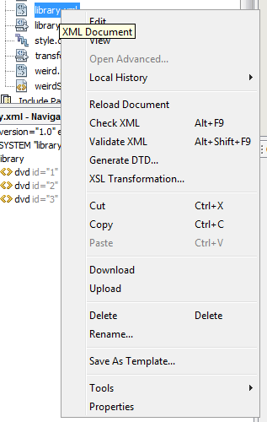
Well-formed & valid
COMPUTER SCIENCE
Not every text file with “<” and “>” in it is an XML document!
Well-formedness: Following the XML language rules
Validity: Obeying certain “structuring” rules

Slide 12
COMPUTER SCIENCE
Validity 1:
Document Type Definitions (DTDs)
Specify the elements, attributes, required/optional items, and nesting within a legal XML document
  May be declared in the prolog of the XML file or in a separate file
  W3Schools tutorial on DTDs
  Example DTDs at W3Schools

Slide 13
DTD Example (Part 1)
COMPUTER SCIENCE
<recipe name="bread" prep_time="5 mins" cook_time="3 hours">
<ingredient amount="3" unit="cups">Flour</ingredient>
<ingredient amount="0.25" unit="ounce">Yeast</ingredient>
<ingredient amount="1.5" unit="cups" state="warm">Water
</ingredient>
<ingredient amount="1" unit="teaspoon">Salt</ingredient>
<instructions>
<step>Mix all ingredients together.</step>
<step>Knead thoroughly.</step>
<step>Cover with a cloth, and leave for one hour in warm room.
</step>
<step>Knead again.</step>
<step>Place in a bread baking tin.</step>
<step>Cover with a cloth, and leave for one hour in warm room.
</step>
<step>Bake in the oven at 350(degrees)F for 30 minutes.</step>
</instructions>
</recipe>
</recipe>

Slide 14
DTD Example (Part 2)
COMPUTER SCIENCE
<!ELEMENT recipe (title,ingredient+,instructions)>
<!ATTLIST recipe
cook_time CDATA #REQUIRED
name CDATA #REQUIRED
prep_time CDATA #REQUIRED>
<!ELEMENT title (#PCDATA)>
<!ELEMENT ingredient (#PCDATA)>
<!ATTLIST ingredient
amount CDATA #REQUIRED
state CDATA #IMPLIED
unit CDATA #REQUIRED>
<!ELEMENT instructions (step)+>
<!ELEMENT step (#PCDATA)>

Slide 15
Data Definition/Validation 2:
XML Schema
COMPUTER SCIENCE
Schema: an underlying organization or structure; a diagrammatic representation, model, or outline. Dictionary.com
  XML Schema: (Wikipedia) an XML vocabulary (DTD is NOT) that describes data structures
  As we will see later, XML Schema can be used to define basic data types for Web services, NOT just to validate XML files
  XML Schema at W3Schools
  Example: Developing an XML Schema (W3Schools)

Slide 16
XML Schema Example 1
COMPUTER SCIENCE
<?xml version="1.0" encoding="UTF-8"?>
<xs:schema xmlns:xs="http://www.w3.org/2001/XMLSchema"
xmlns:tns="http://xml.netbeans.org/schema/recipe"
elementFormDefault="qualified">
<xs:element name="ingredient">
<xs:complexType>
<xs:simpleContent>
<xs:extension base="xs:string">
<xs:attribute name="amount" use="required" />
<xs:attribute name="unit" use="required" />
<xs:attribute name="state" use="optional" />
</xs:extension>
</xs:simpleContent>
</xs:complexType>
</xs:element>
...
</xs:schema>

Slide 17
XML Schema Example 2
COMPUTER SCIENCE
<?xml version="1.0" encoding="UTF-8"?>
<xs:schema xmlns:xs="http://www.w3.org/2001/XMLSchema"
xmlns:tns="http://xml.netbeans.org/schema/recipe"
elementFormDefault="qualified">
…
<xs:element name="instructions">
<xs:complexType>
<xs:sequence>
<xs:element name="step" type="xs:string"
maxOccurs="unbounded" />
</xs:sequence>
</xs:complexType>
</xs:element>
...
</xs:schema>

Slide 18
XML Schema Example 3
COMPUTER SCIENCE
<?xml version="1.0" encoding="UTF-8"?>
<xs:schema xmlns:xs="http://www.w3.org/2001/XMLSchema"
xmlns:tns="http://xml.netbeans.org/schema/recipe"
elementFormDefault="qualified">
...
<xs:element name="recipe">
<xs:complexType>
<xs:sequence>
<xs:element name="title" type="xs:string" />
<xs:element ref="ingredient" minOccurs="0"
maxOccurs="unbounded" />
<xs:element ref="instructions" />
</xs:sequence>
<xs:attribute name="name" type="xs:string" use="required"/>
<xs:attribute name="prep_time" type="xs:string"
use="required"/>
<xs:attribute name="cook_time" type="xs:string"
use="required"/>
</xs:complexType>
</xs:element>
</xs:schema>

Slide 19
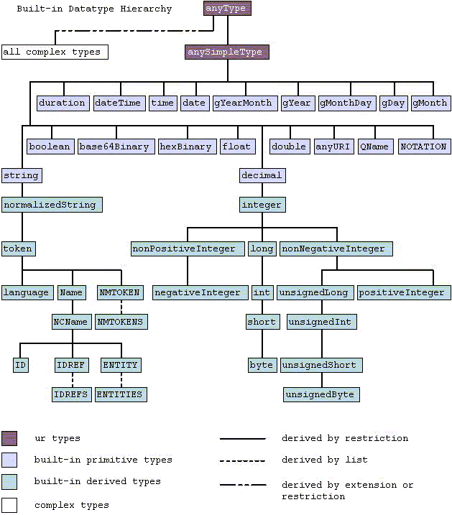
COMPUTER SCIENCE
XML Schema data types

