Slide 1


COMPUTER SCIENCE
Servlets – round-up
Basically everything that can be done with a “normal” Java program, can also be done with a Servlet!
Except GUI things, of course...

Slide 2
COMPUTER SCIENCE
Like?
Interact with other Servlets
JAXB/JSONB
JDBC/JPA to connect to the back end

Slide 3
COMPUTER SCIENCE
Target Architecture
Web/AJAX
Client
Servlet
Service
Back End

Slide 4
COMPUTER SCIENCE
Target Architecture 1: Service Decomposition
“Model”
Web/AJAX
Client
Servlet
Service
POJOs
JAXB
JSONB

Slide 5
COMPUTER SCIENCE
public class Model {
private static Marshaller JAXB_MARSHALLER = null;
static {
try {
JAXB_MARSHALLER = ...
} catch (JAXBException ex) {
...
}
}
private final Library library;
public Model() {
library = new Library();
library.add(new DVD(1,"Breakfast at Tiffany's", "Movie", "Classic"));
library.add(new DVD(2,"Contact", "Movie", "Science fiction"));
library.add(new DVD(3,"Little Britain", "TV Series", "Comedy"));
library.add(new DVD(4,"Harry Potter Returns", "Movie", "Fantasy"));
}
Model 2: Capsule

Slide 6
COMPUTER SCIENCE
@XmlAccessorType(XmlAccessType.FIELD)
@XmlType(name = "", propOrder = {
"title", "format", "genre"
})
@XmlRootElement(name = "dvd")
@JsonbPropertyOrder(PropertyOrderStrategy.ANY)
public class DVD {
@XmlAttribute
private Integer id;
private String title;
private String format;
private String genre;
public DVD() {
}
public DVD(int id, String title, String format, String genre) {
this.id = id;
this.title = title;
this.format = format;
this.genre = genre;
}
public String getTitle() {
return title;
}
Model 1: Annotated POJO #1

Slide 7
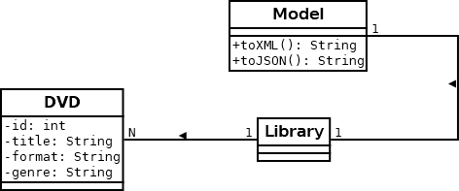
COMPUTER SCIENCE
Target Architecture 1: Service UML

Slide 8
COMPUTER SCIENCE
@XmlAccessorType(XmlAccessType.FIELD)
@XmlRootElement(name = "library")
public class Library {
private List<DVD> dvd;
public Library() {
dvd = new ArrayList<DVD>();
}
public void add(DVD d) {
dvd.add(d);
}
...
Model 1: Annotated POJO #2

Slide 9
COMPUTER SCIENCE
@WebServlet("/service")
public class DVDServlet extends HttpServlet {
@Override
public void doGet(HttpServletRequest request,
HttpServletResponse response)
throws ServletException, IOException {
Model m = new Model();
PrintWriter out = response.getWriter();
switch (request.getHeader("Accept").toLowerCase()) {
case "application/xml":
response.setContentType("application/xml");
out.println(m.toXML());
break;
case "application/json":
response.setContentType("application/json");
out.println(m.toJSON());
break;
default:
response.sendError
(HttpServletResponse.SC_UNSUPPORTED_MEDIA_TYPE);
}
}
Service (Servlet)

Slide 10
COMPUTER SCIENCE
$(document).ready(function () {
$.ajax({
beforeSend: function (req) {
req.setRequestHeader("Accept", "application/xml");
},
type: "GET",
url: "http://localhost:8080/MultiServlet/service",
dataType: "xml",
success:
function (xml) {
$(xml).find('dvd').each(function () {
var title = $(this).find('title').text();
var genre = $(this).find('genre').text();
$('<li></li>')
.html(title + ' (' + genre + ')')
.appendTo('#update-target ol');
}); //close each(
},
error: function (xhr, status, error) {
var errorMessage = xhr.status + ': ' + xhr.statusText;
alert('Error - ' + errorMessage);
}
}); //close $.ajax(
}); //close $(
Client

Slide 11
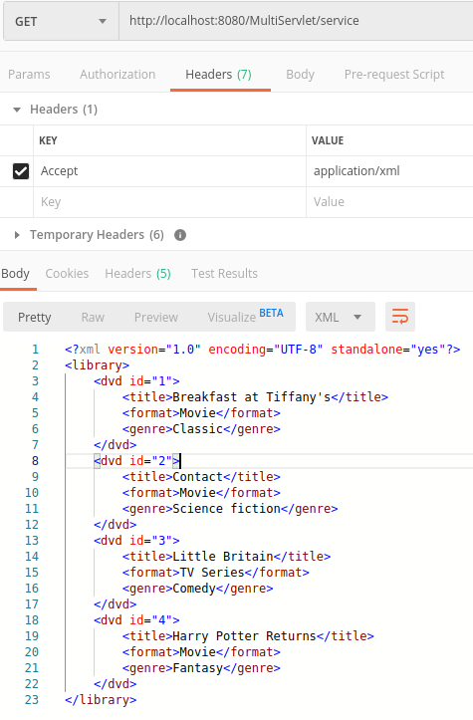
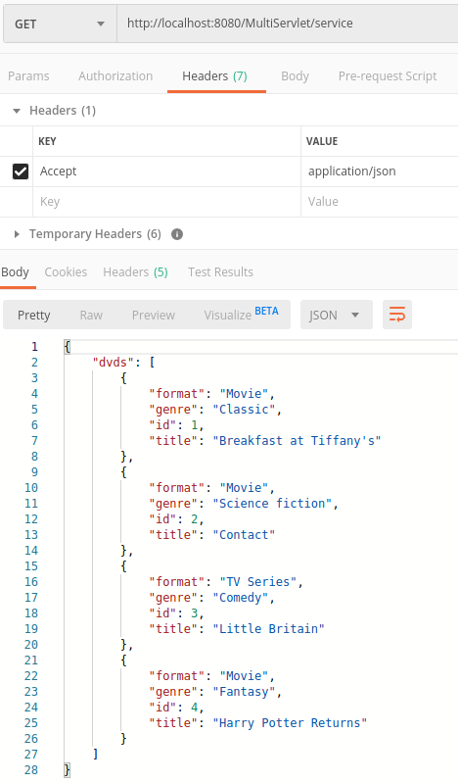
COMPUTER SCIENCE
Server Test via
Postman

Slide 12
COMPUTER SCIENCE
Target Architecture 2:
Data Access Object Connectivity
“Model”
Web/AJAX
Client
Servlet
Service
JDBC
DAO
Back End
POJOs
JAXB
JSONB

Slide 13
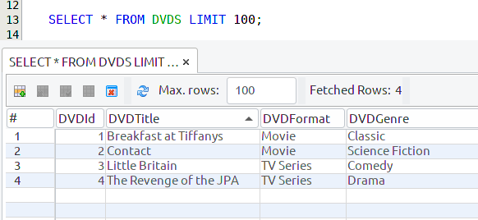
COMPUTER SCIENCE
Data Access Object (DAO)
A simple abstraction that maps
  a DB row into a POJO
  a DB table into a collection of POJOs
List<DVD>

Slide 14
COMPUTER SCIENCE
DAO Blueprint
public interface DVDDAO {
List<DVDS> findAll(); ← Just this one implemented
List<DVD> findById();
List<DVD> findByTitle();
boolean insertEmployee(Employee employee);
boolean updateEmployee(Employee employee);
boolean deleteEmployee(Employee employee);
}

Slide 15
COMPUTER SCIENCE
Model is slightly different!
public Model() {
library = new Library();
List<DVD> interm = new DVDDAO().findAll();
for (DVD d : interm) {
library.add(d);
}
}

Slide 16
COMPUTER SCIENCE
Complete DAO Code → NB project
Core idea:
resultList = new ArrayList<>();
// omit: standard JDBC code to create “stmt”
rs = stmt.executeQuery("SELECT * from DVDS");
while (rs.next()) {
DVD d = new DVD(rs.getInt(1),
rs.getString(2),
rs.getString(3),
rs.getString(4));
resultList.add(d);
}

Slide 17
COMPUTER SCIENCE
Target Architecture 3: JPA (ORM) Connectivity
“Model”
Web/AJAX
Client
Servlet
Service
Back End
POJOs
JPA
JAXB
JSONB

Slide 18

COMPUTER SCIENCE
Welcome to
“JPA on a Java App Server”

Slide 19
COMPUTER SCIENCE
JPA on a Java App Server
1. App Servers are in charge of their
connectivity (Network, DB, …)
2. The DAO architecture cheated a little :-)
3. JPA persistence providers don’t let you
cheat anymore

Slide 20
COMPUTER SCIENCE
JPA on a Java App Server
1. App Servers are in charge of their
connectivity (Network, DB, …)
2. The DAO architecture cheated a little :-)
3. JPA persistence providers don’t let you
cheat anymore

Slide 21
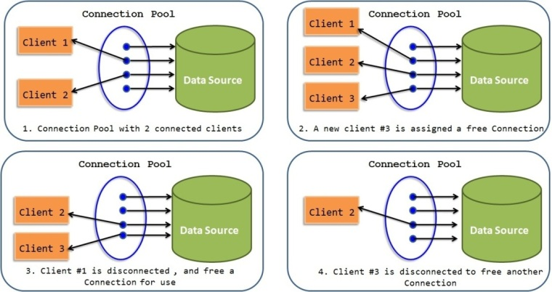
COMPUTER SCIENCE
Connection pooling
http://javainsimpleway.com/connection-pool-overview/

Slide 22
COMPUTER SCIENCE
Data Sources
1. Combine partial functions of JDBC Driver
Manager and DB URL
- Driver class, User name, Password, …
2. Define transaction managemens
- manual vs. JTA
<Resource id="DVDs" type="javax.sql.DataSource">
JdbcDriver com.mysql.cj.jdbc.Driver
JdbcUrl jdbc:mysql://localhost:3306/DVDLibrary?
serverTimezone=UTC
UserName root
Password mysql4me
JtaManaged true
</Resource>

Slide 23
COMPUTER SCIENCE
Some is App server dependent
Payara/Glassfish:
<jdbc-connection-pool
datasource- classname="com.mysql.jdbc.jdbc2.optional.MysqlDataSource" name="mysql_DVDLibrary_rootPool"
… >
<property name="serverName" value="localhost"></property>
<property name="portNumber" value="3306"></property>
<property name="databaseName" value="DVDLibrary"></property>
<property name="User" value="root"></property>
<property name="Password" value="mysql4me"></property>
<property name="URL"
value="jdbc:mysql://localhost:3306/DVDLibrary?serverTimezone=UTC">
</property>
</jdbc-connection-pool>
<jdbc-resource pool-name="mysql_DVDLibrary_rootPool"
description="To connect to the DVD library"
jndi-name="DVDs"></jdbc-resource>

Slide 24
COMPUTER SCIENCE
Some is App server dependent
TomEE:
<Resource id="DVDs" type="javax.sql.DataSource">
JdbcDriver com.mysql.cj.jdbc.Driver
JdbcUrl jdbc:mysql://localhost:3306/DVDLibrary?
serverTimezone=UTC
UserName root
Password mysql4me
JtaManaged true
</Resource>
It looks like TomEE associates a pool automatically

Slide 25
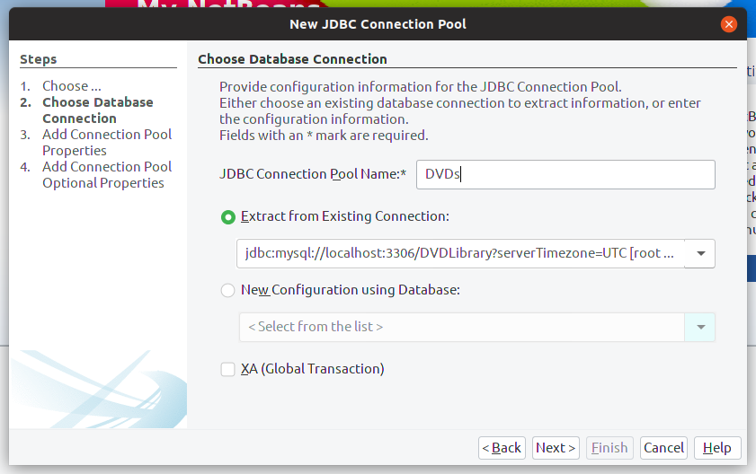
COMPUTER SCIENCE
Problem 1
How to get pools and data sources installed?
1. The IDE does that (not always reliably?)
Deployed with the app
2. You do that manually
Needed for TomEE,
since NB has no idea :-)

Slide 26
COMPUTER SCIENCE
Problem 2
How does the app reference a Data Source?
Easy-ish: persistence.xml
<?xml version="1.0" encoding="UTF-8"?>
<persistence version="2.1" ...
<persistence-unit name="..." transaction-type="JTA">
<jta-data-source>DVDs</jta-data-source>
<class>com.mycompany.jpamultiservlet.DVDS</class>
...
</persistence-unit>
</persistence>

Slide 27
COMPUTER SCIENCE
Problem 3
How does the the server find it?
JNDI

Slide 28
COMPUTER SCIENCE
JNDI (per Univ Technology, Sidney)
JNDI = Java Naming and Directory Interface
JNDI provides a standard way for Java applications to interface with a variety of naming and directory services
JNDI is defined independently of any specific naming or directory service implementation
Different naming and directory services providers can be plugged in under a common API

Slide 29
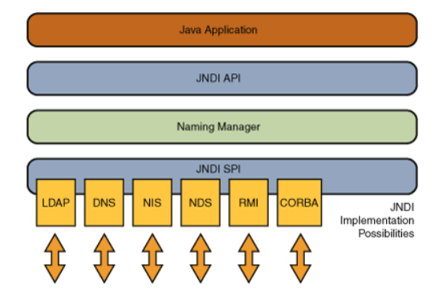
COMPUTER SCIENCE
JNDI

Slide 30
COMPUTER SCIENCE
JNDI
JNDI has two similar but not identical concepts:
Naming service
look up an object by name only
Directory service
look up an object by a set of properties

Slide 31
COMPUTER SCIENCE
JNDI
A naming service is a mechanism used in distributed and non-distributed applications to refer to objects via a name identifying that object
The name used is generally human readable or easily converted into a human readable String
The association between a name and an object is known as a name binding
A name binding is always relative to a given naming context

Slide 32
COMPUTER SCIENCE
App servers & JNDI
App servers maintain their own JNDI contexts.
It’s important to make sure your references in the persistence.xml matches the JNDI name.

Slide 33
COMPUTER SCIENCE
Stepping stone
Consistent mapping!
1. Instance field/accessor names
2. DB column names
3. XML entity names
4. JSON atttibute names

Slide 34
COMPUTER SCIENCE
Stepping stone
@Id
@Column(name = "DVDId")
@XmlAttribute
private Integer id;
@Column(name = "DVDTitle")
private String title;
@Column(name = "DVDFormat")
private String format;

Slide 35
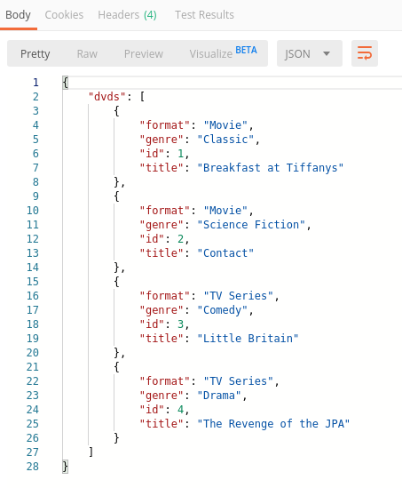
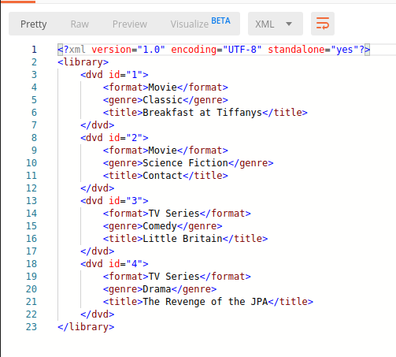
COMPUTER SCIENCE
Finally

