Slide 1
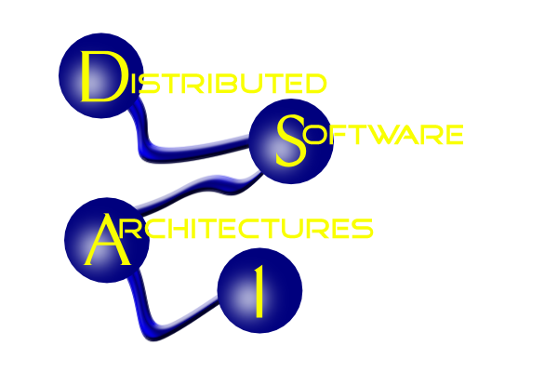

COMPUTER SCIENCE
Session 1: Introduction
Course Structure
Course overview
Software

Slide 2
COMPUTER SCIENCE
Course Structure
Per week: at least one session lecture
sometimes one session discussion, reading, case studies, ...
Material: Lecture notes, readers, slides,
example code (GitHub)
Exercises: easy, make sure you do them
Projects: 4, a bit harder

Slide 3
COMPUTER SCIENCE
Course Overview
Uses Ubuntu VM with
  NetBeans + Java 11
  MySQL DB
  Payara App Server
  PyCharm + Python 3.7

Slide 4
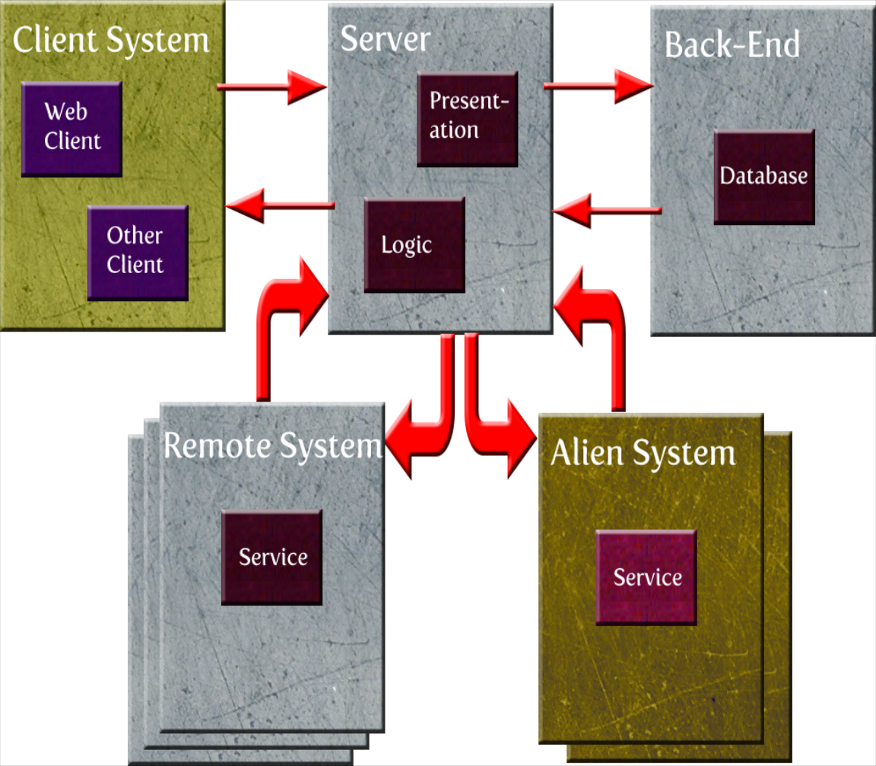
COMPUTER SCIENCE
Target architecture

Slide 5
COMPUTER SCIENCE
Connections:
Client – Server: TCP/IP, http, XML, …
Server – Back End: ODBC, JDBC, ORM, JPA
Server – Remote System: REST, …
Server – Alien System: REST, ...

Slide 6
COMPUTER SCIENCE
Course Outline
1. XML – Basic communication
2. Client-side Programming + JSON
3. Persistence Models (JDBC, ORM, JPA)
4. Web Architectures (Servlets, JSP, MVC, ...)
5. Service-based Architectures (REST, JAX-RS)

Slide 7
COMPUTER SCIENCE
DA characteristics
No shared memory
Parallel activities
Failures are more common
Latency
Heterogeneous components
Security ← !
Scalability

Slide 8
COMPUTER SCIENCE
Transparency –
What should not be seen
1. Location of a service
2. Access to a service
3. Migration/Relocation of a service
4. Replication
5. Concurrency
6. Failure

Slide 9
COMPUTER SCIENCE
Local vs. distributed Software
New topics
1. Sequential vs. concurrent processes
2. Non-determinism of execution
3. States are distributed
4. Communication

Slide 10
COMPUTER SCIENCE
Local vs. distributed Software
Consequences
1. Synchronization necessary
2. Extensive error handling
3. Programming more complex
4. Testing more complex

Slide 11
COMPUTER SCIENCE
Distributed Architectures
1. Comfortable development
2. Stability wrt. failure, load problems, …
3. Integration of
heterogeneous components
4. Development under one paradigm

Slide 12
COMPUTER SCIENCE
What is an architecture?
1. A set of basic components
2. Design rules to build systems
3. Recipes to help the designer
4. Guidelines: penalties, trade-offs, ...

Slide 13
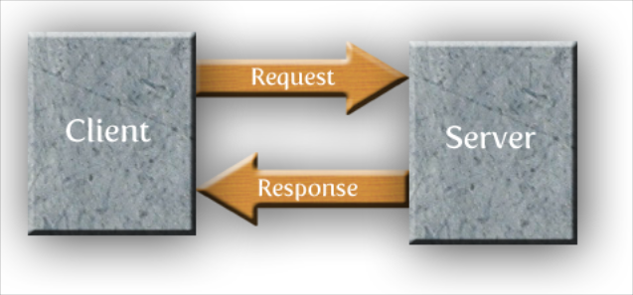
COMPUTER SCIENCE
Generic distributed models 1:
Client/Server

Slide 14
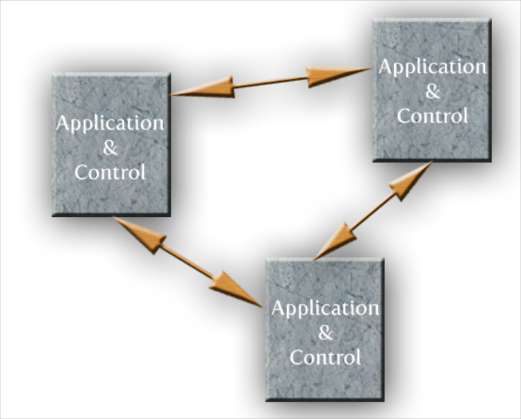
COMPUTER SCIENCE
Generic distributed models 2:
Peer-to-peer
P2P

Slide 15
COMPUTER SCIENCE
Other generic distributed models:
Ad-hoc networks: Jini/Apache River
Agent networks: OAA
Mobile architectures:
PANs (Personal Area Networks)
Bluetooth piconets

Slide 16
COMPUTER SCIENCE
Client-Server in more detail
1. User interface
2. Application logic
3. Database (persistence) component
→ Three-Tier Architecture

Slide 17
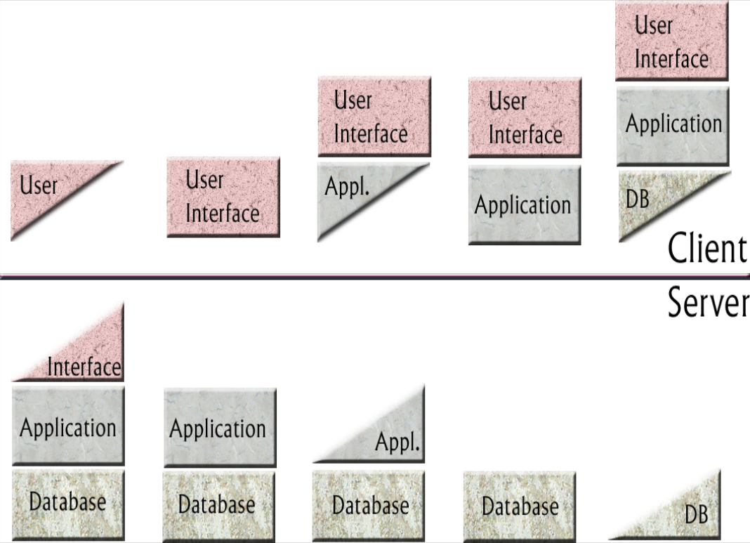
COMPUTER SCIENCE
Component distribution

Slide 18
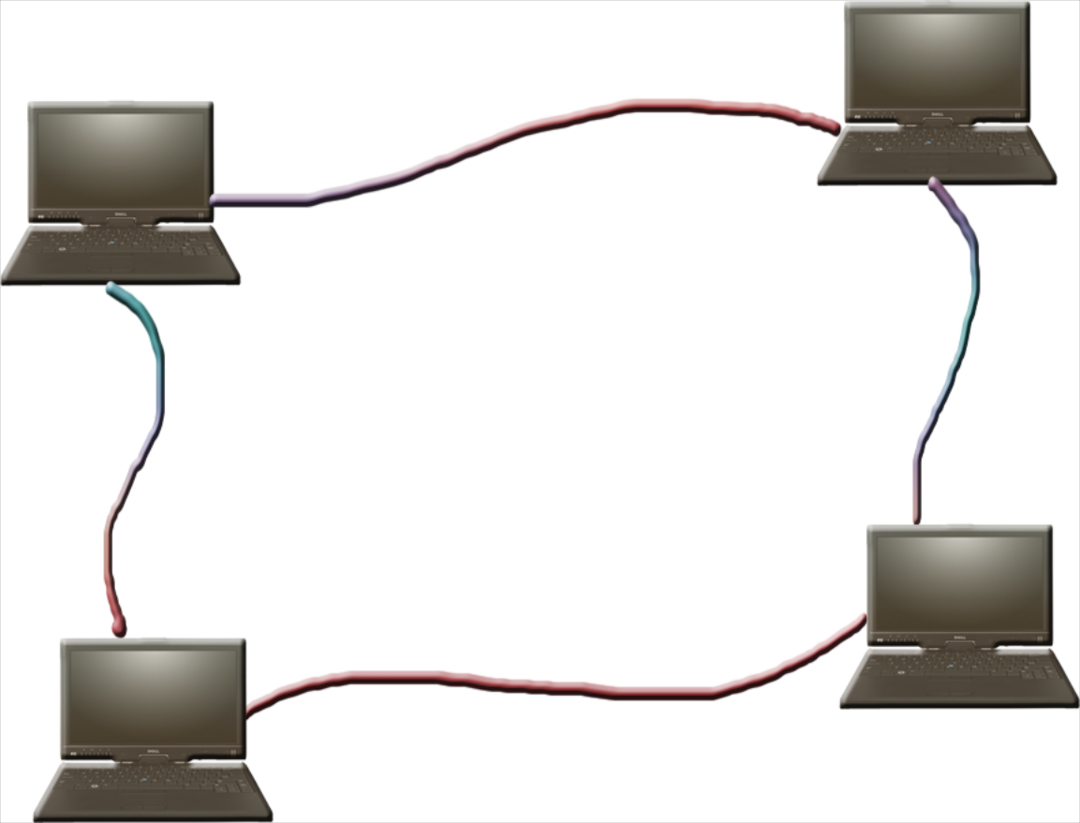
COMPUTER SCIENCE
Distribution infrastructure = Network 1
Local Area Networks (LANs)
Easy to configure and extend
Inexpensive
Wireless versions available

Slide 19
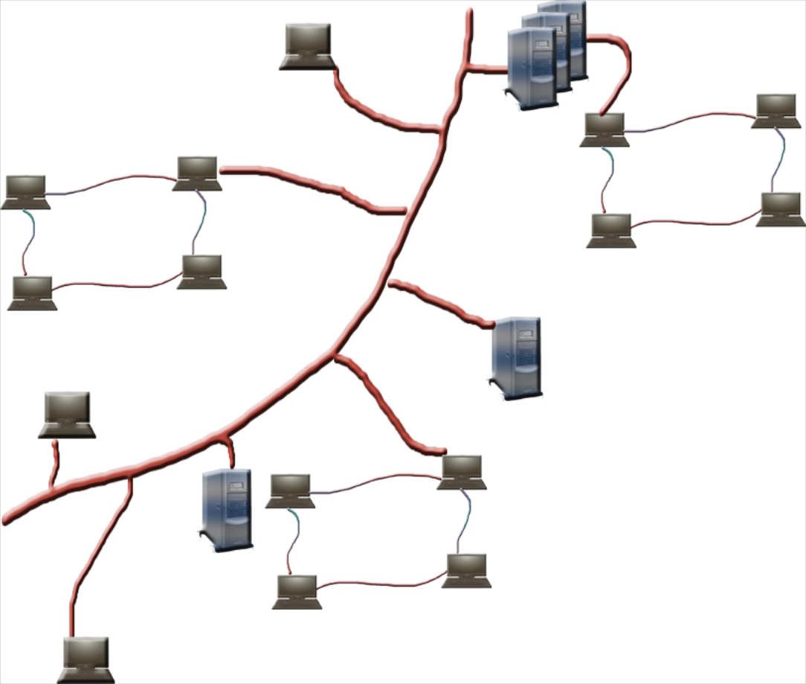
COMPUTER SCIENCE
Distribution infrastructure = Network 2
Wide Area Networks (WANs)
Backbones connect
clients
servers
LANs
Internet and its protocols
http, ftp, ...

Slide 20
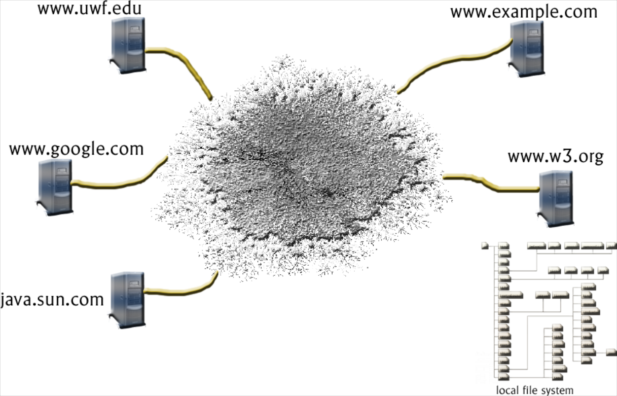
COMPUTER SCIENCE
Distribution infrastructure = Network 3
World Wide Web (WWW)
Similar to Internet
Based on URLs and (X)HTML

Slide 21
COMPUTER SCIENCE
Software Development 1
Choice of tools (see below)
Scalability is always in the back of your mind (cf. Twitter, Wikipedia, ...)
Security is always in the back of your mind

Slide 22
COMPUTER SCIENCE
Software Development 2
Development models
Waterfall, Spiral vs. Agile Development
Developer roles
Tool provider, web designer, component
provider, client programmer, business
logic specialist, ...

Slide 23
COMPUTER SCIENCE
Choice of tools
CGI with C, C++ and ODBC
PHP with MySQL
.NET + VBScript/C#
Python
Java Enterprise Edition (Java EE)

Slide 24
COMPUTER SCIENCE
Java EE
built around Core Java
extends CJ by APIs: JDBC, JPA, JAXB, JAX-RS
integrates Web development: Servlets, JSP
integrates Components: EJB
Variety of custom (MVC)
frameworks: JSF, Struts, Spring, ...

Slide 25
COMPUTER SCIENCE
Java EE shortcomings
Limited paradigms (like most languages)
Heavyweight-ish
Unclear “Roadmap” post Java 8

Slide 26
COMPUTER SCIENCE
Things that are helpful in this course
Core Java: Classes, inheritance, interfaces,
exceptions, packages, ...
Web: HTML, CSS
OS: Processes & Threads
Networks: Layered Architectures: TCP/IP
Sockets
Linux: Here Ubuntu
git

Slide 27
COMPUTER SCIENCE
Software
At least three systems – all Open Source!
NetBeans IDE
Payara Application Server (Glassfish-y)
MySQL database server

Slide 28
COMPUTER SCIENCE
NetBeans (currently 11)
https://netbeans.apache.org/
Now under Apache control – this can become tricky over the next years. We’ll see!
An IDE to develop Java applications involving
Database access via JDBC
Dynamic web applications with JSP/JSF
Distributed applications with EJB
Web Services applications
...

Slide 29
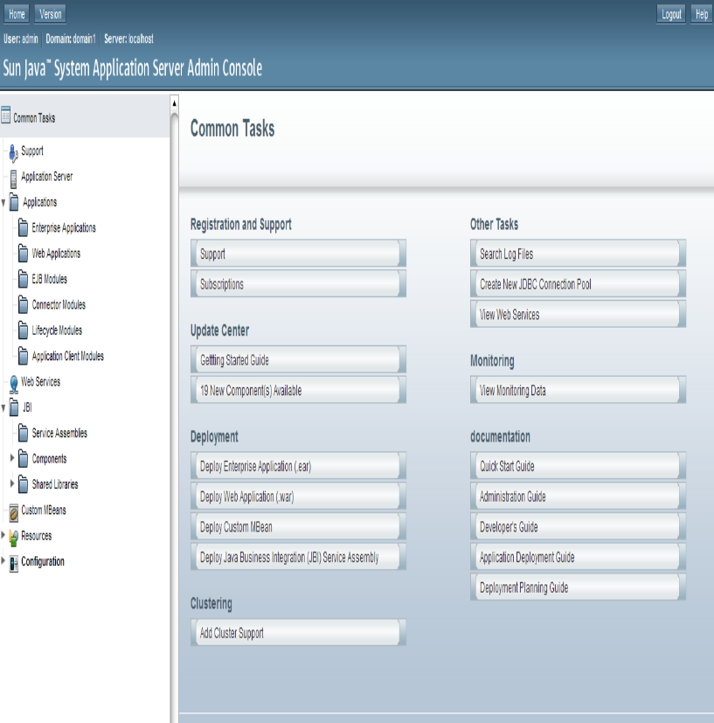
COMPUTER SCIENCE
GlassFish
Now Payara

