Slide 1


XML Processing Models
COMPUTER SCIENCE
“Standard” Processing Models
  DOM Parsing (Document Object Model)
  SAX Parsing (Simple API for XML)
Both parser types are available in all important languages: Java, PHP, JavaScript, ...

Slide 2
COMPUTER SCIENCE
DOM parsers
Reads the complete document – generally by using a
streaming parser
Constructs the DOM.
The program can navigate through this tree by
  a set of methods or
  XPath expressions.

Slide 3
COMPUTER SCIENCE
SAX: Streaming parser
SAX – Simple API for XML
Document is read serially by the parser
Events are activated upon encountering certain elements.
Events are handled by the application to execute certain actions

Slide 4
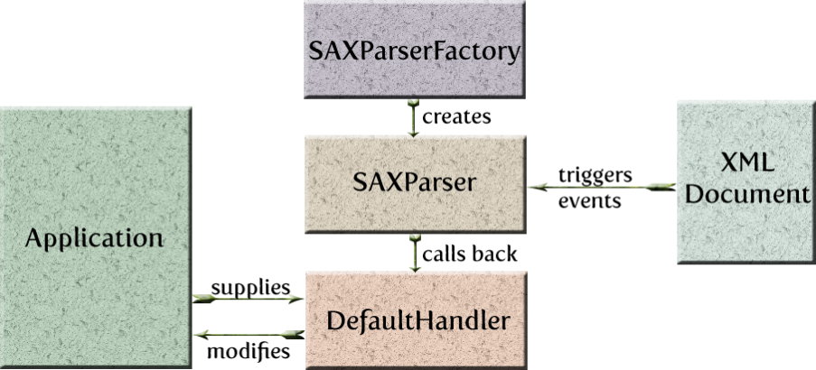
COMPUTER SCIENCE
http://en.wikipedia.org/wiki/Factory_method_pattern

Slide 5
COMPUTER SCIENCE
Case study:
See Lecture Notes and NetBeans demo

Slide 6
COMPUTER SCIENCE
Constructing XML documents
Here – over the “classical” DOM approach!
Build the DOM tree (just like a “normal” tree)
Then transform it into a Stream/File/...
See NB demo!

Slide 7
COMPUTER SCIENCE
Parser Vulnerabilities
Two important ones (both related to Entities)
  File Exposure
  Denial of Service

Slide 8
COMPUTER SCIENCE
Entities and DTD
Entities are a mechanism to define replacement values, an entity name is declared, and when that name is referenced the entity value is read in its place.
Entity values can be defined in line (Internal) or read from a uri (External).
The entity value data substituted in is normally treated as XML and parsed, however this behavior can be modified (see Unparsed Entities).

Slide 9
COMPUTER SCIENCE
Example
<?xml version="1.0" encoding="UTF-8" ?>
<!DOCTYPE library [
<!ELEMENT library (dvd)*>
...
<!ENTITY class "CLASSIC">
]>
<library>
<dvd id="1">
<title>Breakfast at Tiffany's</title>
<format>Movie</format>
<genre>&class;</genre>
</dvd>
...
Appears as
<genre>CLASSIC</genre>

Slide 10
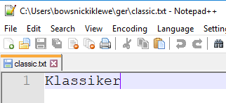
COMPUTER SCIENCE
External Entity Replacement
<?xml version="1.0" encoding="UTF-8" ?>
<!DOCTYPE library [
...
<!ENTITY class SYSTEM ""file:///users/.../ger/classic.txt"">
]>
<genre>&class;</genre> +
<genre>Klassiker</genre>

Slide 11
COMPUTER SCIENCE
Or nicer...
<?xml version="1.0" encoding="UTF-8" ?>
<!DOCTYPE library [
...
<!ENTITY class SYSTEM ""file:///users/.../secrets/secretPw.txt"">
]>
<genre>&class;</genre> -->
<genre>s3cr3t</genre>
XML External Entity Attack (XXE attack)
https://en.wikipedia.org/wiki/XML_external_entity_attack

Slide 12
COMPUTER SCIENCE
Nested Entities
<?xml version="1.0" encoding="UTF-8" ?>
<!DOCTYPE library [
...
<!ENTITY class "&cls;&cls;">
<!ENTITY cls "CLASSIC">
]>
<genre>&class;</genre> -->
<genre>CLASSICCLASSIC</genre>

Slide 13
COMPUTER SCIENCE
This looks like fun!!
<?xml version="1.0" encoding="UTF-8" ?>
<!DOCTYPE library [
...
<!ENTITY lol "lol">
<!ENTITY lol1 "&lol;&lol;&lol;&lol;&lol;&lol;&lol;&lol;&lol;&lol;">
<!ENTITY lol2 "&lol1;&lol1;&lol1;&lol1;&lol1;&lol1;&lol1;&lol1;&lol1;&lol1;">
<!ENTITY lol3 "&lol2;&lol2;&lol2;&lol2;&lol2;&lol2;&lol2;&lol2;&lol2;&lol2;">
<!ENTITY lol4 "&lol3;&lol3;&lol3;&lol3;&lol3;&lol3;&lol3;&lol3;&lol3;&lol3;">
<!ENTITY lol5 "&lol4;&lol4;&lol4;&lol4;&lol4;&lol4;&lol4;&lol4;&lol4;&lol4;">
<!ENTITY lol6 "&lol5;&lol5;&lol5;&lol5;&lol5;&lol5;&lol5;&lol5;&lol5;&lol5;">
<!ENTITY lol7 "&lol6;&lol6;&lol6;&lol6;&lol6;&lol6;&lol6;&lol6;&lol6;&lol6;">
<!ENTITY lol8 "&lol7;&lol7;&lol7;&lol7;&lol7;&lol7;&lol7;&lol7;&lol7;&lol7;">
<!ENTITY lol9 "&lol8;&lol8;&lol8;&lol8;&lol8;&lol8;&lol8;&lol8;&lol8;&lol8;">
]>
<genre>&lol9;</genre> → 1 Billion Laughs

Slide 14
COMPUTER SCIENCE

