Slide 1


COMPUTER SCIENCE
JAXB
“Java Architecture for XML Binding”
As opposed to JAXP
“Java API for XML Processing”

Slide 2
COMPUTER SCIENCE
JAXB
First confrontation with the Java EE principle:
Configuration
Idea: Take a “Plain Old Java Object” (POJO) and describe how it's mapped into a service – XML structure, DB, ...

Slide 3
COMPUTER SCIENCE
JAXB
The main tool for configuration: Java Annotations!
Known (hopefully):
@author, @param...
javadoc
@Override, @Deprecated
Compiler control

Slide 4
COMPUTER SCIENCE
JAXB
Annotations are technically Interfaces
→ they might need to be imported

Slide 5
COMPUTER SCIENCE
JAXB 1: POJO with annotation
import javax.xml.bind.annotation.XmlRootElement;
@XmlRootElement
public class Person {
private String firstName;
private String lastName;
private int age;
public int getAge() {...}
public void setAge(int age) {...}
// the other setters/getters
}

Slide 6
COMPUTER SCIENCE
JAXB 2: Instance creation
Person p = new Person();
p.setFirstName("Gerald");
p.setLastName("Bostock");
p.setAge(55);

Slide 7
COMPUTER SCIENCE
JAXB 3: Convert to XML
<?xml version="1.0" encoding="UTF-8" standalone="yes"?>
<person>
<firstName>Gerald</firstName>
<lastName>Bostock</lastName>
<age>55</age>
</person>
Goes the other way around, too :-)

Slide 8
COMPUTER SCIENCE
JAXB
Principle: Configuration by Exception
A complete set of default configuration options that can be overridden.
If these defaults are acceptable, the annotation effort is minimal.

Slide 9
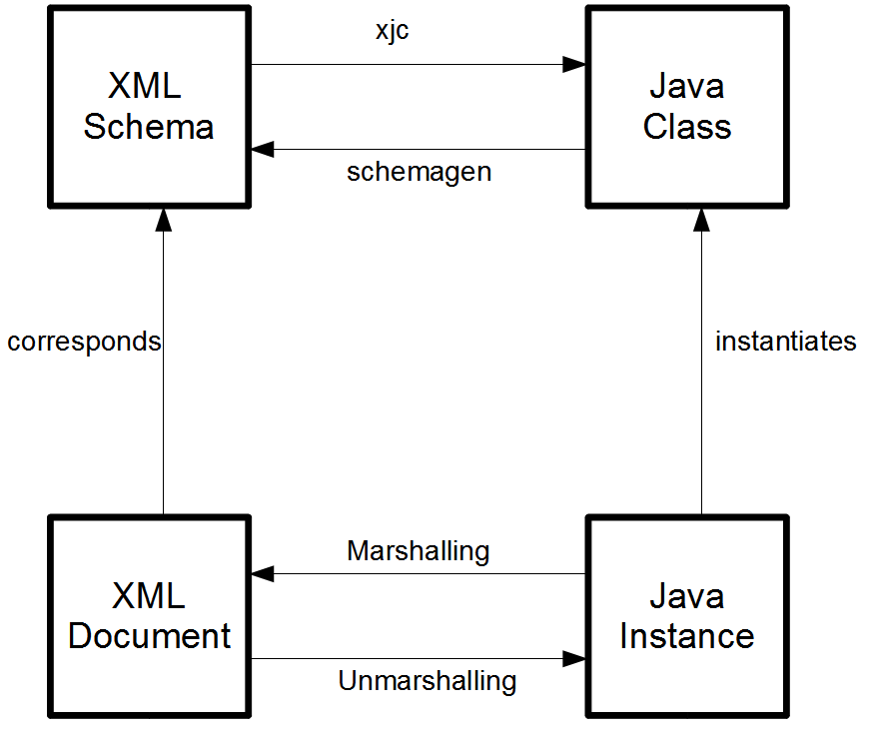
COMPUTER SCIENCE
JAXB

Slide 10
COMPUTER SCIENCE
JAXB: xjc – The XML Java Binding Compiler
<?xml version="1.0" encoding="UTF-8" standalone="yes"?>
<xs:schema version="1.0"
xmlns:xs="http://www.w3.org/2001/XMLSchema">
<xs:complexType name="person">
<xs:sequence>
<xs:element name="age" type="xs:int"/>
<xs:element name="firstName" type="xs:string" minOccurs="0"/>
<xs:element name="lastName" type="xs:string" minOccurs="0"/>
</xs:sequence>
</xs:complexType>
</xs:schema>

Slide 11
COMPUTER SCIENCE
JAXB: run xjc
bernd@ubuntu:~/Dropbox/Distrib/NBProjects/JAXB/xmldata$ xjc person.xsd
parsing a schema...
compiling a schema...
generated/ObjectFactory.java
generated/Person.java

Slide 12
COMPUTER SCIENCE
JAXB: Result of xjc
package generated;
import javax.xml.bind.annotation....;
@XmlAccessorType(XmlAccessType.FIELD)
@XmlType(name = "person", propOrder = {
"age",
"firstName",
"lastName"
})
public class Person {
protected int age;
protected String firstName;
protected String lastName;
public int getAge() {...}
// All the other setters and getters
}

Slide 13
COMPUTER SCIENCE
JAXB: schemagen (Java class → XML Schema)
public class Address {
private String street;
private String city;
private String zipcode;
public String getStreet() {}
// and all the other getters and setters
}
@XmlRootElement
public class Person {
private int age;
private String firstName;
private String lastName;
private Address address;
public int getAge() {…} // and so on...
}

Slide 14
COMPUTER SCIENCE
JAXB: result of schemagen
<?xml version="1.0" encoding="UTF-8" standalone="yes"?>
<xs:schema version="1.0" xmlns:xs="http://www.w3.org/2001/XMLSchema">
<xs:element name="person" type="person"/>
<xs:complexType name="address">
<xs:sequence>
<xs:element name="city" type="xs:string" minOccurs="0"/>
<xs:element name="street" type="xs:string" minOccurs="0"/>
<xs:element name="zipcode" type="xs:string" minOccurs="0"/>
</xs:sequence>
</xs:complexType>
<xs:complexType name="person">
<xs:sequence>
<xs:element name="address" type="address" minOccurs="0"/>
<xs:element name="age" type="xs:int"/>
<xs:element name="firstName" type="xs:string" minOccurs="0"/>
<xs:element name="lastName" type="xs:string" minOccurs="0"/>
</xs:sequence>
</xs:complexType>
</xs:schema>

Slide 15
COMPUTER SCIENCE
JAXB: Marshalling and Unmarshalling
Preparing a Java instance for transmission/storage
Similar to Java serialization/deserialization
No textual representation for Java instances → Strictly done programmatically!

Slide 16
COMPUTER SCIENCE
JAXB: Marshalling/Unmarshalling
1. Always: Annotate Java class(es) [see Lecture Notes]
2a. Create instance, marshal into XML file (or similar)
2b. Read XML file (or similar), unmarshal into instance

Slide 17
COMPUTER SCIENCE
JAXB
Workhorse: JAXBContext
Here: a Factory that creates instances of
Marshaller and
Unmarshaller

Slide 18
COMPUTER SCIENCE
JAXB: Marshalling to System.out
Recipe r = new Recipe();
// Fill instance fields, etc.
try {
JAXBContext jaxbContext =
JAXBContext.newInstance(Recipe.class);
Marshaller jaxbMarshaller = jaxbContext.createMarshaller();
// Make the output pretty printed:
jaxbMarshaller.setProperty(Marshaller.JAXB_FORMATTED_OUTPUT, true);
jaxbMarshaller.marshal(r, System.out);
} catch (Exception ex) {
Logger.getLogger(...);
}

Slide 19
COMPUTER SCIENCE
JAXB: Unmarshalling from XML file
try {
File file = new File("xmldata/recipe2.xml");
JAXBContext jaxbContext =
JAXBContext.newInstance(Class.forName("recipe.Recipe"));
Unmarshaller jaxbUnmarshaller = jaxbContext.createUnmarshaller();
Recipe r = (Recipe) jaxbUnmarshaller.unmarshal(file);
// Check state of the constructed instance
System.out.println(r);
} catch (Exception ex) {
Logger.getLogger(...);
}

