Slide 1


COMPUTER SCIENCE
CSS & XSLT

Slide 2
CSS Introduction
COMPUTER SCIENCE
Cascading Stylesheets present a powerful styling capability for both HTML and XML
Due to the pre-defined nature of html tags, styling concerns are somewhat different, however.
CSS is useful because:
+ A single stylesheet can be used for many pages
+ Different stylesheets might be used to present different views of data
+ They provide a first step toward separation of content and presentation
+ Stylesheets can be cached, speeding browser response

Slide 3
Why are they called
Cascading Style Sheets?
COMPUTER SCIENCE
CSS is based upon a system similar to inheritance:
If a style is provided for an element, the child elements inherit the style
A concept of overriding also applies:
an inline style would override a style defined in the head or prolog of
the document
a style defined in the head would override an
external style sheet.

Slide 4
CSS Rules
COMPUTER SCIENCE
CSS is based upon rules regarding the formatting of various items
Example:
h1, h2, h3 {color:#FF0045;
font-family:Verdana,Arial,sans-serif;
font-weight:bold;}

Slide 5
COMPUTER SCIENCE
Parts of a CSS rule
Selector – identifies the tag or tags with which the rule is associated. Types:
  Universal (*) wildcard
  Type tag names: body, userDefinedElement
  Class: specified as .userDefinedClass (XHTML only)
Declaration
- comprised of attribute/value pairs
- can specify many formatting attributes including color,
background color, font, size, positioning

Slide 6
COMPUTER SCIENCE
<?xml version="1.0" encoding="UTF-8" ?>
<?xml-stylesheet type="text/css" href="library.css"?>
<library>
<dvd id="1">
<title>Breakfast at Tiffany's</title>
<format>Movie</format>
<genre>Classic</genre>
</dvd>
<dvd id="2">
<title>Contact</title>
<format>Movie</format>
<genre>Science fiction</genre>
</dvd>
<dvd id="3">
<title>Little Britain</title>
<format>TV Series</format>
<genre>Comedy</genre>
</dvd>
</library>

Slide 7
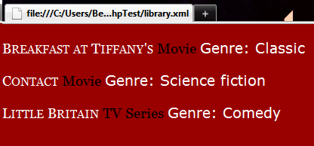
COMPUTER SCIENCE
library { background:#990000; color:white;
font-family: Georgia, Times, serif;
font-size:14pt;}
dvd { display: block; padding-top:20px; }
title { font-variant:small-caps; }
format { color:black; }
genre { font-family: Verdana, Arial, sans-serif; }
genre:before { content:"Genre: ";}

Slide 8
COMPUTER SCIENCE
recipe { background:white; color:black;
font-family: Georgia, Times, serif;
font-size:14pt; margin-left: 100px }
title { font-size: 16pt; font-weight:bold }
ingredient, step { display: block; padding-top:20px }
ingredient:before { content: attr(amount) " " attr(unit) " " }
instructions { color: red; position:relative;
top:50px; font-weight: bold }
instructions:before { content: "Instructions" }
step { font-weight: normal; counter-increment: steps }
step:before { content: counter(steps) ". " }

Slide 9
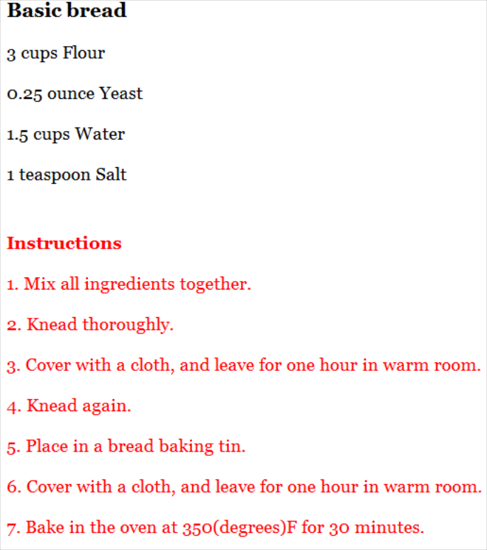
COMPUTER SCIENCE

Slide 10
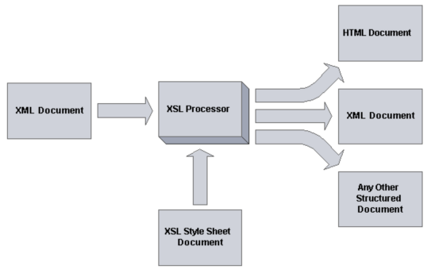
COMPUTER SCIENCE
XSLT Mechanism

Slide 11
XSL Processors
COMPUTER SCIENCE
Available in most modern browsers
For client-side transformations
Available as IDE plug-ins
For development & testing
Available in PL libraries
For client-/server-side transformations

Slide 12
XSLT vs. CSS
COMPUTER SCIENCE
Much (!) more flexible!
Can generate virtually every output format.
CSS follows document structure.
XSLT uses XPath to “jump around” in the
XML document.
Surrounding structures much easier to generate

Slide 13
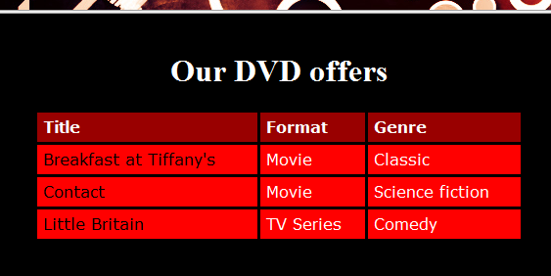
Try this with CSS!
COMPUTER SCIENCE

Slide 14
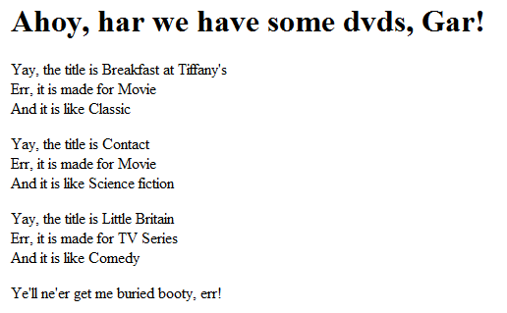
Or this
(for “Speak Like a Pirate Day”)
COMPUTER SCIENCE

Slide 15
Basics of XSLT
COMPUTER SCIENCE
The actual transformation instructions are comprised of:
  template definitions that specify how to transform an element
  template application specifications that request the application of the defined templates to specific elements
  many functional capabilities including iteration, sorting, etc.

Slide 16
Template Definitions
COMPUTER SCIENCE
The definition will always have a “match” attribute to specify what elements to match
<xsl:template match="/">
…
</xsl:template>
The "/" can be any XPath expression – here it's the root element, of course.

Slide 17
Template Definitions
COMPUTER SCIENCE
The template definition is comprised of
  Relevant namespaces
  literal strings to be placed in the transformed document
  XSLT processing instructions
  code to be inserted into the transformed document

Slide 18
The easiest and (at the same time) most difficult style sheet
COMPUTER SCIENCE
<?xml version="1.0" encoding="UTF-8"?>
<xsl:stylesheet version="1.0"
xmlns:xsl="http://www.w3.org/1999/XSL/Transform">
<xsl:output method="xml" version="1.0" encoding="UTF-8"
indent="yes" omit-xml-declaration="no"/>
<xsl:template match="@*|node()">
<xsl:copy>
<xsl:apply-templates select="@*|node()"/>
</xsl:copy>
</xsl:template>
</xsl:stylesheet>

Slide 19
COMPUTER SCIENCE
<?xml version="1.0"?>
<xsl:stylesheet xmlns:xsl="http://www.w3.org/1999/XSL/Transform" version="1.0">
<xsl:output method="html"/>
<xsl:template match="/">
<html>
<head>
<title>My recipe</title>
</head>
<body>
<xsl:apply-templates />
</body>
</html>
</xsl:template>
<xsl:template match="recipe">
<h3>Ingredients</h3>
<ul>
<xsl:for-each select="ingredient">
<li>
<xsl:value-of select="@amount" />
<xsl:text> </xsl:text>
<xsl:value-of select="@unit" />
<xsl:text> </xsl:text>
<xsl:value-of select="." />
</li>
</xsl:for-each>
</ul>
<h3>Instructions</h3>
<ol>
<xsl:for-each select="instructions/step">
<li>
<xsl:value-of select="." />
</li>
</xsl:for-each>
</ol>
</xsl:template>
</xsl:stylesheet>

Slide 20
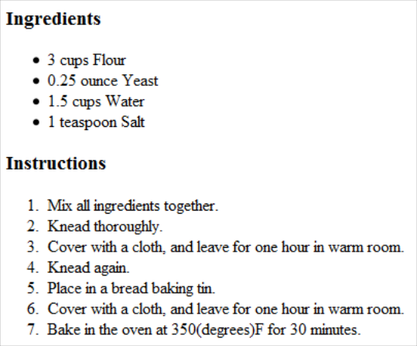
COMPUTER SCIENCE
<html>
<head>
<META http-equiv="Content-Type" content="text/html; charset=UTF-8">
<title>My recipe</title>
</head>
<body>
<h3>Ingredients</h3>
<ul>
<li>3 cups Flour</li>
<li>0.25 ounce Yeast</li>
<li>1.5 cups Water</li>
<li>1 teaspoon Salt</li>
</ul>
<h3>Instructions</h3>
<ol>
<li>Mix all ingredients together.</li>
<li>Knead thoroughly.</li>
<li>Cover with a cloth, and leave for one hour in warm room.</li>
<li>Knead again.</li>
<li>Place in a bread baking tin.</li>
<li>Cover with a cloth, and leave for one hour in warm room.</li>
<li>Bake in the oven at 350(degrees)F for 30 minutes.</li>
</ol>
</body>
</html>

Slide 21
COMPUTER SCIENCE
<xsl:stylesheet xmlns:xsl="http://www.w3.org/1999/XSL/Transform" version="1.0">
<xsl:output method="html"/>
<xsl:template match="/">
<html>
<head>
<title>DVD library</title>
<link rel="stylesheet" href="libhtml.css" type="text/css" media="screen" />
</head>
<body>
<div id="main">
<h1>Ahoy, har we have some dvds, Gar!</h1>
<xsl:for-each select="library/dvd">
<xsl:sort select="title" />
<p>
Yay, the title is <xsl:value-of select="title " /><br />
Err, it is made for <xsl:value-of select="format " /><br />
And it is like <xsl:value-of select="genre " /><br />
</p>
</xsl:for-each>
Ye'll ne'er get me buried booty, err!
</div>
</body>
</html>
</xsl:template>
</xsl:stylesheet>

