Slide 1


COMPUTER SCIENCE
J2EE Application Servers
are - amongst others
Servlet Containers
Servlet: A Java program that generates a http response dynamically.

Slide 2
COMPUTER SCIENCE
Servlet Containers
provide compile-time support
provide run-time support
provide multithreading
provide error handling
provide ...

Slide 3
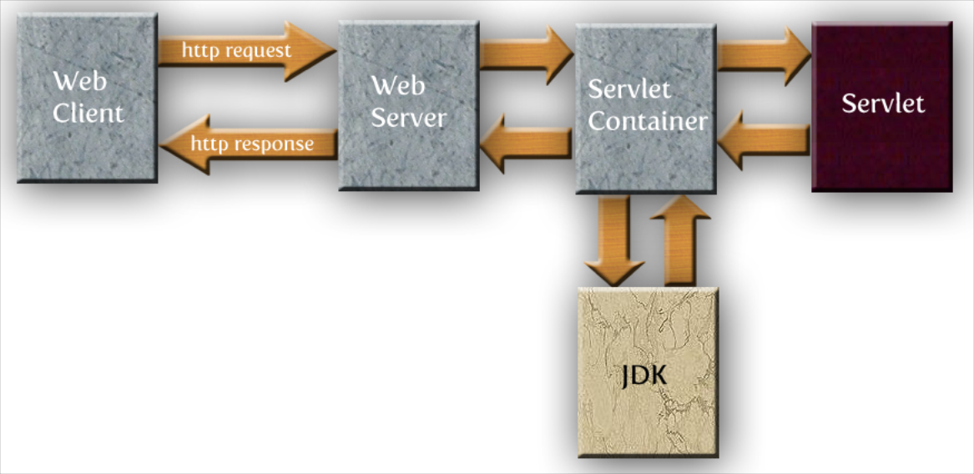
COMPUTER SCIENCE

Slide 4
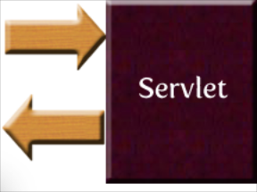
COMPUTER SCIENCE
Servlet fundamental view
accepts requests
sends out responses

Slide 5
COMPUTER SCIENCE
Servlet implementation
based on
Java Servlet API
javax.servlet package

Slide 6
COMPUTER SCIENCE
Servlet blueprint
public interface Servlet {
public void init(ServletConfig config)
throws ServletException;
public ServletConfig getServletConfig();
public void service(ServletRequest req,
ServletResponse res)
throws ServletException, IOException;
public String getServletInfo();
public void destroy();
}

Slide 7
COMPUTER SCIENCE
Servlet lifecycle
Loaded during server startup
init() method is called (once!!)
Servlet accepts requests
Finally, destroy() is called (once!!)

Slide 8
COMPUTER SCIENCE
In most cases
use the HttpServlet class
is abstract
provides methods for GET, POST, ...
Servlets must override at least one of them!

Slide 9
COMPUTER SCIENCE
public class MyFirstServlet extends HttpServlet {
private int accessCount = 0;
@Override
public void doGet(HttpServletRequest request,
HttpServletResponse response)
throws IOException, ServletException
{
response.setContentType("text/html");
PrintWriter out = response.getWriter();
out.println("<html>");
out.println("<head>");
out.println("<title>My First Servlet</title>");
out.println("</head>");
out.println("<body>");
out.println("<h1>Servlet activation " + accessCount++ +
"</h1>");
out.println("Ya see? Servlets are persistent!");
out.println("</body>");
out.println("</html>");
}
}

Slide 10
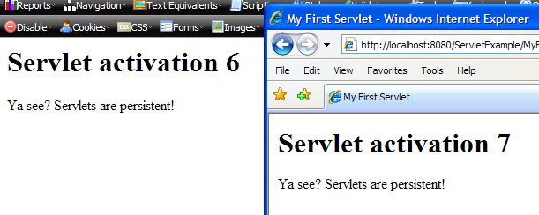
COMPUTER SCIENCE
Only one instance of the Servlet is running!

Slide 11
COMPUTER SCIENCE
Servlet deployment
web.xml describes the Servlet configuration
each web app has its own web.xml
container reads web.xml

Slide 12
COMPUTER SCIENCE
<?xml version="1.0" encoding="UTF-8"?>
<web-app version="2.5" xmlns="http://java.sun.com/xml/ns/javaee" xmlns:xsi="http://www.w3.org/2001/XMLSchema-instance" xsi:schemaLocation="http://java.sun.com/xml/ns/javaee http://java.sun.com/xml/ns/javaee/web-app_2_5.xsd">
<servlet>
<description>Just to test it all</description>
<servlet-name>MyFirstServlet</servlet-name>
<servlet-class>dsa1.servlet.MyFirstServlet</servlet-class>
</servlet>
<servlet-mapping>
<servlet-name>MyFirstServlet</servlet-name>
<url-pattern>/MyFirstServlet</url-pattern>
</servlet-mapping>
<session-config>
<session-timeout>30</session-timeout>
</session-config>
<welcome-file-list>
<welcome-file>index.html</welcome-file>
</welcome-file-list>
</web-app>

Slide 13
COMPUTER SCIENCE
Linking to a Servlet
<html>
<head>
<title>Servlet GO!!</title>
<meta http-equiv="Content-Type"
content="text/html; charset=UTF-8">
</head>
<body>
<a href="/ServletExample/MyFirstServlet">Do it!</a>
</body>
</html>

Slide 14
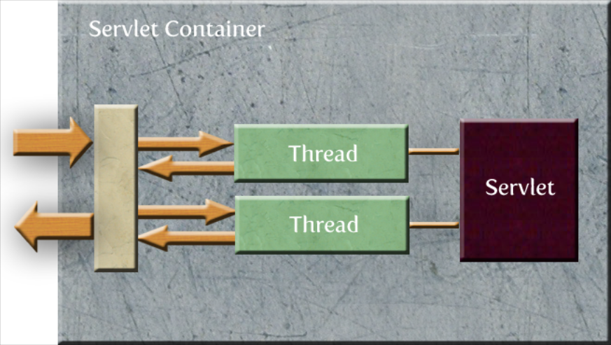
COMPUTER SCIENCE
The devil's in the detail!

Slide 15
COMPUTER SCIENCE
Servlets should (must) be thread-safe!
Make doGet etc. synchronized - or
Localize critical regions manually
out.println("<h1>Servlet activation " + accessCount++ + "</h1>");

Slide 16
COMPUTER SCIENCE
synchronized (this) {
out.println("<h1>Servlet activation " +
accessCount++ + "</h1>");
}
or even
synchronized (this) { accessCount++; }
out.println("<h1>Servlet activation " +
accessCount + "</h1>");

Slide 17
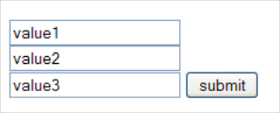
COMPUTER SCIENCE
Request parameters
For example from an HTML form:
<form name="argsGET"
action="/ParamServlet/ParamServlet">
<input type="text" name="param1" value="" /><br />
<input type="text" name="param2" value="" /><br />
<input type="text" name="param3" value="" />
<input type="submit"
value="submit" name="submit" />
</form>

Slide 18
COMPUTER SCIENCE
Default http method: GET
To use POST
<form name="argsPOST"
action="/ParamServlet/ParamServlet"
method=”POST”>
<input type="text" name="param1" value="" /><br />
<input type="text" name="param2" value="" /><br />
<input type="text" name="param3" value="" />
<input type="submit"
value="submit" name="submit" />
</form>

Slide 19
COMPUTER SCIENCE
Done via GET
URL encoding (we know that!)
http://server:8080/ParamServlet/ParamServlet
?param1=value1&param2=value2&param3=value3&submit=submit

Slide 20
COMPUTER SCIENCE
To process the GET request
public void doGet(HttpServletRequest request,
HttpServletResponse response)
throws ServletException, IOException {
response.setContentType("text/html");
PrintWriter out = response.getWriter();
out.println("<html><head>” +
“<title>Reading Request Parameters</title></head>" +
"<body><h1>Reading Request Parameters</h1>" +
"<ul>" +
"<li>param1: " + request.getParameter("param1") + "</li>" +
"<li>param2: " + request.getParameter("param2") + "</li>" +
"<li>param3: " + request.getParameter("param3") + "</li>" +
"</ul></body></html>");
}

Slide 21
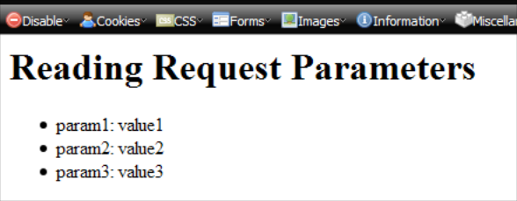
COMPUTER SCIENCE
To deal with the POST version:
public void doPost(HttpServletRequest request,
HttpServletResponse response)
throws ServletException, IOException {
doGet(request,response);
}

