Slide 1
ORM & JPA
Structure

Slide 2
JPA ideas:
Unintrusive: POJOs & Annotations (cf. JAXB)
Based on “Entities” (cf. E/R models)
Objects are “persistable” (rather than “persistent”)
Object “identity” vs. persistent “identity”
Objects are “transactional”
No primitive/built-in objects can be affected.
Rarely used “stand-alone” - connected with
* Enterprise Java Beans (EJBs)
* Servlets
* JAX-RS/JAX-WS providers

Slide 3
JPA ideas:
POJOs & Annotations
As before: Configuration by Exception → Defaults public class Employee { private int id; private String name; private long salary; public Employee() {} public Employee(int id) { this.id = id; } public int getId() { return id; }
... public void setSalary (long salary) { this.salary = salary; }
}

Slide 4
JPA ideas:
POJOs & Annotations
Minimum: @Entity and @Id (more later)
@Entity public class Employee {
@Id private int id; private String name; private long salary; public Employee() {} public Employee(int id) { this.id = id; } public int getId() { return id; }
... public void setSalary (long salary) { this.salary = salary; }
}

Slide 5
JPA ideas:
Persisting objects via an EntityManager
Note: Entities are not persistent, they're persistable!
EntityManagerFactory emf =
Persistence.createEntityManagerFactory("EmployeeService");
EntityManager em = emf.createEntityManager();
Employee emp = new Employee(158); em.persist(emp);

Slide 6
Persistence units
A persistence unit defines a set of all entity classes that are managed by EntityManager instances...
Persistence units are defined by the persistence.xml configuration file.
<persistence>
<persistence-unit name="EmployeeService" transaction-type="RESOURCE_LOCAL">
<class>examples.model.Employee</class>
<properties>
<property name="toplink.jdbc.driver" value="org.apache.derby.jdbc.ClientDriver"/>
<property name="toplink.jdbc.url" value="jdbc:derby://localhost:1527/EmpServDB;create=true"/>
<property name="toplink.jdbc.user" value="APP"/>
<property name="toplink.jdbc.password" value="APP"/>
</properties>
</persistence-unit>
</persistence>

Slide 7
Persistence context
A persistence context handles a set of entities which hold data to be persisted in some persistence store (e.g. a database). In particular, the context is aware of the different states an entity can have [...] in relation to both the context and the underlying persistence store.
Yeah... it's kind of a cache.

Slide 8
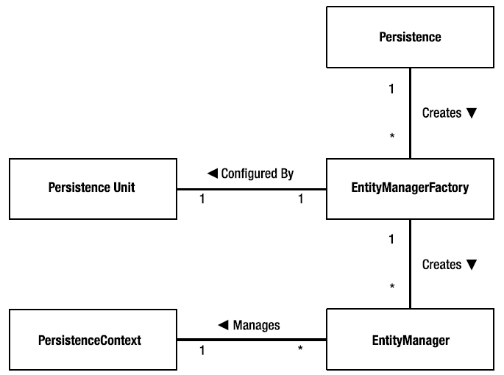
All together

Slide 9
Entity Managers
Can serve two purposes:
1. Control persistence
2. Container for Entities public Employee createEmployee(EntityManager em,int id, String name, long salary) {
Employee emp = new Employee(id); emp.setName(name); emp.setSalary(salary); em.persist(emp); return emp;
} public Employee findEmployee(EntityManager em, int id) { return em.find(Employee.class, id);
}

Slide 10
Entity Managers
Can serve two purposes:
1. Control persistence
2. Container for Entities public Employee createEmployee(EntityManager em,int id, String name, long salary) {
Employee emp = new Employee(id); emp.setName(name); emp.setSalary(salary); em.persist(emp); return emp;
} public Employee findEmployee(EntityManager em, int id) { return em.find(Employee.class, id);
}

Slide 11
Queries
Two ways:
1. Vendor-independent (Java Persistence QL or JPQL)
2. Vendor specific SQL (not here...)
JPQL examples
SELECT e FROM Employee
SELECT e.name FROM Employee e
SELECT e FROM Employee e
WHERE e.department.name = 'NA42' AND e.address.state IN ('NY','CA')
SELECT e.name, e.salary FROM Employee e

Slide 12
More JPQL
Parameterized Queries
Position parameters
SELECT e FROM Employee e
WHERE e.department = ?1 AND e.salary > ?2
Name parameters
SELECT e FROM Employee e
WHERE e.department = :dept AND e.salary > :base

Slide 13
More JPQL
Dynamic queries (like JDBC)
String query = "SELECT e.salary " +
"FROM Employee e " +
"WHERE e.department.name = '" + deptName + "' AND " +
" e.name = '" + empName + "'"; return (Long) em.createQuery(query).getSingleResult();
Named (static) queries (see example) recommended!
@NamedQuery(name="findSalaryForNameAndDepartment", query="SELECT e.salary " +
"FROM Employee e " +
"WHERE e.department.name = :deptName " +
"AND e.name = :empName")

Slide 14
Advanced Mapping Constructs (Overview)
@OneToOne
@ManyToOne
@OneToMany
@ManyToMany
@inheritance(strategy = ...)

