Slide 1
ORM & JPA
Stand-Alone Example

Slide 2
CREATE TABLE Student (
StudentID INTEGER UNSIGNED NOT NULL AUTO_INCREMENT,
Name VARCHAR(45) NOT NULL,
UWFId VARCHAR(13) UNIQUE NOT NULL,
Age INTEGER UNSIGNED NOT NULL,
Major VARCHAR(45),
PRIMARY KEY (StudentID)
);
CREATE TABLE Book (
BookID INTEGER UNSIGNED NOT NULL AUTO_INCREMENT,
CatalogNumber VARCHAR(45) UNIQUE NOT NULL,
Author VARCHAR(45) NOT NULL,
Title VARCHAR(45) NOT NULL,
BorrowerId INTEGER UNSIGNED,
PRIMARY KEY (BookID),
CONSTRAINT FK_Borrower FOREIGN KEY FK_Borrower (BorrowerId)
REFERENCES Student (StudentID)
ON DELETE RESTRICT
ON UPDATE RESTRICT
);

Slide 3
@Entity
@XmlRootElement public class Student implements Serializable { // simplified (see NB project) private static final long serialVersionUID = 1L;
@Id @GeneratedValue(strategy = GenerationType.IDENTITY) private Integer studentID;
@NotNull
@Size(min = 1, max = 45) private String name;
...
@Size(max = 45)
@Column(name = "Major") private String major;
...
@OneToMany(mappedBy = "borrowerId") private Collection<Book> bookCollection; public Student() { } public Student(Integer studentID) { this.studentID = studentID;
} public Student(Integer studentID, String name, String uWFId, int age) {
...
} public Integer getStudentID() ... public void setStudentID(Integer studentID) ...
Automatically generated!

Slide 4
@Entity
@XmlRootElement public class Book implements Serializable { private static final long serialVersionUID = 1L;
@Id
@GeneratedValue(strategy = GenerationType.IDENTITY) private Integer bookID;
@NotNull
@Size(min = 1, max = 45)
@Column(name = "CatalogNumber") private String catalogNumber;
...
@JoinColumn(name = "BorrowerId", referencedColumnName = "StudentID")
@ManyToOne private Student borrowerId;
Automatically generated!

Slide 5
Persistence Unit
<?xml version="1.0" encoding="UTF-8"?>
<persistence version="2.1" xmlns="http://xmlns.jcp.org/xml/ns/persistence" xmlns:xsi="http://www.w3.org/2001/XMLSchema-instance" xsi:schemaLocation="http://xmlns.jcp.org/xml/ns/persistence http://xmlns.jcp.org/xml/ns/persistence/persistence_2_1.xsd">
<persistence-unit name="JPASamplePU" transaction-type="RESOURCE_LOCAL">
<provider>org.eclipse.persistence.jpa.PersistenceProvider</provider>
<class>dsa1.jpa.sample.Student</class>
<class>dsa1.jpa.sample.Book</class>
<properties>
<property name="javax.persistence.jdbc.url" value="jdbc:mysql://localhost:3306/library"/>
<property name="javax.persistence.jdbc.user" value="root"/>
<property name="javax.persistence.jdbc.driver" value="com.mysql.jdbc.Driver"/>
<property name="javax.persistence.jdbc.password" value=""/>
</properties>
</persistence-unit>
</persistence>
Automatically generated!

Slide 6
Some small additions before the two entity classes
@NamedQueries({
@NamedQuery(name = "Student.findAll", query = "SELECT s FROM Student s"),
@NamedQuery(name = "Student.findByStudentID", query = "SELECT s FROM Student s WHERE s.studentID = :studentID"),
...
@NamedQuery(name = "Student.findByMajor", query = "SELECT s FROM Student s WHERE s.major = :major")
})
@NamedQueries({
@NamedQuery(name = "Book.findAll", query = "SELECT b FROM Book b"),
@NamedQuery(name = "Book.findByBookID", query = "SELECT b FROM Book b WHERE b.bookID = :bookID"),
...
@NamedQuery(name = "Book.findByTitle", query = "SELECT b FROM Book b WHERE b.title = :title")})
Automatically generated!

Slide 7
Some small additions inside the two entity classes
@Override public String toString() { // Student return "" + studentID + " " + name + " " + major;
}
@Override public String toString() { // Book return "" + bookID + " " + catalogNumber + " " + author + " " + title + " " + borrowerId;
}
In the domain model that's a reference, not a foreign key!

Slide 8
Finally! public class LibList { private final static EntityManagerFactory emf =
Persistence.createEntityManagerFactory("JPASamplePU"); public static void main(String[] args) {
EntityManager em = emf.createEntityManager();
List<Student> sResults = em.createNamedQuery("Student.findAll").getResultList(); for (Student s : sResults) {
System.out.println(s);
}
List<Book> bResults = em.createNamedQuery("Book.findAll").getResultList(); for (Book b : bResults) {
System.out.println(b);
}
}
}

Slide 9
Finally!
1 John Doe Computer Science
2 Suzy Creamcheese null
3 Jane Doe History
4 Gerald Bostock null
5 Lisa Simpson null
1 TK4412 Leo Tolstoy War and Peace 3 Jane Doe History
2 UY9175 Emily Bronte Wuthering Heights null
3 ZZ0641 Chris Date Database Systems null
4 TK4700 J.K. Rowling Harry Potter and the Deathly Hallows null
5 OZ8441 Leo Tolstoy Anna Karenina null
6 HS3691 Burke Davis The Civil War null
7 HI7762 Bruce Catton The Civil War null

Slide 10
Parameterized named queries bResults = em.createNamedQuery("Book.findByTitle"). setParameter("title","The Civil War").getResultList(); for (Book b : bResults) {
System.out.println(b); }
6 HS3691 Burke Davis The Civil War null
7 HI7762 Bruce Catton The Civil War null
JPQL → SQL (You can see that in NetBeans)
SELECT s,b FROM Student s, Book b WHERE b.borrowerId = s
→
SELECT t0.StudentID, t0.Age, t0.Major, t0.Name, t0.UWFId, t1.BookID, t1.Author, t1.CatalogNumber, t1.Title, t1.BorrowerId
FROM student t0, book t1
WHERE (t1.BorrowerId = t0.StudentID)

Slide 11
Not sure how elegant THIS is...
// Queries with more than one table as a result
// return a list of Object[] (Object Arrays, not Objects!)
// You need to give up type safety here
// Now that's a bad step back into the wild!
List<Object[]> borrowed = em.createQuery("SELECT s,b FROM Student s, Book b
WHERE b.borrowerId = s").getResultList(); for (Object[] a : borrowed) {
Student s = (Student) a[0];
Book b = (Book) a[1];
System.out.println("" + b + " " + s);
}
1 TK4412 Leo Tolstoy War and Peace 3 Jane Doe History 3 Jane Doe History

Slide 12
Actually, you can do it slightly more cleverly... bResults = em.createQuery("SELECT b FROM Student s, Book b
WHERE b.borrowerId = s").getResultList(); for (Book b : bResults) {
System.out.println(b);
System.out.println(b.getBorrowerId());
}
1 TK4412 Leo Tolstoy War and Peace 3 Jane Doe History
3 Jane Doe History

Slide 13
The Entity classes had an @XmlRootElement annotation, remember? try { // ancient code...
JAXBContext jaxbContext
= JAXBContext.newInstance(Student.class);
Marshaller jaxbMarshaller = jaxbContext.createMarshaller(); jaxbMarshaller.setProperty(Marshaller.JAXB_FORMATTED_OUTPUT, true); sResults = em.createNamedQuery("Student.findAll").getResultList(); for (Student s : sResults) { jaxbMarshaller.marshal(s, System.out);
}
} catch (Exception ex) { }
Slowly it's starting to be fun!
<?xml version="1.0" encoding="UTF-8" standalone="yes"?>
<student>
<age>23</age>
<major>Computer Science</major>
<name>John Doe</name>
<studentID>1</studentID>
<UWFId>4711</UWFId>
</student>
...
<student>
<age>34</age>
<name>Lisa Simpson</name>
<studentID>5</studentID>
<UWFId>123123-98</UWFId>
</student>

Slide 14
You can work completely in JPA in some easy cases... public class LibUpdate { private final static EntityManagerFactory emf =
Persistence.createEntityManagerFactory("JPASamplePU"); public static Student findStudent(EntityManager em, int id) { return em.find(Student.class, id);
} public static Book findBook(EntityManager em, int id) { return em.find(Book.class, id);
} public static void main(String[] args) {
EntityManager em = emf.createEntityManager();
// Lisa Simpson (id 5) borrows Harry Potter and the Deathly Hallows (4)
Student lisa = findStudent(em, 5);
Book harry = findBook(em, 4);
// Now... harry.setBorrowerId(lisa); // nice! em.getTransaction().begin(); em.persist(harry); em.getTransaction().commit();
System.out.println(harry);;
}
}

Slide 15
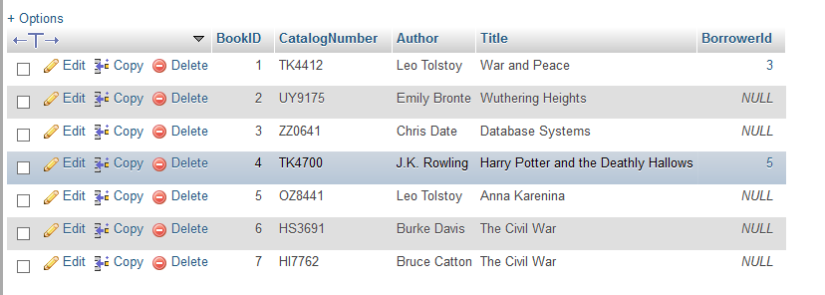
Output
4 TK4700 J.K. Rowling Harry Potter and the Deathly Hallows 5 Lisa Simpson null

Slide 16
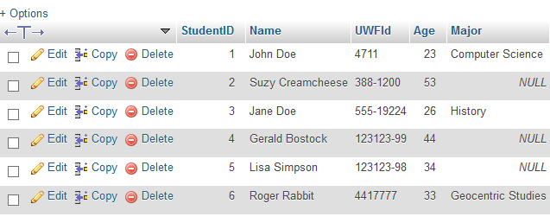
The weird logic of IDs... public class JPAAdd { private final static EntityManagerFactory emf =
Persistence.createEntityManagerFactory("JPASamplePU"); public static void main(String[] args) {
EntityManager em = emf.createEntityManager();
Student roger = new Student(); roger.setName("Roger Rabbit"); roger.setAge(33); roger.setUWFId("4417777"); roger.setMajor("Geocentric Studies");
System.out.println(roger); em.getTransaction().begin(); em.persist(roger); em.getTransaction().commit();
System.out.println(roger);
}
} null Roger Rabbit Geocentric Studies
6 Roger Rabbit Geocentric Studies

