Slide 1
ORM & JPA
Stand-Alone Example 2

Slide 2
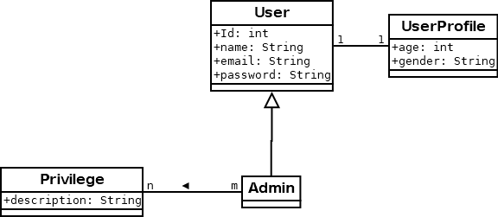

Slide 3
User roger = new User();
roger.setName("Roger");
roger.setEmail("roger@rabbit.com");
roger.setPassword("password123");
UserProfile rogersProfile = new UserProfile();
rogersProfile.setAge(23);
rogersProfile.setGender("male");
rogersProfile.setUser(roger);
roger.setProfile(rogersProfile);

Slide 4
Privilege sudo = new Privilege("sudo");
Privilege addUser = new Privilege("adduser");
Privilege addGroup = new Privilege("addgroup");
Admin ringo = new Admin();
ringo.setName("Ringo");
ringo.setEmail("ringo@ringo.com");
ringo.setPassword("badannng");
UserProfile ringosProfile = new UserProfile();
ringosProfile.setAge(75);
ringosProfile.setGender("male");
ringosProfile.setUser(ringo);
ringo.setProfile(ringosProfile);
ringo.addPrivilege(sudo);

Slide 5
Admin arya = new Admin();
arya.setName("Arya Stark");
arya.setEmail("arya@stark.org");
arya.setPassword("notToday");
UserProfile aryasProfile = new UserProfile();
aryasProfile.setAge(875);
aryasProfile.setGender("female");
aryasProfile.setUser(arya);
arya.addPrivilege(sudo);
arya.addPrivilege(addUser);
arya.addPrivilege(addGroup);

Slide 6
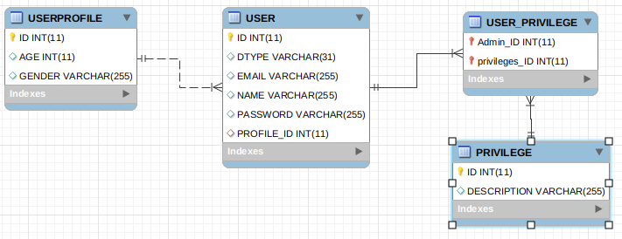
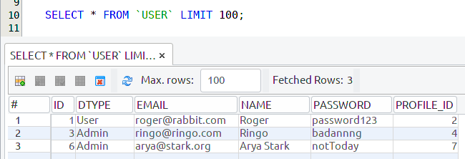
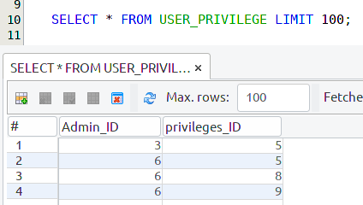
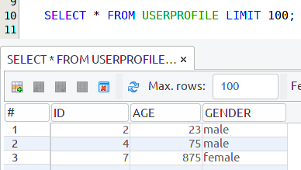
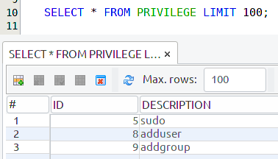
@Inheritance(strategy = InheritanceType.SINGLE_TABLE)

Slide 7
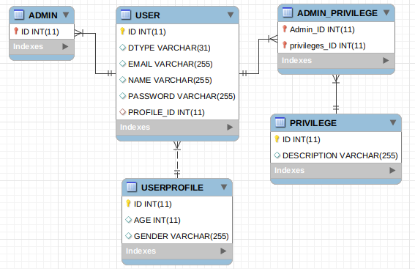
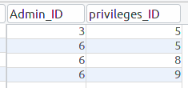
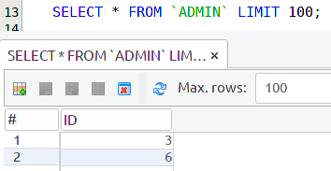
@Inheritance(strategy = InheritanceType.JOINED)

Slide 8
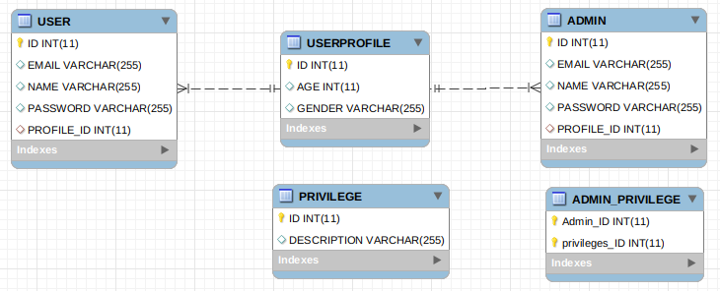
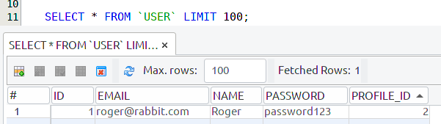
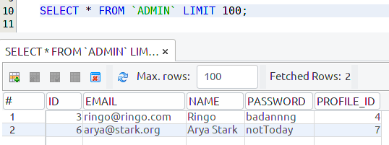
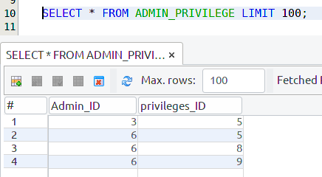
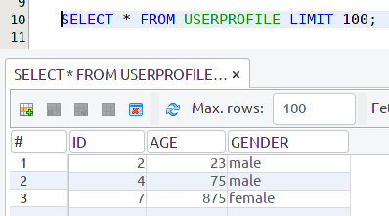
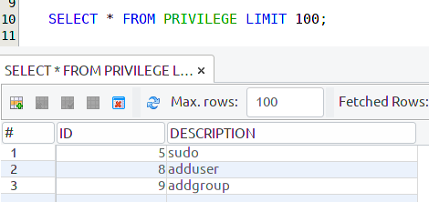
@Inheritance(strategy = InheritanceType.TABLE_PER_CLASS)

